Slide 1
SafeTraceTX 4.6
Product Issue Training
Melissa Krygsman MLS(ASCP)^{CM} SBB^{CM}

Slide 2
Objective
Provide instruction on how to properly issue blood products within the Blood Bank Information System (SafeTraceTX v.4.6)

Slide 3
Related SOPs
Issue Blood and Blood Component from the Blood Bank (Reference # 6475)
SafeTrace (Blood Bank) Application (Reference # 22328)

Slide 4
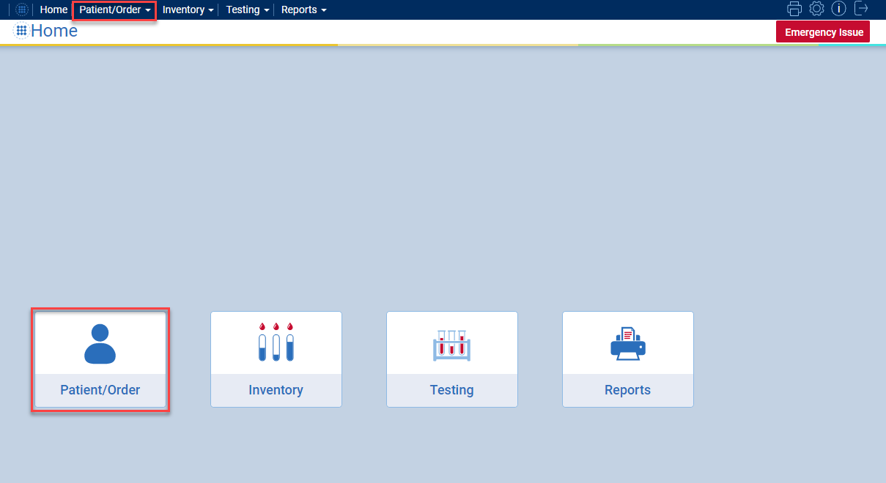
Go to Patient/Order Module

Slide 5
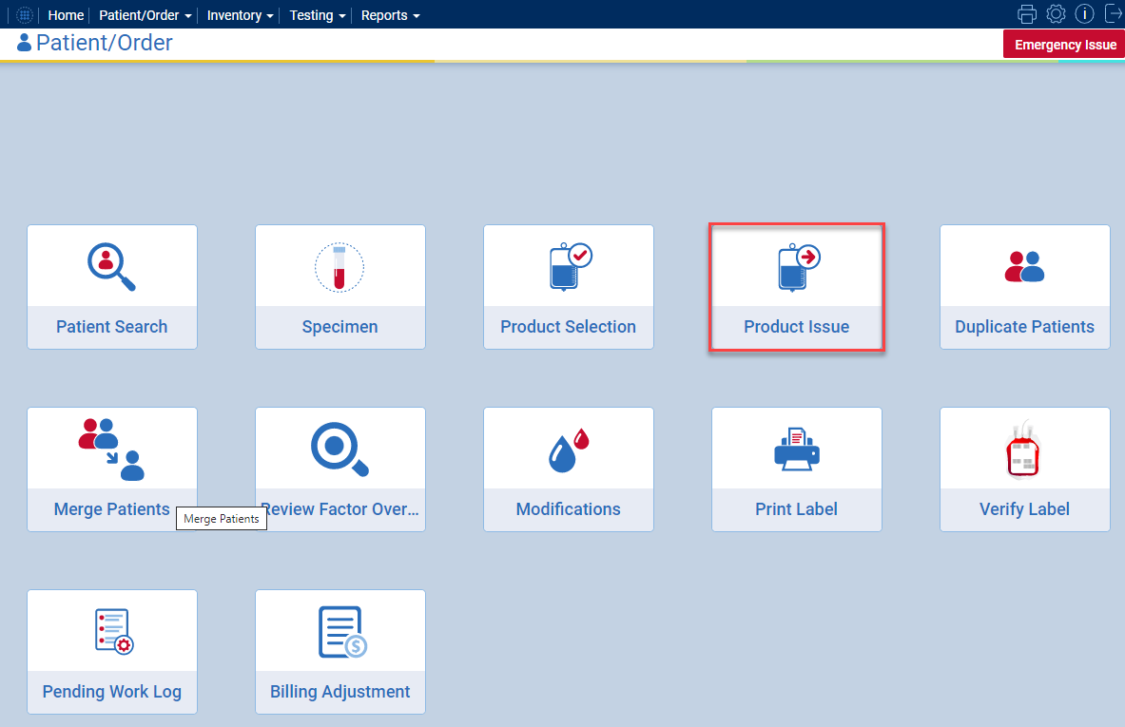
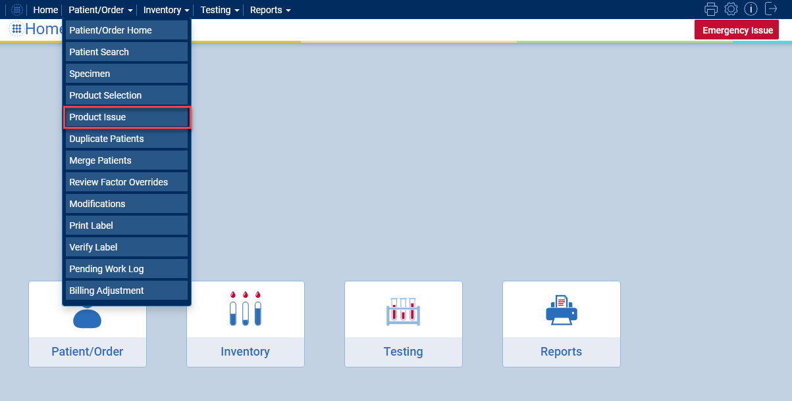
Select “Product Issue”

Slide 6
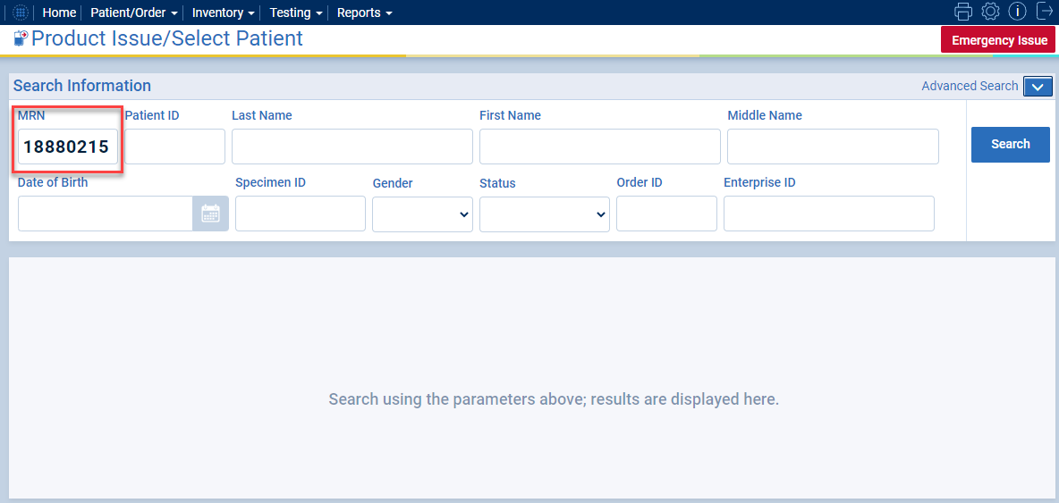
Enter Patient MRN and Search
***Use the information provided on the pick-up slip***

Slide 7
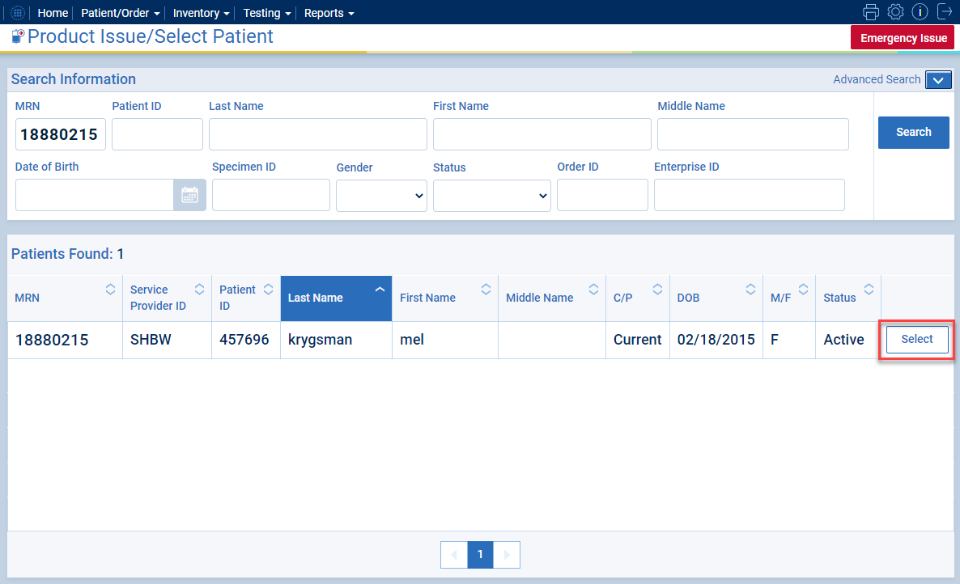
Select Current, Active Status Patient

Slide 8
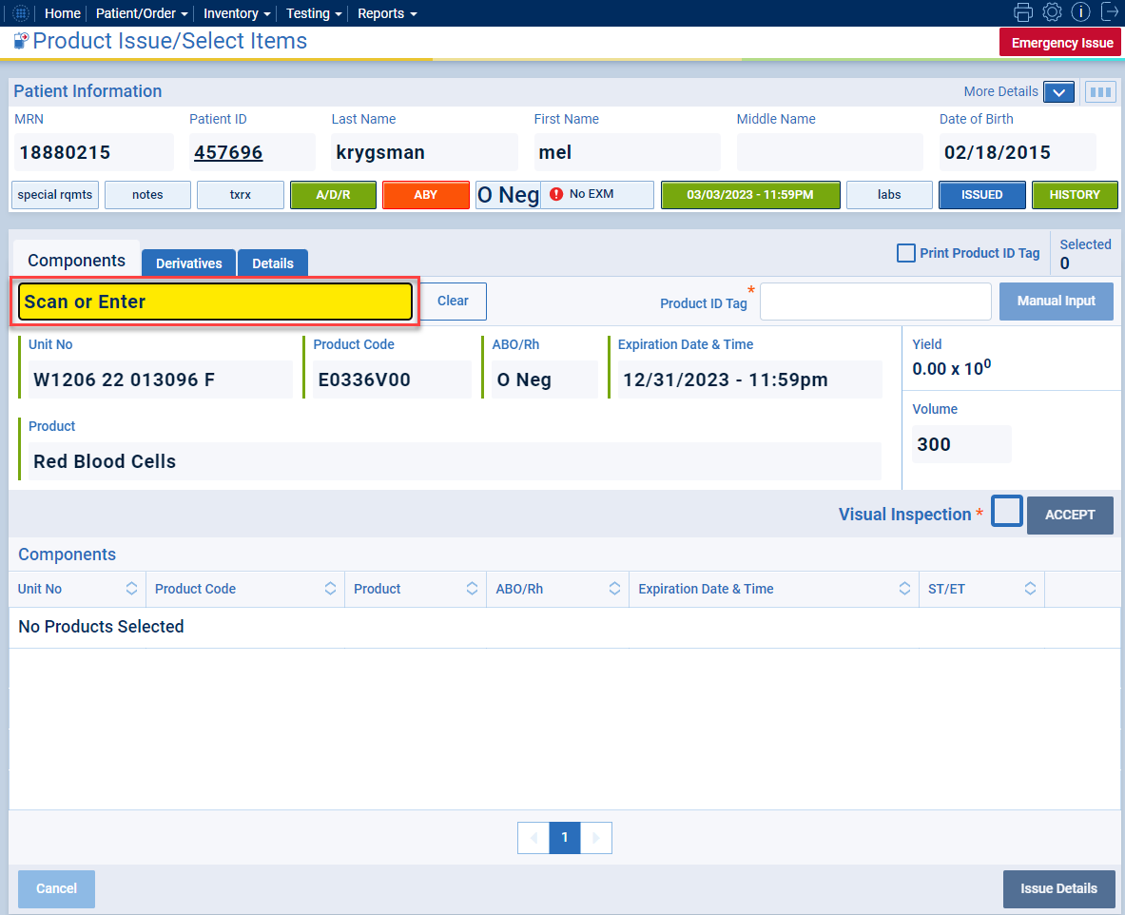
Scan Component Information (Unit Number and Product Code)

Slide 9
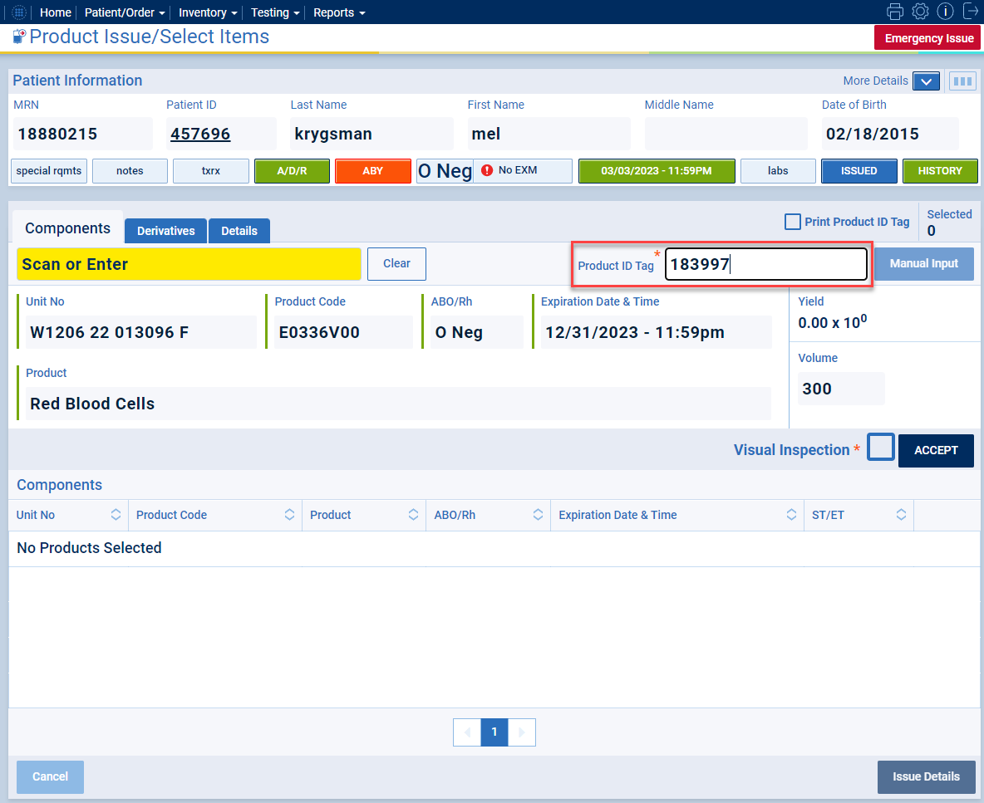
Scan PTag Barcode

Slide 10
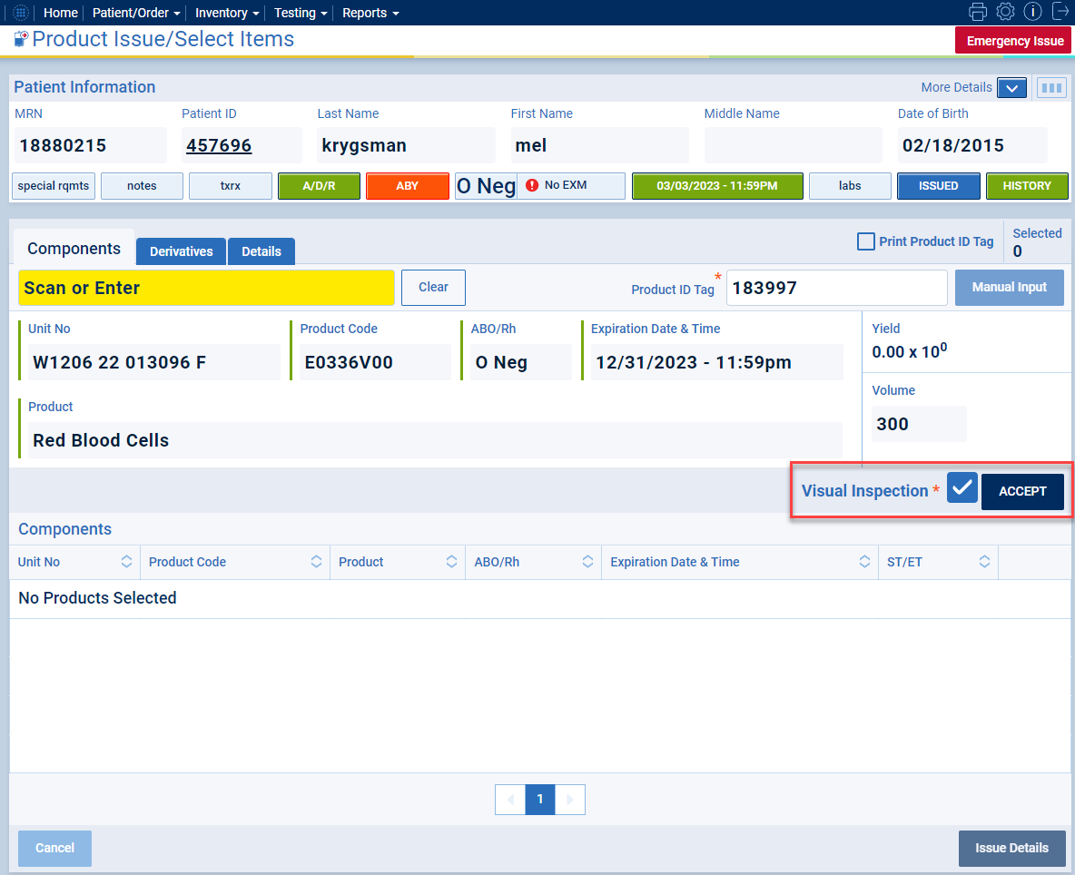
Check “Visual Inspection” and Click Accept

Slide 11
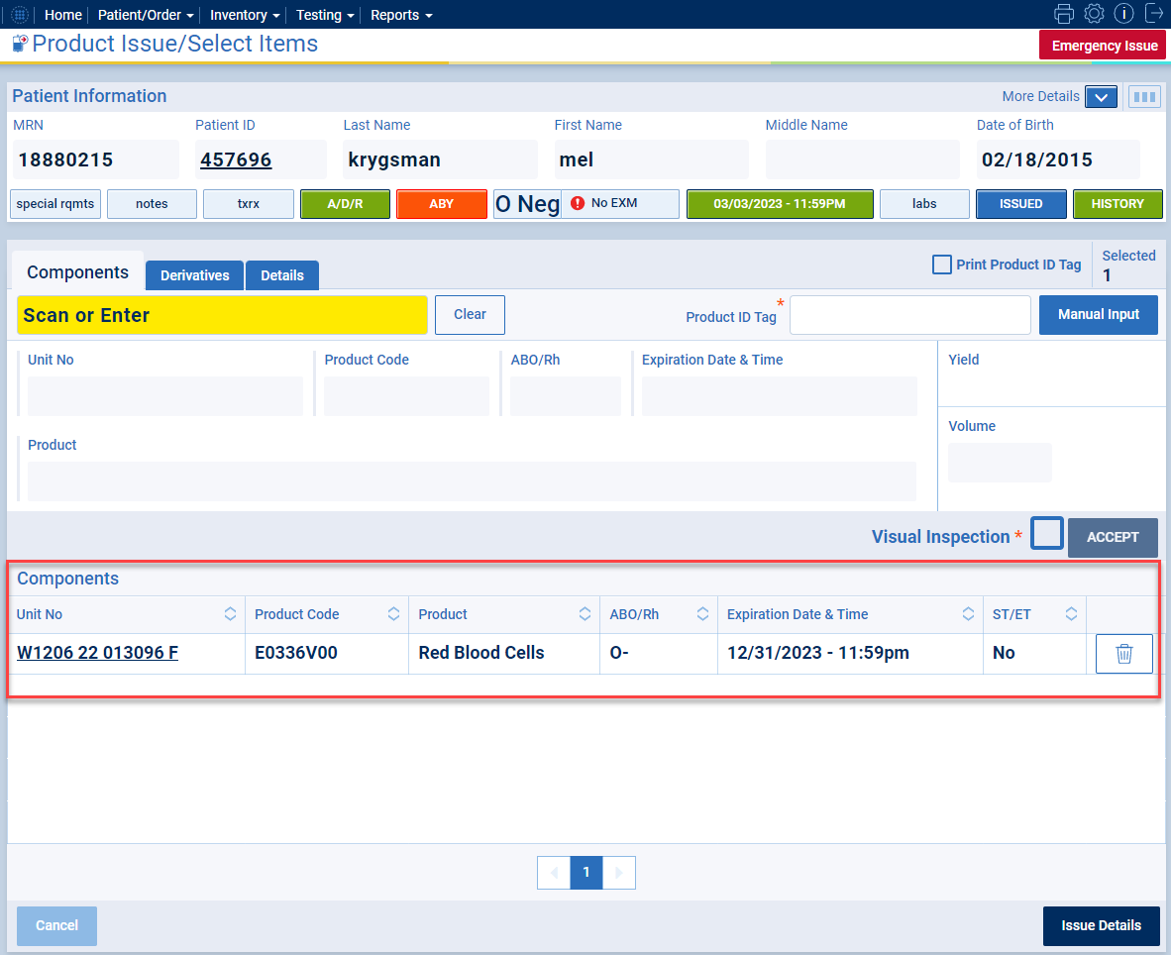
Accepted Components will Drop into Components Grid

Slide 12
Repeat for Each Component
Scan Unit Number and Product Code
Scan PTag Barcode
Check “Visual Inspection” box and Click Accept

Slide 13
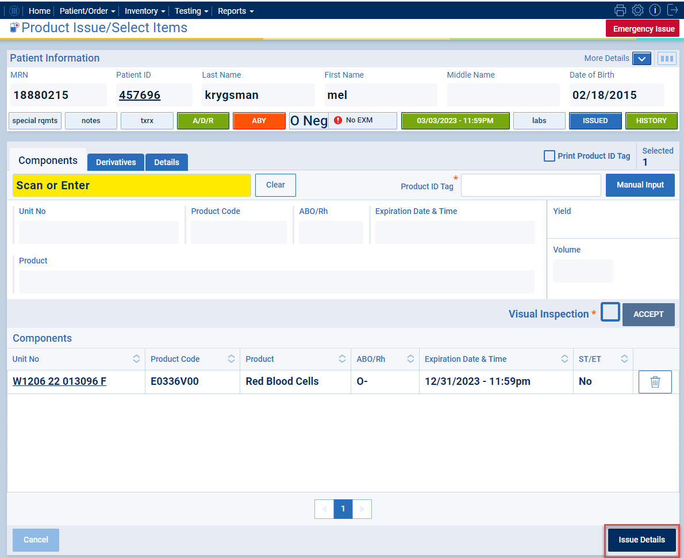
After components have been scanned, click Issue Details
***Ensure that ALL components being issued are in the Components grid prior to moving into Issue Details***

Slide 14
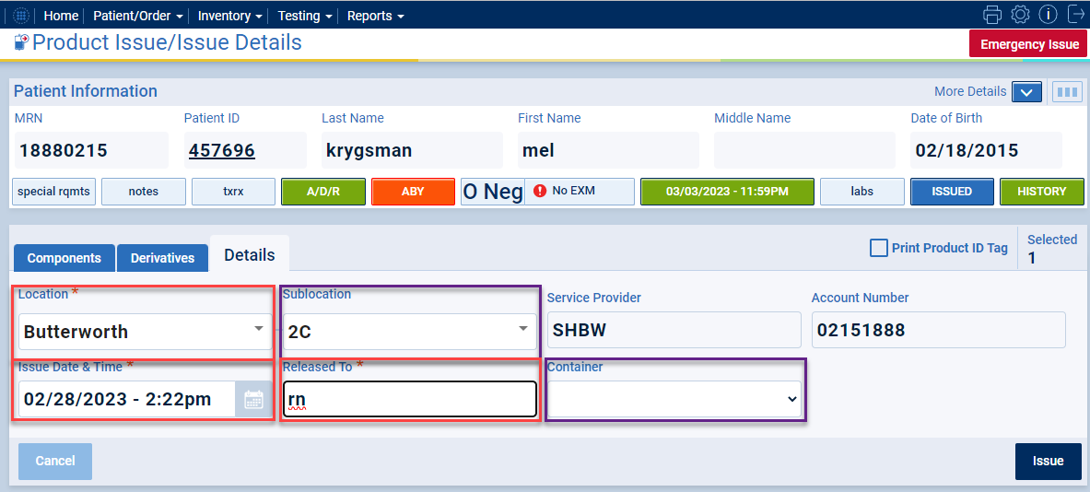
Fill in Required Fields (including Sublocation and Container, if applicable)

Slide 15
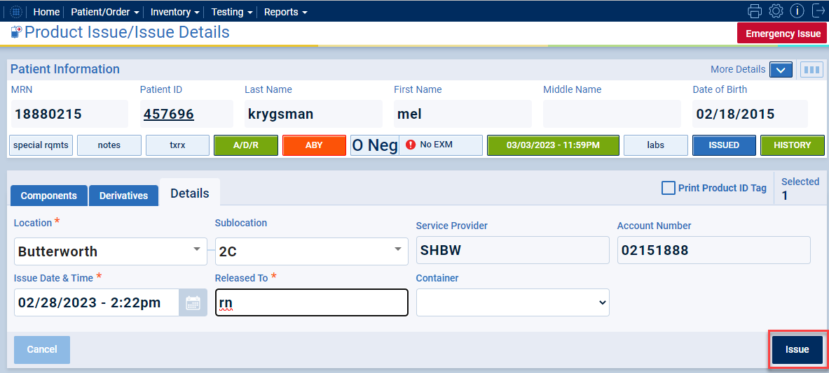
Click Issue

Slide 16
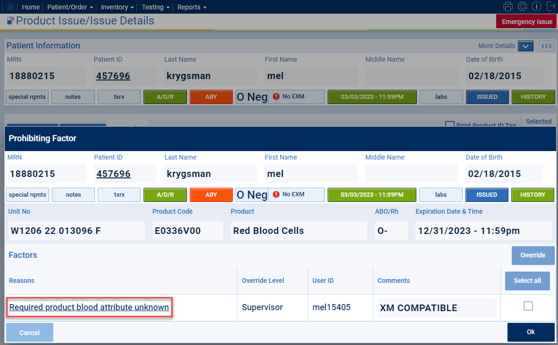
If Prohibiting Factors Exist, review each one by clicking the hyperlink
Important to Note:
Unit number and product code will display for each unit that is affected by a prohibiting factor. There may be multiple pop-ups if multiple units have a factor.

Slide 17
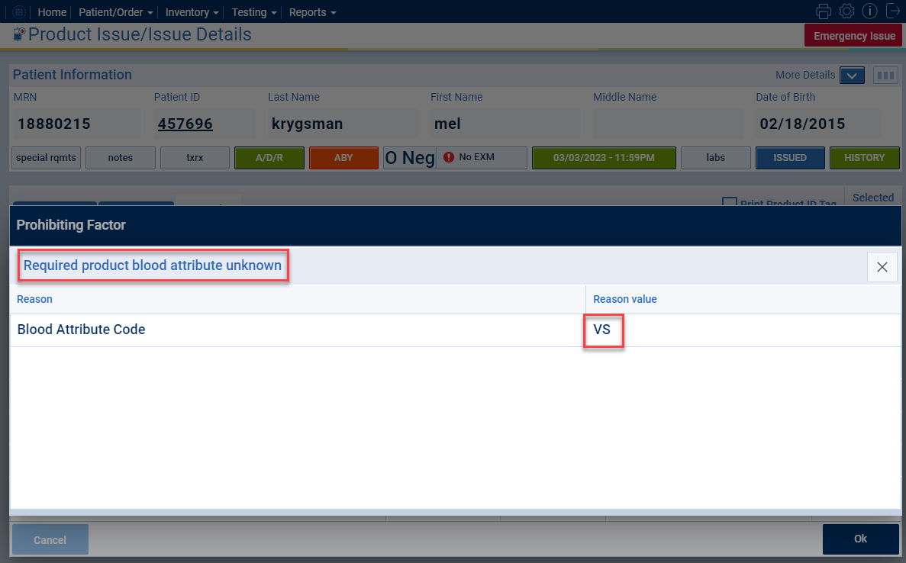
Example: VS antigen type on product is unknown

Slide 18
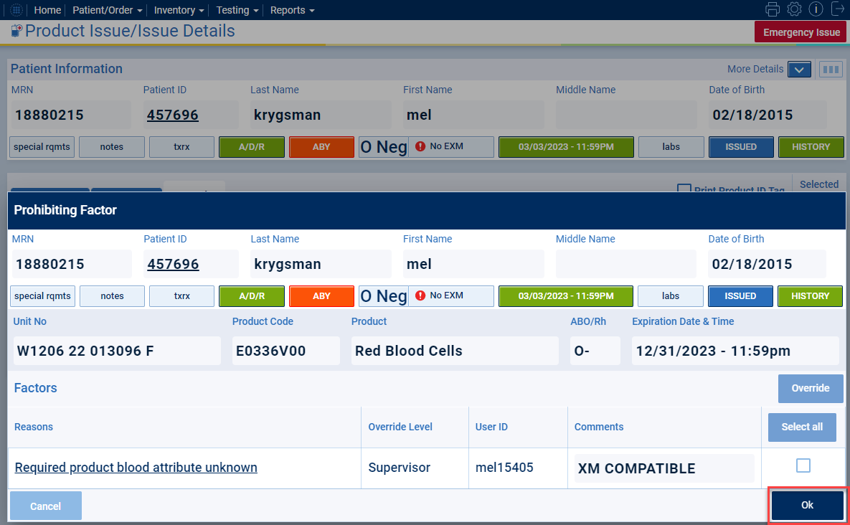
Perform Override if not completed and deemed appropriate and Click Ok after Reviewing

Slide 19
Repeat for Each Component
Click Hyperlink for each Prohibiting Factor and review the details for the prohibiting factor
If override not previously performed and it is deemed appropriate to override, perform override and document in the comment why the override was performed
Click “Ok”
ALWAYS click on the hyperlink of the factor to review the reason for the prohibiting factor. The system is designed to indicate the reasoning why.
If you do not understand the reason for the prohibiting factor, reach out to another tech or lead for consultation prior to completing the product issue process.

Slide 20
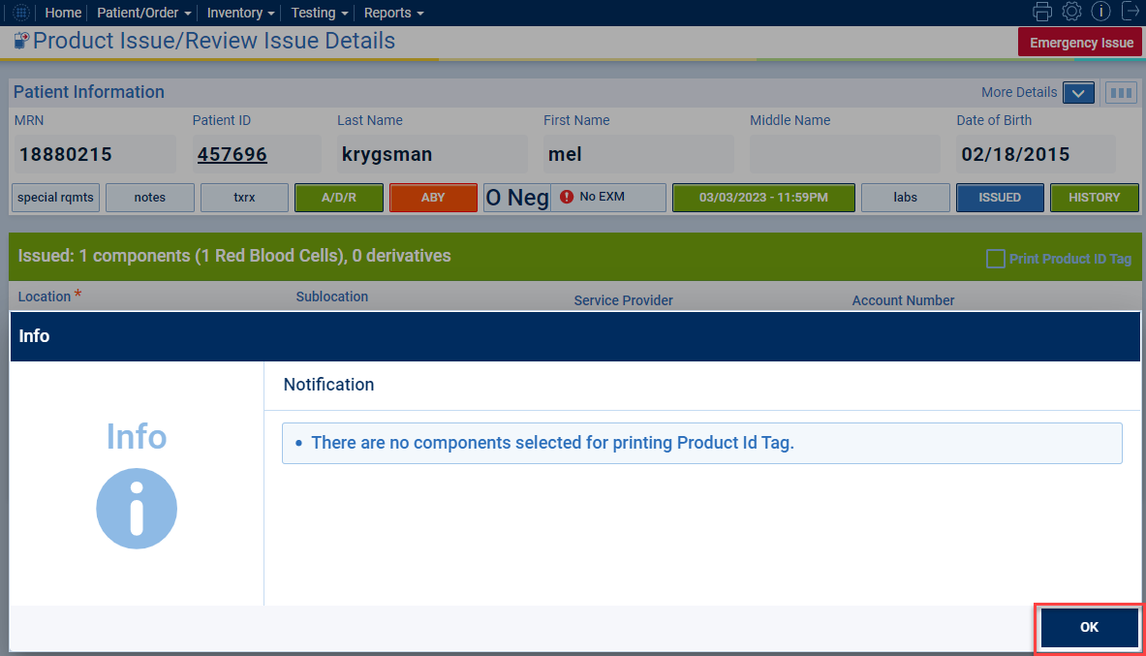
Additional Pop-ups
Additional Pop-ups may display. Be sure to review each one to have an understanding of what may be occurring.
A common pop-up is this notification concerning PTags that were not selected for printing.

Slide 21
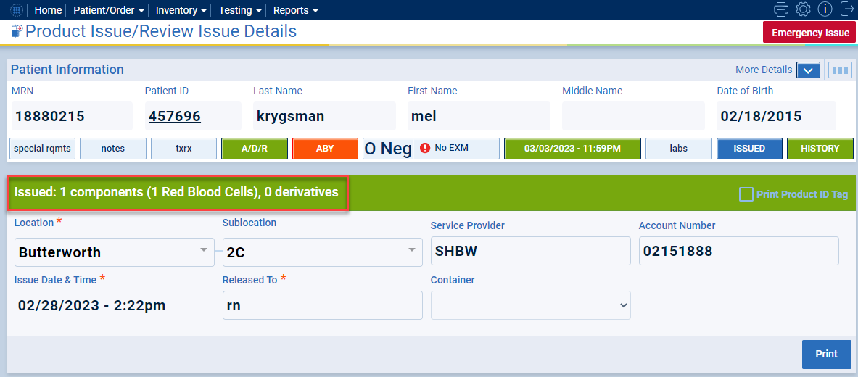
Green Banner will Show Successful Product Issue
***Verify that the number of components and component types match what is being released prior to physically releasing product(s)***

