Slide 1
Incubator Carrier Tote/ Biobag
Rollout

Slide 2
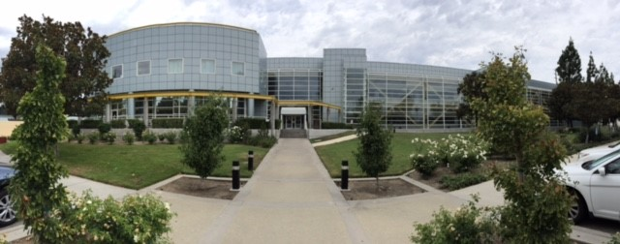
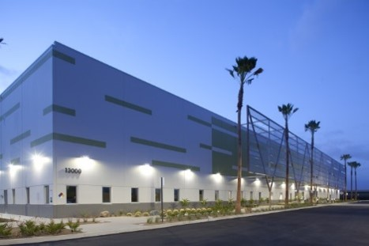
Sherman Way Chino Hills
Regional Laboratories

Slide 3
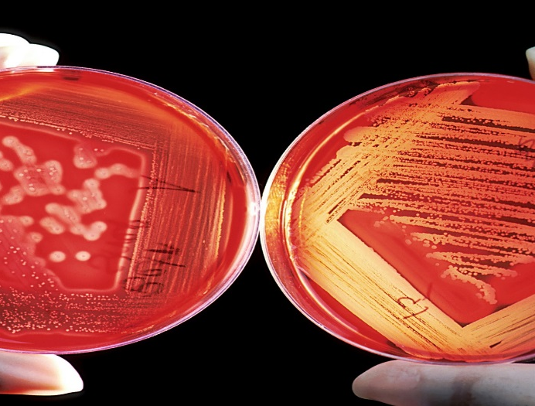
Agenda:
Introductions:
Instructions: Biobag
Instructions: Incubator Carrier Tote
Questions and Answer Session:
Notes:
In this presentation we will be going over: *CLICK*
The purpose of this entire presentation and why we use the incubator tote. *CLICK*
What specimens are transported in the tote. *CLICK*
What to do with the tote when it is not being used for transport. *CLICK*
How to prep the tote for use. *CLICK*
What to do with the tote before transporting samples. *CLICK*
What is done at the lab when the tote is received in the lab. *CLICK*
An overview of the temperature logger inside the tote, and *CLICK*
What measures are taken to ensure this procedure is consistently functioning effectively and accurately.

Slide 4
Instructions for Use: BD GasPak System (AKA:Biobag)
Introduction
The Pathogens
BD GasPak System Packing
The GasPak System
GasPak Paper Sachet
BD GasPak Procedure
Things to Keep in Mind

Slide 5

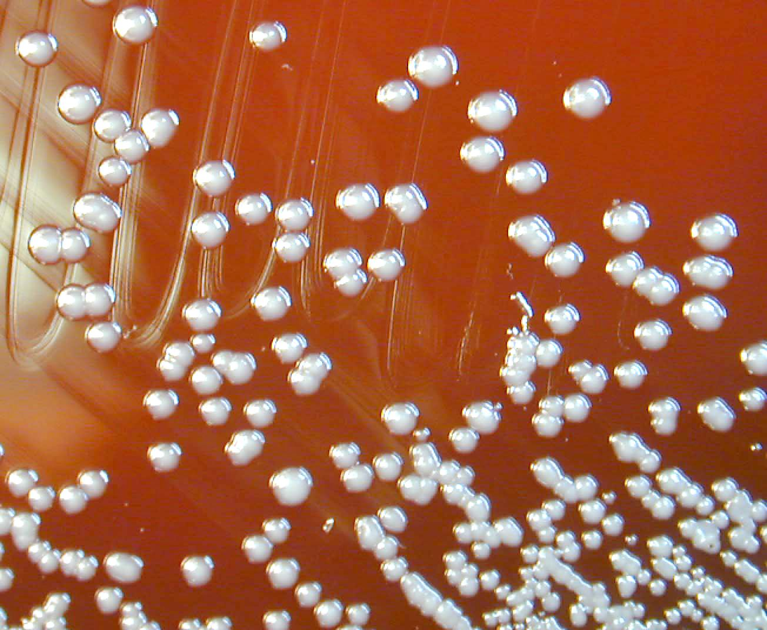
In Respiratory & Sterile Sites
Important Pathogens
Haemophilus species
Neisseria species
Streptococcus pneumonia
Beta hemolytic streptococcus
Burkholderia cepacia complex
Pseudomonas aeruginosa

Slide 6

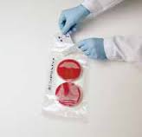
BD GasPak EZ CO2 Gas
Generating Pouch System
(aka: Biobag)
Becton, Dickinson and Company

Slide 7
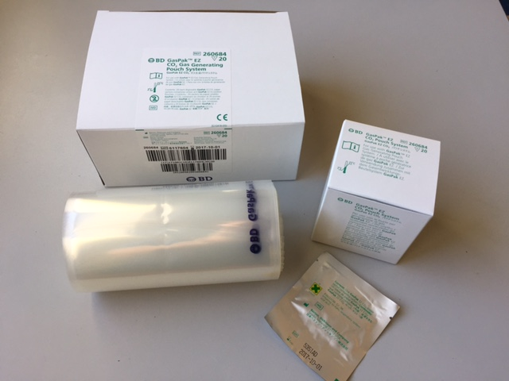
The GasPak System
BD GasPak EZ CO₂ Gas Generating Pouch System Includes
    20 disposable Paper Sachets
    20 Incubation Pouches
    Package Insert
  OneLink order number:

Slide 8
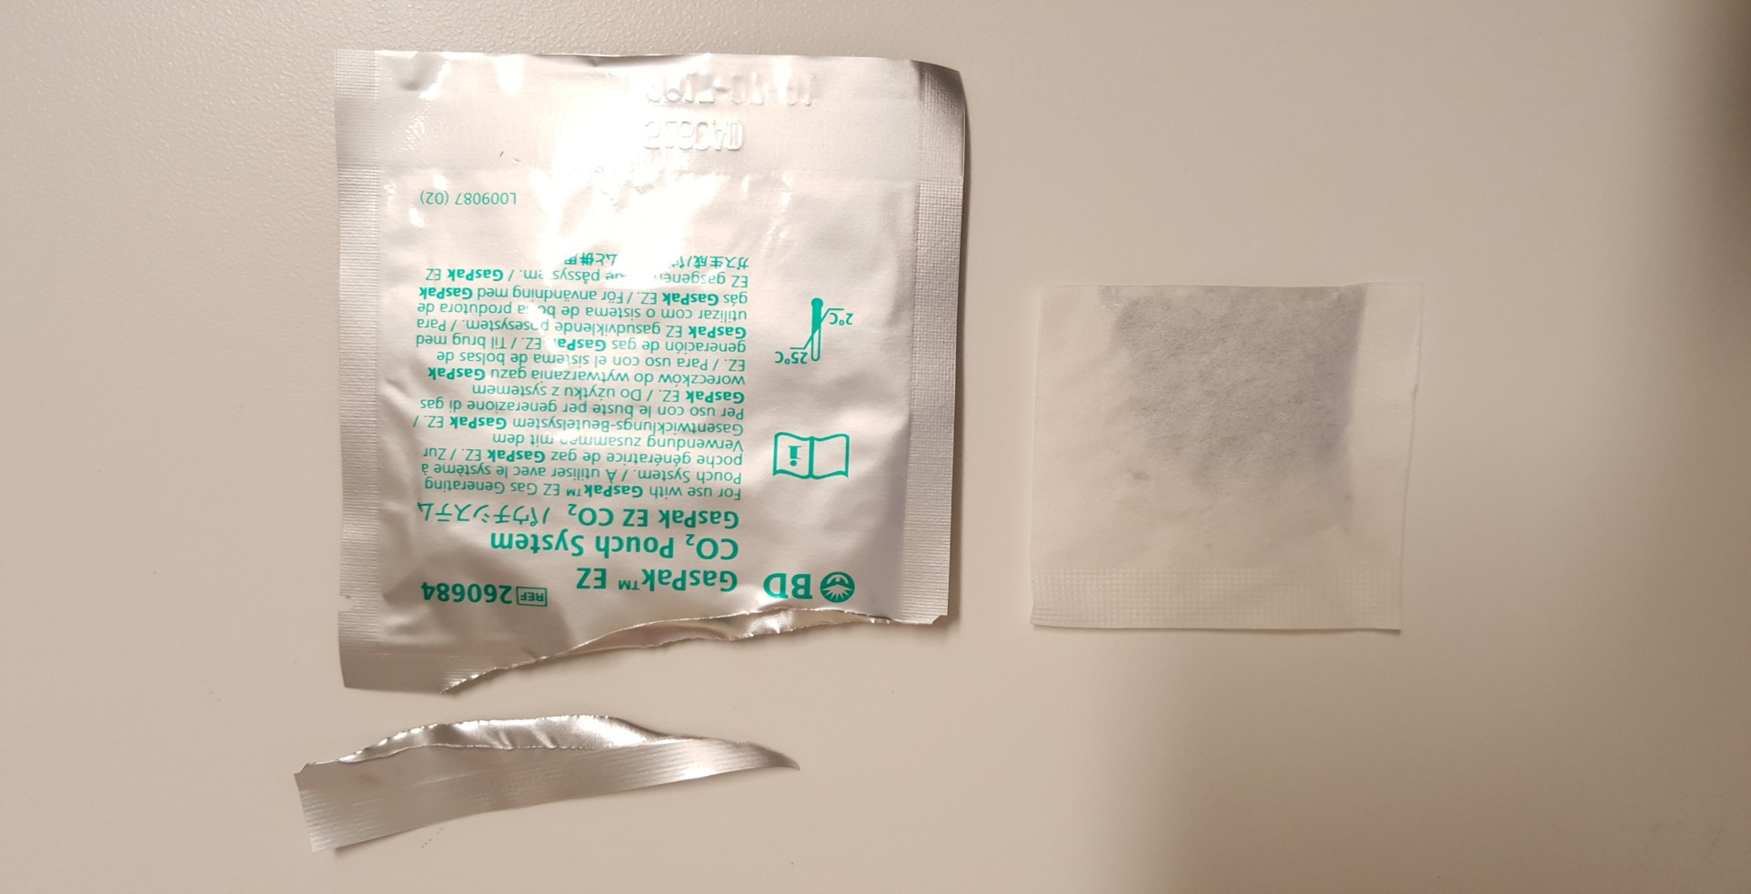
GasPak Paper Sachet
Creates the atmosphere
↓O2 ↑CO2
Produce > 3% CO2
Activated by air

Slide 9
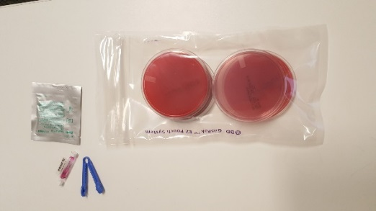
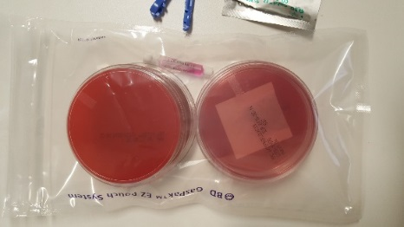
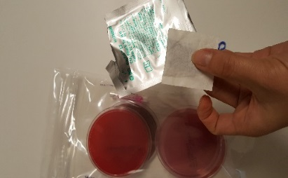
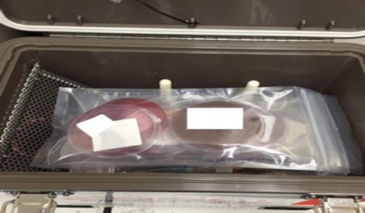
BD GasPak Procedure
Place inoculated plates inside pouch
2. Remove the sachet
3. Place activated sachet in pouch
4. Incubate in carrier

Slide 10
Things to Keep in Mind
Intended Use
  Single Use System
  Sachet activated by exposure to air
  Purpose : atmosphere >3% Carbon Dioxide (C0₂)
  Per Pouch
    1-4 Petri dishes
    One sachet
Warnings and Precautions
  DO NOT reuse
  DO NOT use if packaging is damaged
Storage
  Dry Environment, Room Temperature 2-30°C

Slide 11
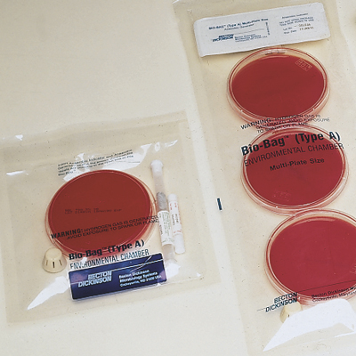
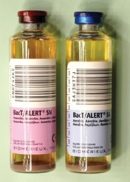
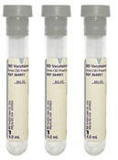

Specimen Transport
Agar plates streaked for sample culture are placed in a CO₂ Biobag
The CO₂ Biobag is placed in the Incubator Carrier Tote for transport to the Regional Lab
Intended Use: For the following culture PLATES ONLY:
    Respiratory Culture Plates
    Sterile Site Culture Plates
    Low Volume Urine Culture Plates
IMPORTANT: NOT for
Blood Culture Bottles
Raw Samples
Notes:
The samples that are transported are agar plates that have been streaked and placed in a CO2 bag. These CO2 biobags will be placed in the tote for transport to the Regional Lab.
It’s important to note that the tote is used for ONLY plated samples that require incubation in 34-37ºC. *CLICK*
They are NOT for blood cultures or raw patient samples. This includes urine tubes, stool samples, sputum in a sputum container or any specimen that is NOT plated. *CLICK*

Slide 12
Instructions for Use: Incubator Carrier Tote
Purpose
The Carrier Parts
The Chargers
Proper Placement of Chargers
Charging the Battery (3 Slides)
Turning “ON” the Carrier
Preparing the Carrier for Transport

Slide 13
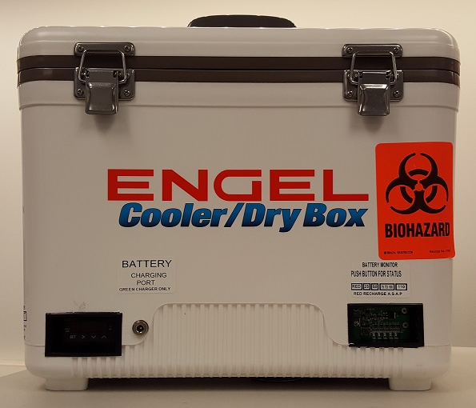
Purpose
Provide instructions for use of the portable Incubator Carrier Tote
Carrier tote used to provide a controlled temperature environment [33-37ºC] for transportation of plated samples for culture
Maintain a constant temperature
Prevents exposure to sub-optimal external conditions
Notes:
The purpose of this presentation to go over how to use the incubator tote.
There are a number of factors that affect the growth of an organism in culture. *CLICK*
The incubator tote is used to keep plated samples at the ideal 34-37ºC required for organisms to grow optimally. By providing a controlled environment, the incubator tote will allow samples to be transported from medical centers to the Regional Lab without compromising the specimens.

Slide 14
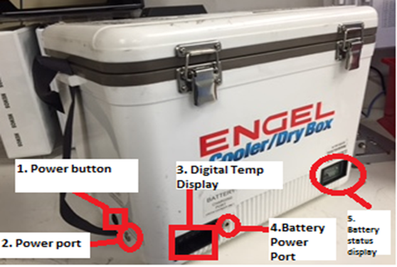
The Carrier Parts
1. Power Button - Powers the unit using battery power.
2. Power Port- Port used to pre-heat incubator.
3. Digital Temperature Display-Displays temperature of carrier.
4. Battery Power Port- Port used to charge the unit/battery.
5. Battery Status Display- Push button for battery power display.

Slide 15
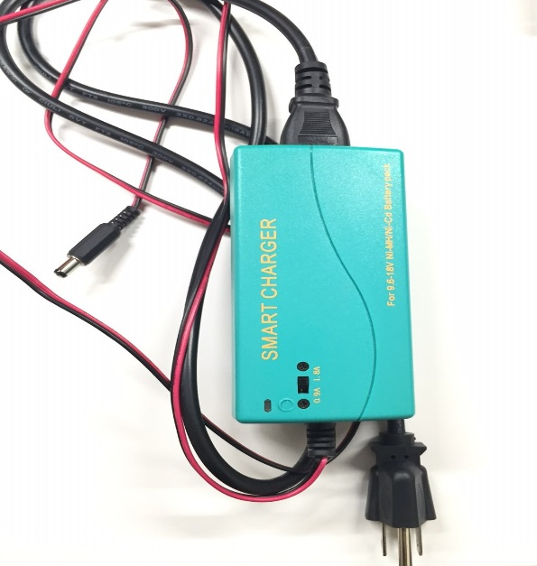
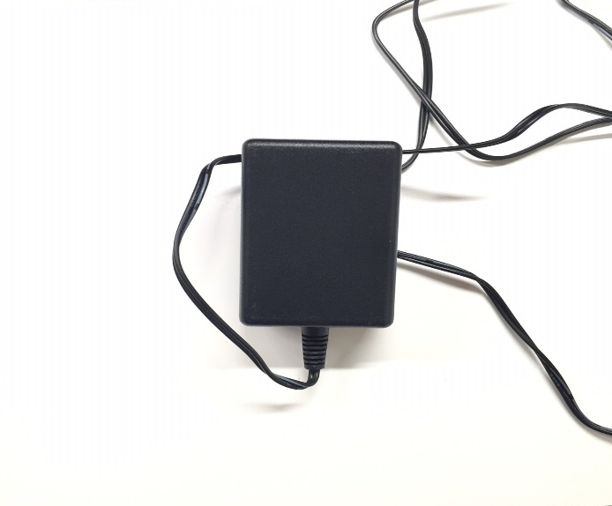
The Chargers
GREEN CHARGER
  Used to charge the Carrier Battery
  20-24 hours for full charge of Carrier
  (When battery drained)
  6-8 hours of power
  (When fully charged)
BLACK CHARGER
  Brings the Carrier to proper temperature without depleting charge
  Similar to an AC adaptor

Slide 16

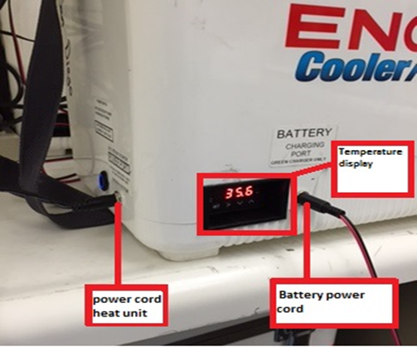

Proper Placement of Chargers
DO NOT SWITCH CHARGERS

Slide 17
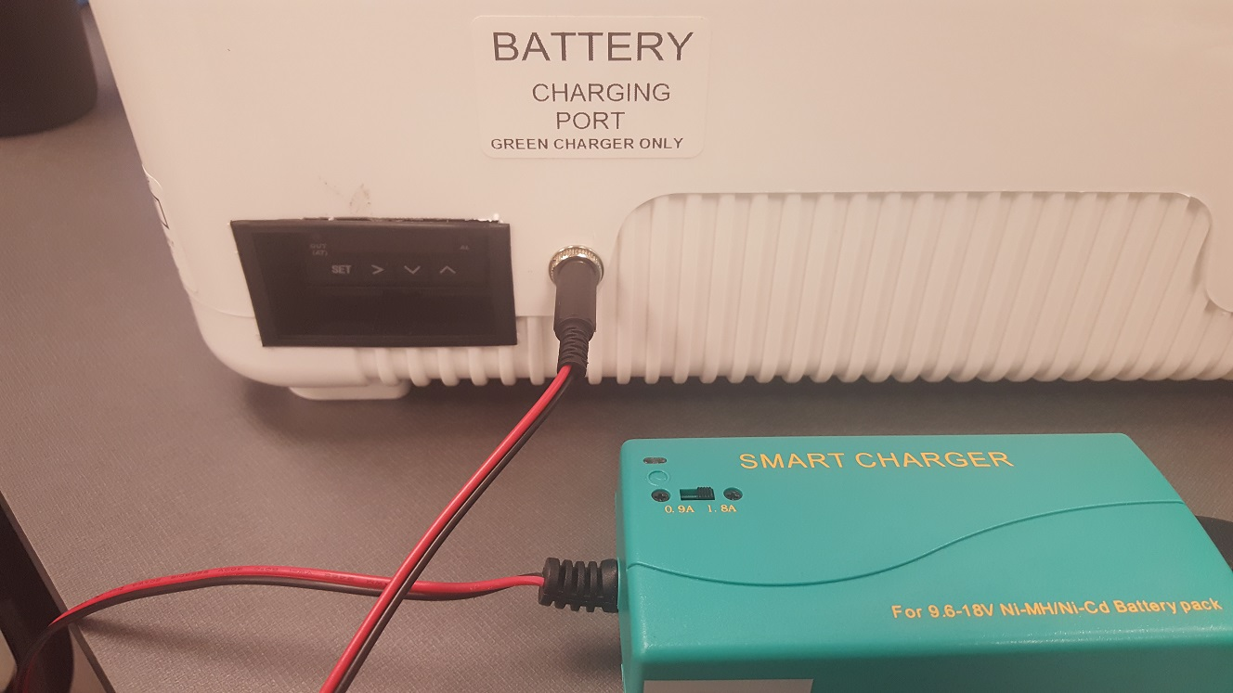
Charging the Battery (Slide #1)
Insert the plug on the green battery charger into the plug on front of the Carrier labeled “BATTERY CHARGING PORT”
  Set the charge current switch on the green battery charger to 1.8A
INSERT plug
IMPORTANT:
Carrier tote must be OFF when charging the battery
Notes:
When the tote is not in use, it’s important to make sure that the battery is charged so that it is ready for use when the time comes. Here we have a basic procedure on how to do that.
The Green Smart Charger plugs into the battery charging port on the tote. *CLICK*
The tote is to be charged at 1.8 Amps, not 0.9 Amps as seen in the figure. *CLICK*
The unit must also be off in order for charging to take place.

Slide 18
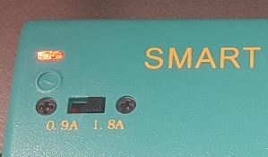
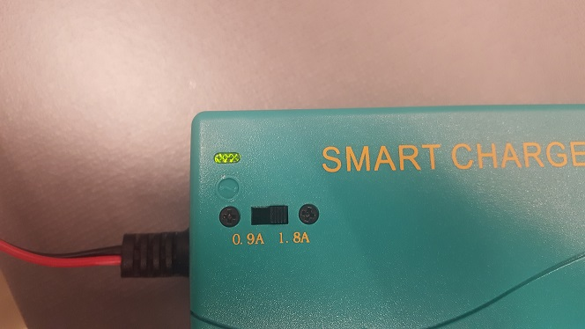
Charging the Battery (Slide #2)
Plug the green battery charger into a wall socket
  The light on the charger will be RED when charging
  The light will turn GREEN when cycle complete
IMPORTANT:
Once cycle is complete the charger will not restart unless it is unplugged and plugged in again
This should be done daily to keep batteries fully charged
RED light
GREEN light
Notes:
After everything is plugged in correctly, the tote will begin the charging cycle. *CLICK*
A red light on the Smart Charger indicates that charging is “in progress.” *CLICK*
A green light indicates that the charging cycle is “complete.” *CLICK*
A couple of notes about charging the battery:
Once the charging cycle is complete, it will need to be unplugged and plugged back in for the cycle to restart. This means that once the indicator turns green, it will remain at green until it is unplugged and then plugged back in.
This is to be done on a daily basis to ensure that the tote is ready when needed. *CLICK*

Slide 19
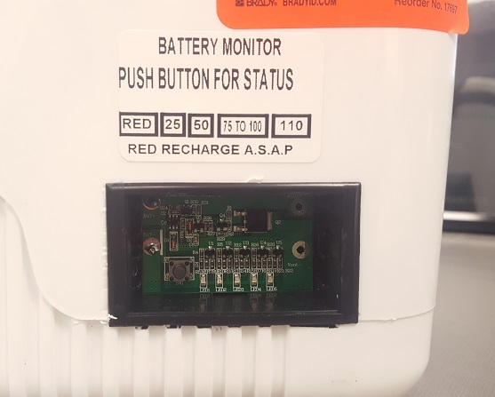
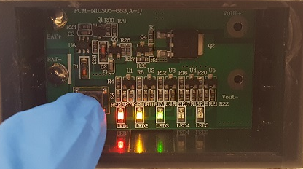
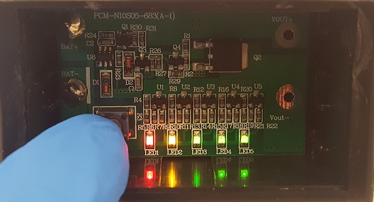
Charging the Battery (Slide #3)
Press the BLACK button on the Battery Monitor on the front of the Carrier to check the charge.
  A MINIMUM of 4 lights must be illuminated otherwise the battery is not fully charged.
Partially Charged
(Non-functional)
Completely Charged
(Functional)
IMPORTANT:
A completely drained battery will require 20-25 hours to charge to capacity
The Carrier uses the Battery power during transport
PRESS black button
Notes:
You can, of course, check the amount of life the battery has. This is done by pressing the BLACK button on the battery monitor located on the front right of the tote. *CLICK*
A minimum of 4 lights must be lit for the unit to function properly. Here you can see what a functioning battery monitor should look like vs. a battery monitor that is non-functional. *CLICK*
It takes about 20-25 hours of charging for a drained battery to have enough power to operate and should display 4 or 5 illuminated lights when the battery monitor is checked.

Slide 20
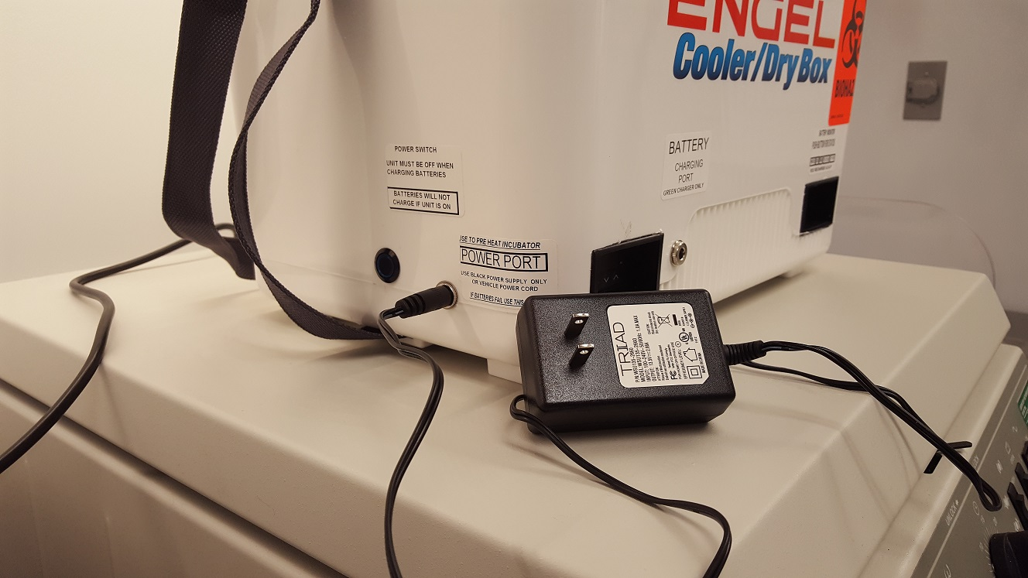
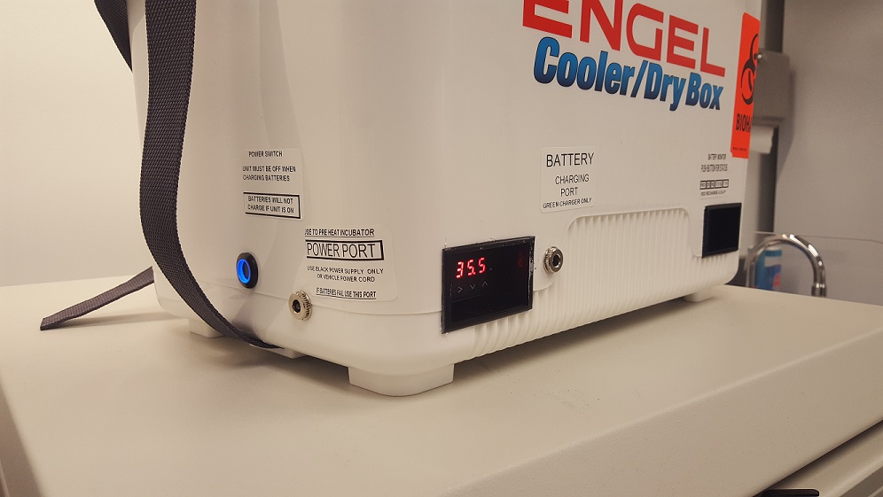
Turning “ON” the Carrier
Insert the Plug from the Black Power Supply into the Power Port on the left side of the Carrier
    The power switch will automatically turn “ON”
    The motor will start up
    The temperature display will light up
Allow the Incubator Carrier unit to come up to temperature (33-37 C) and stabilize before placing plates inside (takes 30 min. to 1 hr.)
Load plates inside Carrier for transport
  IMPORTANT:
  The unit must be turned “ON”, fully charged, and allowed to come up to temperature before putting plates inside
TEMPERATURE display
INSERT plug
BLACK power supply
Notes:
After the tote has enough charge, the inside of the tote must be heated to create the ideal environment for the samples. This will require that the tote be plugged in again. This time the black battery should be plugged into the “POWER PORT” located on the left side of the tote. Once plugged in…*CLICK*
The unit will turn on, the motor will start up, and the temperature will be on display on the front lower left corner of the tote. *CLICK*
It will take about an hour for the unit to heat up and stabilize. The samples can be loaded after the unit has been properly heated and stabilized. *CLICK*
It’s important that the unit be charged (displays a MINIMUM of 4 lights on the battery monitor) in order for the unit to maintain the required environment conditions inside the tote during transport.

Slide 21
Preparing the Carrier for Transport
Unplug the power supply from the power port
Push Power Switch to turn “ON” the unit
    The front temperature display should light up
    BLUE LIGHT on the side should turn “ON”
Record the temperature from the display on the front lower left of the Carrier
6. Send Carrier via RRL-Courier to Regional Lab
TEMPERATURE display
Notes:
When the tote is ready for transport… *CLICK*
Unplug the black charger from the POWER PORT.
Push the power switch button located on the left side of the tote next to the power port to turn on the unit. You can verify that it is on if the temperature is displayed.
Verify that there is a temperature logger inside the incubator.
Record the temperature displayed on the tote and
Send it off to the courier for transport to Regional Lab.

Slide 22
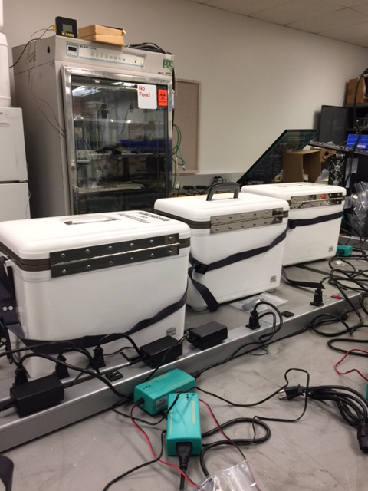
Quality Control: Temperature Indicator Strip (Slide #1)
Lab Technology Services will calibrate the Carrier annually and perform preventive maintenance semiannually
Notes:
In order to make sure that the incubator is working correctly while in use: *CLICK*
The temperature will be logged prior to shipment to the Regional Lab and
The temperature will be logged upon receiving the tote at the Regional Lab before samples are removed. *CLICK*
There is an internal thermometer placed inside the tote that will record the internal temperature of the tote every 30 minutes. If the temperature does not display 34-37ºC, a manager will be informed and the tote will be pulled for service. *CLICK*
The unit will also be calibrated once a year to ensure it is consistently functioning accurately.

Slide 23
Thank you!
Until we meet again…

