Slide 1
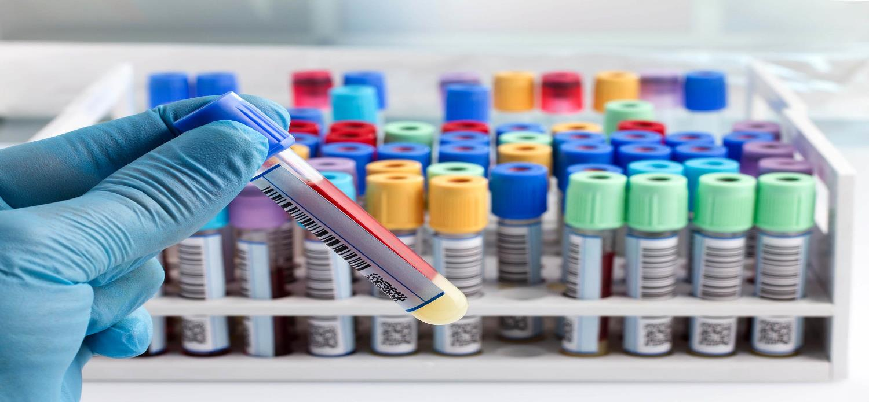
Quest and ARUP Specimen Tracking Workflow
How to track these specimens correctly to reduce delays in testing
Michael A. de la Guardia, CLS, BS MLS(ASCP)^{CM}, MSHM

Slide 2
Quest/ARUP Specimen Tracking Workflow
Specimens Collected in any of the outside MOB Draw Stations

Slide 3

Building the Transfer List in the Clinics
Quest/ARUP Specimen Tracking Workflow
Specimens should be Logged in as Collected and Received immediately after receipt or after blood is drawn.
After spin-down and/or aliquoting, build your transfer list by:
  Click on Transfer Specimen icon
  Click the New button at the bottom of the screen
  The “Location From” should be your default MOB Location
  i.e. MMO MOB SpecTrk
  For Quest or ARUP Specimens the “Location To” should always be RIV MC SpecTrk.
  The Transfer Temp. MUST match what is on the label.

Slide 4
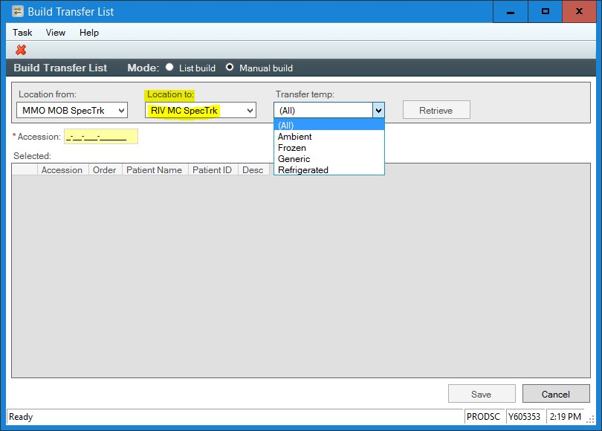
Building the Transfer List in the Clinics
Quest/ARUP Specimen Tracking Workflow
Your Build Transfer List window should look like this:
Once your list is complete. Click Save

Slide 5
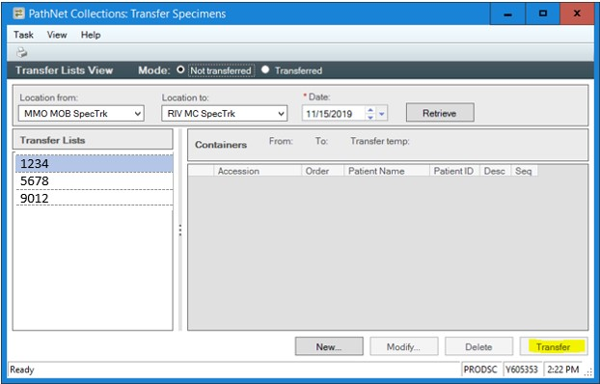
Putting Specimens “In Transit” from Clinics
Quest/ARUP Specimen Tracking Workflow
When closing out transfer lists, make sure you select the correct Input From/To locations and Input date
Then click Retrieve to view your current transfer lists.
Select the Transfer List # you need and then click Transfer

Slide 6

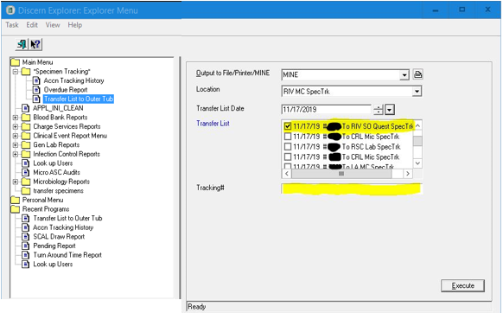
Linking the PacTrak Barcode to Transfer List
Quest/ARUP Specimen Tracking Workflow
Go to the “Explorer Menu”
Under Main Menu, Open the Specimen Tracking File.
  Then Click “Transfer List to Outer Tub”
  After inputting your location and the date, select your transfer list.
  Click in the Tracking# box then Scan your barcode.

Slide 7
Quest/ARUP Specimen Tracking Workflow
Specimens Received from the Clinics or
Collected and Received from the Medical Center

Slide 8
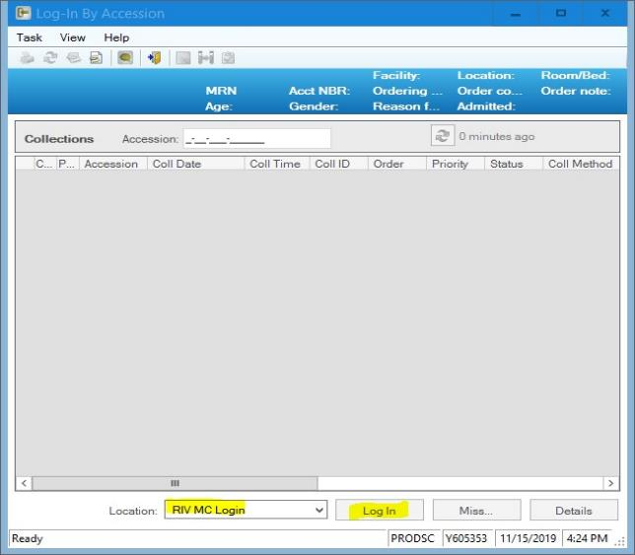
Receiving Specimens in the Medical Center
Quest/ARUP Specimen Tracking Workflow
Whether we are receiving specimens from the clinic, collecting/receiving in LL Lab OP, or receiving specimens from the floors, the specimen log in “Location:” should be RIV MC Login.

Slide 9
Building the Transfer List in the Medical Center
Quest/ARUP Specimen Tracking Workflow
After spin-down and/or aliquoting those that have not been processed and gathering specimens from the clinics, build your transfer list by:
  Click on Transfer Specimen icon
  Click the New button at the bottom of the screen
  The “Location From” should be RIV MC SpecTrk
  Use the following “Location To” for these specimens:
    QUEST: RIV SO Quest Sp
    ARUP: RIV SO ARUP Sp
  The Transfer Temp. MUST match what is on the label.

Slide 10
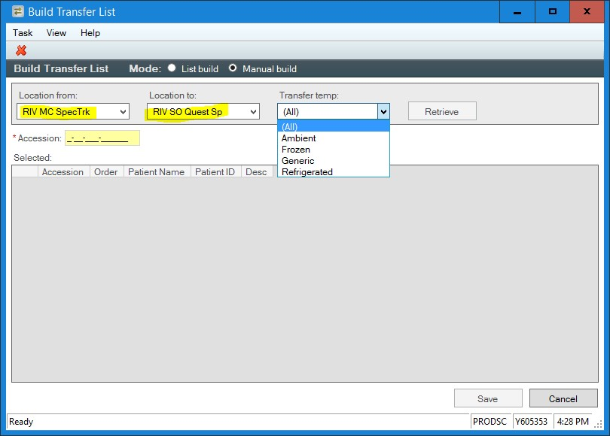
Building the Transfer List in the Medical Center
Quest/ARUP Specimen Tracking Workflow
Your Build Transfer List window should look like this:
Once your list is complete. Click Save

Slide 11
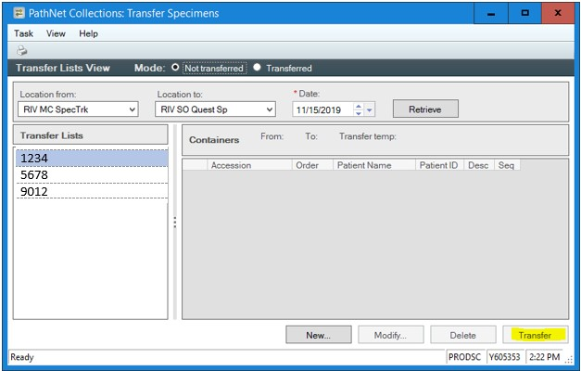
Putting Specimens “In Transit” from RIV MC
Quest/ARUP Specimen Tracking Workflow
After specimens are packed and closing out transfer lists, make sure to select the correct Input From/To locations and Input date
Then click Retrieve to view your current transfer lists.
Note down and Select the Transfer List # you need.
Click Transfer.

Slide 12
Linking ARUP/Quest Barcode to Transfer List
Quest/ARUP Specimen Tracking Workflow
Go to the “Explorer Menu”
Under Main Menu, Open the Specimen Tracking File.
  Then Click “Transfer List to Outer Tub”
  After inputting your location and the date, select your transfer list.
  Click in the Tracking# box then Scan your barcode.

Slide 13
Linking ARUP/Quest Barcode to Transfer List
Quest/ARUP Specimen Tracking Workflow
Each ARUP or Quest specimen transport bag should have a barcode to track the specimens sent in it.
  If using a larger bag that does not have a barcode:
    Get a small bag that does have a barcode.
    Scan this as the barcode to link to the transfer list for the larger bag.
    Place small bag inside the larger along with those specimens.

Slide 14

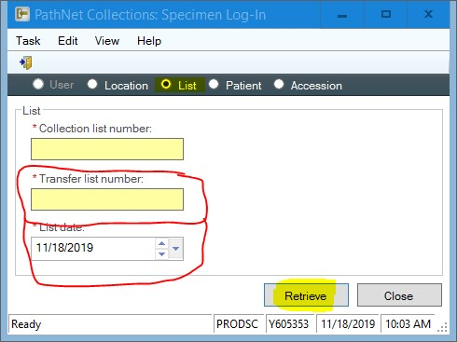
Receiving Quest /ARUP Specimens:
Crossing orders into the Reference Lab Systems
Quest/ARUP Specimen Tracking Workflow
The final and most crucial step.
Go Back to Specimen Log-In
From the main screen select "List" on the top menu.
Using the correct "Transfer List" number for your Quest/ARUP specimens, select the correct "List date“
Click Retrieve.

Slide 15
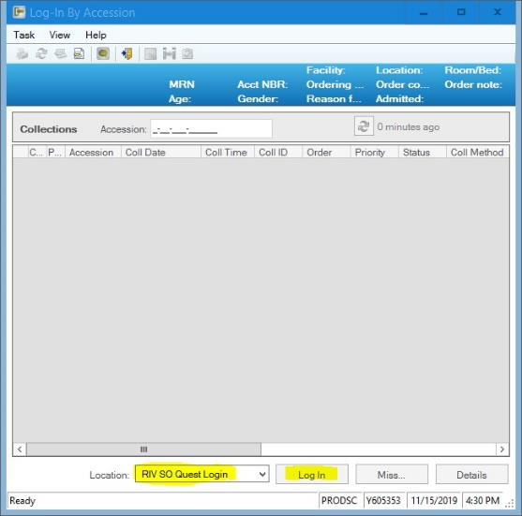
Receiving Quest /ARUP Specimens:
Crossing orders into the Reference Lab Systems
Quest/ARUP Specimen Tracking Workflow
Verify that all of the accessions are listed on the log-in Screen.
Verify that your Log-in “Location:” is one of the following depending on your transfer list:
    QUEST: RIV SO Quest Sp
    ARUP: RIV SO ARUP Sp
Click Log In.

