Slide 1
MODIFIED Q SCORE WITH REFLEX TO SPUTUM CULTURE TRAINING
SCPMG Regional Reference Laboratories Sherman Way – Bacteriology Department

Slide 2
Objectives
01
Discuss the new process of sputum screening to determine the quality and acceptability of sputum for culture processing
02
Review commonly found cells on a sputum smear
03
Demonstrate Cerner reporting of unacceptable and acceptable sputum
04
Discuss some reminders on Sputum & Quantitative Respiratory Culture sample processing

Slide 3
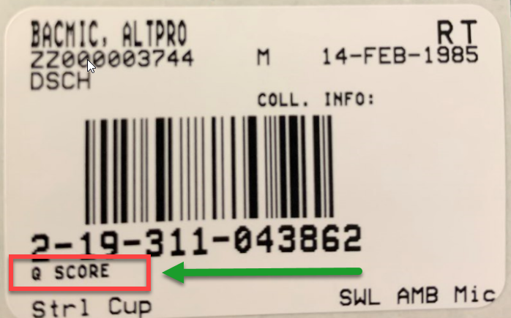
Current Order Label “Q SCORE”

Slide 4
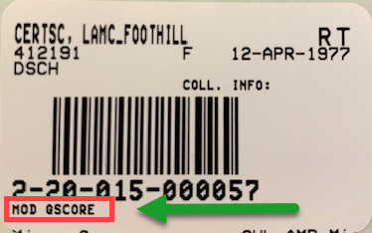
New Order Label “MOD QSCORE”

Slide 5
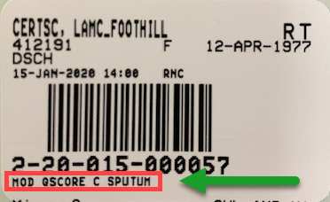
Reflex Order Label “MOD QSCORE C SPUTUM”

Slide 6
Sputum Smear Examination
Scan at least 10 low power fields before making a determination
After the sputum smear is prepared and Gram stained (follow local MC Lab protocol), examine the smear using the LOW-POWER FIELD (10X) OBJECTIVE for the presence of squamous epithelial cells

Slide 7
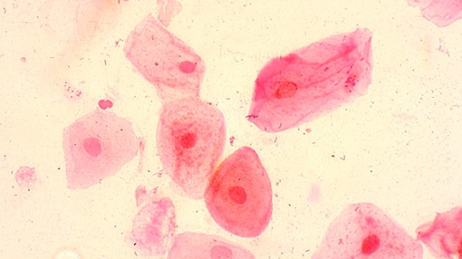
Squamous Epithelial Cells
Lining cells of the oropharynx
Appear as large, flat, plate-like cells with clear or ground glass cytoplasm. The nucleus are small, dense and eccentrically located. The cytoplasm may appear folded.
Easily seen and recognized under low power field (LPF)
The presence in a sputum smear usually indicates contamination with saliva.

Slide 8
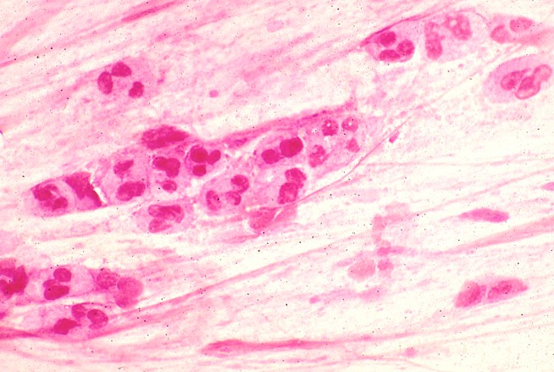
Polymorphonuclear WBCs
Appear as multi-lobed nuclei with granular cytoplasm
Cytoplasm sometimes contains phagocytosed bacteria
Large numbers are present during an acute inflammatory reaction

Slide 9
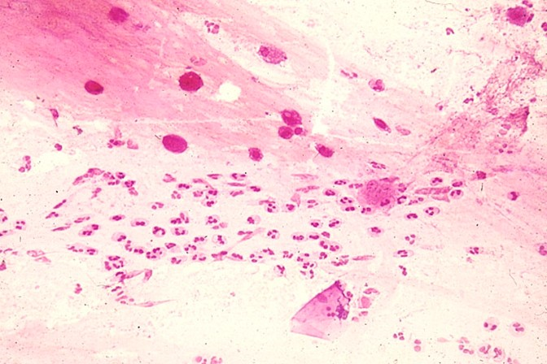
Mononuclear WBCs
A variety of small cells with single lobed nuclei may be present in sputum specimens
Lymphocytes are the most common

Slide 10
Alveolar Macrophages
Mobile cells which can be found in many body tissues, derived mainly from monocytes
Dense frothy or “bubbly” cytoplasm with nucleus located to one side of the cell – often obscured by the cytoplasm. The cells are very densely staining.
Their presence indicates that the specimen originated from the lower respiratory tract

Slide 11
Interpretation
UNACCEPTABLE SPECIMEN
≥10 squamous epithelial cells per
low-power field (LPF)
ACCEPTABLE SPECIMEN
<10 squamous epithelial cells per low-power field (LPF)

Slide 12
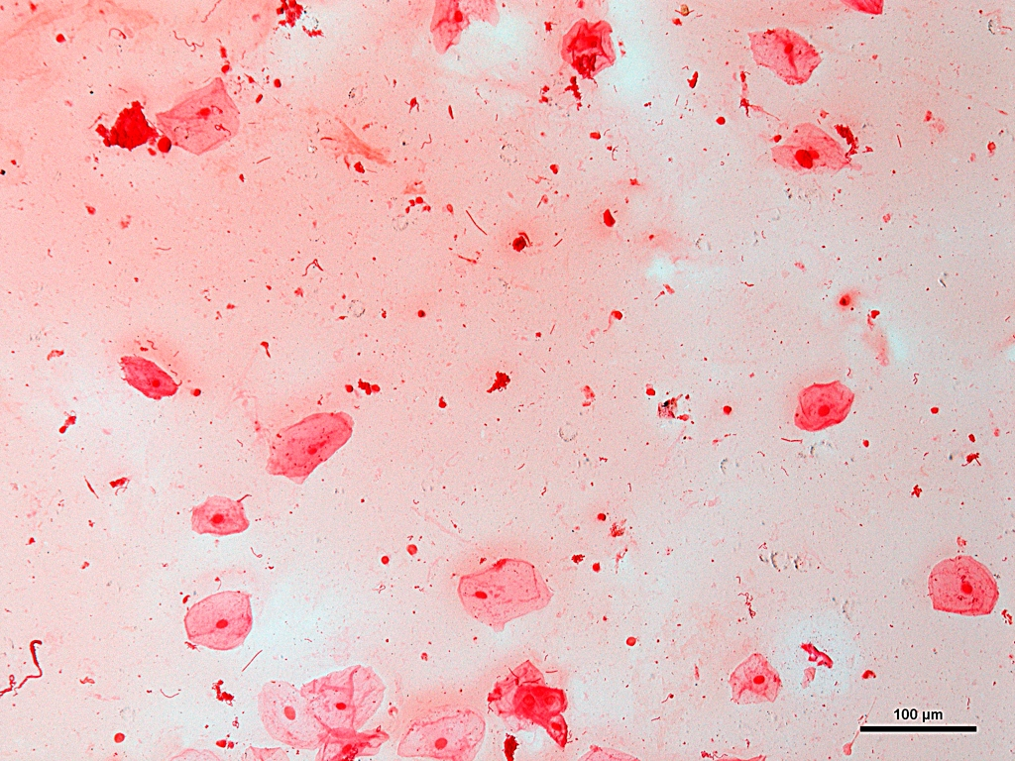
≥10 Epis/LPF present Interpretation: Unacceptable

Slide 13
≥10 Epis/LPF present Interpretation: Unacceptable

Slide 14
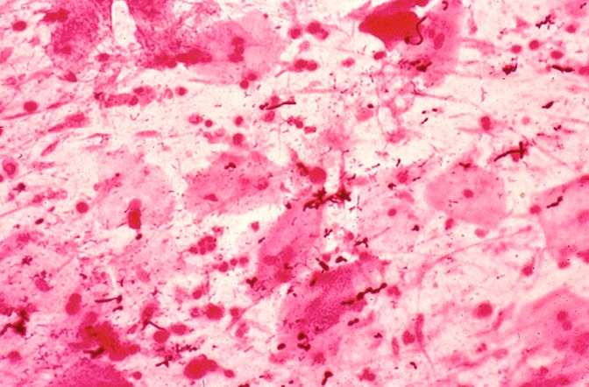
WBCs present but ≥10 Epis/LPF Interpretation: Unacceptable

Slide 15
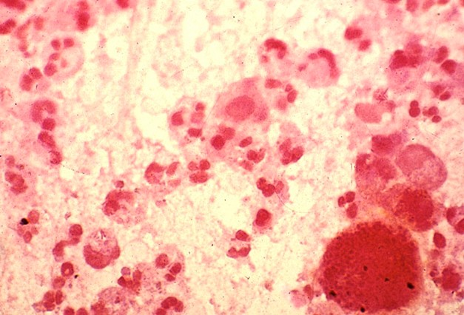
<10 Epis/LPF Many WBCs Interpretation: Acceptable

Slide 16
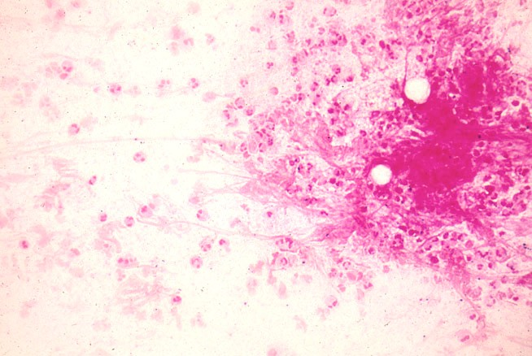
<10 Epis/LPF Many WBCs Interpretation: Acceptable

Slide 17
<10 Epis/LPF Many WBCs Interpretation: Acceptable

Slide 18
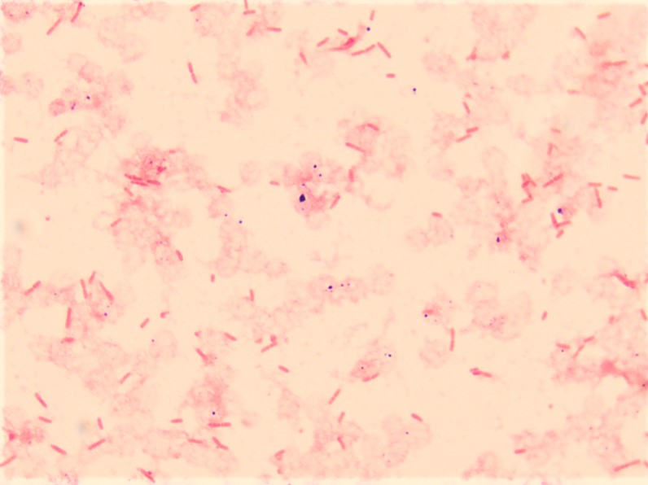
No Epithelial cells (<10/LPF) No WBCs Many GNR present Interpretation: Acceptable

Slide 19
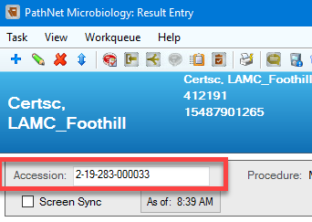
CERNER REPORTING Unacceptable Specimen
1. Log on to CERNER, then on CERNER Apps, click on Result Entry icon for Microbiology
2. At the Result Entry, enter the accession number on the Accession field and press Enter

Slide 20
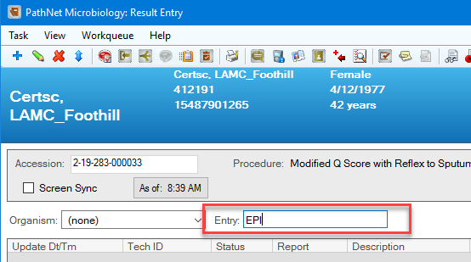
Cerner Reporting – Unacceptable Specimen, continued
3. At the Result Entry, under Entry field, type EPI and press Enter
4. The Add Biochemical – EPI window will appear, then use the down arrow to select the result.

Slide 21
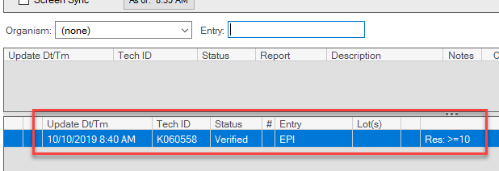
Cerner Reporting – Unacceptable Specimen, continued
5. At the Add Biochemical – EPI window, select >=10 from the drop-down list if the smear has >=10 squamous epithelial cells per LPF then click Verify
The result is now documented on the work card

Slide 22
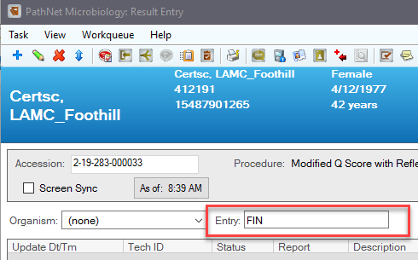
Cerner Reporting – Unacceptable Specimen, continued
6. At the Result Entry window, under Entry field, type FIN and press Enter

Slide 23
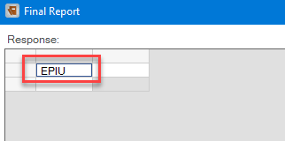
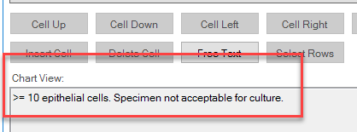
Cerner Reporting – Unacceptable Specimen, continued
7. The Final Report window will appear then type EPIU on the first response cell
8. The result will then display at the Chart View area, then click Verify to release the Final Report.

Slide 24
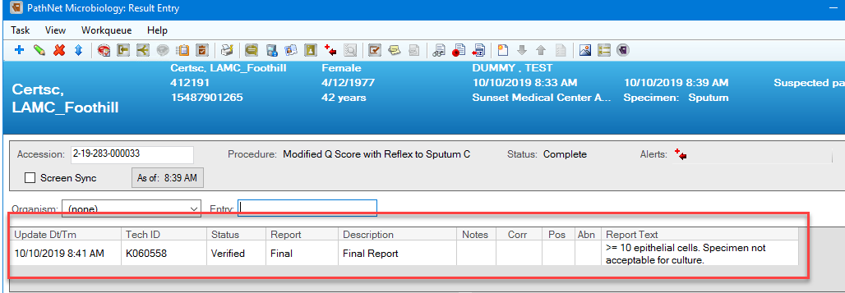
Cerner Reporting – Unacceptable Specimen, continued
9. At the Result Entry window, the Final Report is displayed and status is Complete.

Slide 25
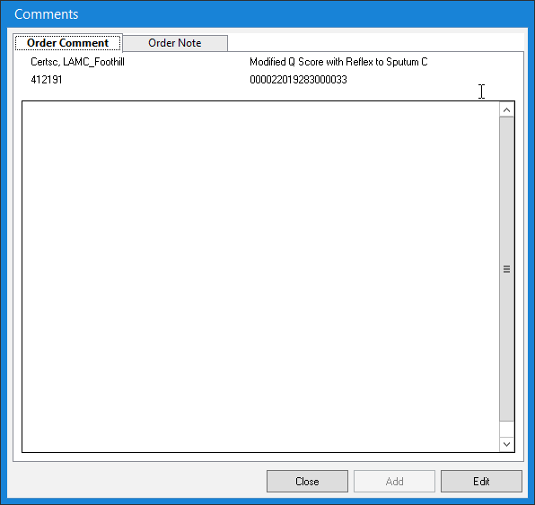
Cerner Reporting – Unacceptable Specimen, continued
10a. If applicable, refer to the local Medical Center Laboratory for call notification and documentation protocol.
Call notification may be documented under Comments.
Click the Comments icon to document.

Slide 26
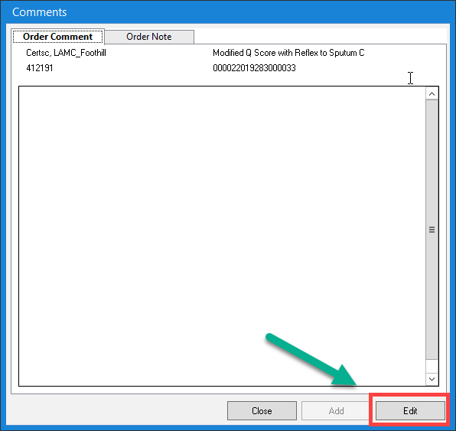
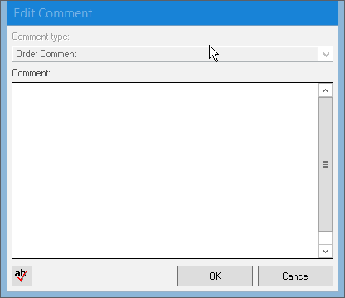
Cerner Reporting – Unacceptable Specimen, continued
10b. Click Edit under Order Comment tab and Edit Comment window will appear. Press F2 to generate the Template window.

Slide 27
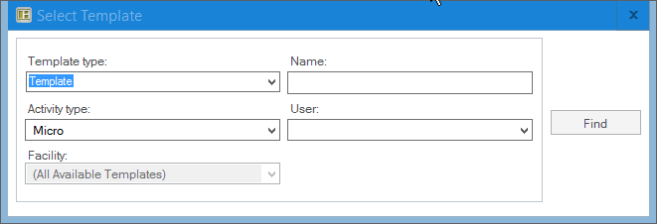
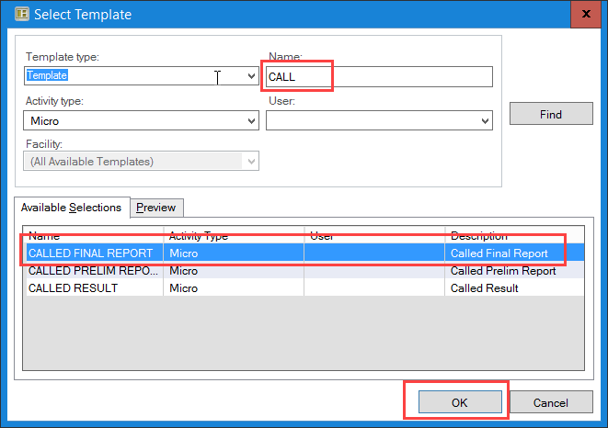
Cerner Reporting – Unacceptable Specimen, continued
10c. At the Template window, type CALL under Name and click OK.

Slide 28
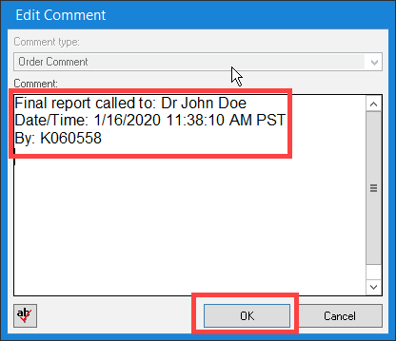
Cerner Reporting – Unacceptable Specimen, continued
10d. Fill up the name of the person called to, date, time and NUID. Press F5 to auto-populate the date and time. Click OK.

Slide 29
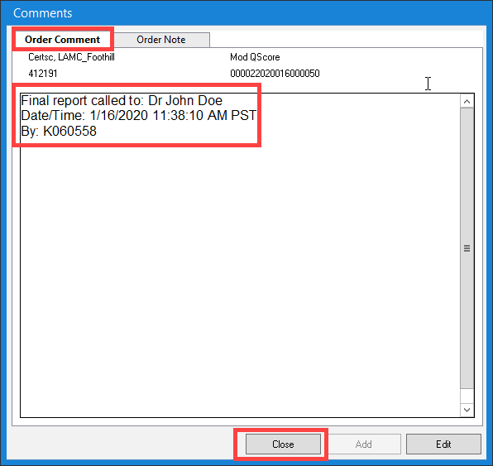
Cerner Reporting – Unacceptable Specimen, continued
10d. The call documentation is now displayed under the Order Comment tab. Click Close to close the window.

Slide 30
CERNER REPORTING Acceptable Specimen
At the Result Entry, enter the accession number on the Accession field and press Enter
Under the Entry field, type EPI and press Enter.

Slide 31
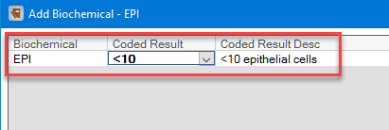
Cerner Reporting – Acceptable Specimen, continued
3. The Add Biochemical – EPI window will appear, then select <10 from the drop-down list, and click Verify
The result is documented on the work card

Slide 32
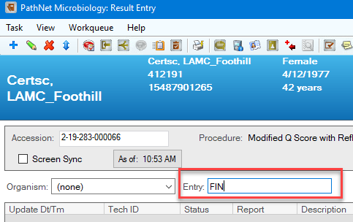
Cerner Reporting – Acceptable Specimen, continued
4. At the Result Entry window, under Entry field, type FIN and press Enter, then the Final Report window will appear

Slide 33
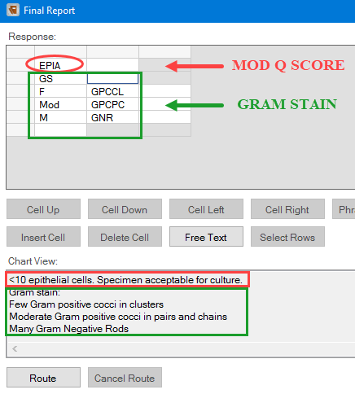
Cerner Reporting – Acceptable Specimen, continued
5. At the Final Report window:
Type EPIA on the first response cell
Then type GS on the second response cell
Enumerate and type the appropriate response value for the Gram stain results on the succeeding cells
The result will display under the Chart View area, then click Verify to release Final Report results

Slide 34
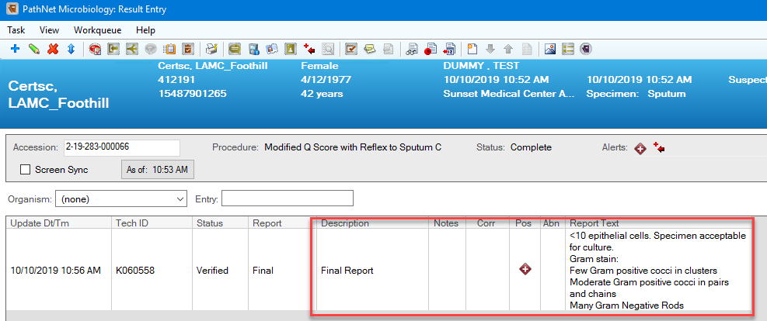
Cerner Reporting – Acceptable Specimen, continued
6. At the Result Entry, the Final Report is then displayed and the status is complete.

Slide 35
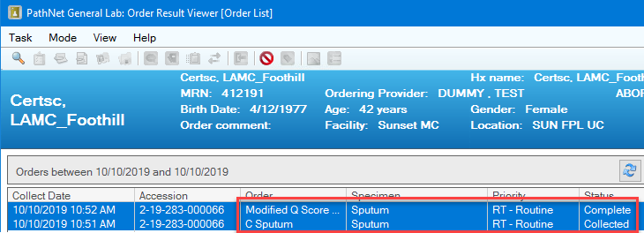
Cerner Reporting – Acceptable Specimen, continued
7. At the Order Result Viewer, the Sputum Culture (C Sputum) is reflexed after the Modified Q Score is final/complete.
The C Sputum will reflect on the barcode label with the same accession number.
8. Micro Login the Sputum Culture order and print the media barcode labels. Inoculate sputum sample onto BAP, CHOC & MAC agar.

Slide 36
Cerner Reporting – Acceptable Specimen, continued
REMEMBER TO DO THE FOLLOWING!
1. Quantitate white blood cells under low-power field (LPF)
2. Report the Gram stain. Quantitate and enumerate morphology of bacteria and yeast under oil immersion field (OIF). See table on the procedure for the appropriate quantitation.
3. Finalize/Complete the report to reflex the Sputum Culture order.

Slide 37
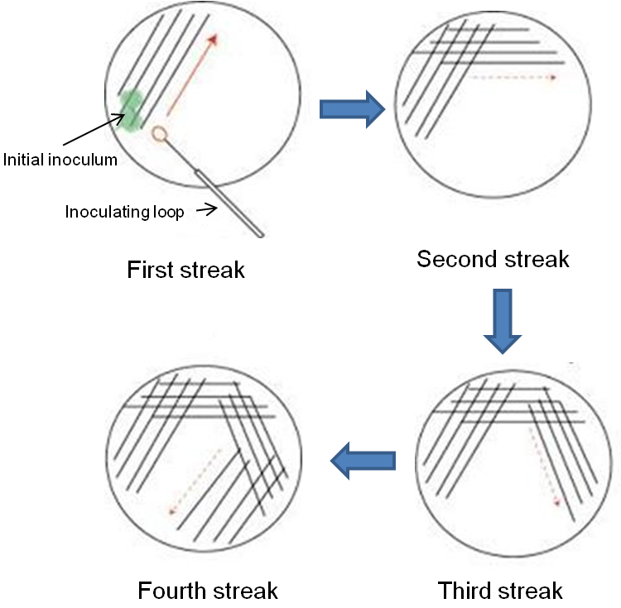
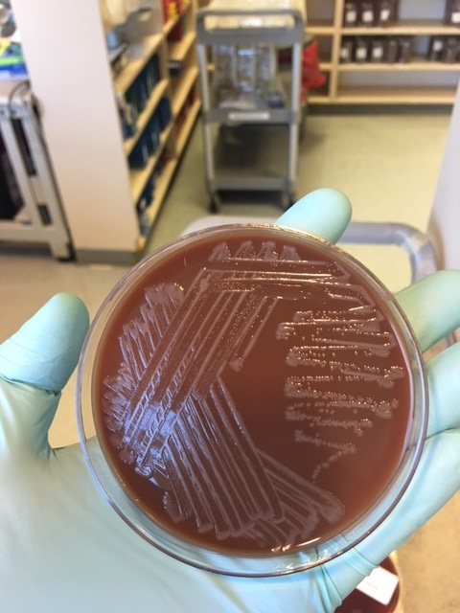
Sputum Culture
Orderable: C Sputum
Source: Expectorated Sputum
Plate Inoculation:
Blood Agar
Chocolate Agar
MacConkey Agar
Four Quadrant Streaking Method – Use 10ul loop for streaking

Slide 38
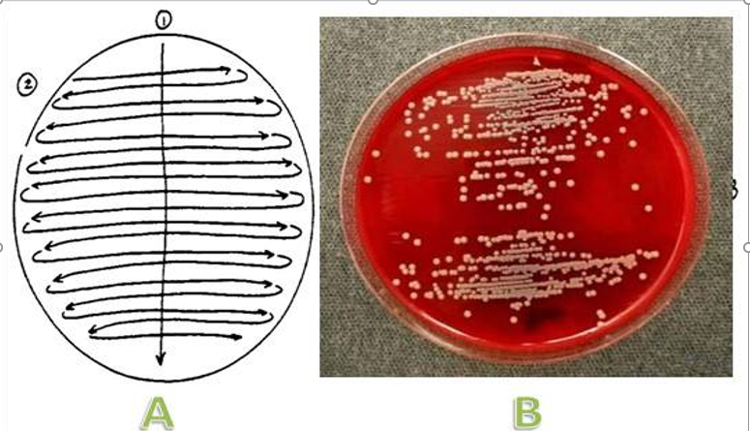
Quantitative Respiratory Culture
Orderable: C RESP QN
Sources: Bronchoalveolar Lavage (BAL), Bronchial Washing, Protected Brush
Plate Inoculation:
Blood Agar
Chocolate Agar
MacConkey Agar
Reported as colony forming units (CFU/ml)
Semiquantitative Streaking Method - use 10ul loop for streaking

Slide 39
GO-LIVE! MARCH 18, 2020
Replacement of the existing Q SCORE [87205ZV] in KPHC with the new order Q SCORE W REFLEX TO SPUTUM CULTURE [87205ZX]
Removal of SPUTUM CULTURE [87070J] from all of the KPHC Preference Lists because ordering will be by reflex only
Inactivation of SPUTUM CULTURE, NEUTROPENIC PATIENT [87070ZZAD].

Slide 40
Additional Resources
Medical Center Lab Procedure (SCPMG-PPP-0367)
Training Checklist
Competency Assessment Quiz (Powerpoint slides)
Competency Assessment Answer Sheet
LabNet
Technical Bulletin

