Slide 1
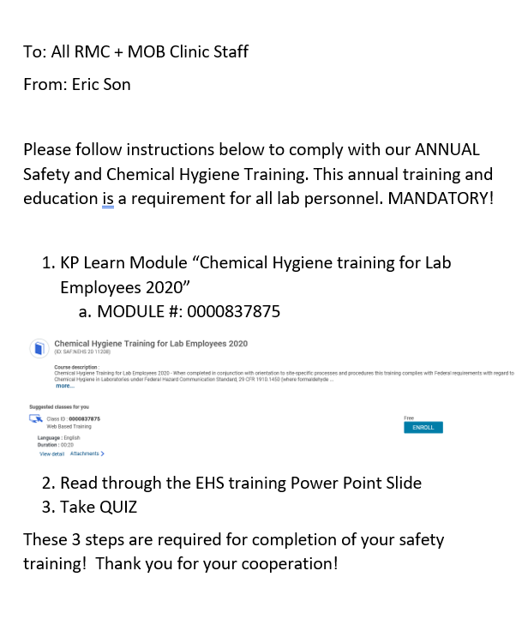

Slide 2
2020
Annual Chemical Hygiene and EH&S Training
Chemical Hygiene Plan (CHP)
Formaldehyde Control of Exposure
Labeling Systems/Secondary Containers
Safety Data Sheets (SDS) / MSDS
Pictograms and Hazards
Spill Response
Fire Safety (RACE, PASS, evacuation)
Chemical Hygiene and Safety Refresher
Waste Management Streams

Slide 3
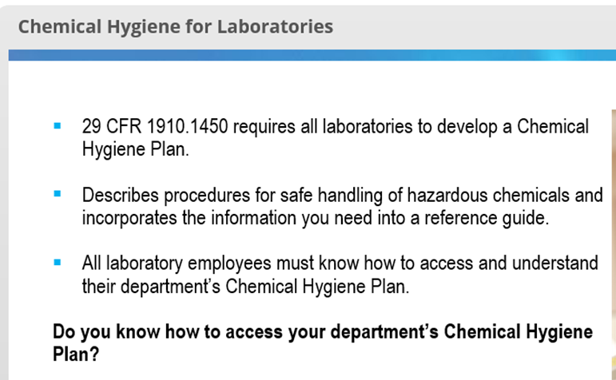
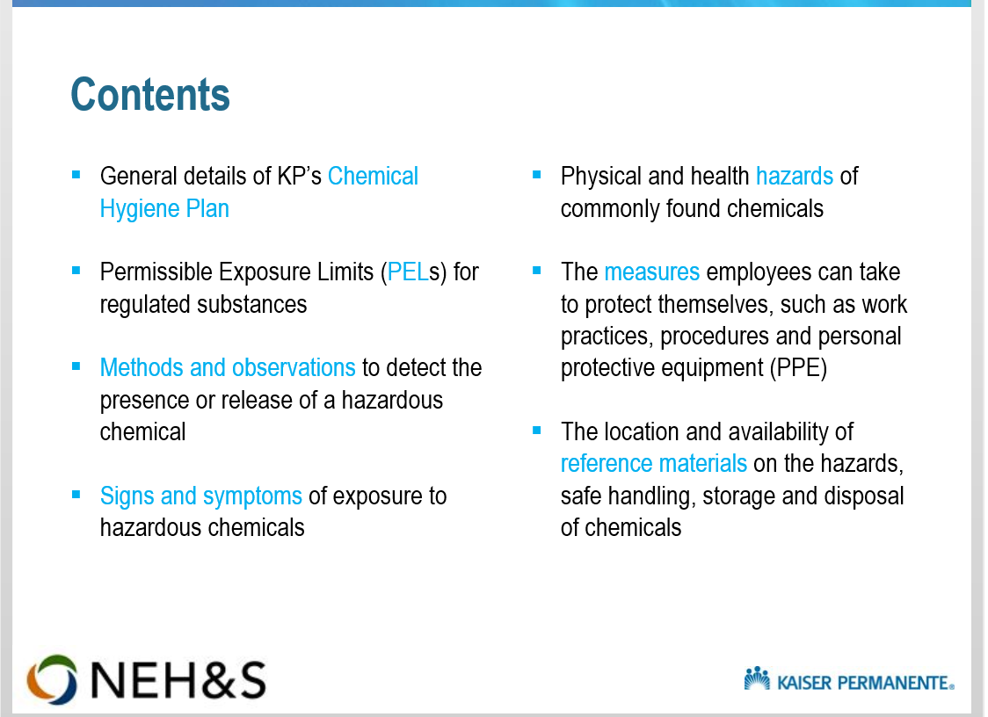

Slide 4
Table of Contents
FORMAL POLICY STATEMENT 2
PURPOSE 3
SCOPE 3
AVAILABILITY 3
RESPONSIBILITIES 3
EMERGENCY CONTACTS 5
GENERAL LAB SAFETY OPERATING PROCEDURES 5
GENERAL CHEMICAL SAFETY 7
Hazardous Material Classification 7
Chemical exposure monitoring 11
Chemical Exposure Controls and Emergency Safety Equipment 12
Chemical Storage 14
Chemical Waste Disposal 15
PRIOR APPROVAL FOR NON-ROUTINE LABORATORY PROCEDURES 16
HIGH-HAZARD CHEMICAL OPERATIONS 16
FORMALDEHYDE HAZARDS 17
SPILLS AND ACCIDENTS 18
RESPIRATORY PROTECTION 22
MEDICAL CONSULTATION AND EXAMINATION 23
TRAINING 24
HOUSEKEEPING 25
RECORD KEEPING 26
REFERENCES 28
APPENDIX A: Formaldehyde Requirements Matrix 29
APPENDIX B: DOT Classification List 31
APPENDIX C: EPA Hazard Classification List 32
APPENDIX D: Target Organ List 33
APPENDIX E: Target Organ Effects 34
APPENDIX F: Incompatible Storage List 35
1

Slide 5
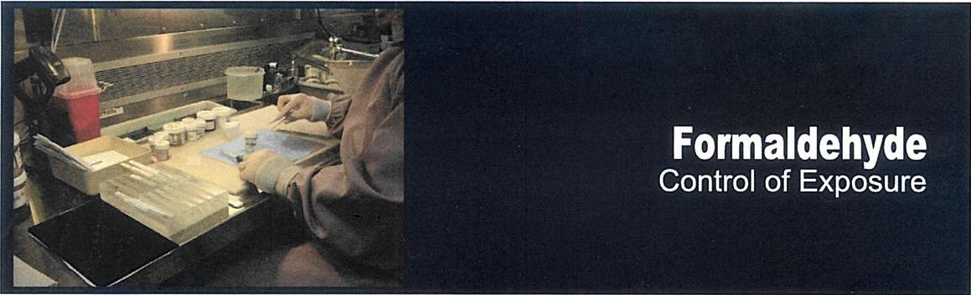
What is Formaldehyde?
Formaldehyde is most commonly found in 10 percent neutral buffered formalin fixative (containing 3.7%), alcoholic formalin (4%), concentrated formalin (37%), or in Bouin's solution (24%) in anatomic pathology labs, operating rooms, and procedure rooms.
What are the Hazarrds?
Overexposure to formaldehyde irritates the eyes, nose and throat. It has the potential to sensitize exposed individuals, which may result in asthma symptoms and skin reactions. Formaldehyde has been designated as a human carcinogen.
What can be done to Reduce the Risk of Exposure?
REMOVE: Consolidation / Substitution
Use formaldehyde-based fixatives with the lowest effective concentration, such as formalin instead of Bouin's solution.
Limit the quantity of formaldehyde in the department to what is immediately needed.
IMPROVE: Requirements and Best Practices
Engineering Controls
Small Volume Use Areas
Good general room air dilution is adequate for clinic departments using pre-filled specimen containers.
Handling Specimens
Place formaldehyde containers including cassette baths and waste jugs near exhaust ventilation during grossing, in order to capture all the vapors from these containers.
Keep containers closed until ready for use.
Recap containers after specimens are placed inside or when emptied for disposal.
Rinse large specimens under water before grossing. Use formaldehyde neutralization pads or sheets where small spills or drips may occur on work surfaces.
Dispensing
Purchase pre-filled containers of formalin or incorporate automatic dispensing systems to replace manual formaldehyde handling procedures.
Dispense large quantities under local exhaust ventilation systems.
Spills or Leaks
Ensure compatible spill materials' are available in sufficient quantities to clean up a spill from the single largest container.
Inspect equipment for leaks periodically.
Clean up spills within 10 minutes.
Due to the differences among room sizes, air supply and exhaust rates, and quantities handled, the following guidelines outline what quantities can be cleaned up without respiratory protective equipment (RPE), with full-facepiece respirators (FFR) or powered air-purifying respirators (PAPR) equipped with formaldehyde cartridges, and which should be treated as emergency spills requiring hazardous waste operations emergency response (HazW0pER).
Large Volume Use Areas
When pouring from containers, use local exhaust ventilation (slot exhaust, grossing stations, fume hoods, etc.) as close as possible to the vapor source. The direction of contaminant air flow must always be away from the user and toward the exhaust capture system.
Keep slots and baffles free from obstructions to maximize effectiveness.
If using a fume hood, the sash height should be at or below the arrow marked on the hood at the time of certification to ensure a face velocity of at least 100 linear feet per minute.
NEH&S
National Environmental.
Health and Safety
 | 1nc'dental, No RPE | Incidental. FFR or PAPR with 'orhralciehyde carteioge | rAvvqg,F3
Clinic | <:ac rn,- | 123 ntl. — 203 rh_ | >23C T—
OR | -.. oua't | '.1 c..a-t —1 gal Lon | >1 gallo-
Pathology | <1 q..art | J. c,..art. — 1 eakon | >1 gallo-
Dispose of all spill clean-up materials as hazardous waste.
^{'1} "3 E 4 ⁶ \L- Pk.0 ₁₂A 1 Nieutraf_{$i}ortn by Sakura (800-725-8723) #TN4304 1.
KAISER PERIVIANENTE
Updated 03/23/2018

Slide 6
Formaldehyde: Control of Exposure
Storage
Keep containers tightly closed.
Store formaldehyde in labeled, secure-top containers, away from strong oxidizing agents, acids, bases, phenols, heat and flame.
Do not store formaldehyde bottles above shoulder level and in any area where a leak would flow to drain.
Transport
When preparing specimen containers for transportation off-site, place in zip lock plastic bags and then in a rupture- and leak-proof securely covered container. Additional absorbent spill materials should line the inside of the transport container.
When transporting specimens in formalin within the medical center, place specimen containers within zip lock plastic bags or leak-proof covered containers.
Disposal
All unused or expired formalin products and used alcoholic formalin products must be managed as RCRA hazardous waste for disposal by a hazardous waste vendor.
All non-alcoholic formalin products may be managed using one of the following options:
Option 1
Pathology specimens in liquid formalin may be collected as hazardous waste without segregating the specimen from the liquid formalin. Use a certified hazardous waste vendor for disposal as hazardous waste.
Option 2
Segregate pathology specimens from liquid formalin. Pathology waste must be collected for disposal by a certified waste handler; manage the spent formalin on-site via drain disposal as detailed below, or collect and dispose of as hazardous waste.
Contact your EH&S professional or Safety Operations Leader to determine whether the waste liquid formalin can be disposed of directly to drain or whether it must first be neutralized. If neutralizing', please see the Formalin Neutralization Fact Sheet for additional process requirements and details. If drain disposal is allowed for untreated used formalin, keep a copy of the current letter of permission to discharge from the POTW on file.
Emergency Eye/Face Wash and Shower
Ensure an eye/face wash is available in the immediate work area. •
If pouring from containers, regardless of amount, ensure a quick drench deluge shower is also available.
If a splash occurs, flush eyes/skin for a minimum of 15 minutes, then seek medical attention.
BEHOOVE: Personal Protective Equipment
Eye
Chemical safety goggles² with indirect vents should be used.
Face shields with chemical goggles should be worn when handling large volumes to protect the entire face from splashes.
Skin
Wear nitrile gloves. Latex may not protect skin for very long and can cause allergic skin reactions.
Aprons should be worn to protect the body.
Impermeable long-sleeve gowns should be worn when decanting and grossing.
Respiratory Protection
Neither surgical masks nor N95 respirators offer respiratory protection against formaldehyde vapors.
Contact your EH&S professional or Safety Operations Leader if you have respiratory concerns or would like to participate in a voluntary respiratory protection program.
Formalin Neutralization Fact Sheet
formalin neutralization
EH&S SafetyNet
formaldehyde page
Occupational Safety and Health
Administration (OSHA)
Formaldehyde Fact Sheet
NOTE: If your department requires training go to: http://learn.kp.org/
1 Neutraform by Sakura (800-725-8723) #TN4304
2 Indirect-vented (fog-free) chemical splash goggles by Lab SafetySupply (800-356-0783), Sellstrom #54877
NEH&S KAISER PERMANENTE
Nat;onal Environmental
Health and Safety Updated 03/23/2018

Slide 7
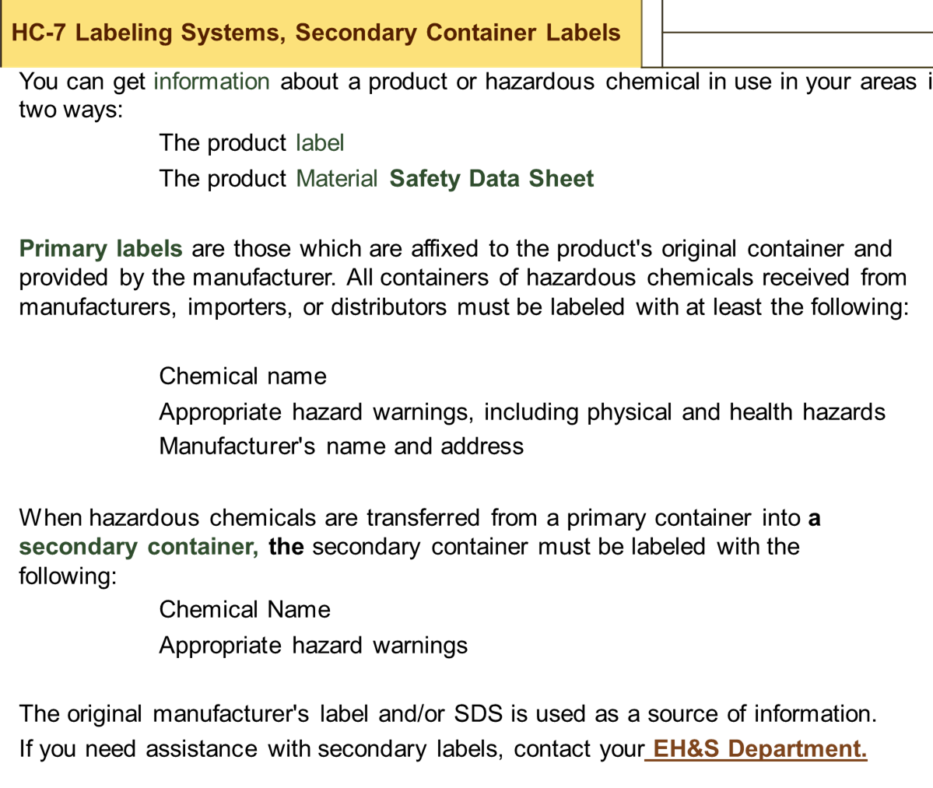

Slide 8
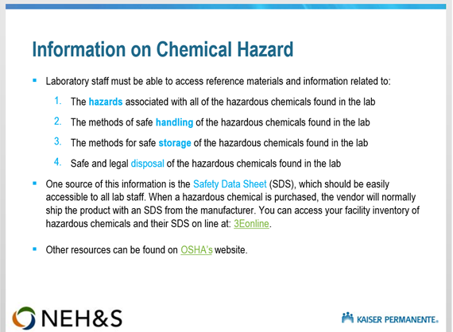
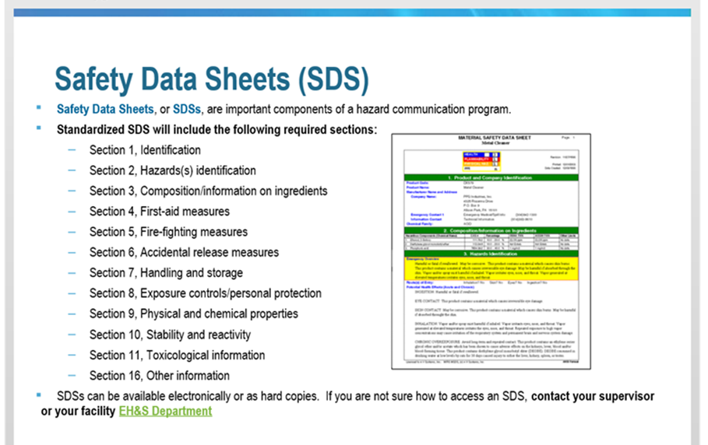

Slide 9
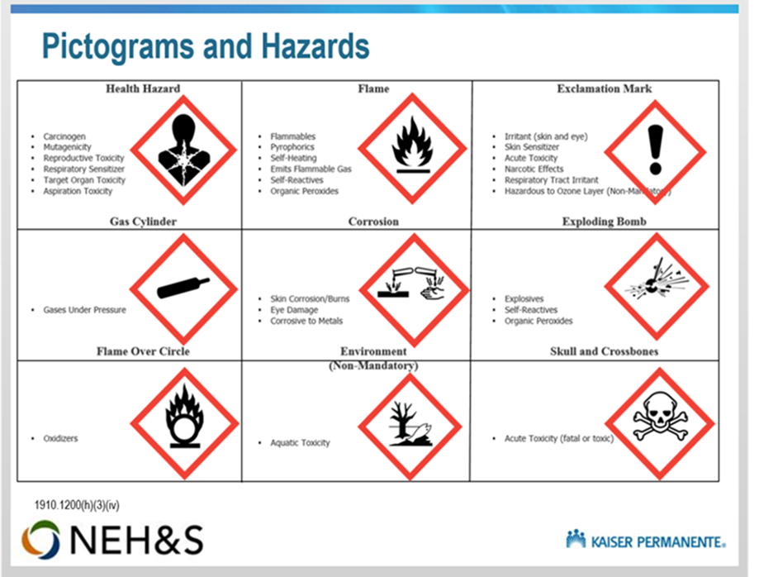
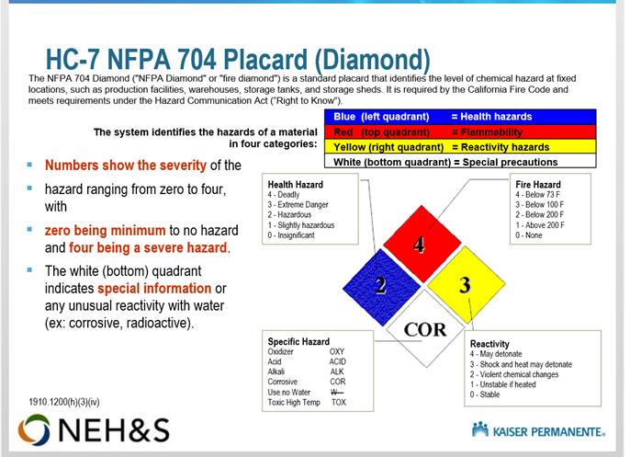

Slide 10
Protecting Yourself / Spill Response
If you are trained to respond to incidental spills, you should follow these procedures for response to incidental spills:
Isolate, Evacuate, Secure: Isolate the spill area. Evacuate everyone from the area surrounding the spill, (the entire room if necessary), except those responsible for clean up of the spill. Secure the area.
Personal Protective Equipment (PPE): If not already worn, put on personal protective equipment as needed, including but not limited to: gloves, chemical goggles with or without a face shield, impervious foot covers and apron.
Respiratory Protection: Response to an incidental spill will not normally require respiratory protection.
Apply absorbents or neutralizers immediately to keep respiratory exposure within safe limits. Allow time for neutralizers to work before cleaning up.
Some chemicals present an inhalation hazard even from small spills and would require use of equipment such as a Powered Air-Purifying Respirator (PAPR). Those spills would be considered an Emergency Response Release, in which case you should evacuate and secure the room containing the spill.

Slide 11
0⁰o ego, KAISER PERIVIANENTE
 | RIVERSIDE MEDICAL CENTER
SAFETY POLICY AND PROCEDURE
SECTION MEDICAL CENTER SAFETY PROGRAM | NUMBER | 112
TITLE | EFFECTIVE
HAZARDOUS MATERIALS PROGRAM | DATE | 9-1-89
 |  | 2-97, 1-00,
 |  | 7-02, 1-03,
 | REVISION DATE | 10-05, 7-08,
 |  | 8-11,10-13,
 |  | 5-15, 10-17
 | PAGE | 17 of 33
SECTION FOUR: CHEMICAL SPILLS:
POLICY:
In the event of spillage of a chemical, every effort shall be made to protect the health and safety of our patients, our employees, and the environment. All appropriate measures will be taken to abate the spill, which include isolation of the affected area, 'spill containment, cleanup, decontamination, and notification to the appropriate response agencies when warranted.
PROCEDURE FOR SMALL SPILL CLEANUP (NON-EMERGENCY):
Notification: The individual who caused or discovered the spill shall immediately notify their supervisor or other supervision.
Isolation: The spill should be isolated by removing occupants from the immediate vicinity of the spill and barricaded to stop others from entering the area.
Cleanup: Cleanup of the spill should be performed by the individual who caused or discovered the spill, providing the spill is of the size and substance that may be safely cleaned without assistance.
Safety First: Material Safety Data Sheets should be reviewed for specific instructions and emergency measures pertinent to the substance involved. The type of material will dictate the method of cleaning a spill and the quantity spilled.
Personal Protective Equipment: Personnel shall don the appropriate personal protective equipment (PPE) during spill cleanup.
Decontamination: All personal protective equipment will be neutralized, if possible, and taken out of service for inspection, cleaning, sanitizing, return to service or disposal. All liquids used in decontamination,

Slide 12
• FIT 4, KAISER P ERMAN ENTE | RIVERSIDE MEDICAL CENTER SAFETY POLICY AND PROCEDURE
SECTION MEDICAL CENTER SAFETY PROGRAM | NUMBER | 112
TITLE | EFFECTIVE
HAZARDOUS MATERIAL$ PROGRAM | DATE | 9-1-89
 |  | 2-97, 1-00,
 |  | 7-02, 1-03,
 | REVISION DATE | 10-05, 7-08,
 |  | 8-11,10-13,
 |  | 5-15, 10-17
 | PAGE | 18 of 33
cleaning and sanitizing shall be contained, labeled. and disposed of as appropriate.
Investigation and Reporting: The department involved in the spill will initiate a Chemical Spill Report Form (Attachment 1). This report must be completed and forwarded to the Environmental, Health and Safety Department within three (3) days.
Corrective Action: The administrator of the involved department will take appropriate steps to ensure that the possibility of a recurrence of the spill is eliminated.
III. PROCEDURE FOR LARGE SPILLS — TEAM RESPONSE:
A. Know When to Get Help: Should personnel believe the spill is too large, or the substance is too dangerous to be safely managed, they must contact the Administrative Spill Response Team by dialing "7777" and relay the information below to the Telecommunications Operator:
Location of the spill.
The chemical involved, if known.
Injuries, if any.
Nature of problem.
Quantity released.
Potential hazards.
B. Assess the Situation: The first team member responding to the spill will assess the nature of the spill, the potential for injury or harm to people in the area, and the possibility of the spill spreading into other areas (i.e., fumes, etc.).
C. Safety First: The team will take appropriate steps to ensure the safety of all persons in the spill area, including evacuation of patients after
appropriate consultation with the medical and nursing staff.

Slide 13
_{e} 4,1% KAISER PERMANENTE | RIVERSIDE MEDICAL CENTER SAFETY POLICY AND PROCEDURE
SECTION MEDICAL CENTER SAFETY PROGRAM | NUMBER | 112
TITLE | EFFECTIVE
HAZARDOUS MATERIALS PROGRAM | DATE | 9-1-89
 |  | 2-97, 1-00,
 |  | 7-02, 1-03,
 | REVISION DATE: | 10-05, 7-08,
 |  | 8-11,10-13,
 |  | 5-15, 10-17
 | PAGE | 19 of 33
SDS/Personal Protective Equipment: The team will review the Safety Data Sheet before beginning any control operations of the spill, and don personal protective equipment (PPE's) as directed.
Outside Agency Response: If the responding team determines that outside assistance is required, the Safety Kleen Co. will be summoned for assistance 1-888-375-5336.
Team Cleanup Procedure: The type of material and quantity spilled will dictate the cleanup procedure, which occurs following the management of a chemical spill. After the area has been isolated, the substance identified, and the SDS consulted, cleanup procedures shall begin in accordance with manufacturer's specifications. The department involved will be assigned with the cleanup responsibility.
Decontamination: All personal protective equipment will be neutralized, if possible, and taken out of service for inspection, cleaning, sanitizing, return to service or disposal. All liquids used in decontamination, cleaning and sanitizing shall be contained, labeled, and disposed of as appropriate.
Termination of the Spill Incident: The Authority to declare an all clear is vested with any member of the Administrative Spill Response Team. The team member shall consult with the medical and nursing staffs, as well as any outside agency prior to declaring an all-clear status.
Investigation and Reporting: The department involved in the spill will initiate the Chemical Spill Report Form (Attachment 1). The initial report must be completed and forwarded to the Environmental, Health and Safety within three (3) days.
Region Notification: If outside assistance is required, Western Environmental, Health and Safety Service Hub will be notified of the situation. Various other reports to outside agencies may be required.
Corrective Action: The administrator of the involved department will take appropriate steps to ensure that the possibility of a recurrence of the spill is eliminated.

Slide 14
• VIP/4, KAISER PERMANENTE | RIVERSIDE MEDICAL CENTER SAFETY POLICY AND PROCEDURE
SECTION MEDICAL CENTER SAFETY PROGRAM | NUMBER | 112
TITLE | EFFECTIVE
HAZARDOUS MATERIALS PROGRAM | DATE | 9-1-89
 |  | 2-97, 1-00,
 |  | 7-02, 1-03,
 | REVISION DATE | 10-05, 7-08,
 |  | 8-11,10-13,
 |  | 5-15, 10-17
 | PAGE | 20 of 33
IV. TELECOMMUNICATIONS DEPARTMENT RESPONSIBILITIES
A. The Telecommunications Operator, upon receiving a call to report a chemical spill, shall take down the following information:
Location of the spill.
The hazardous material involved, if known.
Injuries, if any.
Nature of the problem.
Quantity released.
Potential hazards.
Other information when product is identified.
B. Upon receiving a report of a chemical spill, the Telecommunications Operator shall summon the Administrative Spill Response Team personnel to the spill area:
Manager of Environmental, Health and Safety
Technical Services Director
Director of Environmental Services Department
Director of Laboratory
Director of In-Patient Pharmacy
Director of Security
Nursing Administration
Administrator On Call
The Director may assign a designee.
V. DECONTAMINATION OF PERSONS EXPOSED TO HAZARDOUS CHEMICALS
A. GENERAL
Hazardous chemicals are substances capable of causing harm to people, property or the environment. They can be explosive, flammable, poisonous or corrosive.
The basic goals in treating hazardous exposures are:

Slide 15
KAISER PERNIANENTE Safety Manual, Policy 112 | CHEMICAL SPILL REPORT FORM
Riverside D Offsite MOB 0
_ . Date: Time:
Location (Be Specific):
Area Contaminated:
Material / Amount Spilled:
Persons Involved: (Name, Department, and Employee Number):
Departments Notified: Environmental Services Plant Services Safety Department H Department Manager Clean Up Action Taken By Whom, Time Completed: | I I
Recommendations To Avoid Recurrence:
Form Completed by: Date:
FORWARD COMPLETED COPY TO THE ENVIRONMENTAL,
HEALTH AND SAFETY DEPARTMENT

Slide 16
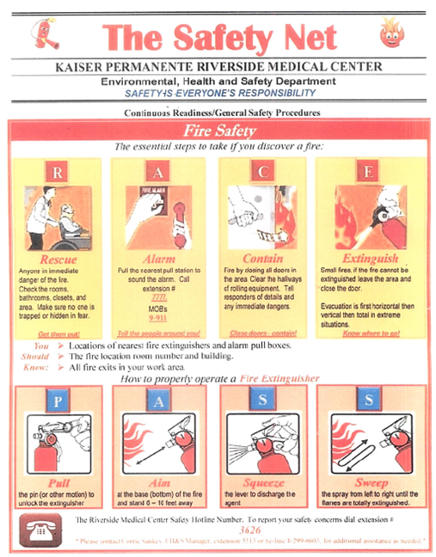

Slide 17
Kaiser Permanente Hospital - Lower Level Laboratory
10800 Magnolia Avenue
Riverside, CA 92505

Slide 18
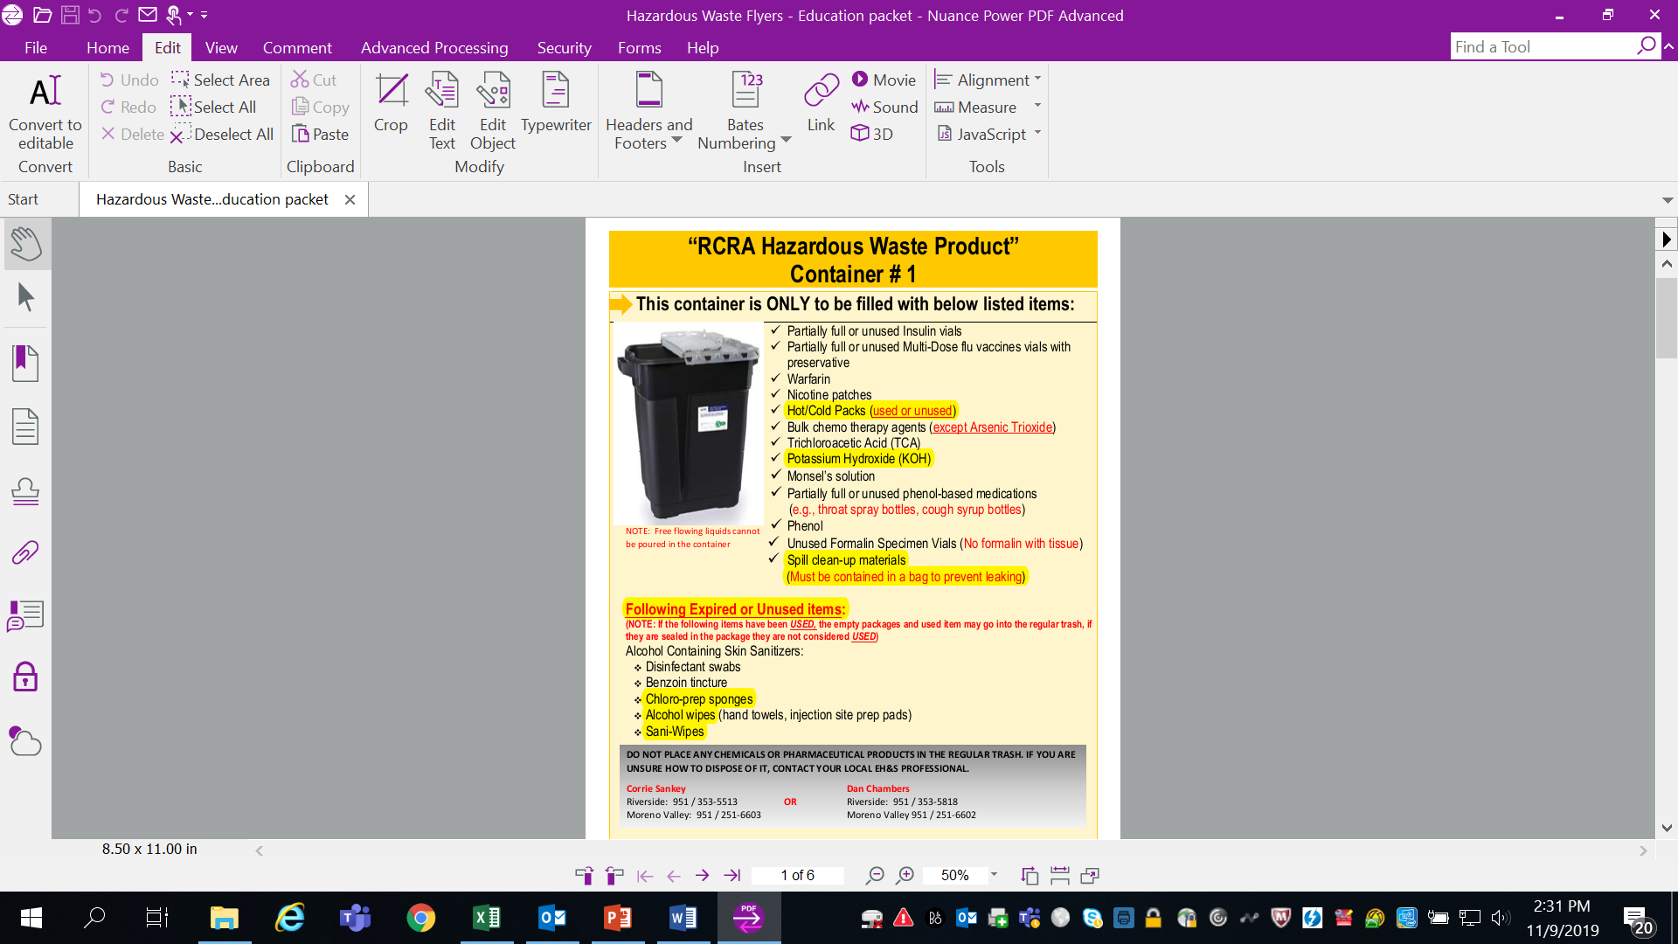

Slide 19
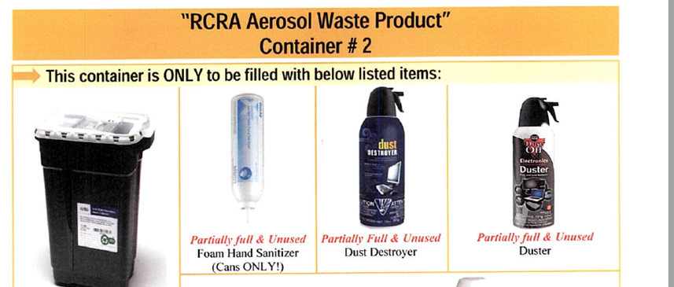
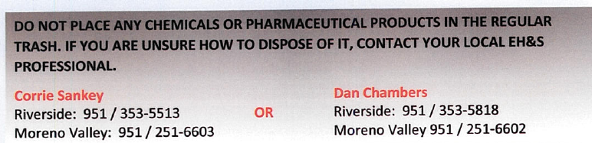

Slide 20

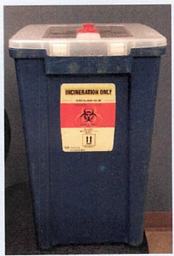
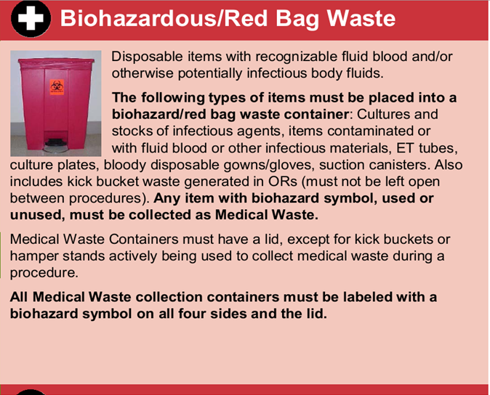
Hand lotion bottles
Soaps and shampoos
Toothpaste
Used cotton balls
Used tourniquets
Used gloves
Expired blood draw tubes (unused)

