Slide 1
Equal Access to Healthcare through Effective Communication at KP: Deaf & Hard of Hearing Members

Slide 2
Agenda
Deaf and Hard of Hearing Effective Communication Video
EID Language Services Overview
Department Resources
Notes:
Talking Points:
Read slide.

Slide 3
Deaf and Hard of Hearing Effective Communication Video
Notes:
Talking Points:
Please take note that this video DOES NOT have sound.
You will now have an experience of a member who is deaf or hard of hearing.

Slide 4
What is Effective Communication?
Individuals who are deaf or hard of hearing may need auxiliary aids or other services to communicate effectively about their healthcare and medical needs.
If a person does not self-identify as deaf or hard of hearing during your initial interaction, check for a note in the patient/member chart to see if they have a hearing disability and/or require an auxiliary aid or service.
Notes:
Talking Points:
Read slide.

Slide 5
Barriers to Effective Communication
Always pay attention for signs that a patient/member or companion is having difficulty understanding you such as:
If the person stares at your lips as you speak and/or they may lean in a lot.
If the person asks you to speak up and/or you find you need to repeat yourself often.
If the person nods in agreement to everything you say or ask and seems confused.
If you become aware that a patient/member or companion may be deaf or hard of hearing you should ASK if they need auxiliary aids or services for more effective communication.
Notes:
Talking Points:
Read slide.
Individuals who are deaf or hard of hearing may need visual communication aids. Following are some examples:
A late deafened person who doesn’t sign may require real-time captioning in order to participate in a conversation with her providers during her hospital stay.
A member who is deaf and blind may require tactile interpreter services.
A deaf person who is not literate in English may not be able to communicate via written notes or texting.
A patient who is hard of hearing may need an amplification device such as a Pocketalker.

Slide 6
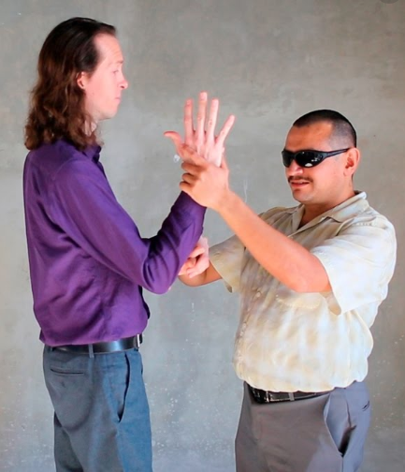
Auxiliary Aids for the Deaf of Hard of Hearing
Auxiliary aids and services include the following:
Tactile signing Individuals who are deaf and blind may put their hands over a signer’s hands to feel the shape, movement, location, of the signing or fingerspelling, etc...
Sign Language Interpreter Services: (face-to-face or video remote) - Use the approved contracted vendors and follow the language assistance processes on how to request.
VRI: a video telecommunication service that uses web cameras on a workstation on wheels or iPads to provide sign language or spoken language interpreting services.
Always allow the individual to identify their preferred method of communication
Kaiser Permanente provides auxiliary aids and services to members, patients, and their companions with disabilities
free of charge.
6
Notes:
Auxiliary aids for the deaf or hard of hearing
Auxiliary aids and services include the following:
Sign Language Interpreters
Video Remote Interpreting (VRI)
Computer-Aided Real-Time Transcription (CART)
Assistive Devices, such as Pocketalker, written materials, and closed captioning
Individuals who are deaf and blind may put their hands over a signer’s hands to feel the shape, movement, and location of the signing or fingerspelling.
Video Remote Interpreting: is a video telecommunication service that uses web cameras on a workstation on wheels or iPads to provide sign language or spoken language interpreting services.

Slide 7
How An Interpreter is Requested | Workflow
Member
Makes appointment
Requests an interpreter
Appointment Center
Checks profile for flags / flags the appointment
Secures interpreter for member
Clinic
Ensures interpreter timely joins the appointment
Documents use of an interpreter
Documents if an interpreter is refused, is not effective, or if VRI equipment is not working
4
Notes:
Talking Points:
An ASL-speaking member’s appointment is automatically flagged at the Appointment Center. They work with two vendors to secure an in-person interpreter.
Appointment notes are made in the member’s chart, indicating the request's status. You will see this in later slides.
If our department books interpreters for members, please continue to the current workflow.

Slide 8
Qualified Professional Interpreter Services
If your department books in-person interpreters directly, you must provide the following to the vendor for billing and confirmation:
16-digit Cost Center (GL String), Business Unit (Region/Entity), Location, and Department Code
Interpreter Expense Code
FDA Approver’s Name and NUID
Patient’s appointment information (Name, Dept, Location, Date, Time, Duration, Preference, etc.)
Working phone number for a vendor to call back with confirmation
See below for a list of vendors:
Network Interpreting Services (800) 284-1043 (ASL only)
Interpreters Unlimited: (844) 855-0249
8
Notes:
Qualified professional interpreter services
When requesting an In-Person Interpreter, you must provide the following to the vendor for billing and confirmation:
16-digit Cost Center (GL String), Business Unit (Region/Entity), Location, and Department Code
Interpreter Expense Code
FDA Approver’s Name and NUID
Patient’s appointment information (Name, Dept, Location, Date, Time, Duration, Preference, etc.)
Working phone number for vendor to call back with confirmation
If you need assistance arranging for a Qualified Professional Interpreter, reach out to your area’s Local Diversity Coordinator or local interpreter services lead.
List of vendors:
Network Interpreting Services (800) 284-1043 (ASL only)
Interpreters Unlimited: (844) 855-0249

Slide 9
Video Remote Interpreting
VRI is a video telecommunication service that uses devices such as web cameras on a workstation on wheels or iPads to provide sign language or spoken language interpreting services.
How to Use
Press LOGIN (user ID & Password auto-populated)
Select the language needed for video.
NOTE: Some languages are available 24/7/365.
Or select the languages via audio option.
NOTE: Audio interpreters are available 24/7/365. If outside the available video hours, video calls will roll over to an audio interpreter.
Provide badge # (NUID) to the interpreter.
If you need assistance locating or using the VRI equipment, reach out to your area’s Local Diversity team Riv-EID@kp.org
Document in the medical record the type of interpreter used (video) and the interpreter ID (will appear on bottom of the video screen)
When finished using the device: sign out, wipe with approved sanitary wipe, return to storage space, and plug in.
9
Notes:
Video Remote Interpreting
VRI, which stands for Video Remote Interpreting, provides the services of an interpreter to people at a different location through a secure video conferencing system.
VRI can be used for American Sign Language interpretation of interactions between Kaiser Permanente employees and members, patients, and their companions who are deaf.
VRI may not be the appropriate solution for every individual who is deaf or for all types of encounters. Consult with the member to make sure VRI would be effective for their needs.
Note that regular testing and maintenance of these devices is required.
If you need assistance locating or using the VRI equipment, reach out to your area’s Local Diversity team at Riv-EID@kp.org

Slide 10
Certified Deaf Interpreter (CDI)
A CDI knows both American Sign Language (ASL) and how to communicate using signs that a deaf person who does not know ASL may use.
CDIs are available through the iPad as well as through the virtual visit platform.
An ASL interpreter may transfer you to a CDI if they realize that the patient is not signing in ASL.
A CDI is always partnered with an ASL interpreter because the CDI is deaf or hard of hearing.
Notes:
Talking Points:
CDI is short for Certified Deaf Interpreters. A CDI knows both American Sign Language (ASL) as well as how to communicate using signs that a deaf person who does not know ASL may use.
Although this service may not be used regularly, CDIs are available through the iPad and the virtual visit platform.

Slide 11
American Sign Language
When It Is Appropriate to Use a Video Interpreter
For both office visits and virtual appointments, we often use video interpreters to provide on-demand American Sign Language (ASL) services, unless it would not provide effective communication, such as in the below situations:
1. The member has specifically requested an in-person interpreter
2. The appointment is lengthy or sensitive
3. The member:
Has a visual impairment
Has an injury or condition that impedes their ability to view the screen
Is in and out of consciousness
Is in the process of childbirth
4. Group class
Notes:
Talking Points:
Read slide.

Slide 12
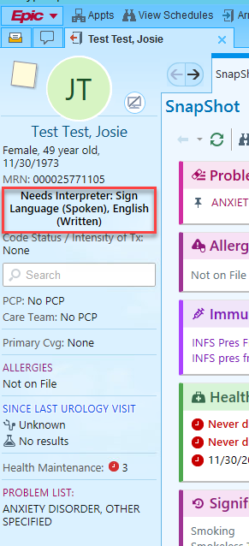
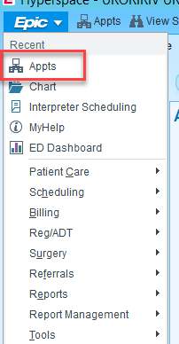
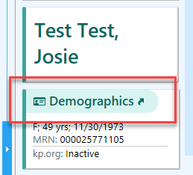
Documentation Requirements; Interpreter Flag | Creating a Hard Stop
Locating Interpreter Required Flag.
Locate a member’s preferred language under their name.
Ensure the member’s Interpreter Required Flag is turned on. The Interpreter Flag is located in the appointment tab. Click Demographics and locate “Additional Demographics’. Please select Yes. Note that this will create a HARD STOP in the chart.
Notes:
Talking Points:
Why is creating a HARD STOP important?
Creating a HARD STOP in the member’s chart will ensure we properly document the use of interpreting services.
Read slide points (1 & 2).

Slide 13
Documentation Requirements; Locating the Questionnaire
You must document when an ASL interpreter is used.
To document ASL services, locate the Language Assistance Services questionnaire. This will be titled “Priority Questions”, or it can be found in the “Questionnaires” Tab. This is the only acceptable method for capturing the use of interpreting services.
Notes:
Talking Points:
There are two ways to access the Language Assistance Questionnaire.
1- Is to click on the Priority Questions.
2- Is to click on Questionnaire on the top ribbon tab.
These are the only acceptable methods for capturing the use of interpreting services.

Slide 14
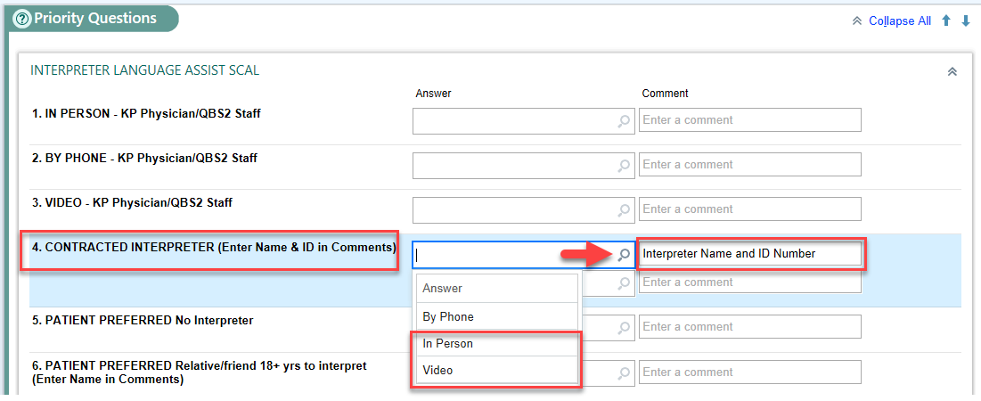
Documentation Requirements; Documenting Contracted Interpreters
You must document when an ASL interpreter is used.
All our ASL interpreters are contracted by an outside vendor. Please select the appropriate resource and document the interpreter’s name and ID number. If a Relative/Friend is used, please use the number 6.
Notes:
Talking Points:
Once you have accessed the Language Assistance Questionnaire, you must document using option 4, Contracted interpreter.
Use the Search icon to display the drop-down menu.
If an in-person interpreter was used, select “In-Person.
If Video Remote Interpreting services were used, you would select “Video.” In the Comment section, you must document the interpreter’s name and ID number.
If a Relative or Friend was the interpreter, you must document their name and relation in the Comment section. Please use option 6 to document a Relative or Friend.

Slide 15
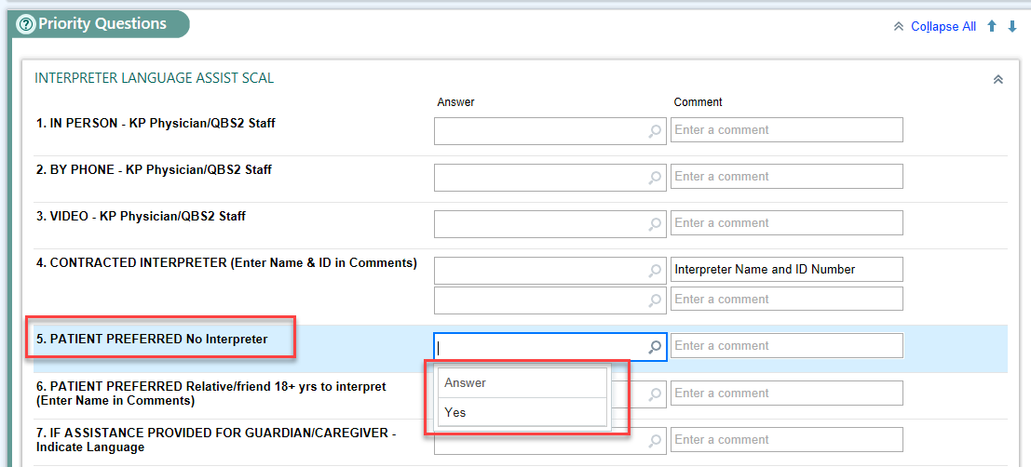
Documentation Requirements; When a Member Refuses an Interpreter
You must document when it is refused.
If a patient refuses interpreting services AFTER it has been offered, you must document their refusal in the chart. Please use number 5 to document.
Notes:
Talking Points:
Sometimes a patient will refuse interpreting services after you have offered them.
If a patient refuses interpreting services, you must document their refusal with option 5.
Use the SEARCH icon to display a drop-down menu and select YES.
Remember, even if a patient refuses interpreting service, the Physician may still use them to ensure effective communication.

Slide 16
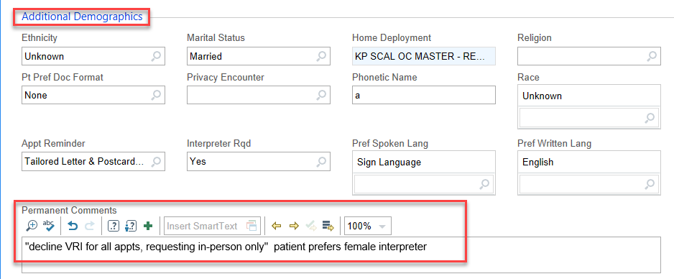
Documentation Requirements; Flagging a Special Request
Flagging an ASL-Speaking member’s interpreting request:
Members can make special requests for interpreting services. For example, a member might prefer a specific gender or type of interpreting service. You can capture those requests in the Permanent Comments under Additional Demographics.
Open the member’s appointment tab.
Click on the Demographics
Document request
Notes:
Talking Points:
There are times when a member might have a special request for interpreting services. We must make every attempt to honor those requests.
To document those special requests, open the member’s chart and then open the Appointment Tab.
Click on Demographics and scroll to the bottom of the page to display Additional Demographics and locate Permanent Comments.
You can free type the special request in Permanent Comments.
Also, the Appointment Center looks at the Permanent Comments when booking an interpreter and tries to honor those requests.
Although we cannot guarantee the request will be honored, the Appointment Center will document they have attempted to fulfill the request.

Slide 17
Thank you!!
Special thanks to all department staff and all your hard work to improve the quality of care. Your commitment to better serving our deaf and hard-of-hearing members is greatly appreciated.
Notes:
Talking Points:
Read slide.

Slide 18
Contact Information
riv-eid@kp.org
Daryl Sanders-Jr | Managerial Consultant 951-353-6904
Frank Martinez | Project Manager 951-353-6912
Notes:
Talking Points:
If you have any additional questions, please contact the EID team.

Slide 19
Department Resources

Slide 20
Important Resources
National Association of the Deaf
Phone number: (301) 587-1788
Greater Los Angeles Agency of Deafness, Inc.
Phone number: (323) 478-8000
Center On Deafness- Inland Empire
Phone number: (951) 275-5000
Helen Keller National Center
Phone number: (516) 944-8900 x1299
------------------------------------------------------------
Local Medical Center Equity, Inclusion and Diversity Consultants
Riv-EID@kp.org
Notes:
Talking Points:
These are web links for important resources.
National Association of the Deaf
Greater Los Angeles Agency of Deafness, Inc.
Center On Deafness- Inland Empire
Helen Keller National Center

Slide 21
EID SharePoint Resources
Language Assistance Vendor Contact List
Job Aids for How to Document the Use/Refusal of Language Assistance Services
Instructions for How to Order and Provide CART Services
What to Do When You Need An Interpreter to Join A Virtual Class
------------------------------------------------------------
Local Medical Center Equity, Inclusion and Diversity Consultants
Riv-EID@kp.org
Notes:
Talking Points:
Read each resource link.

Slide 22
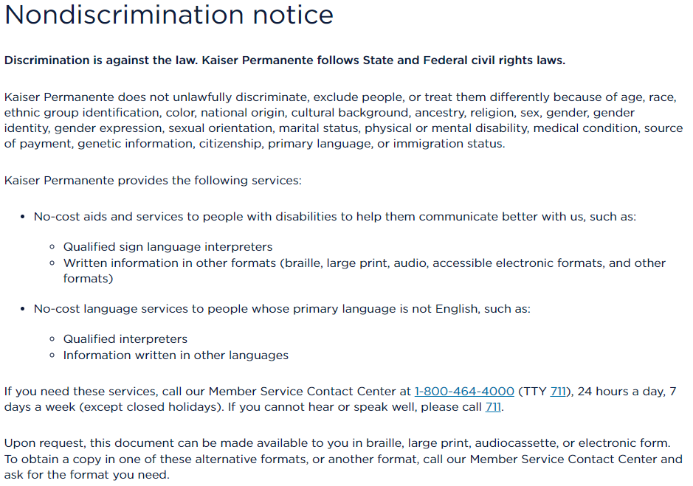
Communication Policies
Equal Access to Healthcare through Effective Communication
https://healthy.kaiserpermanente.org/southern-california/language-assistance/nondiscrimination-notice
Notes:
Talking Points:
Policies are available for review if there are any additional questions.

Slide 23
Manager Resources

Slide 24
Resources for Managers
Tools and templates:
Printable Attestation Form
Attestation Due on December 31, 2023
Printable Attendance Sheet
How to Track Attendance for Virtual Meetings
------------------------------------------------------------
Local Medical Center Equity, Inclusion and Diversity Consultants
Riv-EID@kp.org

