Slide 1
Parasitology Study Guide

Slide 2
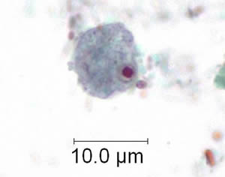
E nana trophozoites measure 6 to 12 µm and possess a single nucleus with a characteristically large, irregularly shaped, blot-like karyosome. Trophozoites of E. nana can be difficult to distinguish from those of Iodamoeba buetschlii.

Slide 3
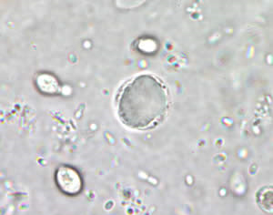
The taxonomic classification of Blastocystis hominis is mired in controversy. It has been previously considered as yeasts, fungi, or ameboid, flagellated, or sporozoan protozoa. Recently, however, based on molecular studies, especially dealing with the sequence information on the complete SSUrRNA gene, B. hominis has been placed within an informal group, the stramenopiles (Silberman et al. 1996). Stramenopiles are defined, based on molecular phylogenies, as a heterogeneous evolutionary assemblage of unicellular and multicellular protists including brown algae, diatoms, chrysophytes, water molds, slime nets, etc

Slide 4
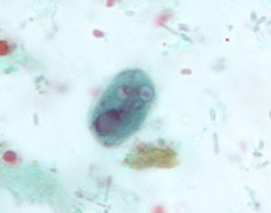
Giardia duodenalis cysts are oval to ellipsoid and measure 8-19 µm (average 10-14 µm). Mature cysts have 4 nuclei, while immature cysts have two. Nuclei and fibrils are visible in both iodine-stained wet mounts and trichrome-stained smears.

Slide 5
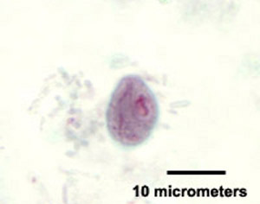
Chilomastix mesnili is a flagellated protozoan generally regarded as nonpathogenic in the human host. Trophozoites are pear-shaped and usually measure 6-24 µm in length. The anterior end is rounded and contains a single nucleus with an eccentric karyosome. The posterior end tapers off to a point.

Slide 6
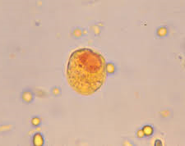
Cysts of Iodamoeba buetschlii vary from being nearly spherical to ellipsoidal, and measure 5-20 µm. Cysts contain a single nucleus that is not visible in either unstained or iodine-stained wet mounts.An important diagnostic feature for this species is the presence of a large compact mass (vacuole) of glycogen in the cyst stage. Although this mass can be visible in unstained wet mounts, in iodine-stained preparations it takes on a darker, reddish-brown color. The glycogen vacuole does not stain with trichrome, but will still be visible as a well-defined mass.

Slide 7
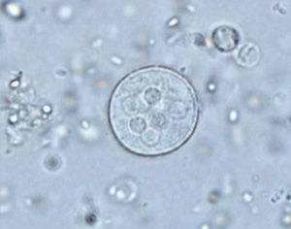
Cysts of Entamoeba coli are usually spherical, but may be elongated, and measure 10 to 35 µm. Mature cysts typically have 8 nuclei but may have as many as 16 or more. Entamoeba coli is the only species in the genus encountered in humans with more than four nuclei in the cyst stage.

Slide 8
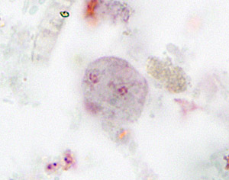
Dientamoeba fragilis is a flagellate that must be morphologically differentiated from the small nonpathogenic amebas. Dientamoeba fragilis has no cyst stage, and its trophozoites measure 5 to 15 µm. The flagella is not usually evident and the pseudopodia are angular to broad-lobed and transparent. While most trophozoites are typically binucleate, some have only one nucleus.

Slide 9
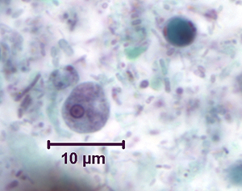
Trophozoites of Entamoeba hartmanni usually measure 5-15 µm. These trophozoites possess a single nucleus that contains a small, compact centrally or eccentrically-located karyosome and fine, uniform peripheral chromatin. Nuclei are usually not visible in unstained specimens. The cytoplasm is finely granular. Movement in living trophozoites is described as nonprogressive.

Slide 10
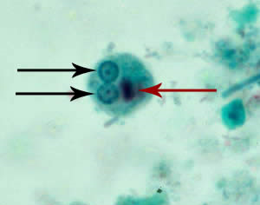
Mature Entamoeba histolytica/Entamoeba dispar cysts have 4 nuclei that characteristically have centrally-located karyosomes and fine, uniformly distributed peripheral chromatin. Cysts usually measure 12 to 15 µm.

Slide 11
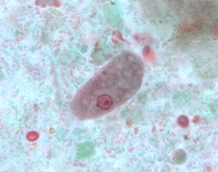
Trophozoites of Entamoeba coli usually measure 15 to 50 µm. The trophozoites possess a single nucleus with a characteristically large, eccentric karyosome and coarse, irregular peripheral chromatin. The cytoplasm is usually coarsely granular and vacuolated (often described as dirty cytoplasm). Pseudopodia may be seen, and are often short and blunt; movement in living trophozoites is nondirectional.

