Slide 1

AP Specimen Receipt
AP Management Team

Slide 2



Agenda
Fresh Specimen Triage
Specimen Labels AP uses
Specimen Triage
Specialty Fresh Specimens

Slide 3




Introduction
The proper collection and transportation of specimens to the laboratory for analyses is required by the laboratory to provide valid analytical results for patient care. Specimens which are improperly collected or transported may result in invalid analytical results, and thus adversely affect patient care. We want to focus on how to identify what is needed when triaging at the time of specimen receipt.

Slide 4

Topic one
Fresh Specimen Triage

Slide 5
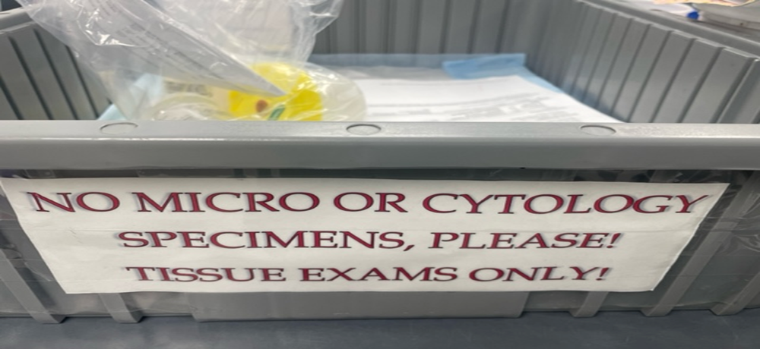
Drop off Bin
Check bin for Fresh specimens every 15 minutes
If outreach specimens drop off move to bins so they do not cover Fresh specimens
Create bins with specimens and requisitions to empty the drop off bin
Will have to go to registration to pick up outreach specimens- keep those in the blue bin to not bury any fresh specimens placed in this bin

Slide 6
Drop Off process
Specimens must be logged in by OR, Radiology, and ENDO
Requisitions need to be time stamped when dropped off
Runners need to verbally communicate and have a direct hand off to staff when a frozen section or fresh specimen is dropped off
After 730pm weekday and on weekends: Fresh specimens will be logged in and placed into the refrigerator to decrease tissue degradation

Slide 7
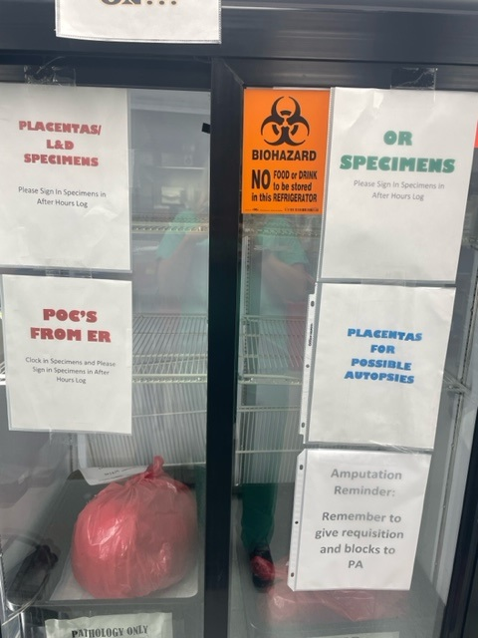
Double Door Refrigerator
Needs to be checked and specimens removed every morning
  Notify other techs if fresh specimens still in fridge
Add formalin to specimens
If specimens are colon, uteri, kidney, urinary bladder, Whipple's- place in to be opened bin for Sr. Pas
Placentas need to have saline poured off and formalin added
Placentas for autopsy- do not add formalin
POC for cytogenetics: do not add formalin
Leg amputations- accession and leave requisition and blocks on PAs cart

Slide 8
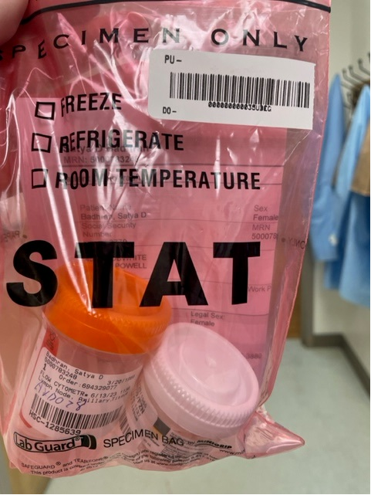

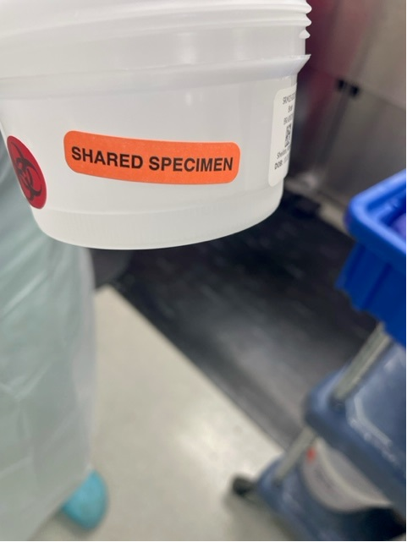
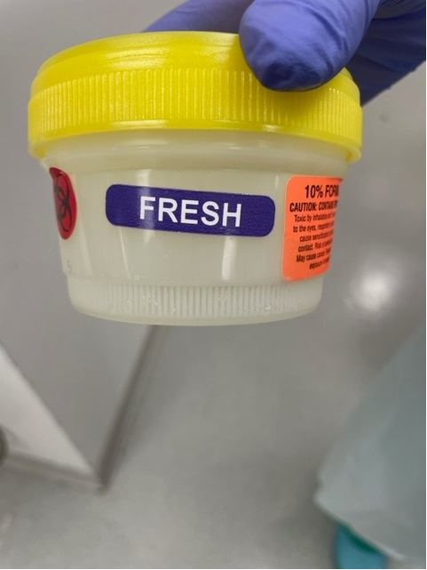
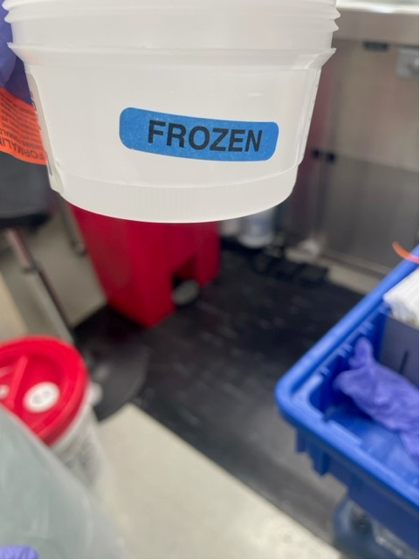
Types of Specimens that need immediate triage
Frozen Section
Fresh specimens
Lymphoma Workup/Flow Cytometry
Shared Specimens
Take to FS room for Frozen immediately
Verify Cultures/ flow not needed
Give Breast cases to SR PA
Add Formalin
Check requisition to determine what needs done first: cultures, lymphoma workup or Frozen Section
Need to be taken to FS room within 15 minutes of drop off for triage

Slide 9
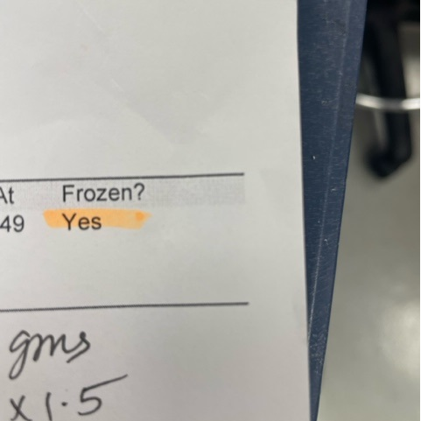
Frozen Sections
DO NOT ADD FORMALIN
Take to Frozen Room ASAP

Slide 10
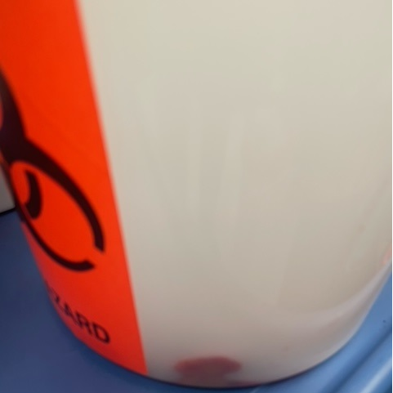
Fresh Specimens
Fresh means no formalin is present
Breast Resections and margins go to PA for triage
BR Margins can have formalin added
Is it a lymph node- double check to make sure a lymphoma work up is not needed
Products of conception/POC- verify cytogenetics not needed

Slide 11
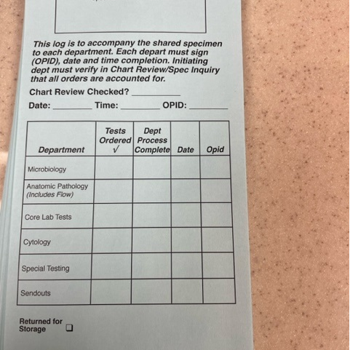
Shared Specimens
Indicate multiple tests ordered and specimen to be shared with other lab departments: check requisition if culture or flow also ordered
Tests should go to micro first if cultures ordered, then AP (FS, Lymphoma workup, routine)
If micro sends blue card ( only at RMH) scan into case to show it came from micro

Slide 12
Topic two
AP Labels

Slide 13
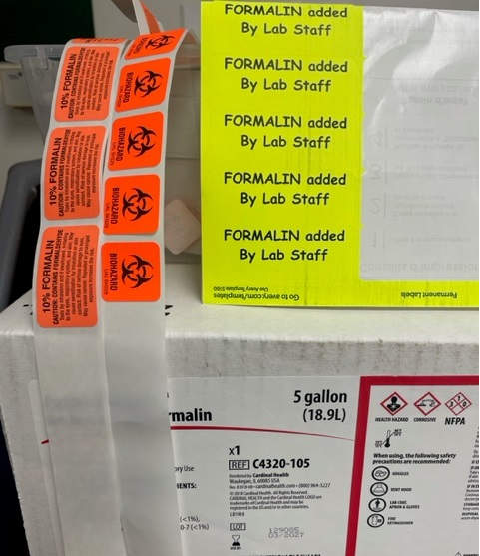
Adding Formalin: PPE / face shield needed
Fill container with appropriate amount of formalin to cover entire specimens
If container too small- transfer specimen and labels to a larger container- call OPR and notify them if they used incorrect size container as education for them
Label container with a 10% formalin label, a biohazard label, and if the AP tech is adding formalin- label with the Formalin added by lab staff

Slide 14
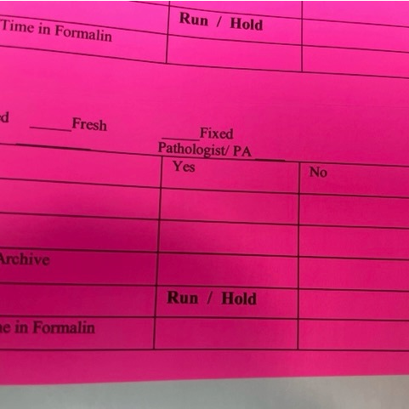
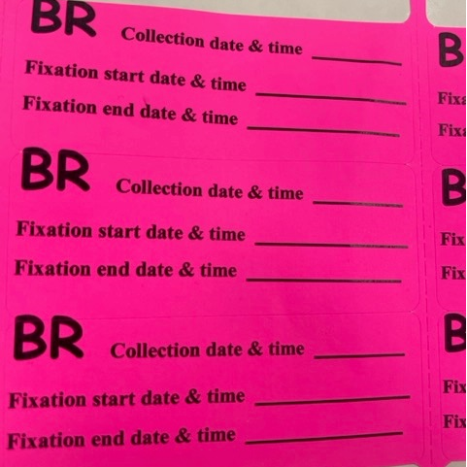
AP Labels
Lymphoma workups require pink triage label
Breast resections and Breast mammo /cores require Breast collection label
Cores for metastatic breast cancer require a breast collection label
Add dates and times when needed

Slide 15
Accessioning/Label Expectations
Double check name, dob and/or social security(best option if available), Complete registration/Insurance, label with epic label, scan requisition
Reg and accessioning of a bin should take estimated 25 minutes
Accessioning of bin with HSC or 500 numbers should take estimated 15 minutes
Appropriate special labels must be used

Slide 16
Topic three
Specimen Triage

Slide 17
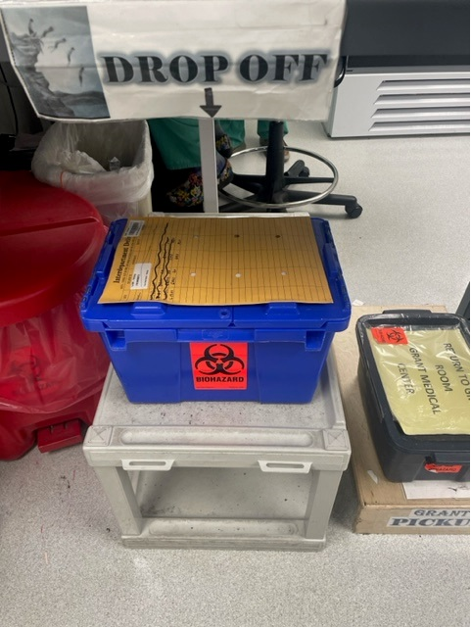
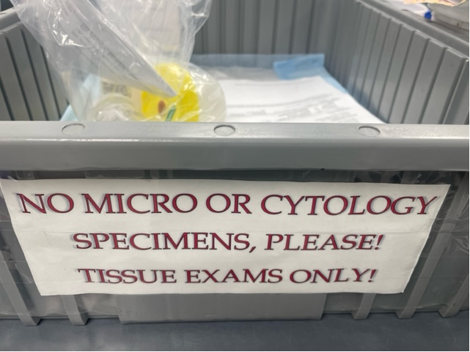
Where specimens will come from
Specimens from other Hospitals
Specimens dropped off in house, couriers, or from blue registration bins
Fresh specimens

Slide 18
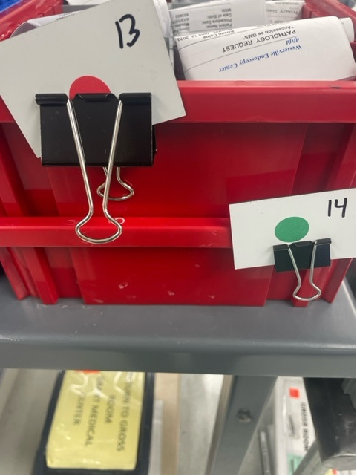
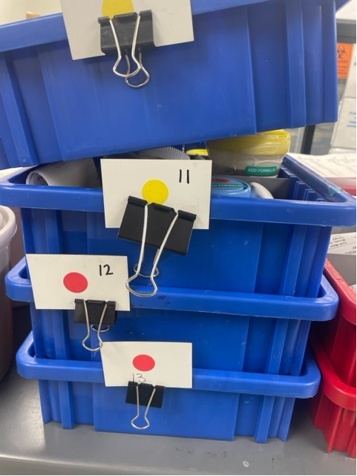
Division of biopsies- bins should have dividers between each case
Rush Specimens- red bins
Specimens from previous day

Slide 19
What is a rush biopsy- red bins
All diagnostic biopsies labeled as “rush”, “liver bx”, “kidney biopsy”, “skin rush”, “DIF”, “brain”, “GI”, pink lymphoma sticker, breast core pink sticker
Internal biopsies from each hospital
  IR(Interventional Radiology)- cores
  CT cores
  Breast Core Biopsies
  Kidney Biopsies
  Liver biopsies
  All core protocol cases
  Oral biopsy
  In house GI biopsies
  Lymphoma workups
  Skin RUSH
  DIF skin cases
  Cases with Pathologist initials
  Brain biopsies

Slide 20

Previous days biopsies
Must look at Date of service on requisition
Place in blue bins with numbers to show how many bins with previous work
Number one to highest needed number and attach to bin with clip
Prioritize older specimens
Halfway through day reassess bins and priorities and double check bins

Slide 21
Do Fresh specimens go in bins?
NO
Only Kidney stones should remain fresh so that chemical analysis can be performed.
All other cases should have formalin added and labeled before going into bins
Offsites should notify Teams through Teams page of any one-off issues they are sending over

Slide 22
SR PA work- small/ medium case should be in blue bins with dividers
Breast resections- Breast bins
Other cases= large tiered bins
Lumpectomies
Partial Mastectomies
Mastectomy
Bilateral Mastectomy
Place cancer resections and other cases in blue bins and in bins
If cases are from day before or older, they should be grossed first the bin with the oldest cases will have a clip on it
When out of room ask the PAs if they can come and clear the specimen bins

Slide 23
Placentas- Routine
All come fresh(no fluid) or in saline to RMH and other hospitals
Shelfs in gross room
Pour saline off
Add formalin- fill entire container
Add formalin, biohazard, and lab staff added formalin
Record Time in Formalin(TIF) on lid with date and initials
If you add formalin, place the yellow formalin added by lab staff label
Top shelf if it has been in formalin for 5 hours
Bottom shelf if requires fixation
DO NOT place colons, uteri or other specimens in this location

Slide 24
Topic four
Specialty Fresh specimens

Slide 25
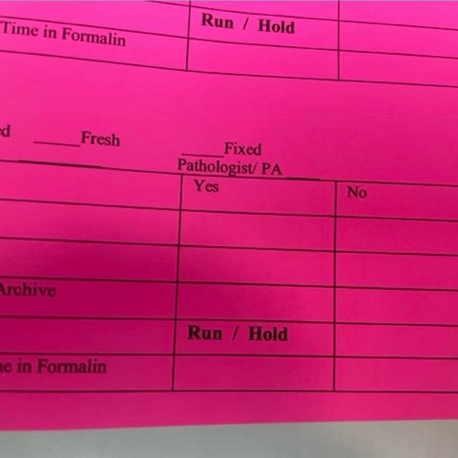
Lymphoma Workup Triage
Fill label out
Label Flow container with patient name, dob, or MRN
Fill out green immuno form
Place pink sticker on requisition and fill out
Record specimen description and measurement on requisition
Offsite locations should place note in teams to notify them a workup is on way over

Slide 26
Kidney stones
Must remain fresh/no formalin
Make copy of requisition: one requisition goes with specimen to MAYO and other goes to pathologist- important to do at offsites when sending to RMH
Requisition with no pathologist initials goes to shelf for Pathologist to review gross
Requisition with pathologist initials and specimen is moved from shelf to bin to be grossed
AP techs should never place kidney stones in bin for send outs
JR/SR PAS place grossed stones in bin after gross completed.
  Bine is taken to send outs at end of day for stones to go to Mayo for chemical analysis

Slide 27
Kidney Biopsies- Random Kidneys- Medical kidney biopsies
Come fresh in orange top container for a pathologist to evaluate for glomeruli
Take to FS room ASAP- as patient on table in procedure
Document on requisition- number of cores and size
Pathologist should record adequacy on requisition and initial
Record Kidney bx to cut on dry erase board
EM goes to office with requisition for them to send out
Document on requisition how cores divided: example one in formalin for light microscopy, one in formalin for EM at OSU, One frozen for IF(immunofluorescence) if pathologist onsite
Marion/DH/ when CJN/NA on vacation- send entire kit to OSU
  Document on requisition how cores divided (see above)
  Package in kit following directions and labeling containers
  Send copy of requisition only to RMH so PAs can dictate gross

Slide 28
DIF : Direct Immunofluorescence for skin punches for rashes and bullous lesions
May come in orange top container- show all fresh skins to FS pathologists before adding formalin
May come in formalin for light microscopy and a second container of Michele’s fixative
May come as one punch in a formalin container that will need to be divided for half to go as light microscopy and half for IF
Always refer to procedure for correct processing instructions
Record DIF on top of requisition

Slide 29
Conclusion
Teamwork and communication is the glue that holds together. Communicate to all when adjustments are needed.
Use Teams to message important specimen information so entire team is aware.

