Slide 1
CELL-DYN Sapphire™ Basic Maintenance
Miscellaneous Testing Processes

Slide 2
Specimen Processing
HANDLING SPECIMENS WITH COLD AGGLUTININS
Cold autoantibodies are present in all human sera to a greater or lesser degree. Cold autoantibodies found in the serum of normal, healthy individuals include anti-I and anti-IH. Generally, they have no clinical significance due primarily to their low concentrations in serum. Autoagglutination of anticoagulated whole blood is characteristic of cold hemagglutinin disease and occurs quickly as blood "cools" to room temperature.
Following are the steps to handle cold agglutinin specimens:
Warm the specimen in an incubator to 37ºC and then rerun it on the instrument.
Compare these results with the one run previously. If correction occurs, go to step f.

Slide 3
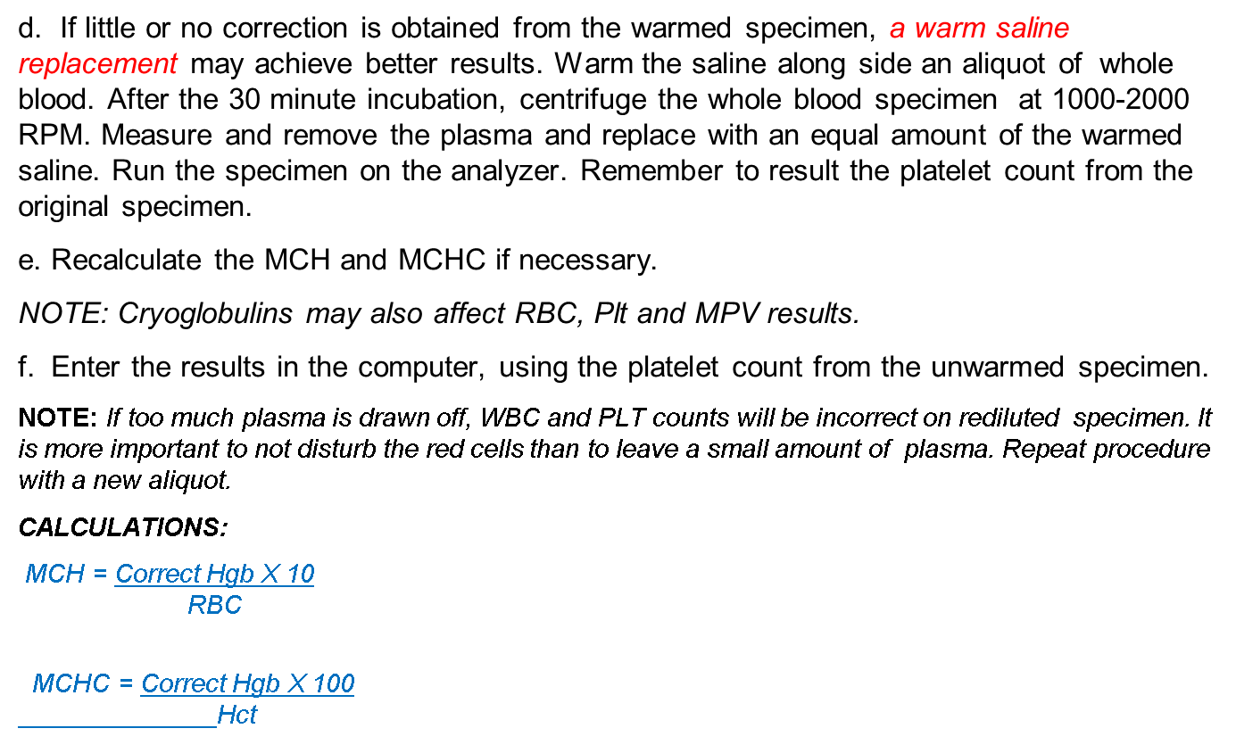
Specimen Processing

Slide 4
Specimen Processing
2. LIPEMIC SPECIMENS
Some patient samples, when run on the Abbott Cell-dyn instruments, have HGB and HCTs that do not "match" because the samples are lipemic (having a high lipid level). The HGB will usually be too high. In this case, a correction must be made before reporting any results.
Following are the steps to handle lipemic specimens:
Determine the HGB, MCH and MCHC on the Cell-dyn Sapphire.
Spin down a portion (aliquot) of the blood specimen and mark the top of the plasma level. (Centrifuge at 2,000 rpms for 5 minutes).
Carefully remove and discard the plasma layer.
Replace the plasma with the same amount of normal saline (add the normal saline to the mark placed on the tube).
Carefully mix the specimen, and run again on the instrument.
Mix well and rerun to obtain correct hemoglobin, MCH, MCHC. RBC should be within ±0.2 X 10⁶ cells/mm³ of previous result.
Manually result derived hemoglobin, MCHC and RBC in EPIC. Add canned comment “Lipemic Specimen. Red Cell indices are derived from saline replacement of plasma”.

Slide 5
Specimen Processing
Lipemic Specimen
CALCULATIONS:
Indices must be recalculated if the RBC value on the rediluted sample is not within acceptable limits. If the RBC result is within acceptable limits, report the HGB, MCH, and MCHC from the rediluted sample.
MCH = HGB (corrected) X 10
RBC
MCHC = HGB (corrected) X 100
HCT

Slide 6
Specimen Processing
3. MANUAL/SPUN HEMATOCRIT
Hematocrit is the volume of red blood cells as a percentage of the volume of whole blood in a sample. A sample of whole blood is drawn into a 75 mm capillary tube, sealed at one end, and then separated by spinning the tube in the HemataSTAT microhematocrit centrifuge. A measurement is then taken to determine the percentage of packed red blood cells to total volume.
PROCEDURE:
Draw a blood sample into a self-sealing 75 mm X 1.1 mm capillary tube. Perform the test in duplicate.
Place the capillary tube in the centrifuge clay end down. Always balance rotating head by placing another capillary tube in the opposite direction. The balancing tube can be an empty tube or another filled tube.
NOTE: Capillary tubes should be placed in the HemataSTAT as indicated by the numbers on the rotor head to obtain best balance. The capillary tubes need to be placed carefully so they will not break. DO NOT FORCE the tubes, rather, let them drop into the tube holder.

Slide 7
Specimen Processing
c. With the door closed, press the RUN button; after accelerating to the proper speed, the RPM will be displayed for 5 seconds followed by a 60 second count down.
NOTE: The centrifuge can be stopped at any time simply by pressing the RUN button again. ALWAYS WAIT FOR THE ROTOR TO STOP BEFORE OPENING THE DOOR.
d. Remove the tube from the device and place it in the groove below the LCD screen and press the ENT button. Select 1.1 mm tube size by pressing the RUN button. The LCD will display: "ENTER INTERFACE: CLAY/RED CELLS."
FIRST - Move the pointer along the tube to Clay/Red cells interface. Press ENT. The LCD will display "ENTER INTERFACE: RED CELLS/PLASMA"
SECOND - Move the pointer to the Red Cells/Plasma interface. Press ENT. (Make sure the pointer is in the middle of the interface angle). The LCD will display: "ENTER INTERFACE: PLASMA/AIR"
THIRD - Move the pointer to the Plasma/Air interface. Press ENT. The LCD will display the HCT valve to the tenth of a percent.
NOTE: If the pointer is not moved or is moved in the wrong direction during the measuring process, the LCD will display the message ENTRY ERROR. Wait for the LCD to clear. When the screen displays "ENTER FUNCTION: < READ SPIN >", you may begin the measuring process again by pressing ENT.
e. Controls are performed following procedure used for patient samples.

Slide 8
Specimen Processing
4. HANDLING SPECIMENS WITH CLUMPED PLATELETS
On occasion, a patient will have a suspect flag message of "platelet clumps" or will display an abnormal platelet histogram from the Abbott Cell-Dyn Sapphire. For accuracy in reporting, the following procedure should be done.
PROCEDURE
1. Draw a fresh specimen (EDTA) and run it immediately. If the problem recurs vortex the specimen for 2 minutes and repeat the count. If the count still indicates clumped platelets, go to step 2.
2. Draw a specimen in sodium citrate. Abbott Diagnostics recommends the use of sodium citrate anticoagulant in most cases. If platelets are still clumped, go to Step 3; if not, go to Step 6.
NOTE: Platelet aggregates may also form in blood anticoagulated with oxalate. Specimens drawn into sodium citrate must be corrected for the dilution by multiplying each parameter by 1.1.
3. Estimate platelet number and size (small, normal, large) from the blood smear.
4. Examine the platelet, WBC histogram, differential scattergrams, and Mono/Poly I Scattergram along with the blood smear. Determine if the platelet clumps are interfering with the WBC count. Perform WBC estimate from stained blood smear to verify total WBC count when total WBC count is asterisked by the Sapphire.
5. Use your laboratory's protocol to verify all reported results. All results with asterisks must be verified by another method or left for Pathologist review and interpretation.

