Slide 1
Coagulation
Training Module
Stago Based Testing

Slide 2
Simplified Cascade
XIII

Slide 3
Super-Simplified Cascade
Common
10
5
2
(Thrombin)
1
(Fibrin)
13
(Clot stabilizer)
Intrinsic
12
11
9
8
Extrinsic
3
(Tissue Factor)
7
Factor 4
Calcium
Ca+
There is no factor 6

Slide 4
Basic Specimen requirements Collection & Storage
Platelet Poor Plasma- <10 X 103/$µ$L platelets
Blue Top- sodium citrate
Calcium chloride is a reagent used in testing to counter the calcium binding properties of sodium citrate.
One part sodium citrate, nine parts whole blood (this is why filling to the line indicated on the blue top is crucial) 9:1 ratio.
Centrifuge blood as soon as possible for 3 minutes at 4500 RPM (on the new centrifuge!), test immediately or follow proper storage techniques.
Storage:
Remove Platelet-Poor Plasma immediately into a plastic tube and refrigerate for no longer than 4 hours.
If testing can not be performed in 4 hours freeze plasma at -70 degrees C.
Ideally thawing should be in a 37C water bath to prevent formation of cryoprecipitate and ran within 2 hours of thawing.

Slide 5
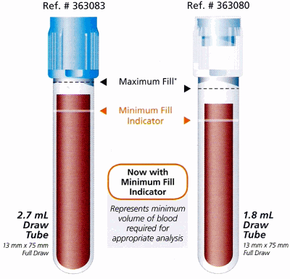
Pre-analytical variables
Testing should be performed at 37degrees Celsius.
Traumatic venipuncture can cause activation of coagulation factors.
Improper storage can deteriorate or (in the case of factor VII) activate factors.
Heparin contamination can cause falsely prolonged results.

Slide 6
Saint Francis Yale Coagulation Testing menu
Routine Testing
PTT
PT/INR
Xa
Fibrinogen
D-Dimer
AT III
Factors 8 & 9
PFA
TEGs/Platelet Mapping
PRUtest
Sed Rate
Special Coags
Thrombin
Factors
Mixing Studies
Protein C & S
LAC

Slide 7
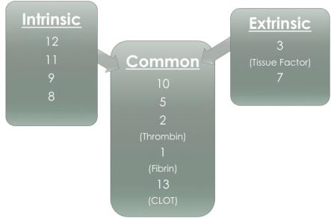
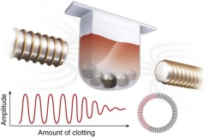
Activated partial thromboplastin time APTT (PTT)
Calibration- Manufacturer
(New lot conversions done as an
in-house study once per year)
QC- Coag Control N + P
Reagents- PTT and Calcium Chloride
Methodology- Viscosity/Clot Based
APTT is a screening test used to evaluate the intrinsic and common pathways.
Prolonged results = a time in seconds that is high, because it is taking an abnormally long time to create and maintain a clot.
Decreased results = a time in seconds that is very short. Always check specimen integrity for a clot in the tube when this occurs below the normal reference range.
Screens for Lupus Anticoagulant.
Monitor Heparin therapy.

Slide 8
PTT with heparinase
The presence of Heparin in a specimen may interfere with the interpretation of various coagulation tests.
The Hepzyme reagent is used as a heparin neutralizer in plasma to rule out heparin contamination in coagulation testing.
No calibrations are needed for the Hepzyme product.
Controls are run with each new lot before put into use.

Slide 9
PTT with heparinase Testing and Interpretation
Order= PTT with Heparinase
If PTT Hep is within normal range, treatment with Hepzyme is not necessary and the PTT can be resulted.
If PTT Hep is abnormal, IM will prompt you to use Hepzyme.
In Epic a field will generate “Hepzyme added?” document YES.
1mL plasma to the Hepzyme vial, reconstitute for 15 min.
Run on the Stago Analyzer using the Hepzyme option.

Slide 10
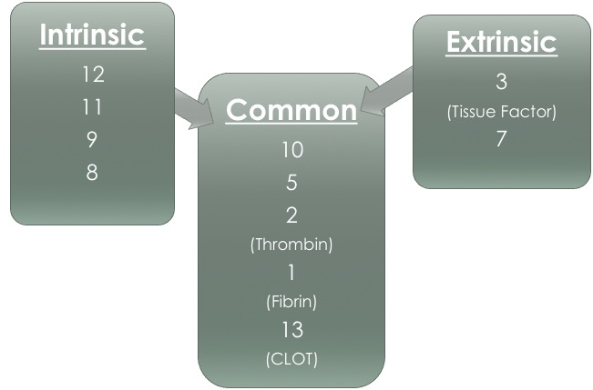
Prothrombin time PT/INR
Calibration-Manufacturer
(New lot conversions done as an
in-house study once per year)
QC- Coag Control N + P
Reagent- Neoplastine
Methodology- Viscosity/Clot Based
PT/INR measures the extrinsic and common pathways.
Factor 7 is a vitamin K dependent factor in the extrinsic pathway. PT/INR is therefore used as a means of monitoring vitamin K antagonistic, oral anticoagulant therapy such as Warfarin (Coumadin).
The international normalized ratio (INR) should be reported along with the PT results using the ISI of the thromboplastin.
The Stago analyzer calculates INR in addition to the PT results. We report out the INR.
INR =

Slide 11
Anti-Xa
Calibration-Xa calibrations are performed with each new lot, every 6 mo. or as needed.
QC- LMWH and HMWH levels 2,7,14
Reagent- Liquid Hep Xa
Methodology- Chromogenic
Used to monitor Heparin therapy.
Dilutions are flagged in IM for results >2.
Dilutions of 1:2 are performed with Normal Pooled Plasma.
Run Xa on dilution offline, print results. Multiply by dilution factor and manually result into Epic.

Slide 12
Fibrinogen
Calibration- Manufacturer
QC- Coag Control N + P
Reagent- Fibrinogen and Owren-Koller
Methodology- Viscosity/Clot Based
Fibrinogen is converted by thrombin to fibrin as the end product of clot formation.
The clotting time of diluted plasma is inversely proportional to the level of plasma fibrinogen. So low fibrinogen levels = high results.
Fibrinogen uses the smallest sample size of all tests on the stago. When errors occur check probe #1 for malfunctions.
Interpretation:
Prolonged indicate low fibrinogen concentrations or inhibitors such as heparin.
Clinical indications for low fibrinogen activity are acquired deficiencies seen in liver disease, DIC and fibrinolysis.
High fibrinogen levels are seen in pregnancy and in women taking oral contraceptives.
Fibrinogen is an acute-phase reactant, with high levels found in acute infections, neoplasms, collagen disorder, nephrosis and hepatitis.

Slide 13
D-Dimer
Calibration- Manufacturer
QC- Liatest N + P
Reagent- Liatest
Methodology- Immunoassay (optical density)
Principal:
D-dimer is present when a blood clot is degraded into fibrin degradation products after fibrinolysis.
Interpretation:
Clinical applications for this test are as follows:
Disseminated Intravascular Coagulation (DIC)
Negative predictor for the diagnosis of a thrombotic episode (ie., DVT, PE)
Efficacy of treatment for a thrombotic episode and screen for possible re-occurance (MI)
Screen for other activation states of coagulation (ie., post-operative, cancer)

Slide 14
AT III
Calibration- Manufacturer
QC- Coag Control N + P
Reagent- ATIII reagent and Owren-Koller
Methodology- Chromogenic
Principal:
Antithrombin slowly, progressively, and irreversibly inhibits the action of thrombin by forming a complex with thrombin.
The inhibition of thrombin by antithrombin is greatly accelerated by heparin.

Slide 15
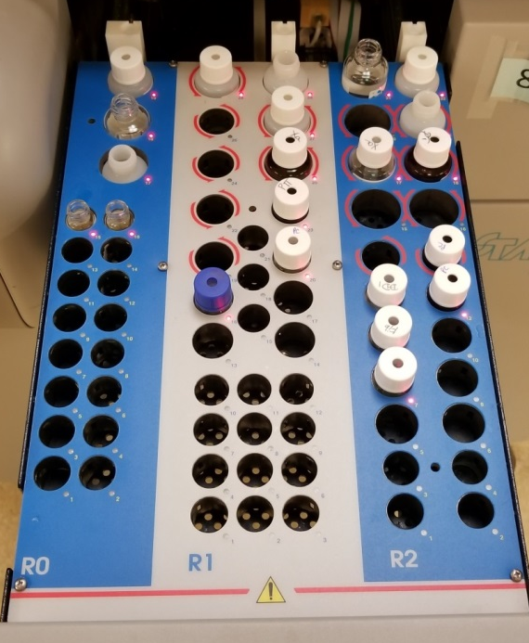
Stago Mechanical Components
Needle (probe) #1, #2, #3
Syringes and O-rings
Lamp
Cuvettes
Conveyor Belt
Incubation wells
Reagent drawer
Cleaning Solution
R0
Calibrators, QC, Diluent, Desorb
R1
Intermediate Reagents, Desorb
R2
Start Reagents, Desorb

Slide 16
Coagulation Station Stago Resulting Quick Guide Refer to Procedure Manuals for all testing when questions arise
PTT (Intrinsic pathway/ Heparin)
*** check abnormals against patients previous results, heparin contamination is a possibility.
< or = to 20.0 - check for a clot. <19 and no clot redraw for confirmation.
> 250 - report *** possible heparin contamination call nurse first.
PTT Heprinase
Result will flag in IM if the value indicates that it needs Hepzyme.
Use Hepzyme diluent. Add 1 mL (or as much as you can if it's a baby) to Hepzyme, reconstitute for 15 min.
In Epic fill in the area which asks if Hepzyme was added.
Run sample in a microtainer and release from IM, it will cross to Epic and final verify if the Hepzyme comment is already filled in.
PT/INR (Extrinsic pathway/ Coumadin or Warfarin)
*** values can change based on patients dosage and dose timing.
PT >120 - reportable
INR >10.0 - reportable
PT < or = to 8 - check for clot
Dimer
> 4 will auto dilute at 1:5 after dilution if >20.00 - reportable
< 0.27 - reportable
Thrombin
< 13.0 - reportable
> 120 - reportable
Fibrinogen
< 60 - check for clot, rerun on another instrument, recollect to verify .
Investigate probe #1 issues (technical errors), rerun on another instrument before reporting.
> 1800 - reportable
Hep Xa
> or = to 2.00 rerun a 1:2 dilution with patient plasma and frozen pooled patient plasma. Multiply results by 2. DO NOT ENTER OR RELEASE a result that says >2.0. If after the dilution procedure the test is still >2.0 you will enter >4.0 in Epic.
> 4 - Reportable
< 0.10 - Reportable
Multiple high (critical) Xa results- investigate probe #3 and check for leaking.
ATIII
Antithrombin testing is run with routine testing. Do not freeze Antithrombin tests.
FACTORS
All shifts run factors VIII, and IX and any STAT factors.
LIFE SHARE
If Life Share calls and needs PT released, type specimen number in Result entry→Result correction→ check box next to test on left side→for reason, choose “other” and enter “charting PT per LifeShare request”→hit OK→click “Edit” on the left side of the screen→click the box under “chart” on the right side of the screen to post the PT result to the chart→Click “save”, then click “final verify”
IM Error Codes
Never turn out results that are highlighted in green and have a “Tech Error” code. This indicates an instrument malfunction.
Special Coag Processing
Specimens should be double spun. The first spin is whole blood. The second spin should be with an aliquot of the initial spin. Finally the double spun aliquot should be transferred to a final tube. Three specimen aliquots are ideal for freezing.

