Slide 1
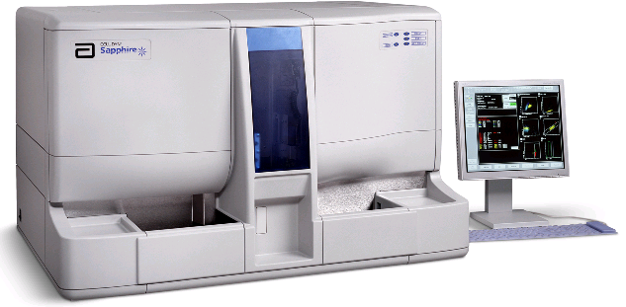
CELL-DYN Sapphire™
Instrument Overview

Slide 2
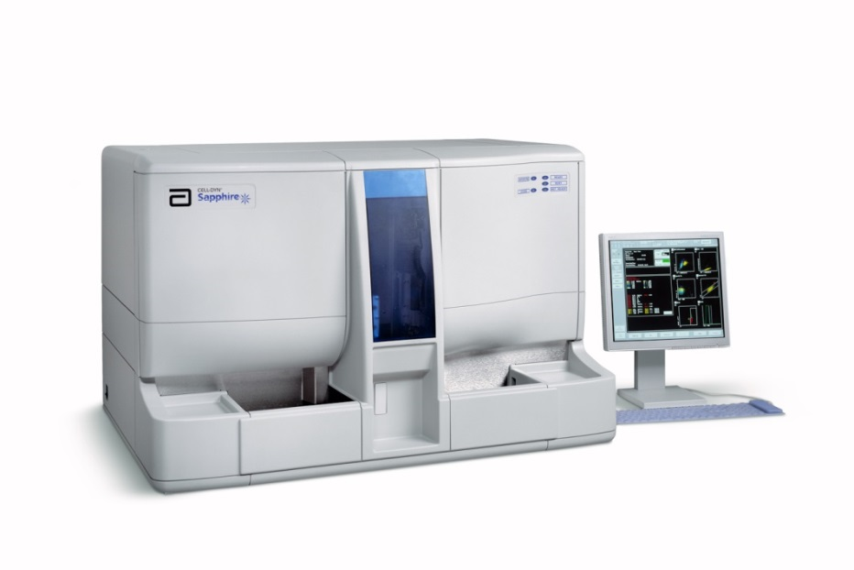
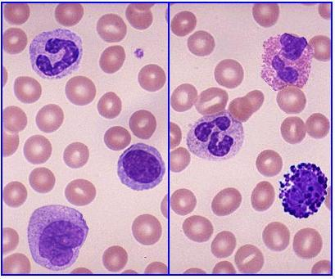
CELL-DYN Sapphire™ Theory of Operation
The CELL-DYN Sapphire is a multi-parameter automated hematology analyzer designed for in vitro diagnostic use in counting and characterizing blood cells including the following:
    White Blood Cells (WBC)
    Red Blood Cells (RBC)
    Reticulocytes
    Nucleated Red Blood Cells (NRBC)
    Hemoglobin
    Platelets

Slide 3
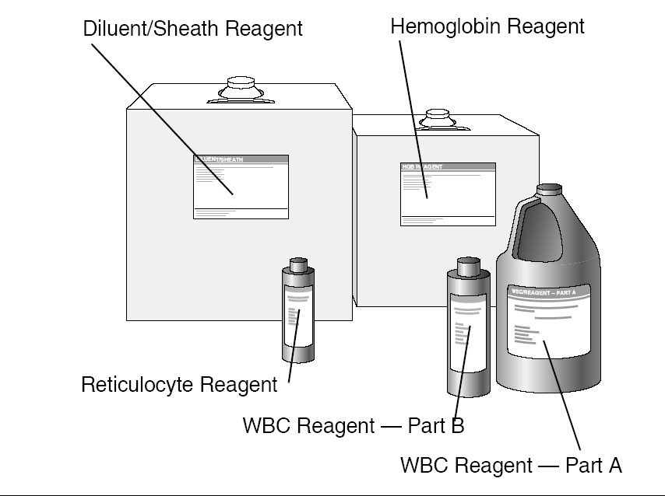
CELL-DYN Sapphire™ Features (continued)
The CELL-DYN Sapphire™ requires only five reagents:
  Diluent/Sheath Reagent
  Hemoglobin (HGB) Reagent
  WBC Reagent Parts A and B
  Reticulocyte Reagent
These reagents perform numerous major functions in both the fluidic and measurement systems.
Five Reagent Reservoirs hold the CELL-DYN Sapphire reagents and are essential for the reagent flow.

Slide 4
CELL-DYN Sapphire™ Reagents
Diluent/Sheath Reagent functions include:
  Fluidics
    Acts as the primary diluting fluid for the RBC/PLT and RETC samples.
    Primes impedance and optics-related syringes and flow paths.
    Rinses Flow Panel tubing and components at the end of each cycle.
    Rinses the RETC Dilution Cup, Aspiration Probe and Vent Needle.
  Measurement
    Prepares each cell for optimal counting and sizing during RBC, PLT and RETC measurements.
    Provides sufficient wetting action to prevent accumulation of air bubbles in the flow system.
    Serves as a sheath fluid for the Optical Flow Cell and Impedance Transducer.

Slide 5
CELL-DYN Sapphire™ Reagents (continued)
Cyanide-Free Hemoglobin (HGB) Reagent functions include:
  Fluidics
    Primes the HGB reagent syringe and tubing.
    Rinses the HGB system.
  Measurement
    Acts as a lysing agent in the HGB dilution by completely destroying the membranes of RBCs.
    Reduces interference from leukocytes by destroying them (and their nuclei).
    Acts as the reagent blank for the HGB measurement.
    Converts HGB to a single chromagen measurable at 544nm.

Slide 6
CELL-DYN Sapphire™ Reagents (continued)
WBC Reagents are maintained separately to enhance their long-term stability and are automatically mixed during sample processing.
WBC Reagent Parts A and B functions include:
    Fluidics
      Acts as the diluting fluid for the WBC sample.
      Primes the WBC Reagent syringes and tubing.
    Measurement
  Note: Both parts A and B are required for WBC measurement
      Maintains WBC integrity and morphology during the measurement process.
      Lyses RBCs and renders them invisible to Analyzer optics.
      Rapidly stains (red) the DNA in the exposed nuclei of any NRBCs or fragile or damaged WBCs present in the sample dilution.

Slide 7
CELL-DYN Sapphire™ Reagents (continued)
Reticulocyte Reagent functions include:
  Fluidics
    Primes the Reticulocyte Reagent syringe and tubing.
  Measurement
    Rapidly stains (green) the nucleic acids of cells present in the Reticulocyte dilution.

Slide 8
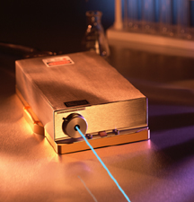
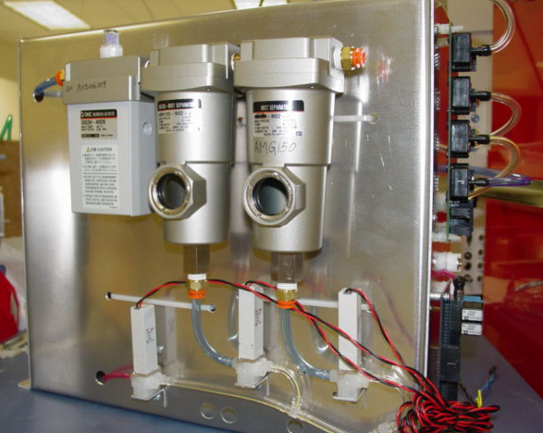
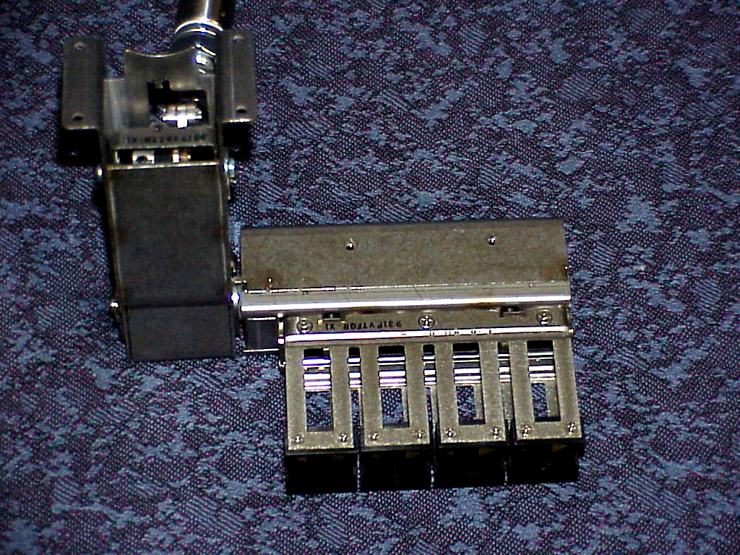
Next, CELL-DYN Sapphire™ Instrument Components…

Slide 9
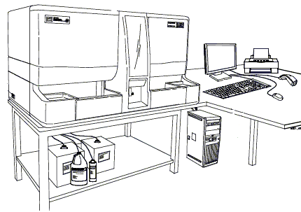
CELL-DYN Sapphire™ Units
The CELL-DYN Sapphire consists of two units:
The first is the Analyzer, it:
  mixes, presents, aspirates, dilutes and gathers raw cell data each specimen.
  supplies system vacuum and three pressure levels used for the transport of samples, reagents, and waste.
The second is the Data Station, it:
  controls all data processing and provides the operator interface for the system.
Analyzer
Data Station

Slide 10
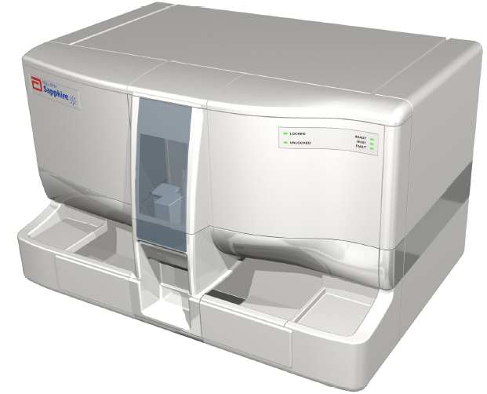
CELL-DYN Sapphire™ Analyzer
A set of covers encloses and protects the analyzer mechanisms. Aside from the Processor Cover, the front panel covers are designed to be easily opened or removed for routine maintenance.
The covers should always be in place during system operation.
Reagent Inlet/Waste Outlet Cover
Front Flow Covers
Processor Cover
* Note: If center (processing) cover sensor is triggered while during processing, a software crash may occur.

Slide 11
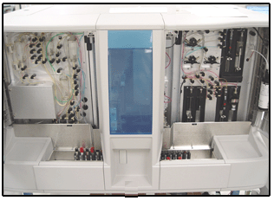
CELL-DYN Sapphire™ Aspiration Subsystem
The main functions of the specimen aspiration components are to:
    Aspirate a precise amount of specimen.
    Pierce the cap of the specimen tube.
    Vent vacuum from the specimen tube.
    Position the Aspiration Probe.
The major assemblies are located in the Sample Processing Area and the Autoloader.
Sample Processing Area
(behind cover)
Autoloader

Slide 12
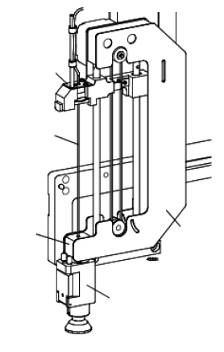
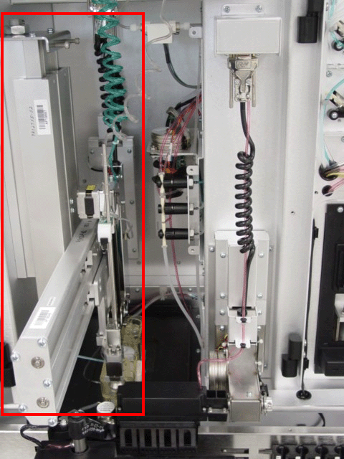
Aspiration Subsystem – Sample Processor
The Sample Processor is mounted to the side frame of the analyzer in the Sampling Area. It consists of an:
  Aspiration Module
    Rail Assembly
    Motors
  Vent Assembly
  Aspiration Head Assembly
The movements are performed either mechanically (motors) or pneumatically depending on the device and the motion.
An Aspiration Pump, located next to the Sample Processor, is used to aspirate a precise volume of blood.
A Clot Detector is used to sense whether an obstruction occurs during specimen aspiration.
Z-Motion Assembly
Clot Detector
Aspiration Pump
Side View
Bottom
Detector
Board
Aspiration
Probe
Wash
Block
Aspiration Head
Assembly
Vent Head
Assembly
Sample Processor
Front View
Aspiration Module
Aspiration Rail Assembly

Slide 13
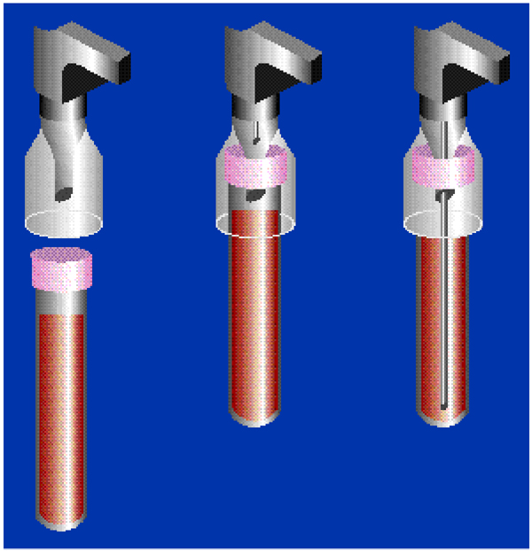
Aspiration Subsystem – Aspiration Pathway
The CELL-DYN Sapphire™ includes a single fluidic pathway:
  The Aspirate Assembly operates during the Autoloader and Open Tube modes using the same Sample Aspiration probe for both open and closed mode sampling.
    only one pathway to calibrate and QC
    no shear valve maintenance
  The Vent Assembly only operates during Autoloader operation.
    Centering Cone centers the specimen for piercing
    Vent Needle vents vacuum from specimen tube
  This approach reduces sample volume with the following minimum requirements for Specimen volumes:
    500µL Open Mode
    500µL Closed Mode
Centering Cone
Whole Blood
Vent Needle
Aspiration Probe

Slide 14
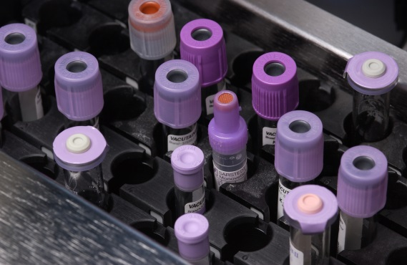
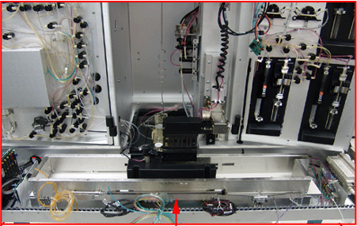
Aspiration Subsystem – Autoloader
The Autoloader holds, advances, mixes, identifies, and presents closed-tube specimens for aspiration. The Autoloader includes the following components:
    Tube Racks and Related Components
    Tube Sensor(s)
    Bar Code Reader
    Spin Assembly
    Mixing Assembly
Spin Assembly
Mixing Assembly
Tube Sensors
Specimen Tubes in Racks
Bar Code Reader
Auto Loader

Slide 15
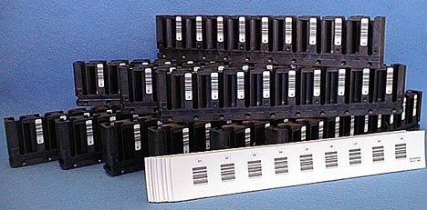
Autoloader Racks
The Autoloader accepts most common types of hematology collection tubes.
It operates with one to ten racks in place.
The specimen bar code label is read for identification at the point of aspiration.
Every rack number and tube position is identified using rack bar code labels.
A rack completion indicator is used to signal the completion of processing.
Racks hold, advance, mix, identify, and present closed-tube specimens for aspiration.

Slide 16

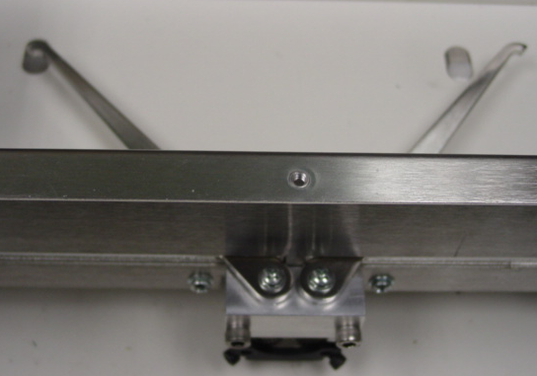
Rack movement
“sweep arms” are moved with an air cylinder to push the racks across the loader.
Left/Right indexing of the racks occurs on the rear wall of the base plate.
A cylinder drives a rod with two spring-loaded pawls (fingers) mounted on it.
The fingers engage grooves in the side of the rack.
Sweep arms
Pawls

Slide 17
CELL-DYN Sapphire™ Fluidic Subsystems
The main functions of the Fluidic Subsystems are to:
    Dilute the specimen
    Dispense and Deliver fluids
    Stage Samples for measurement
The hardware assemblies include:
    Dilution Cups*
    Reagent Reservoirs*
    Fluid Sensors*
    Syringe and Syringe Drive Assemblies
    Peristaltic Pumps
    Valves and tubing
Syringe and Syringe
Drive Assembly
Valves
Peristaltic Pumps
*Not shown in picture

Slide 18
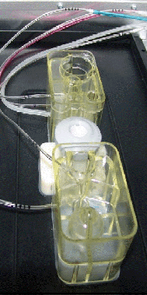
Fluidic Subsystems - Dilution Cup Assemblies
Dilution Cup Assemblies are attached to the Base Plate beneath the Aspiration Assembly and receive the sample from the Aspiration Probe
Assembly
Components
Function
Rear Dilution Cup
RBC/PLT Dilution Cup
RETC Dilution Cup
Prepare and mix the 1:290 RBC/PLT dilution for both impedance and optical measurement
Prepare and mix the 1:1160 Reticulocyte dilution for measurement
Middle Dilution Cup
WBC Dilution/Vortex Cup
Prepare and mix the 1:35 WBC dilution for measurement
Preheats the WBC Reagent
Front Dilution Cup
Hemoglobin Dilution Cup
Cone Rinse Cup
Prepare and mix the 1:215 Hemoglobin dilution for measurement
Clean vent cone and aspiration probe

Slide 19
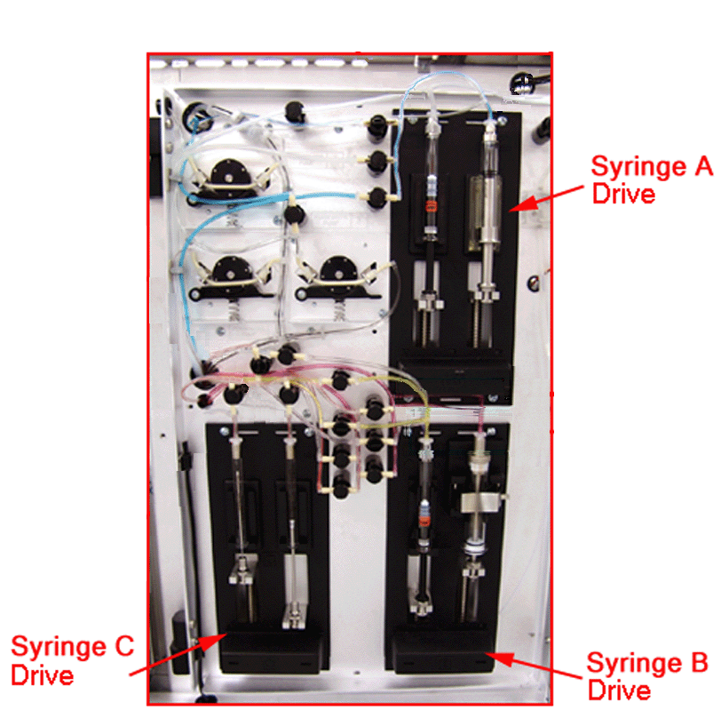
Fluidic Subsystems – Syringe Drive Assemblies
Three syringe drive assemblies (labeled A, B, and C) with seven mounted syringes, are located on the Right Flow Panel of the CELL-DYN Sapphire Analyzer.
  Five syringes provide the reagents for the dilution process.
  Two syringes are used to inject and meter the sample dilution during analysis.
Syringe Drive | Syringes
A | Reticulocyte Reagent Hemoglobin Reagent
B | WBC Reagent Part A WBC Reagent Part B Diluent/Sheath Reagent
C | Impedance Injection/Metering Optical Injection/Metering Require Calibration Verification after change.
Right Flow Panel

Slide 20
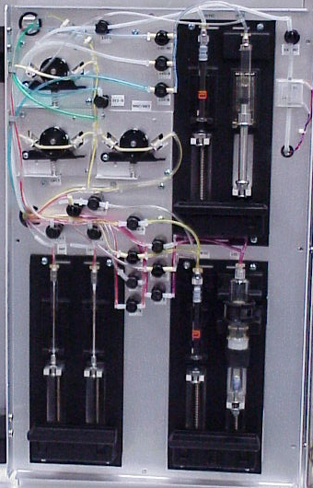
Fluidic Subsystems – Peristaltic Pumps
Three peristaltic pumps located on the Right Flow Panel of the CELL-DYN Sapphire™ system are used to stage the sample for measurement.
Pump #3
HGB and WBC Transfer Pump
Pump #2
Impedance and RETC Transfer Pump
Pump #1
Optical PLT Transfer Pump
Right Flow Panel

Slide 21
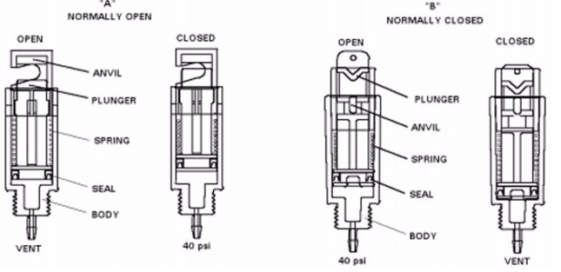
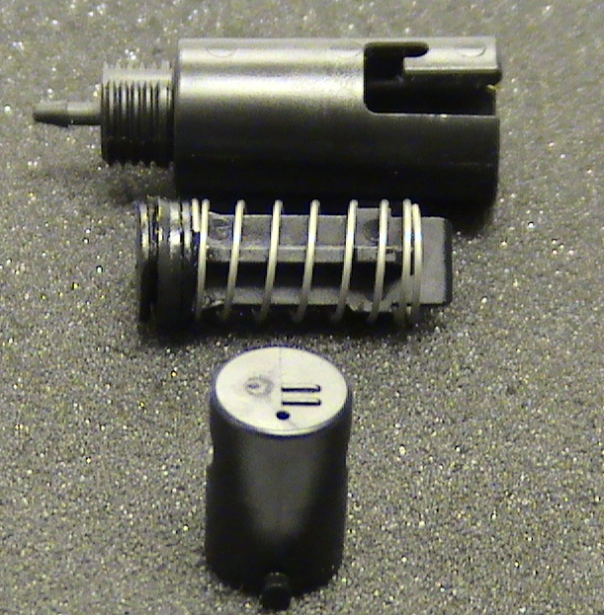
Fluidic Subsystems – Valves and Tubing
The pinch valve system on the CELL-DYN SAPPHIRE™ employs Normally Open and Normally Closed pneumatic pinch valves to control liquid and air flow.
The valves are open or closed, depending on their configuration, by the application of 40psi.
Normally Open Valve tubing
TBG PHARMED 1/32"ID 5/32"OD (S1)
TBG PHARMED 1/16"ID 3/16"OD (S2)
TBG PHARMED 1/8"ID 1/4"OD (SY)
TBG SILICON (S2)
Normally Closed Valve tubing
TBG PHARMED 1/16"ID 3/16"OD (S2)
Normally Open
Normally Closed
Open
Closed
Open
Closed
Anvil
Plunger
Plunger
Spring
Anvil
Spring
Pinch valve Operation
Seal
Seal
Body
Body
Vent
40 psi
40 psi
Vent

Slide 22
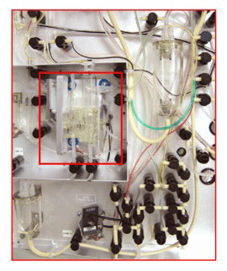
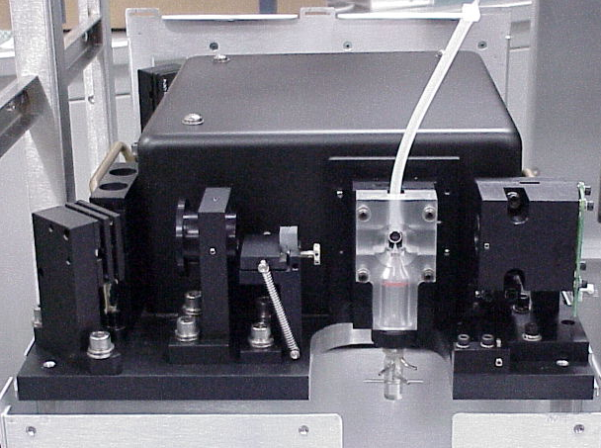
CELL-DYN Sapphire™ Measurement Subsystem
The CELL-DYN Sapphire uses three techniques to obtain specific measurements from whole blood:
    Absorbance Spectrophotometry
    Focused Flow Impedance
    Flow Cytometry (Optical Scatter) and Fluorescence
The hardware assemblies include:
    Hemoglobin Flow Cell
    Impedance Transducer
    Optics Bench
Impedance
Transducer
Hemoglobin
Flow Cell
Left Flow Panel
Optics Bench Assembly

Slide 23
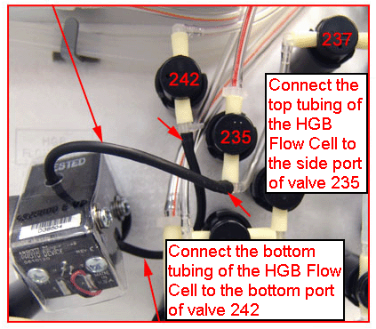
Measurement Subsystem – Flow Cell
Absorption Spectrophotometry is used to measure Hemoglobin Concentration
    A photo detector measures the amount of monochromatic light that passes through a solution. The higher the concentration of the substance, the more light it absorbs.
    8 reads are taken when the sample mixture passes through the flow cell and 8 reads are taken when only HGB Reagent is in the flow cell (Reference Reading).
    Difference between the sample averages and the reference averages is due to absorption by the HGB complex and is used to compute the concentration of HGB in the sample.
The Hemoglobin Flow Cell is located on the lower left portion of the left flow panel.

Slide 24
Measurement Subsystem-Focused Flow Impedance
Focused Flow Impedance:
A sheath stream forces the cells to enter the sensing zone in single file and provides a high number of single cells for analysis
A constant current of 100VDC is passing through the aperture plate. When a cell passes through the orifice, there is increased resistance for the current.
The processed signal provides a measurement of the number and size of particles.
The Transducer Assembly is where the measurement occurs. It contains the following components:
  Pre- and Post-Analysis Chambers
  Impedance Aperture Plate
  Injection Tube, Outer Electrode and Inner Electrode
  Impedance Transducer Cover
Parameters determined using Focused Flow impedance include the following parameters:
  RBCi, MCV, RDW, PLTi, MPV
Pre Analysis Chamber
Post Analysis Chamber
Electrode
Electrode
Aperture plate

Slide 25
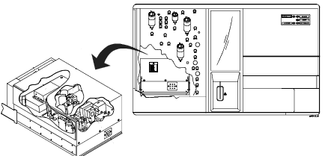
Measurement Subsystem – Optic Bench
Optical Measurements are carried out on an Optical Bench Assembly that uses the principles of light scatter and fluorescence to count, size, and classify cells.
The parameters generated from the optics bench data include the following:
  White Blood Cell Count and WBC 5-Part/Expanded Differentials
  Platelet Optical Count (PLTo and RBCo)
  Reticulocyte Count
  Nucleated Red Blood Cell Count (NRBC)
The Optical Bench is accessed through a pull out drawer for easy front panel access.
The basic optics design:
    Incorporates a solid state blue diode laser
    Includes an assembly with photometers to detect light scatter at 4 angles plus 3 color fluorescence

Slide 26
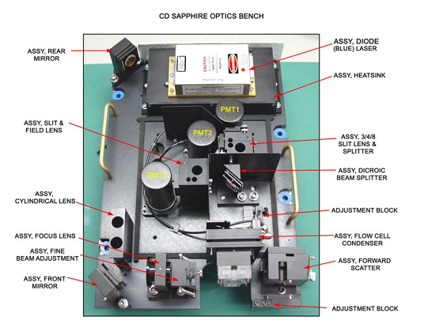
Measurement Subsystem - Optics Bench
Optics Bench Assembly consists of the three main subsystems
  Illumination Subsystem
    laser, mirrors and lenses that direct and shape the laser beam to focus on the sample stream in the center of the Optical Flow Cell.
  Optical Flow Cell Subsystem
    nozzle assembly and Optical Flow Cell.
  Collection/Detection Subsystem
    five optical detectors corresponding forward- and side-angle collection.
      0° Light Loss (ALL) – SIZE
      7° Light Scatter (IAS) COMPLEXITY
      90°D Light Scatter (DSS) - GRANULARITY
      90° Light Scatter (PSS) - LOBULARITY
Optical Bench with Cover Removed

