Slide 1
CELL-DYN Sapphire™
Specimen Processing
and Basic Run

Slide 2
Basic Tests
The most common tests to process on the Cell-Dyn Sapphire are CBC, Hemogram, CBCM, Platelet Count.
CBC, complete blood count, is a blood test used to evaluate your overall health and detect a wide range of disorders, including anemia, infection and leukemia.
Hemogram is part of a CBC test. The following table includes tests and their corresponding parameters that they measure:
Test name | Parameters included
CBC | WBC, RBC, Hemoglobin, Hematocrit, MCV, MCHC, Platelet count, RDW, MPV, and WBC differential
Hemogram | WBC, RBC, Hemoglobin, Hematocrit, MCV,MCHC, Platelet count, RDW and MPV
CBCM | CBC with Manual WBC differential
Platelet count | Platelet
Hemoglobin/ Hematocrit | Hemoglobin and hematocrit
Retic count | Retics

Slide 3
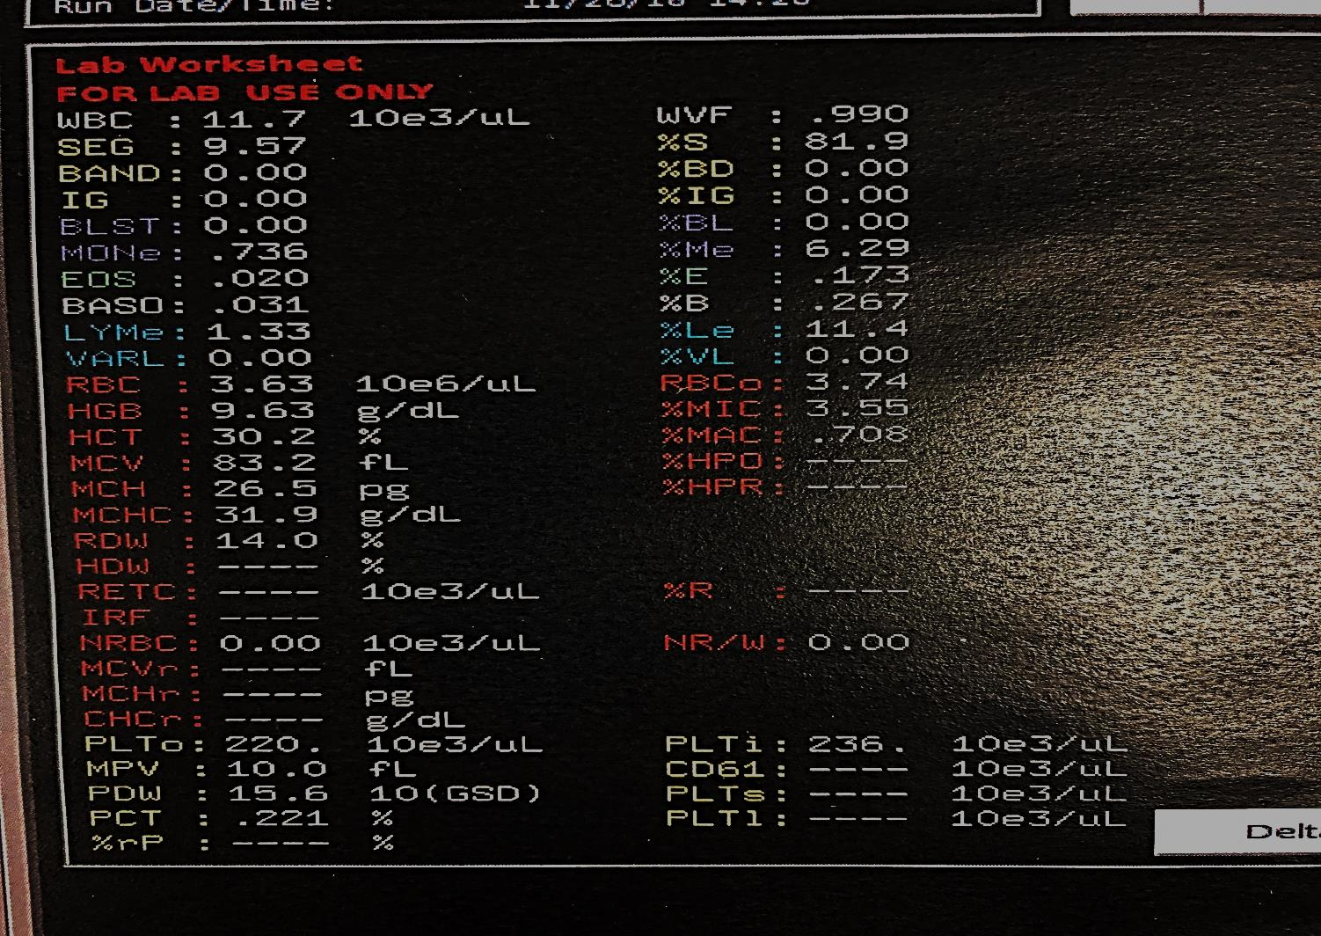
Basic Tests
Sapphire Result screen

Slide 4
Processing Specimens
Acceptable Specimens for Cell-DYN Sapphire
EDTA lavender-top tube is drawn for CBC.
EDTA stands for Ethylenediaminetetraacetic acid.
EDTA functions by binding calcium in the blood and keeping the blood from clotting. The nominal EDTA concentration is 1.8mg EDTA per milliliter of blood.
Sodium citrate blue-top tube is used for patients with platelet clumps only to derive PLT count.
***If a sodium citrate tube is used to derive the platelet count, the platelet result from the analzyer must be multiplied by1.1

Slide 5
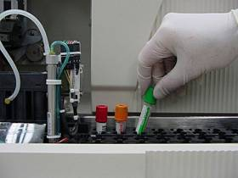
Processing Specimens
The CELL-DYN Sapphire™ offers highly automated specimen analysis.
Specimens in closed tubes can be processed in Autoloader mode.
Can be uncapped and presented for aspiration directly from the extended probe and processed in Open Tube mode.
OR

Slide 6
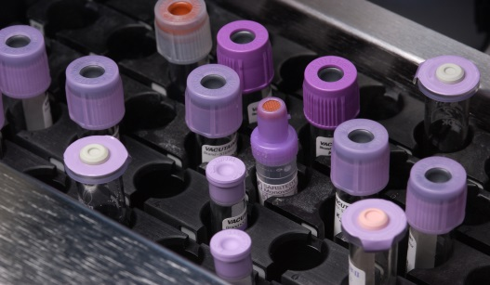
Autoloader Mode – Load Racks
Hold each rack so that the bar code labels on the rack face you.
Each rack has a groove on the side containing the bar code labels and on the left end
Each groove meshes with a corresponding lip in the Autoloader.
Racks can be loaded on either the right side or the left side of the Autoloader, according to your processing needs and the number of specimens you intend to run.
NOTE: Racks can not be loaded straight down in the forward-most position of the Autoloader because of the lip.
Tubes can be placed into racks before or after the racks have been loaded in the Autoloader.
Specimen Tubes in Racks

Slide 7
Processing Specimens
Run Specimens Using the Autoloader
To run specimens using the Standard Processing Conditions:
1. Place tubes into racks.
2. Load the racks onto the Autoloader.
3. Check, and if necessary change, the Standard Processing
Conditions.
􀀍 Standard Processing Conditions setup can be found by selecting
the Setup> button and selecting Work List... from the drop down
menu.
4. Select Run Loader to start the run.

Slide 8
Run Samples in the Autoloader Mode
Click on RUN LOADER to initiate the Run

Slide 9
Processing Specimens
Interrupt the Autoloader
The Autoloader may be interrupted at any time to remove and/or replace racks. It may also be interrupted to run a specimen in the Open Tube Mode.
To Interrupt the Autoloader to Process Samples in Open Tube Mode:
1. Select Interrupt Loader....
2. Select OK.
When the OK option is selected, the system recognizes the operator’s intention to resume Autoloader processing some time in the future. Therefore, the rack currently being processed remains locked. Do not attempt to remove the locked rack as the locking mechanism can be damaged.
3. Select Run Loader to resume processing of samples in the Autoloader

Slide 10
Run Specimens in the Autoloader Mode (cont.)
Click on OK when a window alerts you that Autoloader will halt after the current sample is processed

Slide 11
Processing Specimens
Interrupt the Autoloader continues…
To interrupt the Autoloader to Access Racks Under the Processor Cover:
1. Select Interrupt Loader....
2. Select Remove Rack.
3. When asked Are You Sure?, select Yes.
4. Remove the racks from underneath the Processor Cover.
5. To initiate a new Autoloader Run, place a freshly loaded rack in
the start position and select Run Loader.

Slide 12
Processing Specimens
Run Specimens in Open Tube Mode
The operator can interrupt the Autoloader at any time to aspirate specimens in the Open Tube mode. The following guidelines summarize both required and optional steps for Open Tube mode aspiration.
Using the Next Open Tube Setup Window
1. Select Run Open Tube... button.
2. Select <Specimen ID> field, type the Specimen ID, or use Handheld
Bar Code Reader. Press Enter.
3. (Optional) Select the Search Work List button.
4. (Optional) Select demographics text field. Type information and
press Enter. Repeat for additional fields.

Slide 13
Processing Specimens
Run Specimens in Open Tube Mode continues…
5. Select Close.
6. Uncap well-mixed specimen.
7. Confirm that ID on tube matches ID on the monitor.
8. Immerse the end of the extended probe into the whole blood
specimen tube.
9. Press the Aspiration switch.

Slide 14
Processing Specimens
Run Specimens in Open Tube Mode continues…
10. After two beeps sound, remove the tube and recap the
specimen.
11. For additional specimens repeat the procedure, beginning with selection of Run OpenTube button.

Slide 15
Run Specimens in the Open Mode
The CELL-DYN Sapphire can aspirate from an open tube using the Run Open Tube... button.
Identification information for tubes can be entered manually by typing, or electronically by using a Hand-held Bar Code Reader. Information must include the following two patient identifiers, sample ID and the patients name.

Slide 16
Data Review
Find Data Log Records
To manually find and display a record in the Data Log, select Data Log, scroll through the list, and select the desired record.
1. Select Data Log.
2. Select Find Record....
3. Select desired field and type information. Press Enter key. Repeat steps 1 and 2 for any additional fields.
4. Select either Match Any or Match All button.
5. Select Find button.
6. Select Find Next button.
7. Enter new data. If necessary, select new matching method.
Select Find.
8. Select Close

Slide 17
Data Review
View Data Log Recards
Log Format
1. Select Data Log from the Control Region.
2. Data Log records will display in a tabular list.
The following table describes how to open the Single Record View, change the view, select a new page for viewing, chenge a graph for temporary viewing, print or transmit the record, select a new recard, and close the window.

Slide 18
Data Review
Task | Procedural Steps
Select Data Log record for viewing | 1. If necessary, select Data Log button to open DATA LOG window. 2. Select record to be reviewed. 3. Select View Record button.
Change record viewing page | Select button for new page (Chartable, Laboratory, or Graphs) from window’s View Control Panel Region.
View record demographics | Review displayed record demographics
Change graph for temporary viewing | 1. Select graph icon next to heading of graph being changed. 2. Review menu of graph selections. 3. Select graph for temporary display.
Print report for record being viewed (only for Chartable or Laboratory Pages) | 1. Select Print... button from Shared Region Panel. 2. Select In Color or In B/W button.
Transmit record being viewed | Select Transmit button from Shared Region Panel.
Select new record for viewing | Select Prev, Next, or End Record button from the Single Record View Control Panel.
Change from Log View to Run View | Select Run View button from the Single Record View Control Panel.
Return to DATA LOG window | Select Data Log button from Shared Region Panel.

Slide 19
Specimen Processing
Data Flagging
Suspect Parameter Flags
Suspect Parameter Flags are notifications of possible problems with numerical results and are generated as a result of System Faults or Data Faults. They are indicated by an asterisk [*] or a blank [ ] beside affected results.
Suspect Parameter Flags require review and validation of results before affected results can be reported.
Data faults
Data Faults arise as a result of interfering substances or conditions within the specimen, problematic conditions detected by the algorithms, or, rarely, malfunctions of the System.

Slide 20
Specimen Processing
Data faults continues…
The table below summarizes the Invalid Data Messages and the cause for the condition.
Invalid Data Message | Explanation of Fault Condition
[Known Interference with WBC Results, likely due to PLT Clumping] | Significant interference, likely due to PLT clumping, was detected. WBC results were corrected.
[Suspected Interference with WBC Results, likely due to PLT Clumping] | Significant interference, likely due to PLT clumping, might have affected WBC results. The algorithm was unable to correct the WBC results.
[Number of WBC Events] | A significant percentage of unknown events
[Out-of-Bounds Greater than Preset Limit] | (relative to WBC count) was outside the boundaries within which WBC data are expected to appear. WBC results were corrected.
[Unidentified Fluorescent Population Greater than Preset Limit] | A significant number of unknown small fluorescent cells was detected and classified as Lymphocytes.
[Unidentified Fluorescent Population Less than Preset Limit] | Small numbers of unknown fluorescent cells were detected.

Slide 21
Specimen Processing
Data faults continues…
Invalid Data Message | Explanation of Fault Condition
[Resistant RBC Interference with WBC Results] | A significant number of lyse-resistant RBCs (relative to WBC count) was detected.
[Unable to Find Clear Separation Between WBC Subpopulations] | The algorithm was unable to find clear separation between two or more WBC subpopulations.
[Interference with PLT Results Due to PLT Clumping] | A significant amount of PLT clumping was detected and PLT results were underestimated.
[PIC/POC Delta] | The difference between PLTo (optical) and PLTi (impedance) exceeded the preset limit. Specimen requires a manual PLT estimate if the flag is not resolved.

Slide 22
Specimen Processing
Reflex Testing Using Lytic Potential Test Selection
Lytic potential is the product of both lysing duration and lytic strength and is annotated as [L], [L+], [L++] in the Test Selection> menu. Test selections have increasing levels of lytic potential, as follows:
• CBC [L] or CBC+RETC [L]
• CBC+RETC, Resistant RBC [L+]
• CBC, Resistant RBC [L++]
The following table summarizes the test selection Lytic Potential, and
suggested guidelines for the use of the test selection.

Slide 23
Specimen Processing
Reflex Testing Using Lytic Potential Test Selection
Test Selection | Lytic Potential | Guidelines
CBC [L] | Normal | Normal specimens, including pediatric specimens
CBC+RETC [L] | Normal | Normal specimens, including pediatric specimens
CBC, WBC Extended Count [L] | Normal | • Leukopenic specimens • Reflex response to FP? Suspect Population Flag • Possible reflex response to WBC suspect parameter flags
CBC+RETC, Resistant RBC [L+] | Mid | • Pediatric specimens with low volume • Possible reflex response to the Resistant RBC Suspect Parameter flag
CBC, Resistant RBC [L++] | High | Possible reflex response to the Resistant RBC Suspect Parameter flag.

Slide 24
Specimen Processing
Interfering Substances and Conditions
The following interfering substances and conditions can affect the listed parameters. Although the CELL-DYN Sapphire has been designed to flag samples with interfering substances, it may not always be possible to do so.

Slide 25
Interfering Substances and Conditions
Parameter Affected | Interfering Substance and Conditions
WBC and WBC Differential | • Cryoglobulin and Cryofibrinogen • Fragile WBCs Hemoglobin C Crystals (Intra-erythrocytic hemoglobin masses) • Lyse-resistant RBCs • Neutrophil aggregates • NRBCs • PLT clumps
RBC | • Auto agglutinins • Cold agglutinins • Elevated WBK concentration • Giant PLTS • Hemolysis (in vitro) • Small leukocytes [in cases where the leukocyte concentration is high (>100 x 109/L) and MCV is high]
HGB | • High lipids (>700mg/dL) • High WBCs (>250 x 109/L, based on concentrated, normal† WBCs) • High bilirubin (>33mg/dL) • Hemoglobin C Crystals (Intra-erythrocytic hemoglobin masses)
MCV | • Auto agglutinins • Cold agglutinins • Elevated WBC concentration • Giant PLTS • Hemolysis • Hyperglycemia • Leukocytosis with macrocytic anemia

Slide 26
Interfering Substances and Conditions
Parameter Affected | Interfering Substance and Conditions
PLT (optical) | • Auto agglutinins • Cold agglutinins • Cryofibrinogen • Cryoglobulins • Giant PLTS • Microcytic RBCs • PLT clumps • PLT satellitism • RBC fragments and WBC fragment
MPV | • Giant PLTS • PLT clumps • RBC fragments • WBC fragments
NRBC | • Fragile lymphocytes (as found in non-Hodgkin’s lymphoma, and occasionally in chronic lymphocytic leukemia and acute leukemia) • Lyse-resistant RBCs • Non-viable WBCs
RETC | • Auto agglutinins • Babesiosis • Basophilic stippling • Cold agglutinins • Giant PLTs • Howell-Jolly bodies • Malaria • PLT clumps • RBC auto-fluorescence

Slide 27
Potential Causes of Spurious Results
This table provides a detailed list of potential causes of spurious results with automated hematology analyzers.
Parameter | Causes of Spurious Increase | Causes of Spurious Decrease
White Cell Count (WBC) | • Cryoglobulin, cryofibrinogen • Heparin • Monoclonal proteins • Nucleated red cells • Platelets clumping • Unlysed red cells | • Clotting • Smudge cells • Uremia plus immunosuppressants
Red Cell Count (RBC) | • Cryoglobulin, cryofibrinogen • Giant platelets • Elevated white cell count • (> 30,000/ìL) | • Cold agglutinins • Clotted specimen (microclot) • Hemolysis (in vitro) • Polycythemia (increased RBC coincidence) • Microcytic red cells
Hemoglobin (HGB) | • Carboxyhemoglobin (> 10%) • Cryoglobulin, cryofibrinogen • Hemolysis (in vivo) • Elevated white cell count • (> 30,000/ìL) • Hyperbilirubinemia, severe Lipemia • Abnormal plasma proteins | • Clotted specimen (microclot)

Slide 28
Potential Causes of Spurious Results
Parameter | Causes of Spurious Increase | Causes of Spurious Decrease
Hematocrit (Packed Cell Volume - Manual Method) | • Hyponatremia • Plasma trapping | • Excess EDTA • Hemolysis (in vitro) • Hypernatremia
Mean Cell Volume (MCV) | • Autoagglutination • High white cell count (> 50,000/ìL) • Hyperglycemia • Reduced red cell deformability • Swollen red cells | • Cryoglobulin, cryofibrinogen • Giant platelets • Hemolysis (in vitro) • Microcytic red cells
Mean Cell Hemoglobin (MCH) | • High white cell count (> 50,000/ìL) • Spuriously high hemoglobin • Spuriously low red cell count | • Spuriously low hemoglobin • Spuriously high red cell count
Mean Cell Hemoglobin Concentration (MCHC) | • Auto agglutination/Cold Agglutination • Clumping • Hemolysis (in vivo and in vitro) • Spuriously high hemoglobin (Lipemic) • Spuriously low hematocrit | • High white cell count (> 50,000/ìL) • Spuriously low hemoglobin • Spuriously high red cell count
Platelets (PLT) | • Cryoglobulin, cryofibrinogen • Hemolysis (in vivo and in vitro) • Microcytic red cells • Red cell inclusions • White cell fragments | • Clotting • Giant platelets • Heparin • Platelet clumping • Platelet satellitosis

