Slide 1
Saint Francis Laboratory Safety training
Mislabeled or Unlabeled
Specimen Reporting
July 2021

Slide 2
Training objectives Why is correct specimen labeling important?
Identifying patients correctly is the #1 National Patient Safety Goal.
As a part of the hospital team the laboratory ensures that we meet this goal by only accepting correct and accurately labeled specimens.
To assist and track this important aspect of patient care the lab QSE department has developed workflows for reporting when specimens are sent to the Lab unlabeled or incorrectly labeled.
This training module is intended to define reporting workflows for laboratory employees throughout the Saint Francis Health System.

Slide 3
Unlabeled specimen workflow
Unlabeled
Specimen
No label, unable to determine identification
Discard specimen
Inpatient (IP)
IP Mis/Unlabeled Specimen Report
(Sup, Lead, Tech in charge only)
QSE Dept.
Label present but not affixed
Irretrievable specimen
Outreach ID error
Outreach
Outpatient Mis/Unlabeled Specimen Report
Customer Service
QSE Dept.
Can the specimen be redrawn?
NO
YES
Nursing Home
(Main Lab Only)
Outpatient Mis/Unlabeled Specimen Report
Lab Support Office
QSE Dept.
Redraw in EPIC with the reason “Specimen Unlabeled”
QSE runs reports to track

Slide 4
Mislabeled specimen workflow
Mislabeled
Specimen
Mislabeled Specimen (Wrong Patient ID)
YES
Have results been charted?
NO
Result Correction
Comm. Log communication required.
Redraw in EPIC with the reason: “Drawn from Wrong Patient”
Irretrievable specimen
Outreach ID error
Can the specimen be redrawn?
YES
QSE runs reports to track
NO
Nurse or Physician must reorder test, specimens are collected again and lab will credit the patient.
Inpatient (IP)
Outreach
Nursing Home
(Main Lab Only)
Outpatient Mis/Unlabeled Specimen Report
Outpatient Mis/Unlabeled Specimen Report
IP Mis/Unlabeled Specimen Report
(Sup, Lead, or Tech in charge only)
Always add Clinical Lab as secondary location in Verge report.
Verge the Incident (Sup, Lead, or Tech in charge only)
Customer Service
Lab Support Office
QSE Dept.
QSE Dept.
QSE Dept.
QSE Dept.

Slide 5
When to report a mislabeled specimen
Clarification:
You should always follow the workflow defined in this training to report patient ID related, mislabeling incidents.
This workflow is not intended to address labeling issues that are un-related to ID incidents.
Labeling issues not covered under this process include but are not limited to: twisted labels, wrinkled labels, multiple test labels (for the same patient) on one tube or unreadable barcodes.

Slide 6
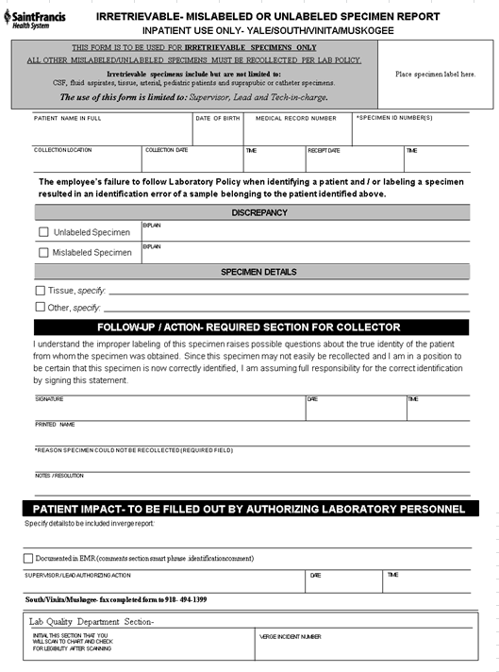
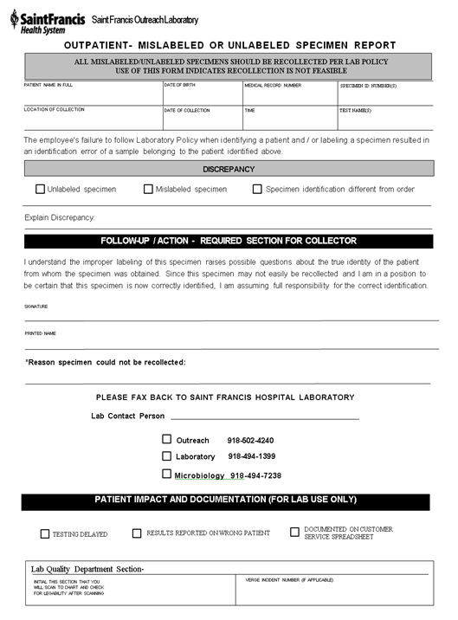
Mislabeled/unlabeled specimen reports
Inpatient
Outpatient

Slide 7
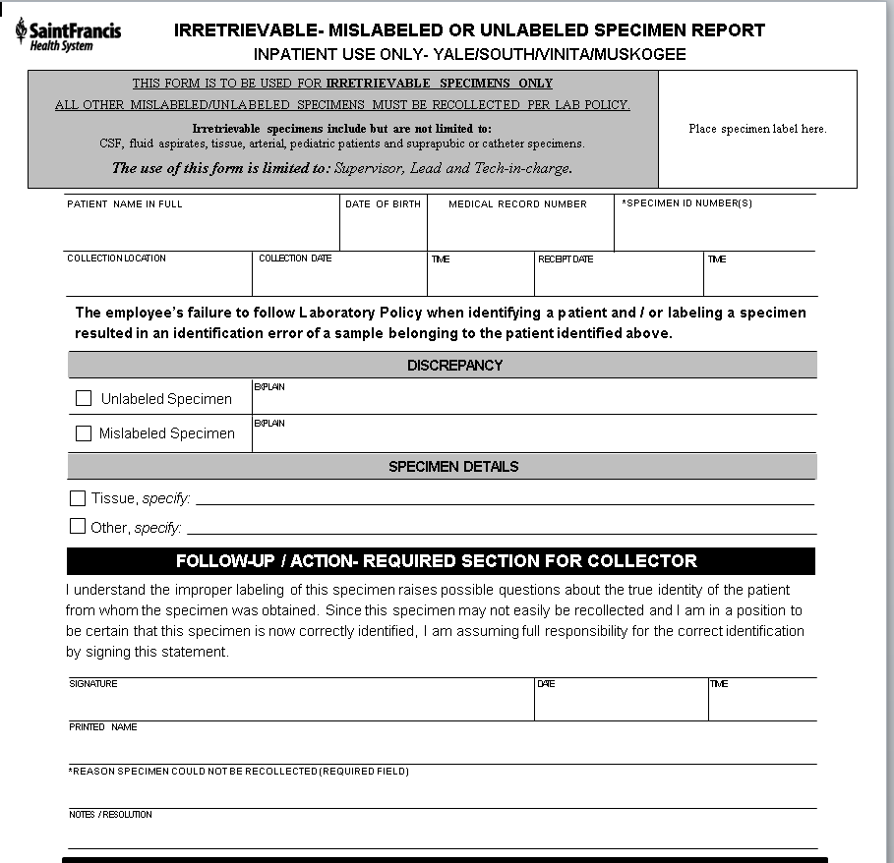
Inpatient Mislabeled/Unlabeled specimen reports
The decision to allow use of this form for relabeling instead of redrawing the specimen must be made by a Supervisor, Lead or Tech in Charge.
This form is only used for Irretrievable specimens including but not limited to: CSF, fluid aspirates, tissue, arterial, pediatric patients and suprapubic or catheter specimens.
For Blood Bank related specimen labeling errors refer to Blood Bank policies and training.
This report is signed by a nurse or phlebotomist who can attest to the identification of the patient and physically label or correct the specimen error.
The form must be filled out completely and must be signed by the authorizing lab personnel.
There must be documentation in the EMR that testing was completed on a specimen verified by this process. Document in the comment section using the smart phrase (.identificationcomment).
Submit form to QSE department by leaving in mailbox (main lab) or faxing (entities).

Slide 8
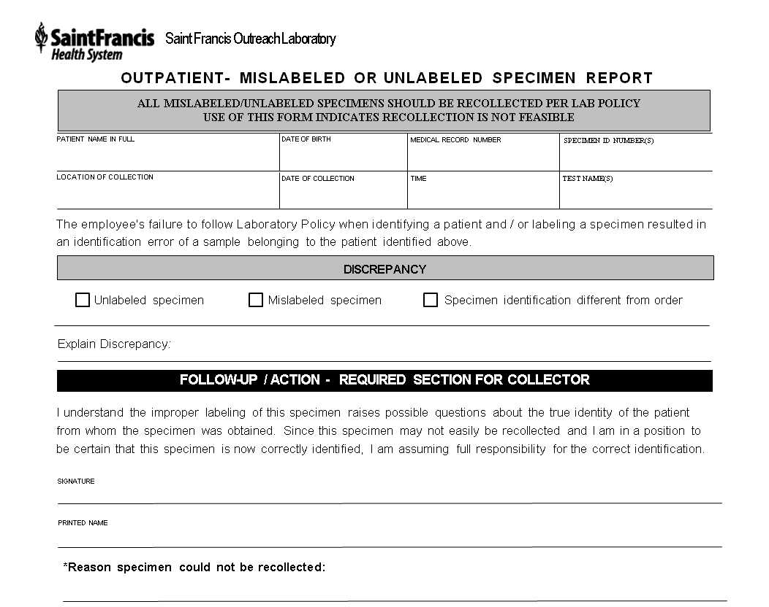
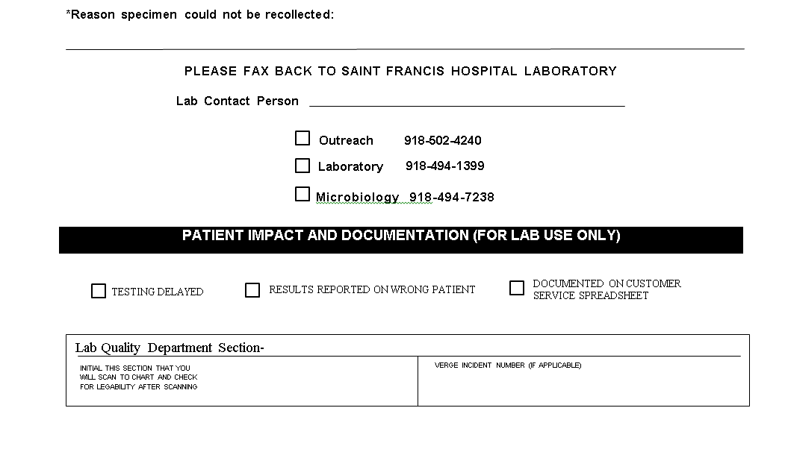
Outreach Mislabeled/Unlabeled specimen reports
This form is used for Outreach and Nursing Home identification issues.
The form must be signed by a nurse or phlebotomist who can attest to the identification of the patient.
If the error is found after transport to the Main Lab perform testing offline:
Outreach- Enter a follow up task in Epic “Outreach Specimen Issue”. Perform testing offline, print results and leave the specimen and paperwork for customer service to contact the collector for attestation.
Nursing Home (Montereau, Aberdeen Heights)- fax form to nursing home for nurse to sign attesting to patient ID.
Remember to include specimen ID numbers and explain the discrepancy (issue).
Submit completed form to the QSE department.

Slide 9
What happens after we submit the report?
The report is scanned onto the Patient's chart for documentation. Remember this when filling out the report. This is a VERY transparent process so be professional and fill out the report completely.
Follow up is completed:
Inpatients- All reports are Verged (Safety Reporting Database).
Outreach- All reports are entered into the Outreach Customer Service tracking spreadsheet for follow up by Leadership. This incorporates Physician offices that are not available in Verge.
All incidents are included in the monthly Accurate Identification Study published by the QSE department.
The Accurate ID Study includes:
Redrawn specimens noted to have an ID issue.
Verged Result Corrections due to ID issues.
Specimen Reports from Inpatients and Outpatients.

Slide 10
Questions?
If questions arise please direct them to your Supervisor for immediate resolution or your QSE coordinators for follow up.
Coordinators:
Meredith Butcher- 918-494-6369
Amanda Coe- 918-494-6379

