Slide 1
Sf Hospital Yale pneumatic tube system
Standard Operation, Specimen Packaging Guidelines and Spill Prevention

Slide 2
Pneumatic tube system- overview
The Pneumatic Tube System is a mechanical system used by the entire hospital to transport Laboratory Specimens, Blood Transfusion Products, and Pharmacy Products.
There are 111 individual tube stations in use at the SF Yale Campus.
Over 5,000 tube system transactions occur per day.
The system moves carriers at a speed of 17 miles per hour.
The time it takes from dispatch to arrival is dependent on the volume of tubes in the system at any given time, but on average it takes 1-3 minutes.

Slide 3
Pneumatic tube system Standard operation

Slide 4
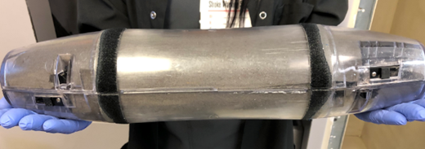
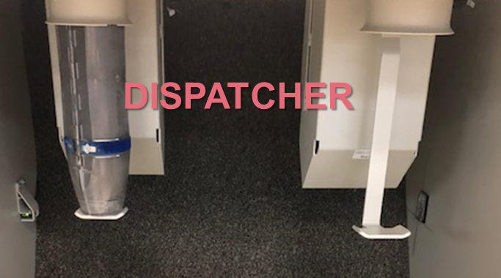
Sending procedure
Place items to be sent in an empty carrier. (Follow all packaging guidelines.)
Close carrier and insure both latches are secured!
Place carrier in dispatcher.

Slide 5
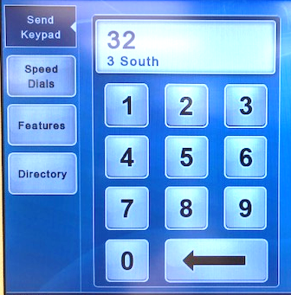
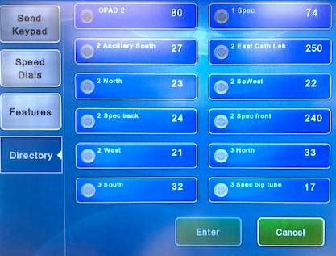
Sending procedure- continued
Type in the tube station number.
OR
Press “Directory” select the destination and press “Enter”.

Slide 6
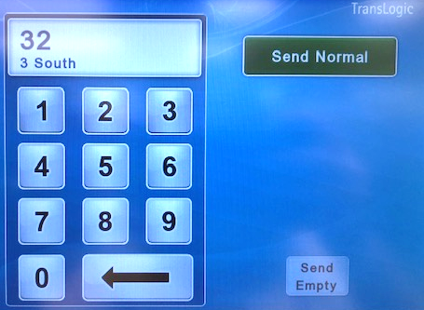
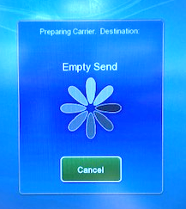
Sending procedure- continued
To send, press “Send Normal”.
The carrier will now dispatch when the path is ready.

Slide 7
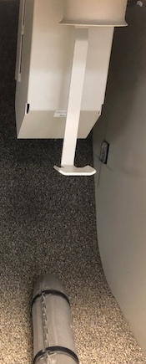
Receiving procedure
The message “Incoming non-RFID carriers” indicates carriers will be arriving at your station.
Carriers will drop into the station from a shoot behind the dispatch carrier.
Remove carriers promptly as they arrive to prevent the receiver from becoming full and shutting off your station.
If carriers or latches are damaged or the foam is missing remove the carrier from the system and call engineering.

Slide 8
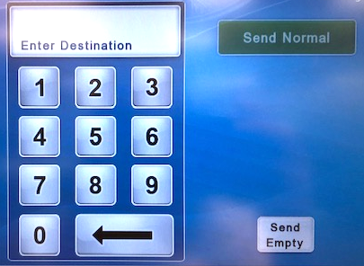
Send empty carriers
If your station says “Return surplus non-RFID carriers” you need to send out empty carriers.
This is an important task for two reasons.
Returning empty carriers to the system ensures that other stations receive the empty carriers they need to send specimens.
Each station is programed to allow only a certain number of empty carriers. If your station has too many surplus carriers your station status will become unavailable.

Slide 9
Send empty carriers- Continued
Send empty non-standard carriers to the station indicated on the carrier.
Send empty non-standard carriers to the tube station indicated on the carrier.
If no station is indicated simply place the carrier in the dispatcher and press “Send Empty”.
Send empty standard carriers by pressing “Send Empty”.

Slide 10
Specimen packaging guidelines and spill prevention

Slide 11
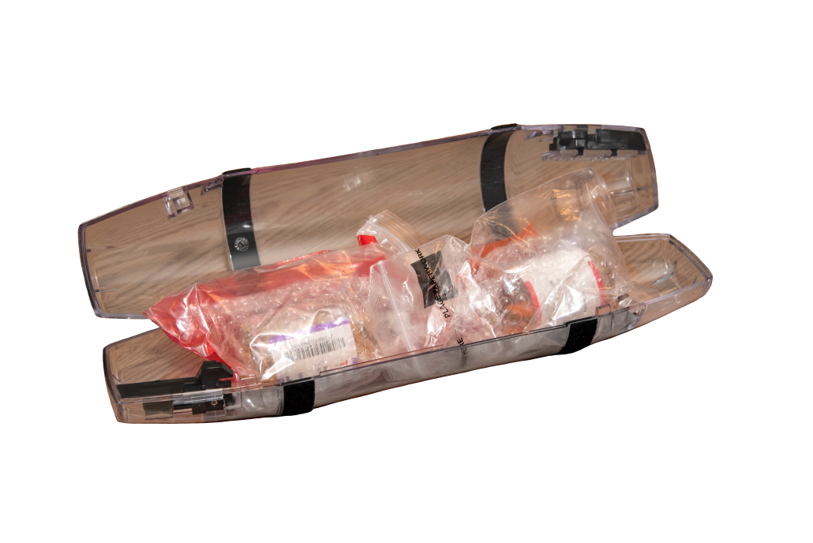
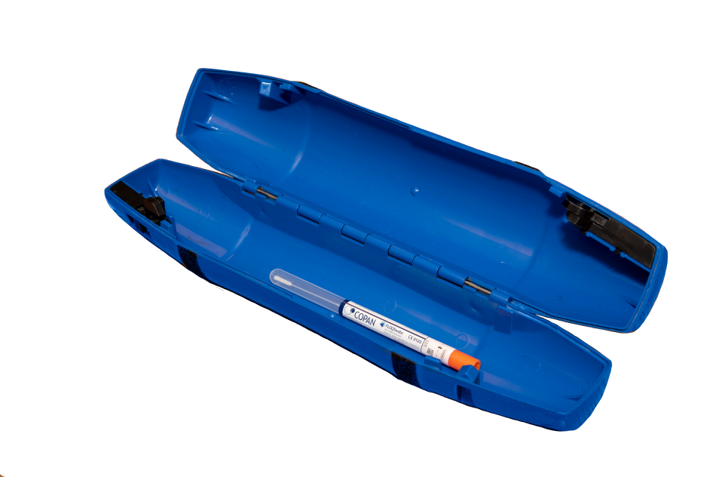
Packaging guidelines- spill prevention
Safety incidents involving the pneumatic tube system cause system wide shutdowns and are primarily due to leakage and spills from improperly packaged specimens.
Examples include:
Use of non-leak tight containers
Failure to tighten container lids
Failure to package in biohazard bag
Tube system carriers without foam liners
Improperly packaged blood culture bottles

Slide 12
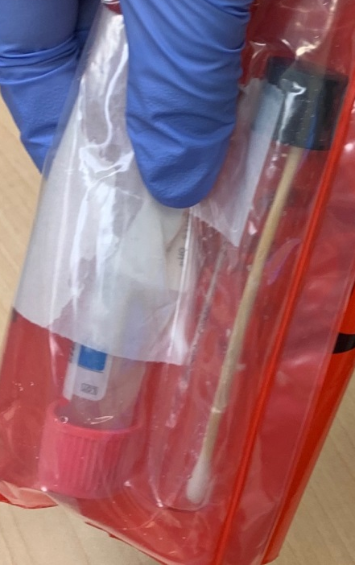
Packaging guidelines- spill prevention
All specimens must be appropriately packaged in a leak-proof container and placed in a secondary container, usually a ziploc specimen bag labeled as BIOHAZARD.
Remember to seal the biohazard bag.

Slide 13
Packaging guidelines- spill prevention
A spill in the pneumatic tube system requires a downtime for decontamination that can affect the entire hospital.
If any liquid leaks out of the zip lock bag into the pneumatic tube foam liner, immediately page:
Monday- Friday 0730-1600
Engineering: 918-761-9635
Nights and Weekends
Engineer on Duty: 918-761-1111

Slide 14
Packaging guidelines- spill prevention
All carriers transporting specimens must be foam lined. This requirement is intended to cushion the specimens during transport and avoid breakage.
If a new foam liner is required, remove the unlined tube from circulation and call the Lab or Engineering to obtain a new liner.

Slide 15
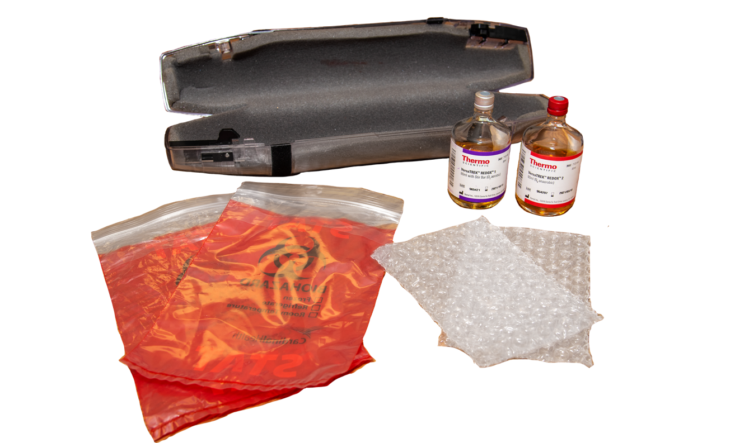
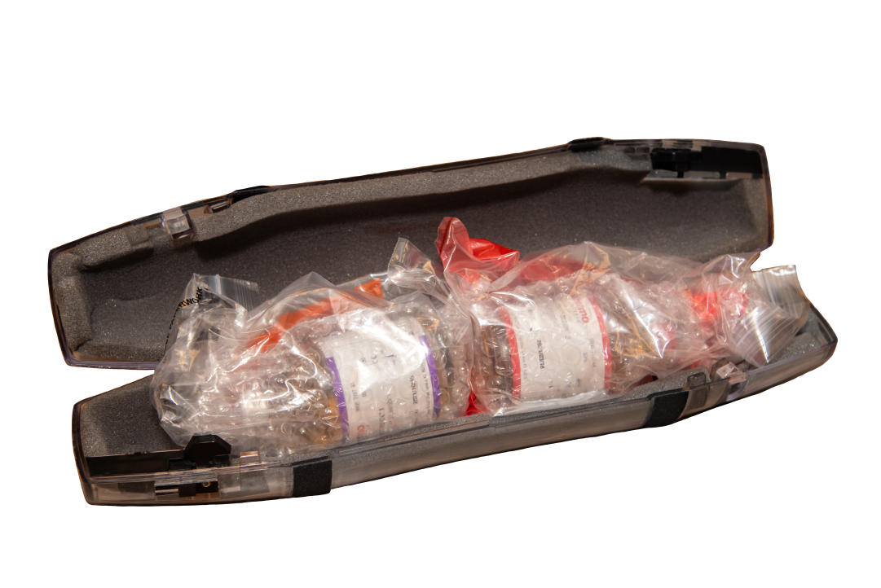
Packaging guidelines- Blood cultures
4” Tube System
Requirements: bubble bag and biohazard bag
Place each bottle in a bubble bag and in a biohazard bag.
Seal bags and place in a foam lined 4” carrier, with bottom of bottles touching.

Slide 16
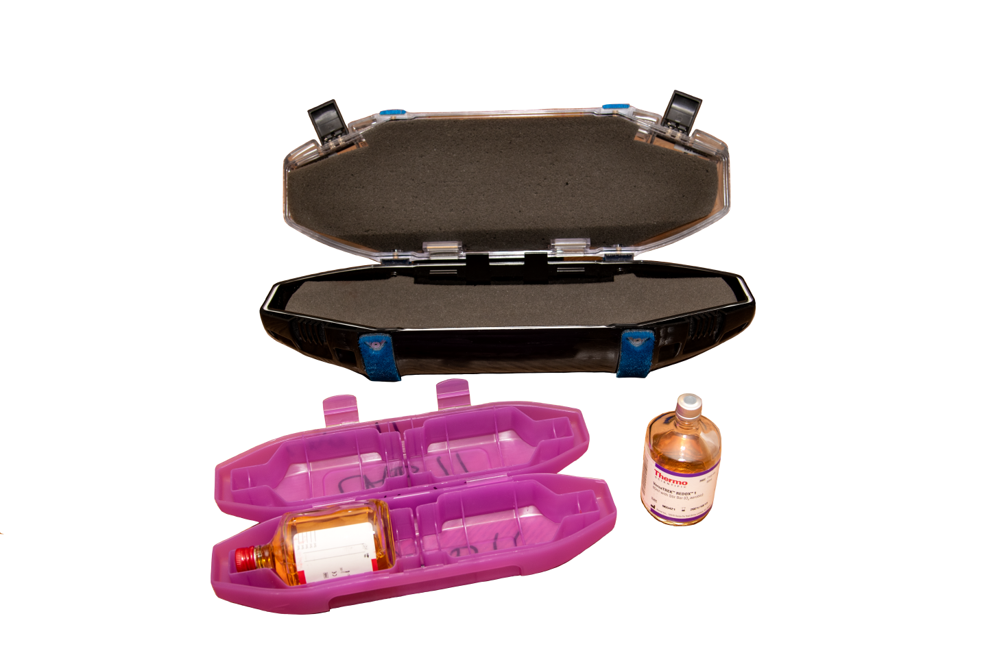
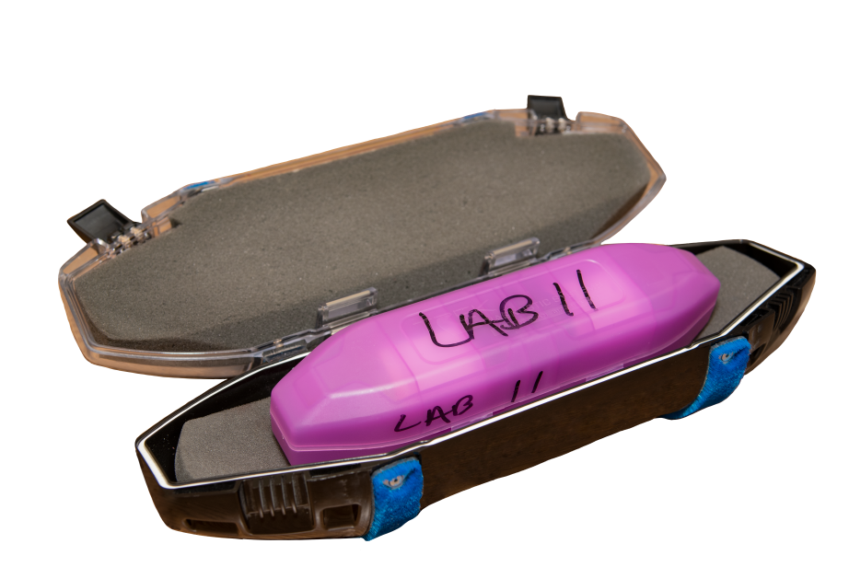
Packaging guidelines- Blood cultures
6” Tube System
Requirements: plastic carrier
Place blood culture
bottles in a plastic carrier prior to placing closed carrier in the foam lined 6” carrier.

Slide 17
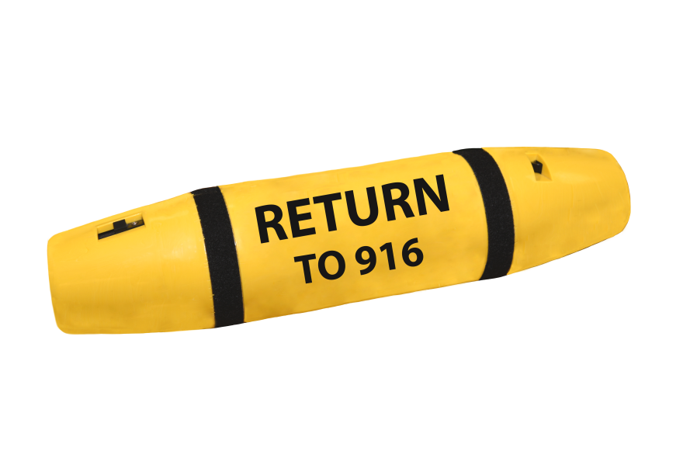
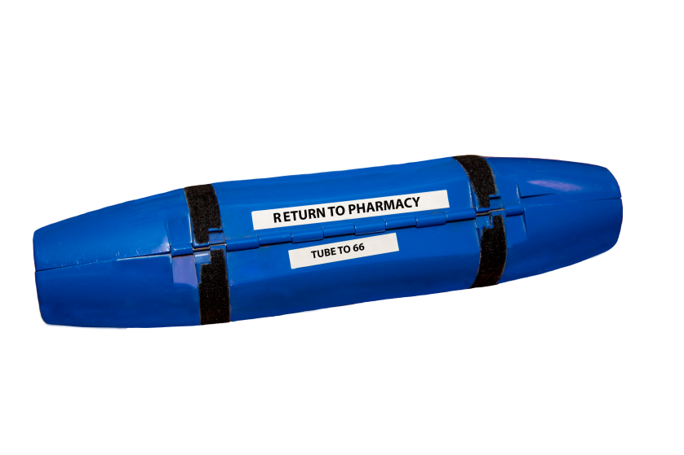
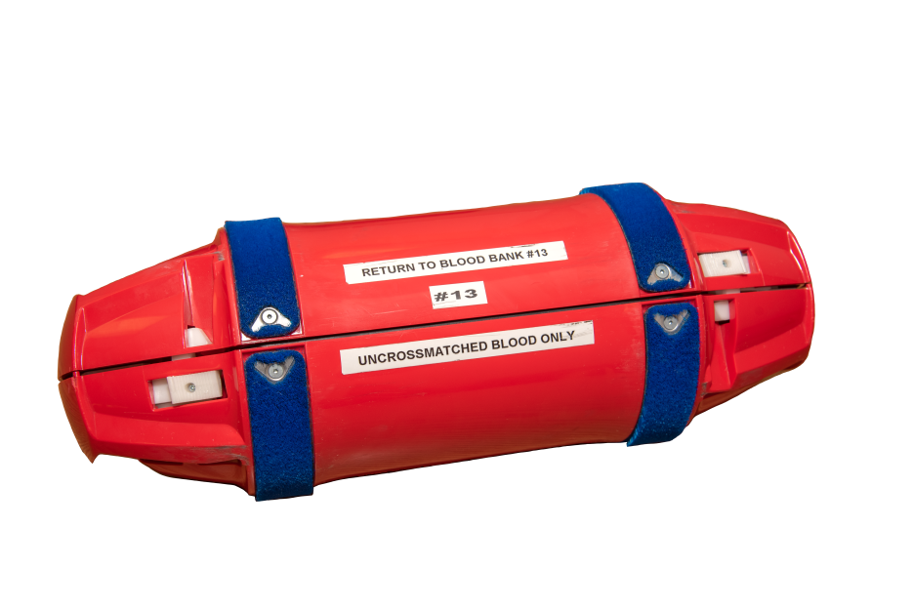
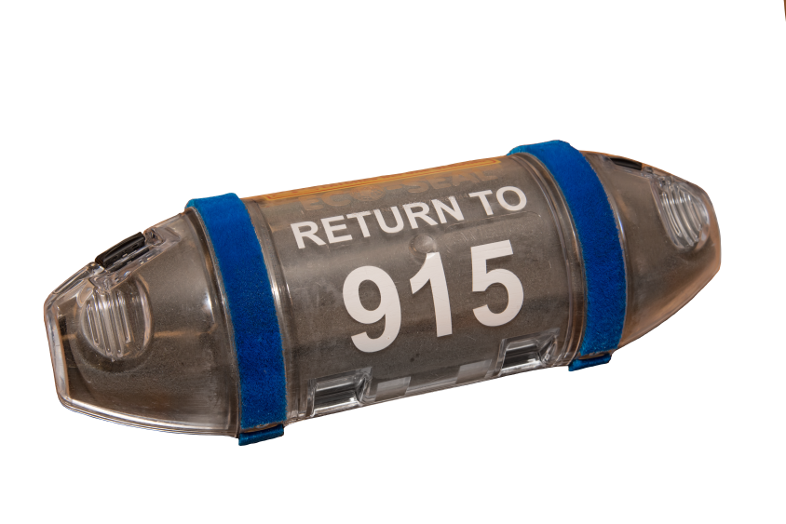
Tube station- nonstandard carrier types
4” BLUE Carriers
4” YELLOW Carriers
Blue carriers are designated for pharmacy
use only. Do not send lab specimens in
these carriers. Return empty carriers to
Station 66
Yellow carriers are for transporting STROKE blood to the Laboratory from TEC
6” BLACK Carriers
6” RED Carriers
Red carriers are used for
UNCROSSMATCHED blood transport
only. Return to Blood Bank station 13
Return Black carriers to the station
indicated on the tube. These
carriers are designated for TEC

Slide 18
Acceptable specimens
for transport in the
Pneumatic Tube System

Slide 19
Acceptable specimens
Urine or stool in screw-top plastic container (less than 120mL).
Blood or body fluids in vacutainer tubes, multiple tubes from one patient may be sent together.
Non-respiratory culture specimens in Culturettes or screw-top sterile containers less than 120mL.
All e-swabs.

Slide 20
Acceptable specimens
Properly packaged blood cultures.
Blood gas specimens in syringe with leur lock tip (within 15 min of collection).
Glass slides in a slide holder.
Blood components per Transfusion Service policy. Do not return empty blood component bags in the tube system.

Slide 21
Unacceptable specimens
for transport in the
Pneumatic Tube System

Slide 22
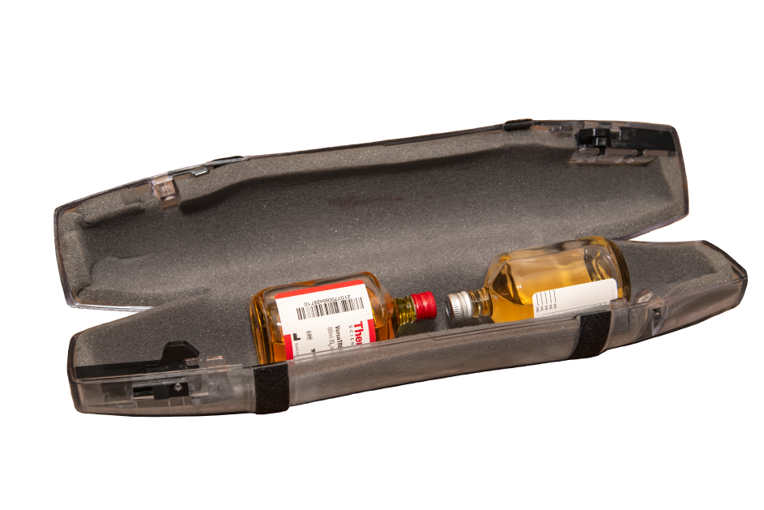
Unacceptable specimens
Respiratory specimens with the potential for infectious aerosolization or droplets including:
Bronchial Alveolar Lavage (BAL)
Sputum
Pleural Fluids
Respiratory washes or aspirates
Pathology and/or cytology specimens.
Irretrievable CSF and body fluid specimens.
Body fluids in bags or glass bottles (exception: properly packaged blood cultures).

Slide 23
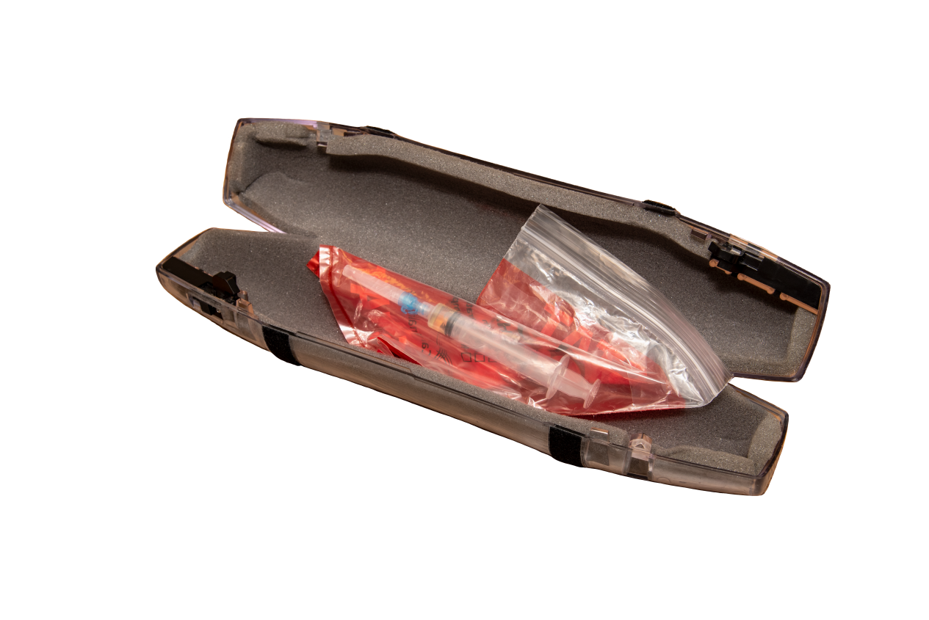
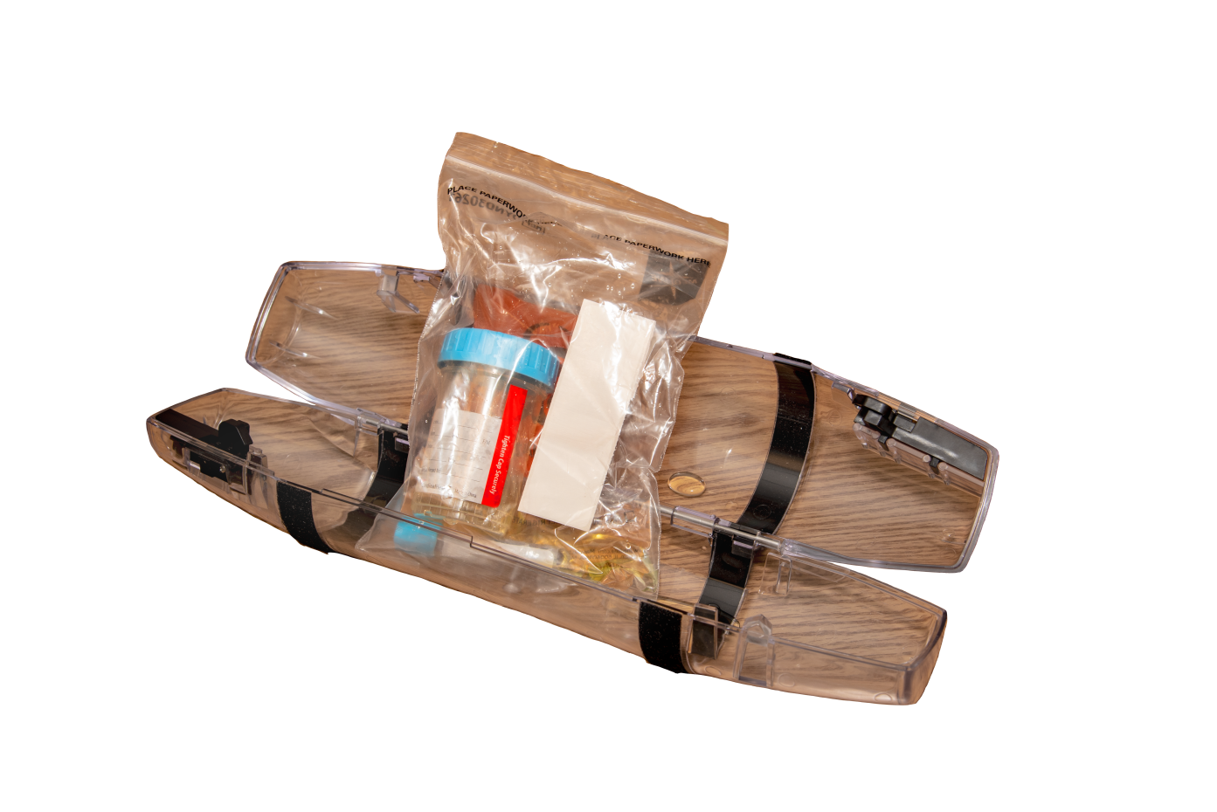
Unacceptable specimens
Specimens with needles attached.
Non-leak tight containers.
Unlabeled specimens.
Spiked blood components.

Slide 24
Reference:
Transport of Specimens in Computerized Tube System
LAB.04.04.01.00

