Slide 1
CELL-DYN Sapphire™ Basic Maintenance
Maintenance Part 1

Slide 2
CELL-DYN Sapphire™ Maintenance
Processing Cover Opening or Removal
The Processor Cover is located in the middle of the front of the Analyzer and fits over the Autoloader, Mixing Assembly and Sample Processing Assembly and is not intended to be removed by the operator during routine operation.
Use the following procedure to remove the Processor Cover as part of maintenance or troubleshooting.
1. If probe is not retracted, select Analyzer>, Special Protocols...,Clean Loader Components to raise the probe and unlock the cover.
2. Disconnect the Open Tube Mode Activation Switch wire, the System is unable to process samples.
Open Tube Mode Activation Switch Wire

Slide 3
CELL-DYN Sapphire™ Maintenance
Processing Cover Opening or Removal continues…
3. From the top of the cover gently pull forward to remove the Locking Tabs from the slots, and then lift up on the cover to remove.

Slide 4
CELL-DYN Sapphire™
Daily Maintenance
Vent needle clean
Auto clean with 10% Bleach Solution
Background check
Run QC
Check moving averages

Slide 5
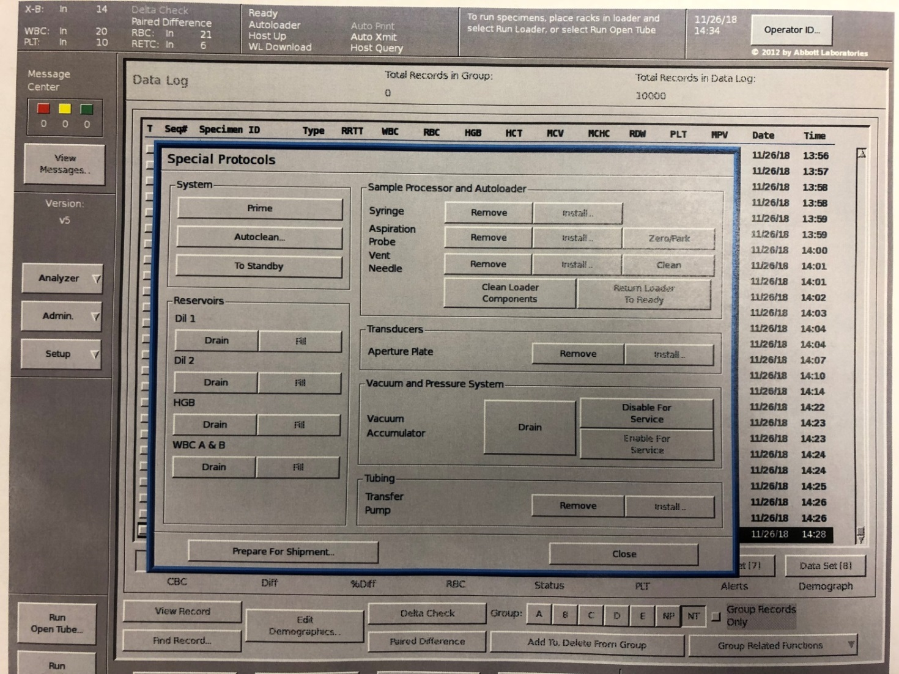
CELL-DYN Sapphire™ Daily Maintenance
Daily Vent Needle Clean- Select the function and allow the instrument to perform the procedure.

Slide 6
CELL-DYN Sapphire™ Daily Maintenance
Daily Auto Clean Procedure
1. Fill a container with at least 5 mL of a 10% Bleach (sodium hypochlorite solution).
2. Select Analyzer> from the Control Panel.
3. Select Special Protocols... from the Analyzer menu.
4. In the SPECIAL PROTOCOLS window, select the Autoclean... button.
5. In the Open Tube Mode sampling area aspirate the 10% Bleach by holding the tube up until the probe touches the bottom of the tube.
6. Press the aspiration switch to activate the Autoclean cycle.
7. Hold the tube in place until two beeps sound, indicating that the 10% Bleach has been aspirated. Do not remove the tube until the probe retracts after the two beeps.

Slide 7
CELL-DYN Sapphire™ Daily Maintenance
Daily Auto Clean Procedure continues…
System Status Region will display Busy: Running Specimen until the Autoclean cycle is complete.
8. Select the Close button to close the SPECIAL PROTOCOLS window.
The Maintenance Log entry window will appear upon completion of the autoclean.
9. When the System returns to Ready status, run two background counts or a Prime cycle to rinse the fluidics. Ensure that background results are within specifications before running
controls.
10. Verify System performance by running controls before running patient specimens.

Slide 8
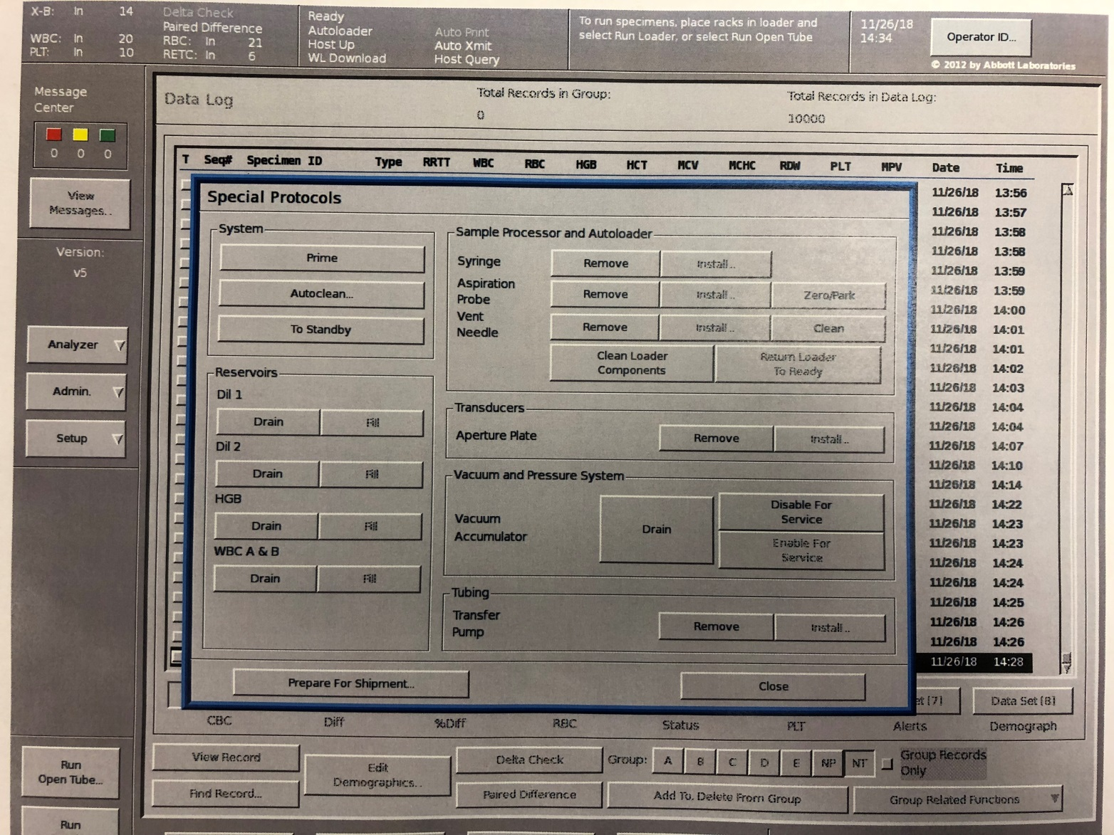
CELL-DYN Sapphire™ Daily Maintenance

Slide 9
CELL-DYN Sapphire™ Daily Maintenance
Run a Background Count
Although the System automatically runs a background count at the end of
Prime, additional Normal and RETC background counts can be run on
demand using the following procedure.
1. Select the Run Open Tube... button to open the NEXT OPEN TUBE
SETUP window.
2. Select the Specimen Type> button.
3. Select Background from the menu.
4. Select Normal from the Sub Type> menu to check the
background counts for the CBC subsystem.
To check the background count for the RETC subsystem, select
RETC from the Sub Type> menu. CBC and RETC background counts
are done when RETC is selected.

Slide 10
CELL-DYN Sapphire™ Daily Maintenance
Run a Background Count continues….
5. Select the Close button to exit the NEXT OPEN TUBE SETUP window.
6. Press the aspiration switch to start the background counting
cycle.
7. Ensure that background counts are within acceptable limits
before running controls and patient specimens.(See next slide)

Slide 11
CELL-DYN Sapphire™ Daily Maintenance
Background acceptability criteria:
 | Background Concentration Limits
 | SI | USA
WBC | ≤ 0.10 x 10 ⁹ /L | ≤ 0.10 x 10³/μL
RBC | ≤ 0.02 x 10¹² /L | ≤ 0.02 x 10⁶/μL
HGB | ≤ 1.0 g/L | ≤ 0.10 g/dL
PLTo | ≤ 5.00 x 10 ⁹/L | ≤ 5.00 x 10³/μL
RETC | ≤ 5.00 x 10 ⁹ /L | ≤ 5.00 x 10³/μL

Slide 12
CELL-DYN Sapphire™ Daily Maintenance
Run Quality Control (Closed mode)
Autoloader Procedure Using QC Labels on Commercial Controls
The following is the recommended procedure for running commercial
controls along with patient specimens in the Autoloader.
1. Place a QC Label corresponding to the desired QC File on each
control tube.
2. Place controls in an Autoloader rack and load racks in the
Autoloader.
3. Select the Run Loader button.
The test selections and limit set information are taken from the setup
criteria in the QC Files. Results for controls are automatically directed to
the QC Files indicated by the QC Labels.

Slide 13
CELL-DYN Sapphire™ Daily Maintenance
Use the following procedure to run quality control specimens in Open Tube Mode.
1. Select Run Open Tube...
2. Select Specimen Type> and select QC.
3. Select Sub type> and choose the target QC file for the first control
sample.
It is not necessary to enter any other processing conditions since
processing will be based on the information in the target QC file.
4. Select Close.
5. Mix the control specimen well, and uncap the tube.

Slide 14
CELL-DYN Sapphire™ Daily Maintenance
Quality control specimens in Open Tube Mode continues…
6. Immerse the end of the extended probe into the control
specimen tube.
7. Press the Aspiration switch.
8. After two beeps sound, remove the tube and recap the
specimen.
9. Repeat the process for remaining control specimens.

Slide 15
CELL-DYN Sapphire™ Daily Maintenance
XB and Moving Average Programs
Moving Average program information is accessed and changed in the Moving Average Shared Region View as shown in the figure below. The Moving Average Shared Region View:
• Provides access to results for all Moving Average Programs.
• Selecting a program button displays those results.
• Current batch data, sealed batches and Levey-Jennings graphs can be displayed. Current batches are the current samples running. Sealed batches are the average of 20 patient samples. This average informs the tech if there might be analyzer issues and indicates data trends that needs to be addressed.
Open this window selecting the QC> button and selecting Moving Average Programs... from the menu.

Slide 16
CELL-DYN Sapphire™ Daily Maintenance
XB and Moving Average Programs
Current batch

Slide 17
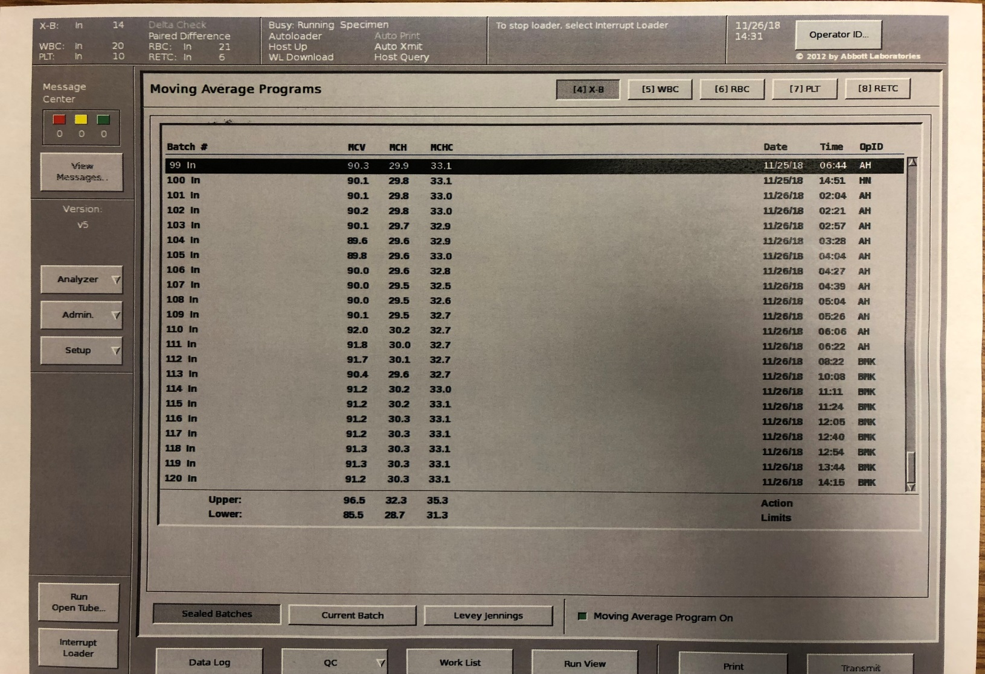
CELL-DYN Sapphire™ Daily Maintenance
XB and Moving Average Programs
Sealed batches

Slide 18
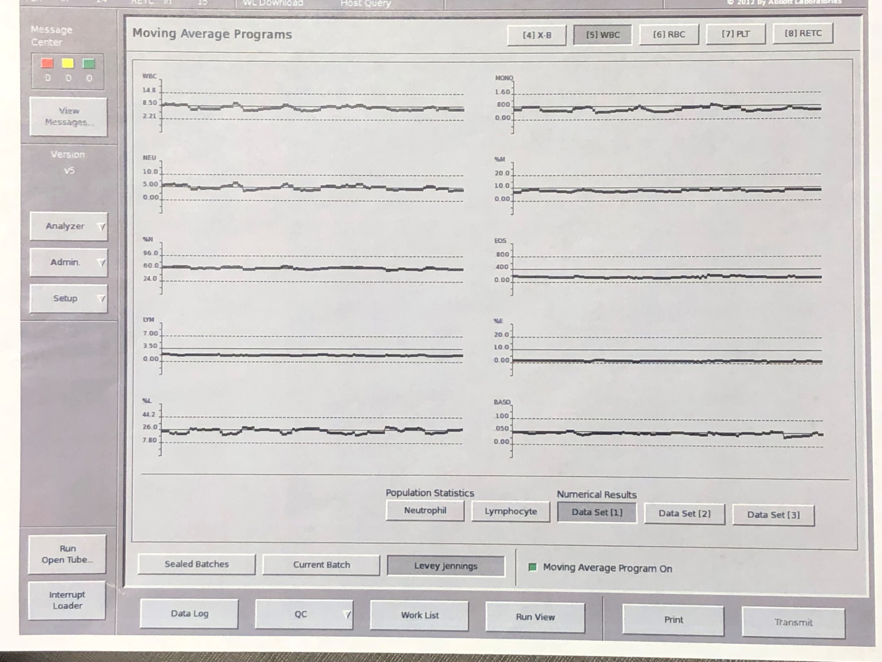
CELL-DYN Sapphire™ Daily Maintenance
XB and Moving Average Programs
Levey Jennings

Slide 19
CELL-DYN Sapphire™
Weekly Maintenance
1. Autoloader Weekly Cleaning
2. HGB Reagent Syringe Cleaning
3. Sample Transfer Pump Tubing Replacement
4. Vent Assembly Unit Replacement

Slide 20
CELL-DYN Sapphire™ Weekly Maintenance
Autoloader Weekly Cleaning
Cleaning the Autoloader Tray, Racks, and Rack Completion Indicators is recommended as a weekly procedure to ensure proper movement of the racks. However, any blood spills in the Autoloader Tray and Rack area, should be cleaned up immediately.
Remove Autoloader Racks
1. Select Analyzer>
2. Select Special Protocols....
3. From the Sample Processor and Autoloader area of the SPECIAL PROTOCOLS window, select the Clean Loader Components button.
4. Wait until a message in the Status Panel area indicates that the System is disabled and prepared for cleaning loader components.
5. Remove the racks from the Autoloader tray. (To remove racks, start with the rack in the right corner the front of the Analyzer. Racks that are closest to the Processing area must be slid towards the front of the Analyzer and lifted straight up for removal.

Slide 21
CELL-DYN Sapphire™ Weekly Maintenance
HGB Reagent Syringe Cleaning
The HGB Reagent Syringe on Syringe Drive A2, (5 mL) is the only syringe on the CELL-DYN Sapphire that should be cleaned monthly. The other syringes can be cleaned as needed.
Removing Syringe
1. Select the Analyzer> button from the Control Panel. Select Special Protocols... from the Analyzer menu.
2. From the Sample Processor and Autoloader area of the SPECIAL PROTOCOLS window, select the Syringe Remove button.
3. Wait until a message in the Status Panel area indicates that the System is disabled and prepared for syringe removal.
4. Open the Right Flow Panel Cover to gain access to Syringe Drive Assembly A.
5. Remove the HGB Reagent Syringe by pulling it straight out.
6. To detach the tubing from the HGB Reagent Syringe, grasp the Luer-Lok fitting at the top of the syringe. Turn the syringe clockwise to release it.
7. Push the syringe plunger in all the way to dispense the reagent into an appropriate waste container.

Slide 22
CELL-DYN Sapphire™ Maintenance
HGB Reagent Syringe Cleaning continues…
Cleaning of Syringe
1. Submerge the syringe in the container of deionized water to remove any crystalline deposits. Aspirate deionized water into the syringe until it is full, but do not remove the plunger from the barrel. Alternately, aspirate and expel the deionized water several times.
CAUTION: Pushing or pulling on the plunger when the syringe is dry could damage the plunger.
2. Dry the outside of the syringe with a paper towel.
Reinstalling Syringe
1. To reattach the tubing to the syringe, place the Luer-Lok fitting on the syringe and rotate the syringe counter-clockwise until it is fingertight.
CAUTION: Be careful not to overtighten the fitting or crimp the associated tubing.
2. Reinstall the HGB Reagent Syringe, making sure that the tubing is not twisted.

Slide 23
CELL-DYN Sapphire™ Weekly Maintenance
Reinstalling Syringe continues…
3. Adjust the plunger depth as necessary. Position the syringe so that the collar of the syringe barrel is clipped into the syringe bracket slot. See the following figure.
4. From the Sample Processor and Autoloader area of the SPECIAL PROTOCOLS window, select the Syringe Install... button.
5. Ensure that the syringe is installed properly and select the OK button.
6. Close the Right Flow Panel Cover.
7. Select the Close button to close the SPECIAL PROTOCOLS window.
8. When the System returns to Ready status, ensure that background results are within specifications before running controls and patient specimens
9. Verify System performance by running controls before running
patient specimens

Slide 24
CELL-DYN Sapphire™ Weekly Maintenance
Sample Transfer Pump Tubing Replacement
Replacement of tubing in the three Sample Transfer Pumps is recommended as a monthly maintenance procedure to ensure proper fluid movement through the Analyzer and prevents leaks. However, optimal frequency can vary from laboratory to laboratory depending on instrument use.
Replace the Sample Transfer Pump Tubing one pump at a time to prevent errors in reconnecting the tubing.
Removing Sample Transfer Pump Tubing
1. Select Analyzer>
2. Select Special Protocols...
3. From the Tubing area of the SPECIAL PROTOCOLS window, select the Transfer Pump Remove button.
4. Wait until a message in the Status Panel area indicates that the System is disabled and prepared for Sample Transfer Pump Tubing removal; then open the Right Flow Panel Cover to gain access to the pumps.

Slide 25
CELL-DYN Sapphire™ Weekly Maintenance
Removing Sample Transfer Pump Tubing continues…
5. While pressing the release lever down, away from the rollers, pull the tubing from under the pump rollers.
6. Remove the tubing from the brackets that hold it on each side of the rollers. (See the following figure.)
7. Disconnect the tubing from the plastic fittings.

Slide 26
CELL-DYN Sapphire™ Weekly Maintenance
Replacing Sample Transfer Pump Tubing
1. Connect the new tubing to the plastic fittings.(See the following figure.)
2. Place the tubing into the bracket guides. Hold the release lever open and push the tubing under the pump rollers. Be sure to position the tubing in the center of the rollers.
3. Ensure that the tubing is not crimped or folded.
4. From the Tubing area of the SPECIAL PROTOCOLS window, select the Transfer Pump Install... button.

Slide 27
CELL-DYN Sapphire™ Weekly Maintenance
Replacing Sample Transfer Pump Tubing continues…
5. Ensure that the Sample Transfer Pump Tubing is installed properly and select the OK button.
6. Close the right Flow Panel Cover.
7. Select the Close button to close the SPECIAL PROTOCOLS window.
8. When the System returns to Ready status, ensure that background results are within specifications before running controls and patient specimens.
9. Verify System performance by running controls before running
patient specimens.

Slide 28
CELL-DYN Sapphire™ Weekly Maintenance
Vent Assembly Unit Replacement
Abbott recommends replacing the Vent Assembly Unit at least every 5,000 Autoloader cycles to maintain optimal performance. Each laboratory should determine its replacement schedule for the Vent Assembly Unit based on the estimated average number of Autoloader cycles run per day. The following table provides guidelines for establishing such a schedule.
Daily Autoloader Cycles Vent Assembly Unit Schedule | Vent Assembly Unit Schedule
725 or more | *at least every week
350 or more | at least every two weeks
250 or more | at least every three weeks
175 or more | at least every four weeks
* Vent needle replacement is performed with weekly maintenance.

Slide 29
CELL-DYN Sapphire™ Weekly Maintenance
Vent Assembly Unit Replacement
Use the following procedure to replace the Vent Assembly.
1. Confirm that the System is in Autoloader mode. If the Autoloader is processing specimens, allow specimens to complete processing or interrupt it.
2. Select the Analyzer>.
3. Select Special Protocols….
4. From Sample Processor and Autoloader area of the SPECIAL PROTOCOLS window, select the Vent Needle Remove button.
5. Wait until a message in the Status Panel area indicates that the System is disabled. Open the Right and Left Flow Panel Covers and remove the Processor Cover for access to the Sample Processing area.
6. Disconnect the tubing from the Vent Head Drain Connector on the back side of the Vent Head Unit above the Centering Cone.
Be careful not to bend or break the connector when removing tubing. (See the following figure.)

Slide 30
CELL-DYN Sapphire™ Weekly Maintenance
Vent Assembly Unit Replacement
WARNING: Potential Biohazard. The Vent Needle is sharp and potentially contaminated with infectious materials. Exercise caution when handling the Vent Assembly Unit. Do not grasp, lift, or handle the Vent Assembly Unit by the Centering Cone. Do not push up on the Centering Cone when handling the Vent Assembly Unit. This will expose the Vent Needle.

Slide 31
CELL-DYN Sapphire™ Weekly Maintenance
Vent Assembly Unit Replacement
7. Release the Vent Assembly Unit from the Vent Assembly Carriage Pivot. Using your thumb and index finger, depress and hold the Vent Assembly Release Button with your thumb while pressing down on the rear end of the Vent Assembly Unit to release the rear pin from the Pivot with your index finger. (See the following figure.)

Slide 32
CELL-DYN Sapphire™ Weekly Maintenance
Vent Assembly Unit Replacement
8. Unhook the front pin and remove the Vent Assembly Unit from the Vent Assembly Carriage hook by slightly tipping the Vent Assembly Unit down and lifting the unit towards the rear of the Analyzer.(See the following figure.)

Slide 33
CELL-DYN Sapphire™ Weekly Maintenance
Vent Assembly Unit Replacement
9. The Vent Assembly Unit can now be removed from the Sample Processor area and discarded in an appropriately marked, puncture resistant container before treatment and disposal. Do not make any attempts to remove the Vent Needle from the Vent Assembly Unit.
10. Reconnect the tubing to the Vent Head Drain Connector on the back side of the Vent Head Unit above the Centering Cone. Be careful not to bend or break the connector when connecting the tubing. (See the following figure.)

Slide 34
CELL-DYN Sapphire™ Weekly Maintenance
Vent Assembly Unit Replacement
11. Hook the Vent Assembly Unit onto the Vent Assembly Carriage by placing the front pin of the Vent Assembly Unit onto the Vent Assembly Carriage Hook and guide the rear pin up and into the Vent Assembly Carriage Pivot to lock the unit in place. (See the following figure.)

Slide 35
CELL-DYN Sapphire™ Maintenance
As-Needed Maintenance
As-needed procedures are performed to prevent or eliminate a problem. These procedures can also be performed in the course of troubleshooting (See Section 10: Troubleshooting and Diagnostics in the Operator’s Manual) or in response to direction from your Country Service and Support Center.
Aspiration Probe Cleaning/Replacement
Aspiration Probe Cleaning
The Aspiration Probe is automatically cleaned in the Autoclean procedure. However, sometimes the Aspiration Probe must be cleaned more thoroughly to remove an obstruction.
1. Select Analyzer>.
2. Select Special Protocols....
3. Select the Aspiration Probe Remove button.
4. Select the Aspiration Probe Install... button.

Slide 36
CELL-DYN Sapphire™ Maintenance
Aspiration Probe Cleaning continues…
Selecting the Install... button leads to an automatic rinse of the
Aspiration Probe.
5. Select the Close button to exit the SPECIAL PROTOCOLS window.
6. When the System returns to Ready status, ensure that background results are within specifications before running controls and patient specimens.
7. Verify System performance by running controls before running patient specimens.
WARNING: Potential Biohazard. The probe is potentially contaminated with infectious materials. Exercise caution when handling the probe

Slide 37
CELL-DYN Sapphire™ Maintenance
Aspiration Probe Replacement
Abbott recommends replacing the Aspiration Probe at least every 360 Autoclean cycles to maintain optimal performance. Each laboratory should determine its replacement schedule for the Aspiration Probe based on the estimated average number of Autoclean cycles per run day. The following table provides guidelines for establishing such a schedule.
Daily Autoclean Cycles | Recommended Aspiration Probe Replacement Schedule
3 | at least every four months
2 | at least every six months
1 | at least every twelve months

Slide 38
CELL-DYN Sapphire™ Maintenance
Removing Aspiration Probe
1. Check the Status Panel area to confirm that the System is in Autoloader mode. If the Autoloader is processing specimens, interrupt it.
2. Select Analyzer>
3. Select Special Protocols...
4. Select the Aspiration Probe Remove button.
5. Wait until a message in the Status Panel area indicates that the System is disabled and prepared for Aspiration Probe removal.
6. Open the Right and Left Flow Panel Covers and remove the Processor Cover for access to the Sample Processing area.
7. Grasp the Aspiration Probe under the collar and push it up slightly to allow access to the base of the tubing.

Slide 39
CELL-DYN Sapphire™ Maintenance
Removing Aspiration Probe continues…
8. Using a hemostat in one hand and holding the probe under the collar with the other, pry up on the base of the tubing using the hold down screw as a leverage point. (See the following figure.)

Slide 40
CELL-DYN Sapphire™ Maintenance
Removing Aspiration Probe continues…
9. Pull out on the retaining clip completely to release the collar of the probe. (See the following figure.)
CAUTION: There is a small spring located on top of the probe. Be
careful not to lose the spring when you remove the probe.
10. Slide the probe down and out of the Aspiration Probe Mount.
11. Gently remove the probe from the Wash Block by pulling it up and to the right, being careful not to bend the probe more than necessary.
12. Remove the spring and set it aside.

Slide 41
CELL-DYN Sapphire™ Maintenance
Replacing Aspiration Probe
1. Replace the spring on top of the probe.
2. Insert the tip of the new probe into the Wash Block by holding the middle of the probe and bending the probe slightly to allow the top of the probe to clear the mount.
3. Move the probe up and down in the Wash Block to ensure that it is moving freely.
4. Push the probe up into the Aspiration Probe Mount.
5. Reinstall and push the Retaining Clip in until its collar is held by the retaining clip.
6. Reattach the tubing by pushing it firmly onto the top of the probe.
7. Be sure that it fits snugly on the probe.

Slide 42
CELL-DYN Sapphire™ Maintenance
Replacing Aspiration Probe continues…
8. From the Sample Processor and Autoloader area of the SPECIAL PROTOCOLS window, select the Aspiration Probe Install... button.
9. Ensure that the Aspiration Probe has been replaced properly and select the OK button.
10. Replace the Processor Cover, ensure the Open Tube Mode Aspiration Switch wire has been reconnected, and close the Right and Left Flow Panel Covers.
11. Select the Close button to exit the SPECIAL PROTOCOLS window.
12. When the System returns to Ready status, ensure that background results are within specifications before running controls and patient specimens.
13. Verify System performance by running controls before running patient specimens

Slide 43
CELL-DYN Sapphire™ Maintenance
Barcode Reader Cleaning
Use the following procedure to clean the Bar Code Reader window as part of troubleshooting bar code misreads. The BAR CODE READER Window is located on the left side of the back of the Bar Code Reader.
CAUTION: Exercise caution to avoid scratching the BAR CODE
READER Window.
1. Select Analyzer>.
2. Select Special Protocols....
3. Select Clean Loader Components
4. Wait until a message in the Status Panel area indicates that the System is disabled and prepared for cleaning components.
5. Open the Right and Left Flow Panel Covers and remove the Processor Cover for access to the Sample Processing area.

Slide 44
CELL-DYN Sapphire™ Maintenance
Barcode Reader Cleaning continues…
6. Remove the Bar Code Reader Shield.
7. With a cotton swab moistened with lens cleaner, clean the glass window with a gentle stroking motion. Stroke in only one direction to avoid smearing. (See the following figure.)

Slide 45
CELL-DYN Sapphire™ Maintenance
Barcode Reader Cleaning continues…
8. Dry it with a lint-free wipe.
9. Replace the Bar Code Reader Shield.
10. Replace the Processor Cover, ensure the Open Tube Mode Aspiration Switch wire has been reconnected, and close the Right and Left Flow Panel Covers.
11. Select the Return Loader to Ready button.
12. Select the Close button to exit the SPECIAL PROTOCOLS window.
13. When the System returns to Ready status, verify Bar Code Reader performance by running a patient or control specimen with a bar code label.

