Slide 1
Alinity h basic run
Training Module / Competency

Slide 2
Basic Tests
The most common tests to process on the Alinity h are:
  CBC w/ Differential
  Hemogram
  CBCM
  Reticulocyte Count
  Hemoglobin / Hematocrit
  Platelet Count
CBC = Complete Blood Count
  Is a test used to evaluate the overall health and detect a wide range of disorders including anemia, infection, and leukemia.
  Hemogram is part of a CBC test but does not include the differential (manual or automated).

Slide 3
Basic Tests
Test Name | Parameters Included
CBC w/ Differential | WBC, RBC, Hemoglobin, Hematocrit, MCV, MCHC, Platelet count, RDW, MPV, and WBC 5-part differential
Hemogram | WBC, RBC, Hemoglobin, Hematocrit, MCV,MCHC, Platelet count, RDW and MPV
CBCM | CBC with Manual 5-part differential
Reticulocyte Count | Reticulocyte
Hemoglobin / Hematocrit | Hemoglobin and Hematocrit
Platelet Count | Platelet

Slide 4
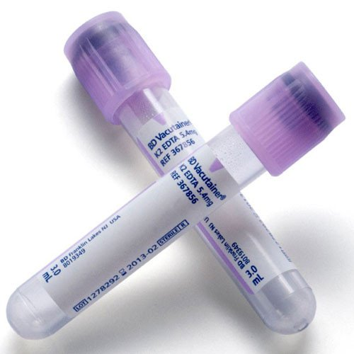
Processing Specimens
Acceptable Specimens for Alinity h-series
  The anti-coagulant of choice for CBC testing is EDTA Lavender-Top Tube
    EDTA = Ethylenediaminetetraacetic acid
      Functions by binding calcium in the blood and keeping the blood from clotting.
      The nominal EDTA concentration is 1.8mg EDTA per milliliter of blood
  The minimum volume required be the analyzer is 340 µL of whole blood
  For patients with “platelet clumps,” a Sodium Citrate Blue-Top is used ONLY to derive the PLT count.
    ***If a sodium citrate tube is used to derive the platelet count, the platelet result from the analyzer MUST be multiplied by 1.1***

Slide 5
Processing Specimens
Testing on the Alinity h can be performed using two main methods of sampling:
  Closed Tube Mode
  Open Tube Mode

Slide 6
Processing Specimen
Closed Tube Mode
  In order to use the Alinity h in a fully automated mode, special specimen racks must be used:
    These racks have a capacity of 10 capped specimens.
    Continual operation allows processed racks to be removed and unprocessed racks to be added without interrupting analysis.
  Microtainers CAN be loaded into racks.
    ***MUST check microtainers for clot before loading into rack!***
  The closed-tube rack can be loaded in either direction so that tube position 1 or tube position 10 faces the operator.
    The module begins to test the tube in tube position 1 first.

Slide 7
Processing Specimens
Open Tube Mode
  Used primarily for STAT specimens.
    Open tube mode will interrupt closed-tube mode to allow techs to prioritize specimens.
  In order to activate open tube mode:
    a tech must press “Open Tube” icon on the main screen of the display.
    On the Test drop-down list, tap a test.
      CBC + Diff
      CBC + Diff + RETIC
    Tap “Reserve” to transition the system to open-tube processing.
      The Alinity h will finish processing the current specimen

Slide 8
Processing Specimens
8 mm diameter tube hole
13 mm diameter tube hole
Bar code label flag holder
Cap pocket: Allows for placement and storage of open-tube cap during processing
15 mm diameter tube hole
11 mm diameter tube hole
Tethered-cap clip
Open Tube Mode
    In the SID box, scan the bar code on the specimen tube or type the SID.
    Mix the specimen.
    Tap “Confirm Tube Mixed”.
    Uncap a well-mixed specimen and place the tube in the appropriate open-tube rack.
    Position the rack so that the tube is located closest to the lane entrance.
      The tube cap can be placed in the indented area on the top of the rack next to the tube location.

Slide 9
Processing Specimen
Open Tube Mode
    Place the open-tube rack in any available routine or STAT lane that is not reserved and push the rack until it clicks into position and locks in the lane.
    The sample handler robot lifts the rack and moves it to the open-tube sampling position inside the module. After sample aspiration is completed, the sample handler robot returns the rack to the lane.

Slide 10
Results Review
Reviewing Patient Results
  The System Control Center (SCC) stores all numerical results, graphical data, and demographic information for Alinity hq modules
  On the Results screen, the operator can view the following information for quality control, calibrators, backgrounds, and patient results for Alinity hq.
    Flag to review record
    Sequence number
    Sample type
    SIDs
    Patient IDs
    Patient names
    Test types
    Module type
    Module serial number and name
    Rack ID and tube position
    Status
    Numerical results only for Alinity hq
    Run date and time

Slide 11
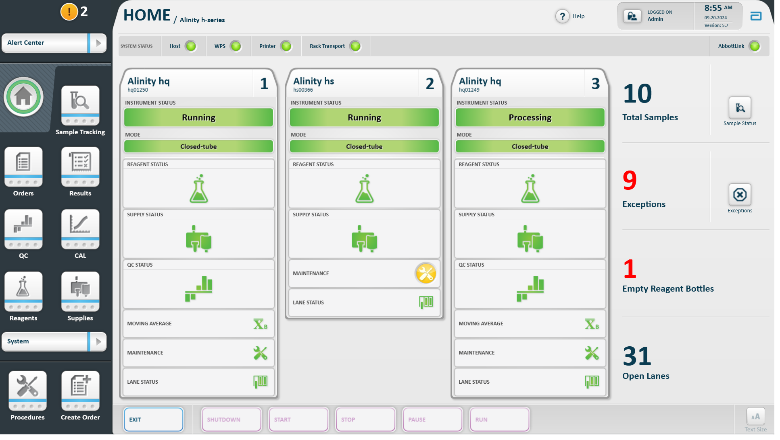
Basic Tests
(Picture of Alinity h result screen)

Slide 12
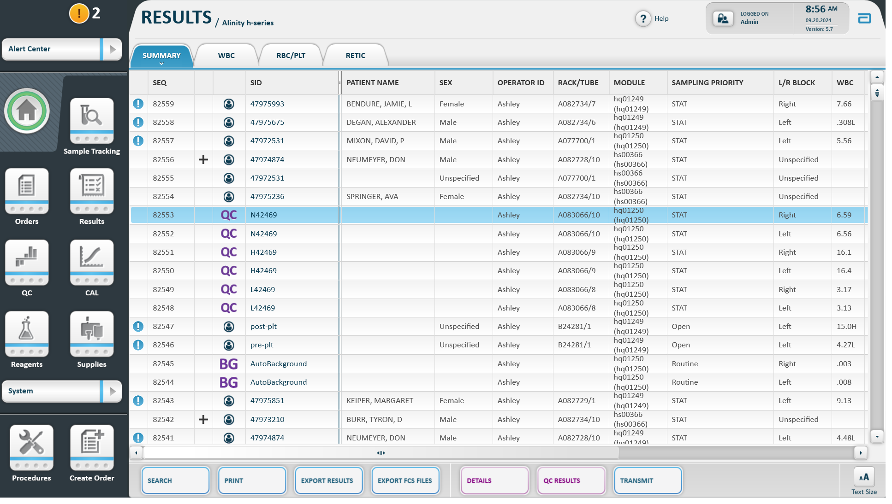
(Picture of results screen)

Slide 13
Results review
Reviewing Patient Results (continued…)
  For a quick view of results, on the “Results Screen” you can review patient/QC/Background results by scrolling through the different tabs at the top of the screen (Summary, WBC, RBC/PLT, RETIC)
  Can perform the following actions from the “Result Screen”:
    Search
    Print
    Export Results (to USB)
    Export FCS Files (exports data w/out patient information)
    Details (look at individual run data and scatterplots)
    Transmit (re-transmit data from completed testing)

Slide 14
Review Results
Reviewing Patient Results (continued…)
  Details View
    Allows tech to see numerical data and scatterplots of individual runs
    Can review different test data by selecting the following side tabs:
      Reportable
        Displays results that are reportable to the patient chart in EPIC and their associated scatterplots.
      Extended
        Displays additional information related to individual sample:
          Reagent Lot #
          Water Quality
          Rack/Tube ID and position of sample
          System Messages and Flags associated with sample run

Slide 15
Review Results
Reviewing Patient Results (continued…)
  Details View
    Allows tech to see numerical data and scatterplots of individual runs
    Can review different test data by selecting the following side tabs:
      WBC
        Displays numerical data and scatterplots related to WBC parameters
      RBC/PLT/RETIC
        Displays numerical data and scatterplots related to RBC, PLT, and RETIC parameters
      RUO
        Displays numerical results for WBC, RBC, PLT, RETIC, and “Research Use Only” parameters
        AKA Lab View

Slide 16
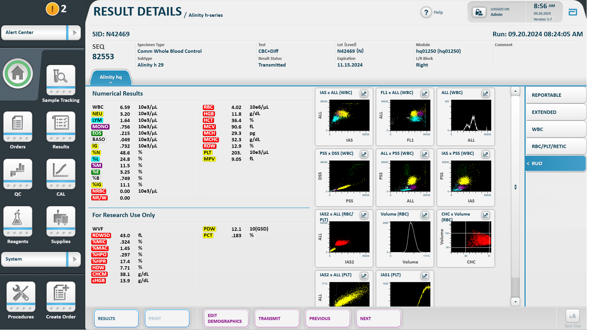

Slide 17
System Messages and Flagging
Data Flagging
  System Messages
    Are used to notify the operator about potential system problems or sample results that may require further review or action.
    Messages and data flags are displayed on the Extended tab of the “Results Details” screen when the system detects conditions that are not appropriate for system operation.
  Flags
    Data flags notify the operator that results for some or all parameters DO NOT meet the acceptance criteria or cannot be displayed.
    On the Result Details screen:
      Invalid Data is displayed in RED and marked with a red "X". The words "INVALID DATA" appear next to the title "Numerical Results".
      Suspect results, the values are displayed in RED.

Slide 18
System Messages and Flagging
Data Flagging
  Flags
    The system uses the following categories of data flags for the Alinity hq:
      Data Flags
      Morphilogical Flags
      Numerical Result Flags
      Conditional Flags

Slide 19
System Messages and Flagging
Data Flags
  Data flags are notifications of potential problems with numerical results that originate from the software algorithm or sample characteristics.
  The data flags notify the operator that results for some or all parameters DO NOT meet the acceptance criteria in the algorithm or cannot be displayed.
  Data flags can also be the downstream effect of morphological flags.
  E.g.
    “HGB Reference Out of Range”
    “MCHC Out of Range. Check Sample Integrity”
    “NEU / LYM / MONO / EOS / BAS / nRBC / IG Boundary Not Found”
    “Outside Analytical Measurement Range”…etc

Slide 20
System Messages and Flagging
Morphology Flags
  Are displayed for a specific parameter or a group of parameters if the system’s evaluation of measurement data indicates the potential presence of an abnormal or immature subpopulation, or interfering substances.
  Morphology flags enable the system to identify and alert the operator to the presence of clinically relevant morphological abnormalities and may warrant further review:
    Slide Review
    Manual Differential
    WBC / PLT Estimate

Slide 21
System Messages and Flagging
Morphological Flag | Display Name | Description
Platelet Clump | PLT Clump | Indicates the presence of platelet clumps (aggregates). Depending on the degree of clumping, triggering this flag may make PLT results suspect or invalid.
Left Shift | Left Shift | Indicates the presence of increased numbers of band neutrophils. Band neutrophils are included in the neutrophil granulocyte count.
Blast | BLAST | Indicates the presence of blast cells. Blast cells can make some WBC differential results suspect or invalid based on the number of blasts.
Variant Lymphocytes | VAR LYM | Indicates the presence of increased numbers of reactive, activated, or abnormal lymphocytes. It may also suggest the presence of blast cells. Variant lymphocytes are included in the lymphocyte count.
RBC Fragments | RBC Frag | Indicates the presence of RBC fragments or schistocytes. RBC fragments can make RBC results suspect or invalid based on the degree of fragmentation.
Unlysed nonfluorescent RBC | rstRBC | Indicates the presence of unlysed RBC (for example, target cells or sickle cells). Unlysed nonfluorescent RBC does not require the correction of WBC results.
RBC Asymmetry | ASYM | Qualitatively indicates asymmetry of RBC volume histograms due to the presence of RBC volume heterogeneity, including but not limited to transfused red cells, reticulocytosis, RBC morphological abnormalities, and clonal disorders. The flag makes MCV and related results suspect.

Slide 22
System Messages and Flagging
Numerical Flags
  Numerical result flags are displayed if a numerical result exceeds its limit or if a problem with a numerical result calculation occurs
  Two Types
    Limit Set Flags
    Calculation Status Flags

Slide 23
System Messages and Flagging
Limit Set Flags
    Displayed if:
      A numerical result falls outside the patient or QC limits for a sample that has been configured by the operator
      A numerical result falls outside the background limits
      A numerical result falls outside the operator’s established reference range
        L = below ref range
        H = above ref range
      A numerical result falls outside the operator’s critical limits
        LL = Critical Low
        HH = Critical High

Slide 24
System Messages and Flagging
Conditional Flags
  Are configured by the supervisor
    Delta Checks
    Interpretive Result Messages
If flagging occurs, appropriate troubleshooting or actions should be performed to investigate and resolve instrument/specimen issues.
  Reviewing slide under microscope
  Checking patient chart for clinical correlation
  Reviewing correlation with past lab results
  Re-running sample (etc…)

Slide 25
Testing Reagents
The Alinity hq requires 6 reagents in order to function properly:
  Diluent Reagent
  Hemoglobin (HGB) Reagent
  WBC Reagent
  Reticulocyte Reagent
  Water from WPS
  AutoClean Reagent

Slide 26
Testing Reagents
Diluent Reagent functions include:
  Fluidics
    Acts as the primary diluting fluid for the RBC, PLT, and RETC samples.
    Primes pumps and flow paths
    Rinses tubing and components at the end of each cycle.
  Measurement
    Prepares each cell for optimal counting and sizing.
    Provides sufficient wetting action to prevent accumulation of air bubbles in the flow system.

Slide 27
Testing Reagents
Cyanide-free Hemoglobin (HGB) Reagent functions include:
  Fluidics
    Primes the HGB reagent tubing.
    Rinses the HGB system.
  Measurement
    Acts as a lysing agent in the HGB dilution by completely destroying the membranes of RBCs.
    Reduces interference from leukocytes by destroying them (and their nuclei).
    Converts HGB to a single chromogen measurable at 540nm.

Slide 28
Testing Reagents
WBC Reagent functions include:
  Fluidics
    Acts as the diluting fluid for the WBC sample.
    Primes the WBC Reagent tubing.
  Measurement
    Maintains WBC integrity and morphology during the measurement process.
    Lyses RBCs and renders them invisible to Analyzer optics.
    Rapidly stains the DNA in the exposed nuclei of any NRBCs or fragile or damaged WBCs present in the sample dilution.

Slide 29
Testing Reagents
Reticulocyte Reagent functions include:
  Fluidics
    Primes the Reticulocyte Reagent tubing.
  Measurement
    Rapidly stains the nucleic acids of cells present in the Reticulocyte dilution.

Slide 30
Testing Reagents
Water (from WPS)
  Fluidics
    Dilutes the AutoClean Solution to a final concentration of 0.525% sodium hypochlorite.
    Acts as a cleaning agent for some Alinity hq module components.
  Measurement
    Serves as a sheath fluid for the Optical Flow Cell
    Serves as a reference blank in the HGB measurement.

Slide 31
Testing Reagents
AutoClean Solution
  Fluidics
    Cleans the internal pathways of the Alinity hq module.
    6% sodium hypochlorite solution.
      The solution is combined with clinical laboratory reagent water (CLRW)-compliant water from the external water purification system to provide the final 0.525% sodium hypochlorite concentration.

Slide 32
Testing Reagents
The Alinity hs requires the following reagents and supplies in order to function properly:
  Reagents
    Smear Fix
    Wright-Giemsa Stain
    Phosphate Buffer
  Supplies
    Glass Slides
    Smear Tape Cartridge
    Slide Label Cartridge

Slide 33
Testing Reagents
Smear Fix
  Fixes and provides permeability of the cells in preparation for staining
  Preserves the morphology of the cells

Slide 34
Testing Reagents
Wright-Giemsa Stain
  Provides Romanowsky dyes (a variety of thiazines and eosins) that are required to stain blood films.
  These dyes impart coloration to cells and other blood elements to enable
    the differential identification of cells
    quality assessment of cell morphology for diagnostic purposes.

Slide 35
Testing Reagents
Phosphate Buffer
  Maintains optimal pH for staining that contributes to the reliability of the stain quality.
  Promotes the appropriate conditions for the interaction of the dyes and color production.
  Provides rinsing solution for the stained slides and the aspiration probe.
  Rinses the aspiration and pierce probes between samples.

Slide 36
Testing Reagents
Glass Slides
Slide Label Cartridge
  a ribbon that uses thermal transfer printing on the print area of the glass slides.
Smear Tape Cartridge
  contains a roll of spaced smear blades that make contact with the blood drop
  The smear blades are single use only:
    prevents used blades from making contact with unused blades
    Eliminates carryover between specimens

Slide 37
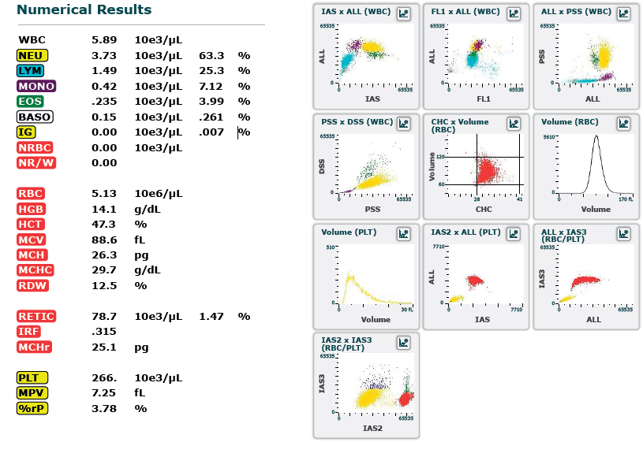
Data Presentation
WBC Parameters
Scatterplots and Histograms
RBC Parameters
PLT Parameters

Slide 38
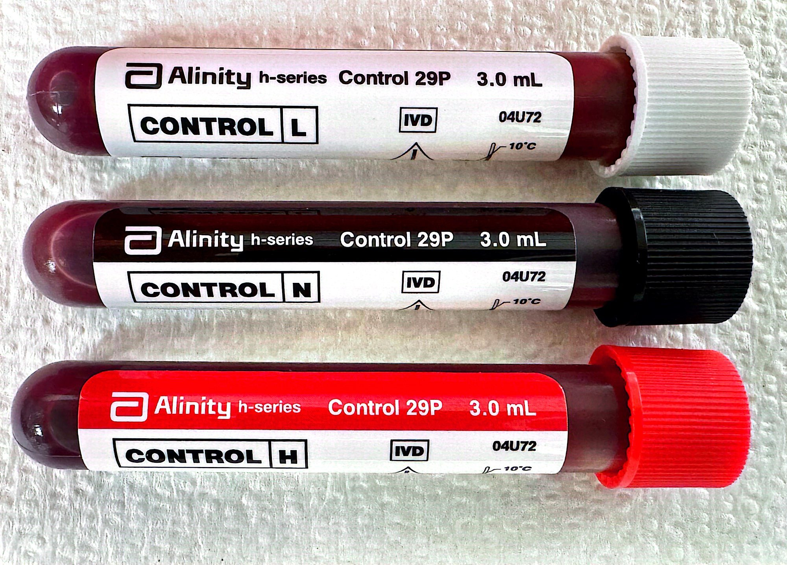
Quality control
Quality controls are run on every shift to ensure the instrument is performing as expected and to ensure accurate patient results.
  QC specimens are of a known value range.
    Low
    Normal
    High
  Analyzer result must fall within this range to pass.
  Any failures of QC requires a rerun of QC or additional troubleshooting in order to resolve the discrepancy.

Slide 39
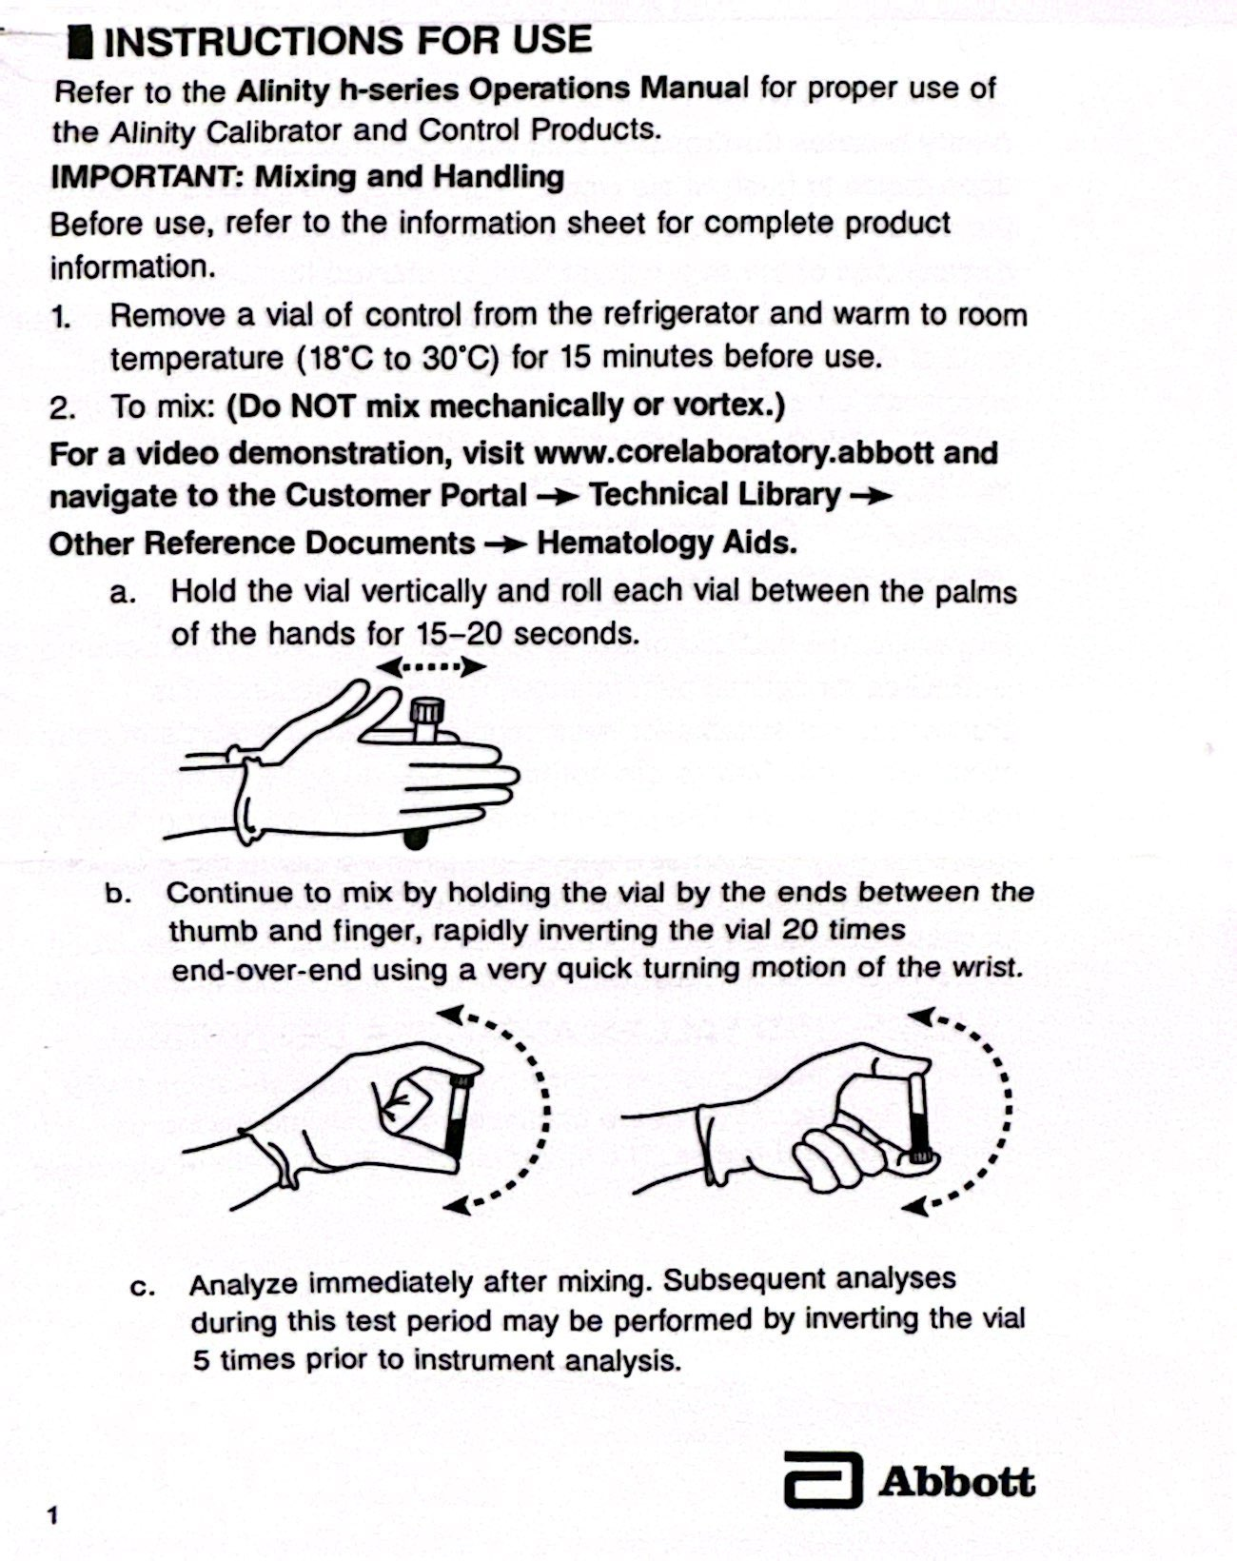
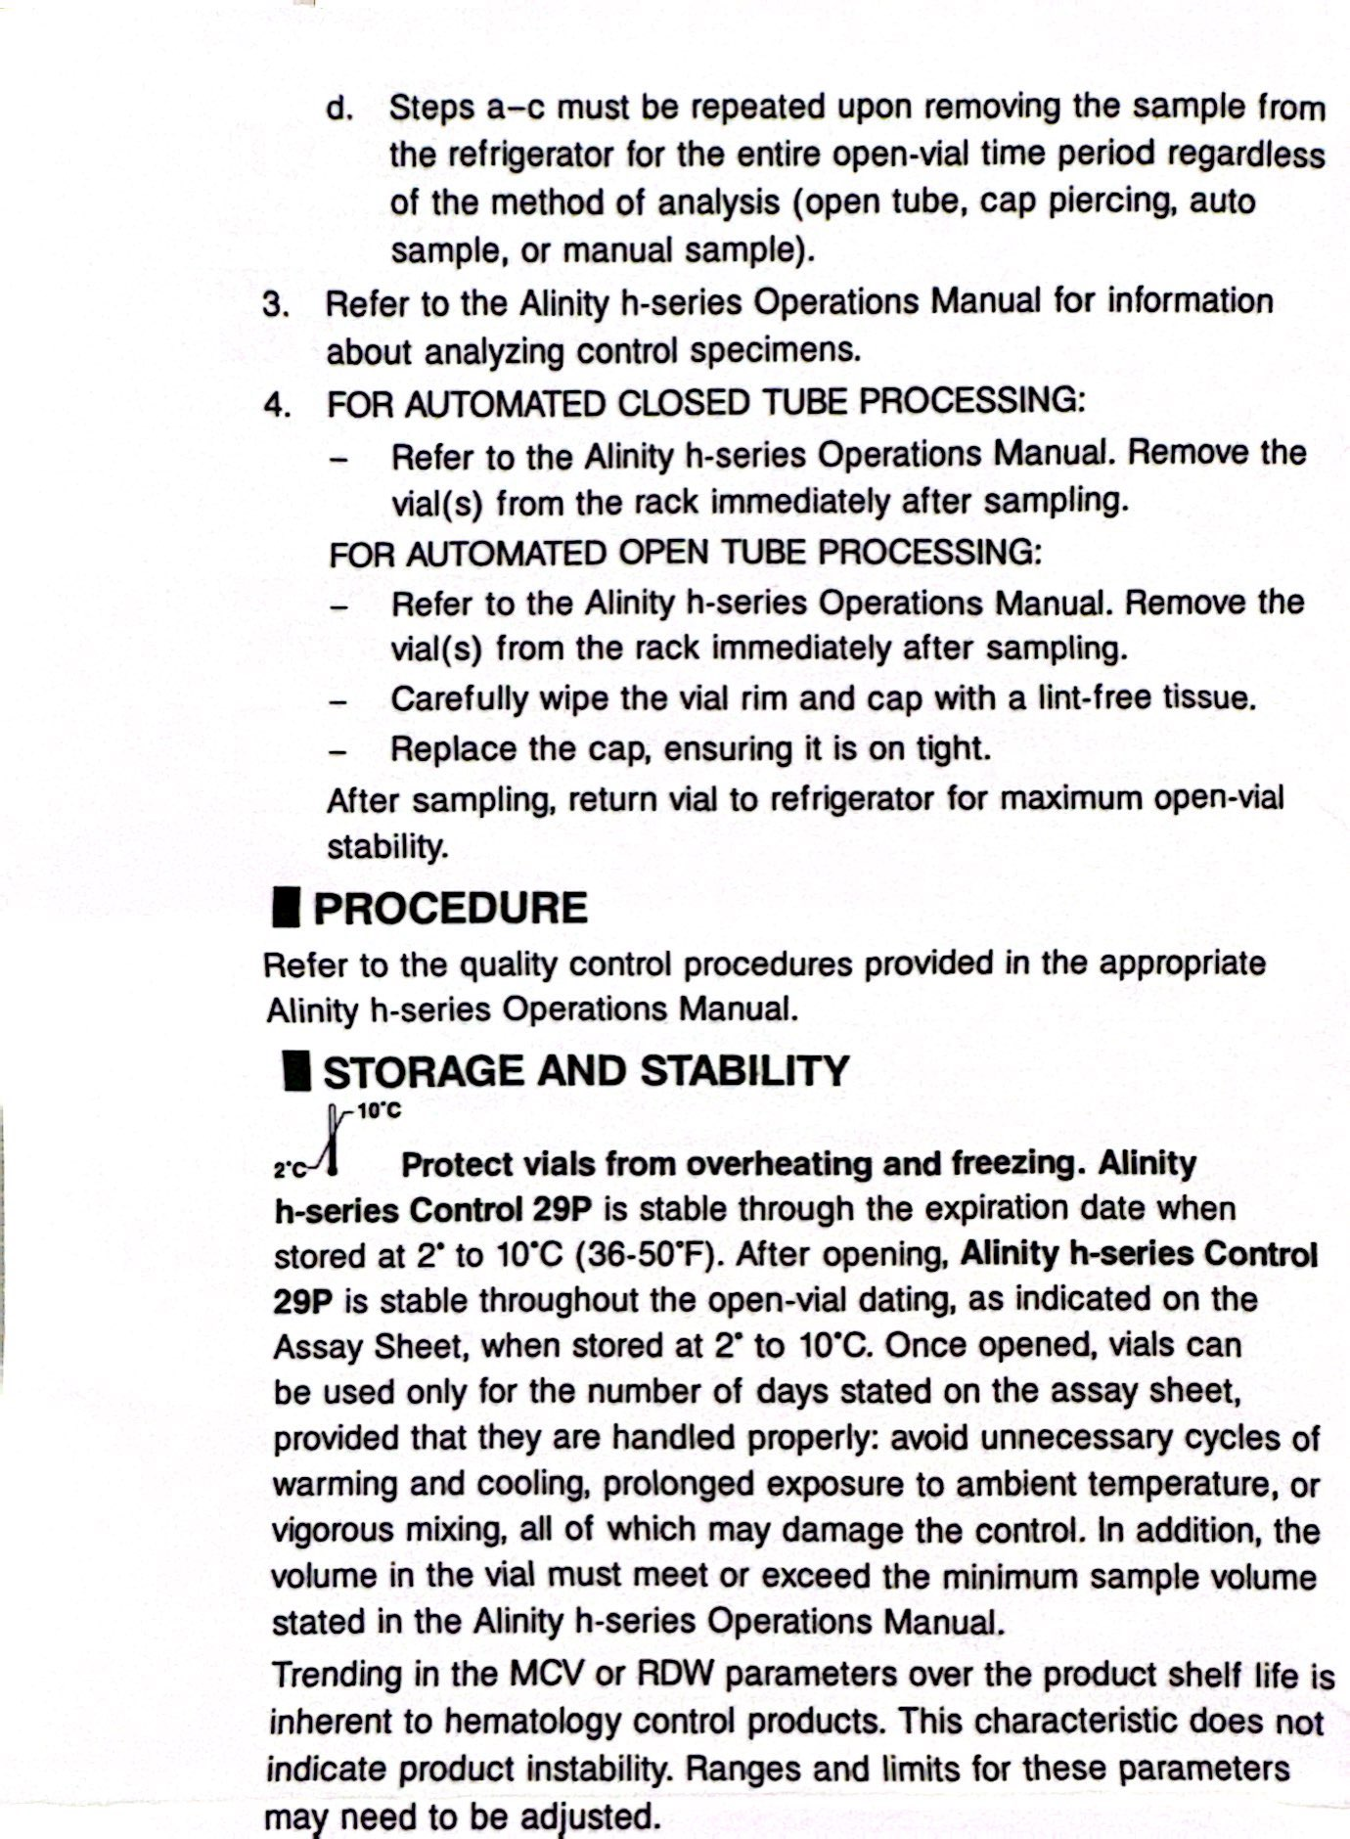

Slide 40
Quality Control
Running Controls
Load the quality controls into an close-tubed rack and place on a lane of the instrument.
After analysis, view the results to ensure there are no results out of range.
  Failed QC will have a “!” by it
    “H” values are high.
    “L” values are low.
    “X” means invalid
  MUST resolve QC failures and document corrective action before continuing patient testing.
    Perform Background Check
    Re-Run QC
    New QC
    Change Reagent
    Perform Daily/Weekly/As-Needed Maintenance
    Perform Calibration
    Call Customer Service

Slide 41
Quality Control
Check XB and Moving Averages
  Provides the tech with information regarding the instrument’s performance over time.
    Levy-Jennings displays the patient values plotted over time.
    Sealed batches are averages of 20 patient samples.
    Current batch is the current group of 20 sample being run.
  Uses the patient’s data to monitor population values and instrument performance
    If moving average error occurs, it may indicate a systemic error that is contributing to a bias or shift in analysis and needs tech intervention.
      Can detect changes in sample handling, reagents, instrument performance

Slide 42
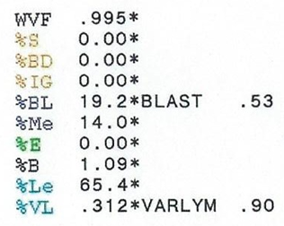
Troubleshooting
The Alinity h will sometimes display an error message/code after a run has completed. This information will help the tech in determining the next course of action.
  BAND, IG, BLAST, VARLYM
    Immature or questionable cells detected
    manual differential is required for further investigation.
  rstRBC
    A significant number of lyse-resistant RBCs are suspected of being present
      Causing the WBC and nRBC results to be inaccurate/false
      Usually due to either sickle cell or fetal cell interference
    Check specimen for clot
    Make a slide for manual review
    RR Specimen on another module

Slide 43
Troubleshooting
The Alinity h will sometimes display an error message/code after a run has completed. This information will help the tech in determining the next course of action.
  PltClmp
    PLT clumps are suspected of being present during WBC analysis
    Check specimen for clot
    Make a slide for manual review
    Vortex specimen for 2 min. and rerun (DO NOT RELEASE PATIENT RESULTS!!!)
    if platelet clumps are present in first drawn specimen → recollect
      Verified by tech under a microscope
    If PLT Clumps present in redrawn specimen
    Put in “PLT CLMP Flag” in patient’s chart with the following comment
      “When collecting Hemg, CBC, CBCM, please draw a PURPLE top (EDTA) and BLUE top (Sodium Citrate) together and send down to lab.” → Put in specimen for redraw

Slide 44
Troubleshooting
PltClmp (continued…)
  When purple and blue top arrive:
    Purple Top
      run purple as normal → PltClmp Flag? → check specimen for clot → make a slide → vortex and rerun
    Blue Top
      run blue top with SID barcode blacked-out
        PLT count valid → multiply PLT value by 1.1
        PLT value invalidated and PLT CLMP Flag still? → Check for a clot → make a slide → vortex and rerun
  Diffing Tech will review Purple and Blue Top peripheral smears under the scope and perform PLT estimate if necessary.
    PLT Estimate from Blue Top slide? → Multiply estimate by 1.1

Slide 45
Troubleshooting
The Alinity h will sometimes display an error message/code after a run has completed. This information will help the tech in determining the next course of action.
  Lipemic Specimens
    Patient’s blood contains high lipid content
      MCHC is falsely elevated (>37)
      Hgb is falsely elevated
    Place specimen in warmer for 30 min.
    Make a slide for manual review
    Remove specimen from warmer, mix, and immediately rerun
    If MCHC is still too high → perform Saline Replacement
Notes:
Hgb measurement is based on turbidity (how much light is transmitted and absorbed)

Slide 46
Troubleshooting
The Alinity h will sometimes display an error message/code after a run has completed. This information will help the tech in determining the next course of action.
  Cold Agglutinins
    Cold autoantibodies are present in specimen
      MCHC is falsely elevated (>37)
      RBC and Hct are falsely decreased
    Place specimen in warmer for 30 min.
    Make a slide for manual review
    Remove specimen from warmer, mix, and immediately rerun
    If MCHC is still too high → perform WARM Saline Replacement
Notes:
Why confirm Hct manually? → Don’t want to use a calculated value to measure another calculated value → MCHC = (Hgb/Hct) x 100

Slide 47
Troubleshooting
The Alinity h will sometimes display an error message/code after a run has completed. This information will help the tech in determining the next course of action.
  Saline Replacement:
    Mix the specimen well and aliquot a portion into a bullet centrifuge test tube
    (Cold Agglutin → Warm saline and an aliquot of the whole blood specimen for 30 minutes)
    Spin down the aliquot and mark the top of the plasma level
      Centrifuge at 2,000 rpms for 5 minutes
    Carefully remove and discard the plasma layer
    Replace the plasma with the same amount of saline
      For Cold Agglutin use warm saline
    Mix well, and rerun
      Cold Agglutin → Incubate the specimen again before mixing and rerunning

Slide 48
You are now ready to take the test.

