Slide 1
High Sensitivity Troponin
SFH Core Lab - Chemistry Department

Slide 2
Summary and Explanation of Test
Background:
  Cardiac troponin I is a regulatory subunit of the troponin complex associated with the actin thin filament within cardiac muscle cells. Troponin I, in conjunction with troponin C and troponin T, plays an integral role in the regulation of muscle contraction.
  Three distinct tissue-specific isoforms of troponin I have been identified from skeletal and cardiac muscles. The cardiac isoform exhibits only 60% similarity with the skeletal muscle isoform and contains additional amino acids at the N-terminus.
    cTnI has a molecular weight of approximately 24,000 daltons.
  Cardiac troponin I reaches peak concentrations in approximately 8 to 28 hours and remains elevated for 3 to 10 days following MI. Cardiac troponin is the preferred biomarker for the detection of myocardial infarction based on improved sensitivity and superior tissue-specificity compared to other available biomarkers of necrosis, including:
    CK-MB, myoglobin, lactate dehydrogenase, and others.

Slide 3
Summary and Explanation of Test
Background:
  The high tissue specificity of cTnI measurements is beneficial for identifying myocardial infarction in clinical conditions involving skeletal muscle injury resulting from surgery, trauma, extensive exercise, or muscular disease.
  High tissue specificity of cTnI, however, should not be confused with the specificity for the mechanism of injury (e.g., MI versus myocarditis).
    When an increased value for cTnI is encountered (e.g., exceeding the 99th percentile of a reference control population) in the absence of evidence of myocardial ischemia, other etiologies for cardiac damage should be considered. Elevated troponin levels may be indicative of myocardial injury associated with:
      Heart Failure
      Renal Failure
      Chronic Renal Disease
      Myocarditis
      Arrhythmias
      Pulmonary Embolism
      Other clinical conditions.

Slide 4
Summary and Explanation of Test
Background:
  Per the fourth universal definition of MI, the term myocardial injury should be used when there is evidence of elevated cardiac troponin (cTn) values with at least one value above the 99th percentile upper reference limit (URL).
  The myocardial injury is considered acute if there is a rise and/or fall of cTn values.
    The term acute myocardial infarction should be used in specific situations when there is acute myocardial injury with clinical evidence of acute myocardial ischemia and with detection of a rise and/or fall of cTn values with at least one value above the 99th percentile URL and at least one of the following:
      symptoms of myocardial ischemia
      new ischemic electrocardiogram (ECG) changes
      development of pathological Q waves
      imaging evidence of new loss of viable myocardium or new regional wall motion abnormality in a pattern consistent with an ischemic etiology
      identification of a coronary thrombus by angiography.

Slide 5
Summary and Explanation of Test
High Sensitivity Troponin (hs-Tnl) Assay
  Defined as assays which can achieve less than or equal to 10 %CV at the 99th percentile of a healthy population and are capable of detecting troponin in greater than 50% of both men and women individually.
  Clinical studies have demonstrated the release of cTnI into the blood stream within hours following MI or ischemic injury. High sensitivity assays can detect elevated levels of cTnI (above the 99th percentile of an apparently healthy reference population) within 3 hours after the onset of chest pain.
  This assay is an automated, two-step immunoassay for the quantitative determination of cTnI in human plasma (lithium heparin) using chemiluminescent microparticle immunoassay (CMIA) technology.

Slide 6


Principle of Testing
Sample and Anti-troponin I antibody coated paramagnetic microparticles are combined and incubated.
The cTnI present in the sample binds to the anti-troponin I coated microparticles. The mixture is washed.
Anti-troponin I acridinium-labeled conjugate is added to create a reaction mixture and incubated. Following a wash cycle, Pre-Trigger and Trigger Solutions are added.
The resulting chemiluminescent reaction is measured as a relative light unit (RLU). There is a direct relationship between the amount of cTnI in the sample and the RLU detected by the system optics.
+
+
+
+

Slide 7
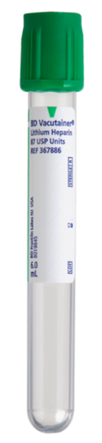
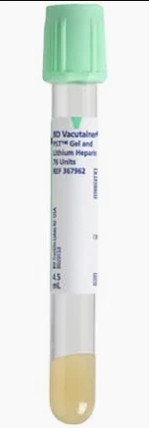
Specimen Collection, Processing, and Stability
Collection
  Plasma collected in lithium heparin tubes with or without gel separator can be used for the STAT High Sensitivity Troponin-I Assay
  Specimens should be filled ≥ 50%
    Short Samples can interfere with testing
  Do NOT test grossly hemolyzed specimens.
  EDTA is NOT an acceptable tube type for collection for SFH.
Processing
  Samples should be centrifuged at 4500 rpm for 3 minutes for complete separation.
  Inspect specimens for particulates. If present, mix and centrifuge the specimen to remove particulates prior to testing.
  Inspect all samples for bubbles and remove any bubbles present before sample analysis
  The minimum sample volume required to perform STAT hs-TnI test = 260 µL
Storage
  Centrifuged samples may be stored up to 8 hrs at 15-30ºC prior to being tested.

Slide 8
Dilution Protocol
Samples with a cTnI value exceeding 3600 ng/L are flagged with the code “>3600 ng/L” and may be diluted with the Automated Dilution protocol
  The analyzer performs a 1:30 dilution of the sample and automatically calculates the concentration by multiplying the result by the dilution factor.
**No dilutions may be performed on any specimen beyond the 1:30 auto-dilution.**
  Auto-diluted samples with a cTnI value exceeding 60,000 ng/L are flagged with code “>60,000 ng/L”
  Manual dilutions are NOT acceptable per the package insert.
  Any physician requesting this needs to be transferred to Dr. Wayne or Dr Thompson.
    Internal studies show there is no acceptable diluent for troponin.
    “Dilutions” performed by the instrument is actually a change in patient/reagent ratio.

Slide 9
Interpretation and Reporting
Reportable Interval for Alinity-i STAT hs-TnI Assay
  Reportable Interval: 3 – 60,000 ng/L
  High-sensitivity troponin cannot be correlated to “traditional” troponin.
    Correlation studies failed both at the low range and the wider AMR range.
Results
  rounded to the nearest whole number.
  **We do NOT report out decimal places over the phone.**
  If you are reading results from the instrument we’ve included the decimal place for QC reasons, however for patients, always round the number to the closest whole number.

Slide 10
Interpretation and Reporting
Established Normal Reference Ranges
  Female: 0-14 ng/L
  Male: 0-35 ng/L
  Unknown: 0-27 ng/L
  Normal ranges are based on 99th percentile of normal health USA population.
  Any question that is related to “unknown” gender range or flags:
    Unknown gender situation occurred due to the troponin orders being entered into EPIC prior to gender demographic being entered into the patients chart. Unknown ranges were added as a safety measure to ensure these patients didn’t have an abnormal troponin slip thru the system unnoticed.
    If gender specific ranges/flags are desired, then they will need to place another troponin order set into Epic after the demographics are updated. Lab can then manually enter the results and credit the previous order.
Abnormal Troponins
  Elevated troponin does NOT differentiate acute from chronic.
  This type of diagnosing is NOT something the lab is equipped to do.
    Elevated troponin duration in plasma varies patient to patient due to a number of factors like
      initial trauma
      continued tissue death
      renal function
      other factors
  The reason for Abnormal Troponin results is NOT something the lab can speculate on.
  What the Lab can say:
    “Abnormal troponin level was detected which suggest a myocardial injury has occurred.”

Slide 11
Interpretation and Reporting
Only need to call one time for the first Abnormal / Positive hs-TnI result
Initial Positive Troponins
  Initial Positive Troponins per visit
    Will be called to a care team member and comm-logged in EPIC if it’s the first abnormal/positive result.
    Initial Positive Troponins >3,600 ng/L
      Will be called immediately to a care team member, comm-logged in EPIC, and resulted.
      Lab will correct with diluted troponin results ONLY when requested by the physicians.
        Any physician complaints about this workflow should be directed to Dr. Wayne or Dr. Thompson.
        Any nursing complaints about this can be directed to the Core Lab Manager.
Positive Troponins After “Initial Positive”
  All positive troponins after the “Initial Positive” will wait until the dilution is completed before resulting.

Slide 12
Interpretation and Reporting
Initial Positive Delta’s
  Will be called to a care team member and comm-logged in EPIC, if it’s the first abnormal/positive result.
Negative Delta’s
  These will not flag and this is by design.
  Negative deltas in abnormal ranges are expected.
    Large delta’s within normal range are highly unlikely.
  Negative Delta ≥ 6 within the normal range would indicate an issue with the baseline, 1 hour, or 3 hour sample and the lab tech should perform the following actions:
    Visual inspection of the tube
    Repeat testing
    Other instrument troubleshooting steps should be taken
**No one should try and interpret Delta values, or their meaning.**
  This is a very complicated subject that requires a great deal of patient information to accurately identify the cause of an increase or decrease of troponin.
  What the lab can say: “Increase in troponin was detected from the baseline which suggest myocardial injury.”
Notes:
Only need to call one time for what ever the first abnormal is

Slide 13
Additional Notes
Add-ons
  MUST be samples within 8 hrs of collection
  ONLY the lab can add-on a 0 hr,1 hr, or 3 hr hs-troponin
    Careful attention to timing of collections needs to be considered if any lab personal add-ons these test to previously collected samples.
  Non-lab personal can ONLY add-on the random troponin test
    This test does NOT offer the delta calculation. This is intentional.
Physician Questions/Complaints
  Physician clinical questions received by any lab phone should be directed to Dr. Wayne or Dr. Thompson.
  Warren Clinic Physician complaints about TAT need to be directed to Jay
    CC Mat Pollard and William Stevens
    Please include as many facts as possible about the complaint.
Non-Physician Questions/Complaints
  Any non-physician complaints/questions you don’t feel able to address from:
    RN
    RN manager
    Doctors office manager
  Direct these Q’s and/or complaints to William Stevens phone and/or email, or to Jay Hupp’s if they ask for him specifically.

Slide 14
Additional Notes
Normal Range Canned Comment​
  “Result is within 99th percentile of healthy individuals. Immunochemical evidence does not suggest myocardial injury at this time. Serial determinations at timed intervals are recommended to detect elevated levels and to rule out acute myocardial damage.​”
Abnormal Range Canned Comment​
  “Elevated test result is suggestive of myocardial injury. Conditions other than myocardial infarction can also elevate troponin including other cardiovascular disease, severe infection, pulmonary embolism, and renal failure. Correlate results with the clinical presentation.​”
Abnormal Delta Canned Comment​
  “The change in troponin level is suggestive of myocardial injury. Conditions other than myocardial infarction can also elevate troponin including other cardiovascular disease, severe infection, pulmonary embolism, and renal failure. Correlate results with the clinical presentation.​”
  Normal Reference range results with abnormal delta flag will suppress the normal reference range comment leaving only the abnormal delta comment.​
  **Abnormal delta canned comment only triggers for an abnormal delta with a positive increase from baseline. Negative delta values or “normal” delta changes will result in no delta canned comment.​**

Slide 15
High Sensitivity Troponin Flow Chart
(see image)
High-sensitivity Troponin Flow Chart
  Algorithm was approved by Cardiology, TEC, and pathology.
  Physician questions about this should be directed to Pathology.
  Nursing questions about the algorithm or workflow sheet should be redirected to the ordering provider.
Positive Troponin (Abnormal Result)
  hs-TnI results that exceed normal reference range for M/F = Abnormal Result / Positive Troponin
  Females: cTnI > 14 ng/L
  Males: cTnI > 35 ng/L
  Unknown: cTnI > 27 ng/L

Slide 16
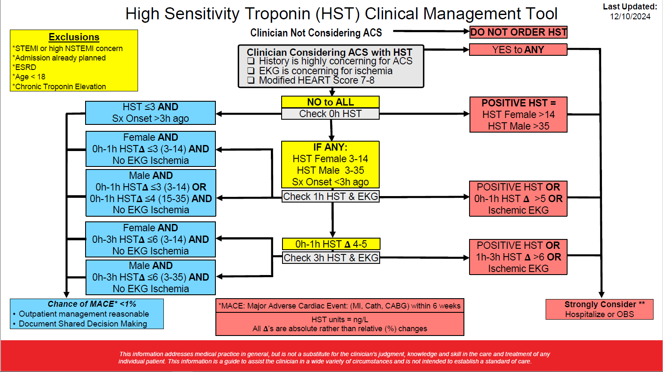

Slide 17
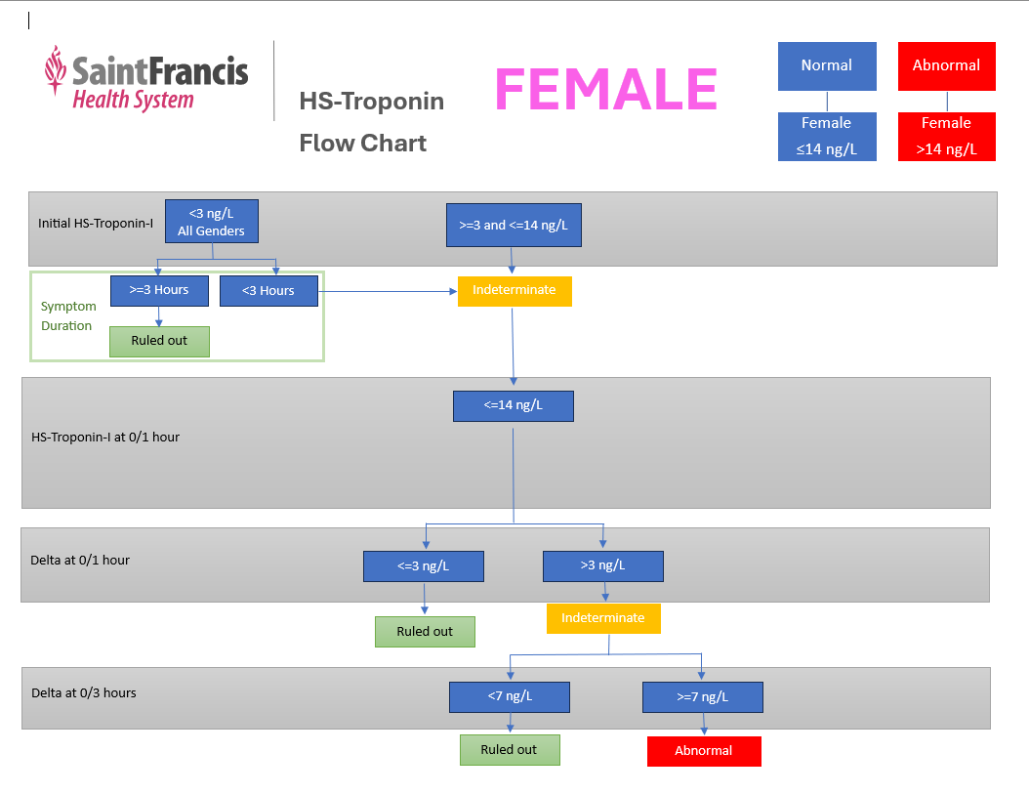

Slide 18
hs-Troponin Flow Chart – Female (Written)
Initial Troponin is ran
  cTnI <3 ng/L for M/F & Symptom Duration ≥ 3 hrs → Patient ruled out of Myocardial injury
  cTnI <3 ng/L for M/F & Symptom Duration < 3 hrs → Indeterminate → Reflex to 1 hr
  3 ≤ cTnI ≤ 14 ng/L → Indeterminate → Reflex to 1 hr
  cTnI > 14 ng/L → Abnormal / Positive hs-TnI
1 hr Troponin is ran
  cTnI ≤ 14 ng/L & Delta of 0/1 hr is ≤ 3 ng/L → Patient Ruled out of myocardial injury
  cTnI ≤ 14 ng/L & Delta of 0/1 hr is >3 ng/L → Indeterminate → Reflex to 3 hr
  cTnI > 14 ng/L → Abnormal / Positive hs-TnI
3 hr Troponin is ran
  cTnI ≤ 14 ng/L & Delta of 0/3 hr is <7 ng/L → Patient Ruled out of myocardial injury
  cTnI ≤ 14 ng/L & Delta of 0/3 hr is ≥ 7 ng/L → Abnormal / Positive hs-TnI
  cTnI > 14 ng/L → Abnormal / Positive hs-TnI

Slide 19
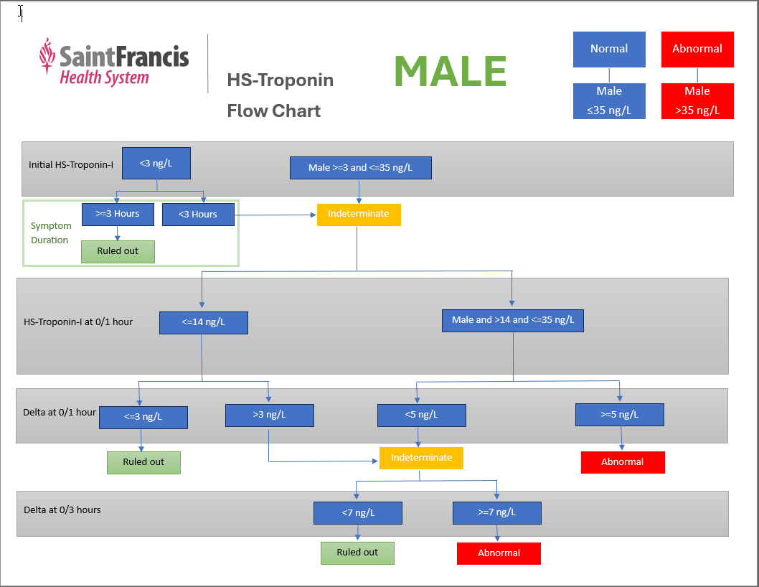

Slide 20
hs-Troponin Flow Chart – Male (Written)
Initial Troponin is ran
  cTnI <3 ng/L for M/F & Symptom Duration ≥ 3 hrs → Patient ruled out of Myocardial injury
  cTnI <3 ng/L for M/F & Symptom Duration < 3 hrs → Indeterminate → Reflex to 1 hr
  3 ≤ cTnI ≤ 35 ng/L → Indeterminate → Reflex to 1 hr
  cTnI > 35 ng/L → Abnormal / Positive hs-TnI
1 hr Troponin is ran
  cTnI ≤ 14 ng/L & Delta of 0/1 hr is ≤ 3 ng/L → Patient Ruled out of myocardial injury
  cTnI ≤ 14 ng/L & Delta of 0/1 hr is >3 ng/L → Indeterminate → Reflex to 3 hr
  14< cTnI ≤ 35 ng/L & Delta of 0/1 hr is < 5 ng/L → Indeterminate → Reflex to 3 hr
  14< cTnI ≤ 35 ng/L & Delta of 0/1 hr is ≥ 5 ng/L → Abnormal / Positive hs-TnI
  cTnI > 35 ng/L → Abnormal / Positive hs-TnI
3 hr Troponin is ran
  14< cTnI ≤ 35 ng/L & Delta of 0/3 hr is <7 ng/L → Patient Ruled out of myocardial injury
  14< cTnI ≤ 35 ng/L & Delta of 0/3 hr is ≥ 7 ng/L → Abnormal / Positive hs-TnI
  cTnI > 35 ng/L → Abnormal / Positive hs-TnI

Slide 21
hs-Troponin FAQ’s for Nursing
Why are we changing Troponin methods?
  The 2021 American College of Cardiology/American Heart Association Chest Pain guidelines endorse high sensitive troponin as the preferred biomarker for assessment of patients with acute chest pain because it allows rapid detection of myocardial injury and has increased diagnostic accuracy. The increased sensitivity of the troponin assay (i) allows earlier detection of myocardial injury, and (ii) enables the detection of even lesser amount of cardiac injury – often undetected by conventional assays. This allows shorter serial testing intervals and the implementation of Accelerated Diagnostic Protocols (ADPs) that will facilitate the rapid triage of chest pain patients and shorter emergency department lengths of stay. Hs-cTn is rapidly becoming the standard of care in hospitals across the US.
Why is the assay called High-Sensitive Troponin?
  This hs-TnI assay has improved analytical performance, especially at low levels, compared to the older conventional TnI assays.

Slide 22
hs-Troponin FAQ’s for Nursing
How will results from the new test look different than the current one?
  Currently, a normal result for both males and females is <0.05 ng/mL (or 50 ng/L on the new test).
  The new result will be in whole numbers, have male and female ranges and will be reported with a delta value (see algorithm).
    The new reference range for females is 0-14 ng/L (0.014 ng/mL on old test)
    The new reference range for males is 0-35 ng/L (0.035 ng/mL on old test).
What type of tube can be used for this test and how much is needed?
  5 mLs of blood should be drawn in a lithium heparin (green) top tube.
Can this test be shared with other tests on the same specimen (ie CMP and hsTrop)?
  For optimal turnaround time this test should not be shared.

Slide 23
hs-Troponin FAQ’s for Nursing
What if the troponin is not drawn on time?
  The “0-hour” specimen is considered the baseline.
  The “1-hour” specimen should be drawn one hour post the baseline.
    The 1-hour specimen should not be drawn early as premature results are uninterpretable.
    Any troponin drawn between the 1-3 hour mark should be treated as the “1 hour.”
  The “3-hour” specimen should be drawn three hours from the baseline.
    Troponins drawn between the 3-6 hour mark should be treated as the “3 hour.”
Can we do “add-on” testing to a pre-existing specimen?
  Specimens are good for 8-hours post collection.
  Add-ons only allowed on random specimens.
How long does testing take compared to the current method?
  Test time is the same as the current method which is 29 minutes once it is placed on the automation line.

Slide 24
hs-Troponin FAQ’s for Nursing
Will the lab be calling all abnormal troponin result?
  The first initial abnormal result (value or delta) will be called.
  Subsequent values will not be called. This is the current practice.
How will Epic flag Abnormal results?
  Abnormal results in Epic will flag with one red up arrow.
Can patients be ruled out with a single troponin value?
  Low-risk patients presenting after 3 hours of symptoms with non-ischemic ECGs may be “ruled-out” with a single hs troponin result below the level of detection (≤ 3 ng/L) in conjunction with utilizing cardiac risk stratification.
Can the new troponin test be trended with the old test?
  No, these tests can not be trended together.

Slide 25
hs-Troponin FAQ’s for Nursing
Are there other causes for an elevated cTnI besides AMI?
  Yes. Patients with chronic comorbidities that cause non-ischemic cardiac injury will often have hs-cTnI values above the 99th%, but usually < 100 - 150 ng/L. Thus, the initial differential at these hs-cTnI concentrations must be kept broad and include conditions responsible for insidious and acute causes of myocardial injury (all of which can result in non-ischemic cardiac injury):
    Heart Failure,
    Chronic Kidney Disease
    Myocarditis
    Cardiotoxic drugs
    Cardiomyopathy
    Amyloidosis
    Sepsis
  Unlike AMI, these comorbidities will not result in significant deltas when serial hscTnI testing is performed over several hours, unless their onset is acute rather than chronic.

Slide 26
hs-Troponin FAQ’s for Nursing
What caveats should I be aware of?
  It is important to note that acute MI, patients presenting early (within the first 2 hours of chest-pain symptoms) may have values below the limit of quantitation.
  Finally, late presenters may not exhibit increasing cTn values as their cTn concentrations have "plateaued" but not yet started to decrease.
What number should I call if I have a technical question?
  Call the Core Lab Supervisor at x20461 if you have a technical question.

