Slide 1
CAP Proficiency Testing Guide
P&lms

Slide 2
What is Proficiency Testing?
Proficiency testing is a program of unknown samples that are to be tested and formally evaluated, generally by an outside third party (CAP).
Proficiency testing is a requirement from accrediting agencies (VA, Joint Commission, CMS, etc.) to verify that the testing locations and personnel can competently and accurately perform patient testing.
Failures in proficiency testing will result in the inability to perform those tests on patients and could ultimately result in licensure being withdrawn from specific testing locations.

Slide 3
Proficiency Testing Requirements
Proficiency testing must…
be performed in the same manner as patient tests
follow laboratory policies and procedures
be performed by certified trained and competent staff
be rotated amongst certified staff
follow all special instructions per the CAP instruction packet
performed in the timeframe allotted

Slide 4
Proficiency Testing Requirements
Proficiency testing may not…..
be shared/compared between testing facilities or personnel
be tested in a manner that varies from patient tests (don’t run in duplicate if that’s not how you would test a patient)
be sent to another facility or reference lab
Be used for correlation or comparison between laboratory instruments prior to the submission due date

Slide 5
Upon Receipt of Survey
Follow the steps outlined in the Standard Work, CAP Proficiency Testing.
Standard Work - PROCESS IMPROVEMENT CAP.docx (sharepoint.com)

Slide 7
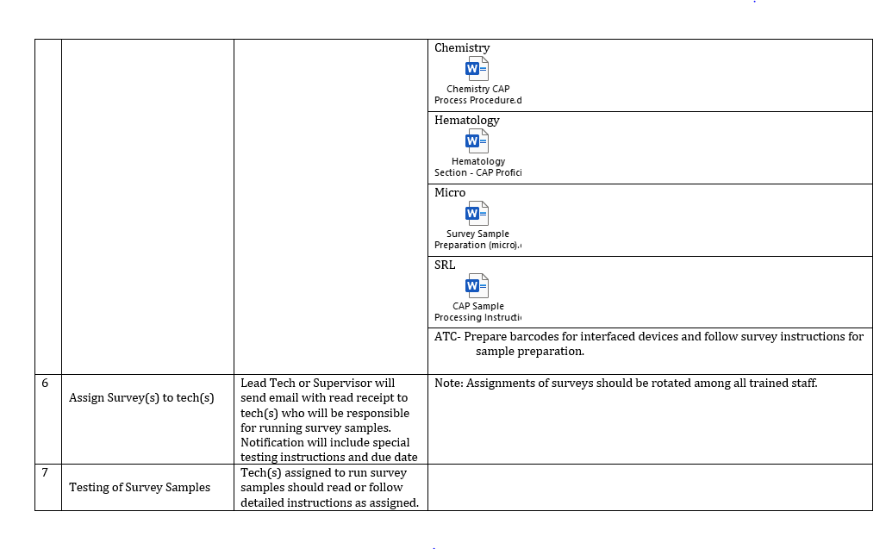

Slide 8
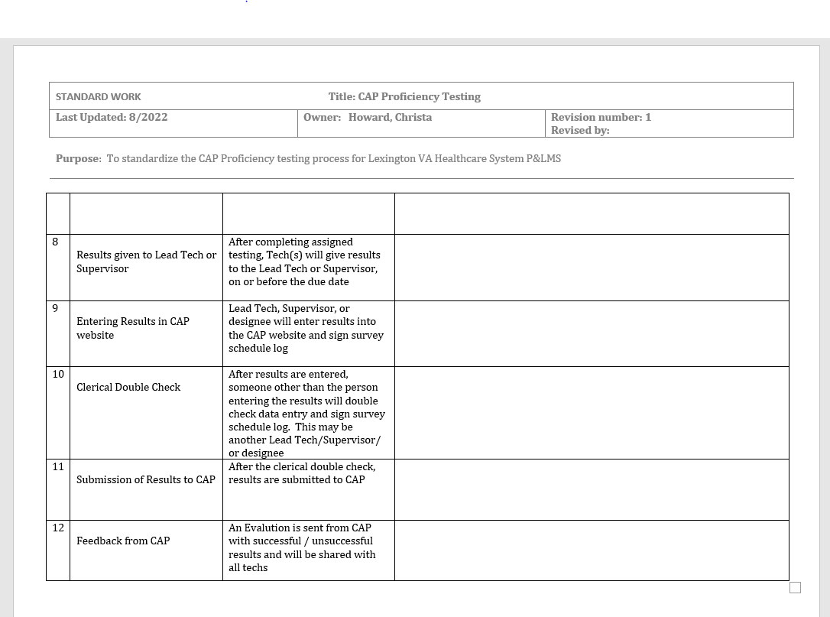

Slide 9
Please see the section Lead or Supervisor if you have specific questions. Thank you.

