Slide 1
Fairview Laboratory Services
LEAN Principles and Tools - An Introduction

Slide 2
Why LEAN?
Market changes requiring us to do more with less
Shrinking reimbursement for what we do
Aging of our work forces – many retirements and a shrinking pool of new graduates for replacements
By 2014, 27.5% of our staff is eligible to retire and in 2019 that number rises to 38.4%
We need to maximize the resources we currently have.

Slide 3
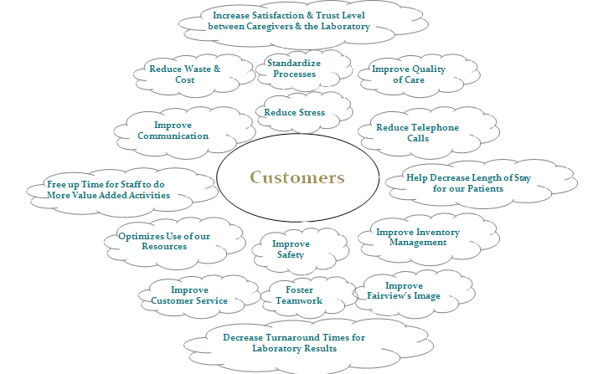
What is the Value to our Customers?

Slide 4


LEAN Terminology and Definitions
Kaizen (Continuous Improvement)
  The Japanese term for improvement; continuous improvement involving everyone - managers and workers. In manufacturing , kaizen relates to finding and eliminating waste in machinery, labor or production methods. “Kai “ means to change or correct and “Zen “ means good.
  Combines the collective talents of a company to create an environment to identify and continually eliminate waste from any process.
--Kai
--Zen

Slide 5
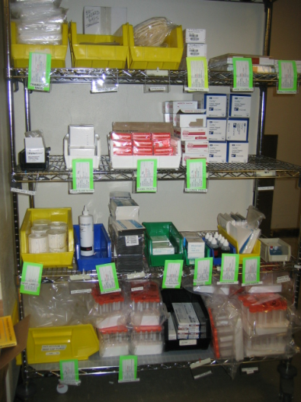
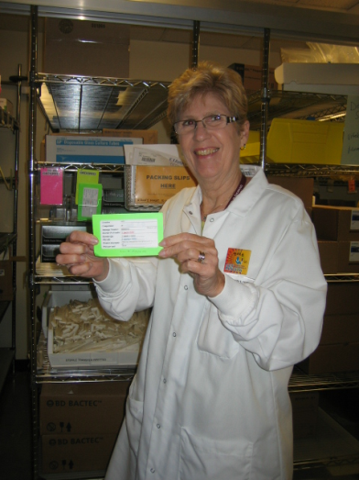
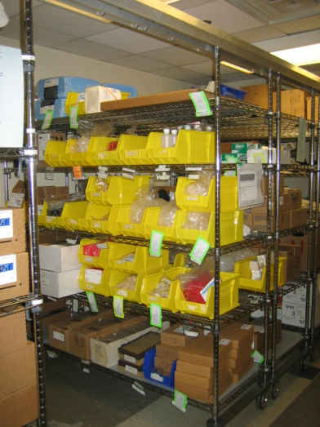
LEAN Terminology and Definitions
Kanban (Pull System) Referred to as “yellow card” at some sites
  Kanban is a simple supply-movement system that depends on cards and boxes/containers to maintain supply inventory. The essence of the Kanban concept is that all supplies should only be ordered as needed so that there is no storage in the work area.
  Eliminates waste from inventory and overproduction. Can eliminate the need for physical inventories and instead will rely on signal cards to indicate when more goods need to be ordered.

Slide 6

LEAN Terminology and Definitions
Standardized Work
  Applying current best practices which forms a baseline for future improvement activities. The new standard becomes the baseline for further improvements and so on.

Slide 7
Your Role in LEAN
  Participate
  Keep an open mind
  Be flexible
  Cooperate
  Communicate
  Sustain the gain
  Think big picture
  Be patient with each other
  Have Fun
  Think - Idea - Do - Do Again - Keep on doing ---------Success

Slide 8
Your Role in LEAN
  Our goal is to do LEAN with you not to you.
  This information is being provided so you may actively participate in ways to improve your work.
  Contact your supervisor or manager to find out more about LEAN teams at your site
  Without you we will not be SUCCESSFUL

