Slide 1
Lab / Pathology Faculty/Managers Meeting
April 2018

Slide 2
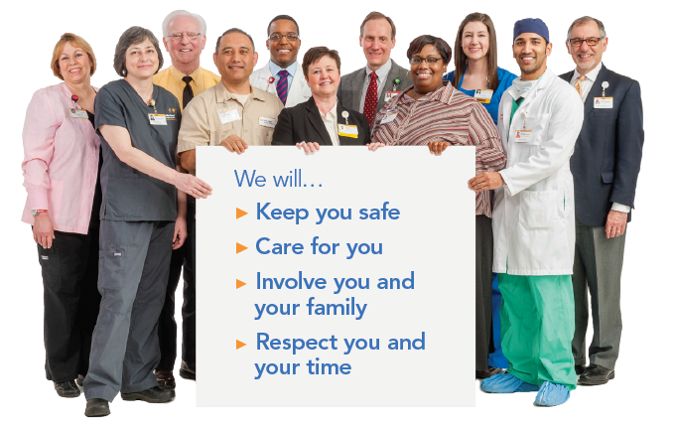
Patient and Family Promise

Slide 3
Causes of Death, US: 2013
Notes:
Despite our best efforts and the best efforts of healthcare providers around the country, our actions sometimes lead to unintended harm to our patients. No wakes up to purposefully make mistakes. Only 5% of medical harm is caused by incompetent of poorly intended care. The majority of events are system failures related to the complexity of health care, not bad people.

Slide 4
The Challenge
“The biggest challenge to moving toward a safer health system is changing the culture from one of blaming individuals for errors to one in which errors are treated not as personal failures, but as opportunities to improve the system and prevent harm.”
-The Institute of Medicine

Slide 5
Safety Focus for April 2018
RL6 Reporting
A clinical laboratory incident / credit report may be completed prior to entering the information into RL6.

Slide 6
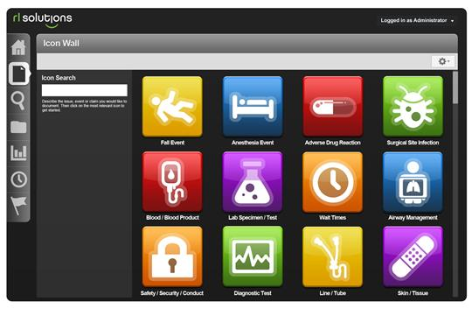
Report: Problems, Errors, Events & Concerns
What to Report | How to Report
Anything that harms a patient or employee | Share with your direct inline leader Report in incident reporting system – RL – using Intranet.
Anything that threatens to harm a patient or employee
Reporting for Success
Report
“Good Catches”
in addition to patient safety incidents
Icon link on WakeOne screen, every desktop, and found on “Clinical Applications and Links” page

Slide 7
Harm Happens at Wake Forest Baptist 2016
Serious Safety Event
Moderate to Severe Harm or Death
CAUSING
Precursor Safety Event
Serious Safety Event
Near Miss Safety Event
Deviations from Best Practice Care

