Slide 1
Lab Safety Focus for May 2018
Cross Check and Coach!!

Slide 2
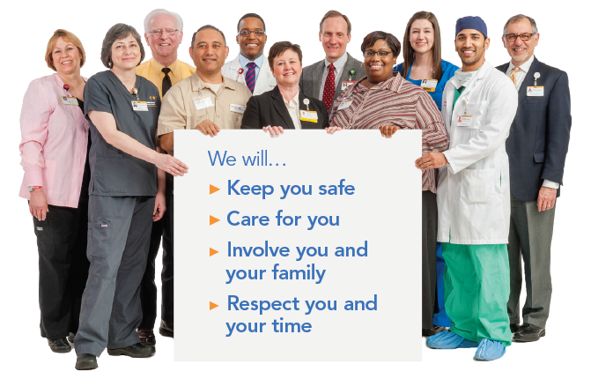
Patient and Family Promise

Slide 3
High Reliability - AHRQ
“High reliability organizations are organizations that operate in complex, high-hazard domains for extended periods without serious accidents or catastrophic failures.”
“High reliability goes beyond standardization; high reliability is better described as a condition of persistent mindfulness within an organization.”
“High reliability organizations work to create an environment in which potential problems are anticipated, detected early, and virtually always responded to early enough to prevent catastrophic consequences.”

Slide 4
High Reliability
U.S. Amusement Parks
Fatality chance: 1 in 34 million
Rides operated by college students daily
U.S. Commercial Flight
Fatality chance: 1 in 11 million
Fly daily for 123,000 years before fatality
Notes:
WFBH Winston only campus has moderate to severe harm on average every 10.7 days (2017)

Slide 5
Harm Happens at Wake Forest Baptist 2017
Moderate/Severe Harm
Death
Notes:
34 patients with moderate to severe harm including 2 deaths on the Winston campus only in 2017. On average a patient at the Winston campus is harmed about once every 10.7 days.
5

Slide 6
Harm Happens Here 2018
Children
AGES LESS THAN 18
Adults
AGES 18-65
Seniors
AGES 65+
MODERATE / SEVERE HARM  DEATH
Notes:
6

Slide 8
Safety Focus May 2018
Cross-Check
Look out for each other
Work together – “two heads are better than one”
Identify potential problems; seek advice from teammate
Offer to check your peers – point out the unintended
Notes:
Every flight I have ever been on, flight attendants cross check before departure – it’s usually announced by the pilot – they walk up and down the aisle numerous times before departure to make sure seatbelts are fastened, carry-on luggage is safely stowed in the overhead bin or under the seat in front of you, your seat back is upright and your folding tray is in it’s upright and locked position, all mobile phones and electronic devices are turned off.
Take advantage of working together to perform fast & easy verifications of each other’s work. Every employee is responsible for the safety of our patients and each other.

Slide 9
Cross-Check and Coach Each Other
Watch out for each other
Peers check each other’s work
Teammates are willing to be checked
Effectively coach
Provide feedback and help
Reinforce good habits
Help extinguish bad ones
Use the “lightest touch” possible
Key phrase: “What you permit, you promote.”

