Slide 1
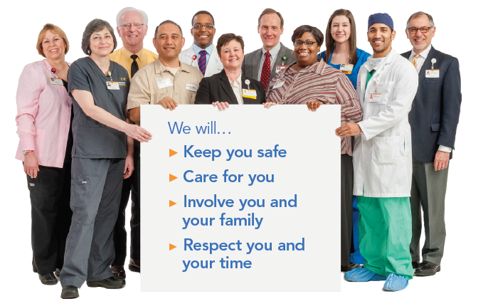
Patient and Family Promise

Slide 2
Safety Focus of the Month May 2018
Communicate Clearly:
Make sure we give and receive accurate and complete information
We act on information we have been given
Co-workers act on information they have been given
Can you recall a time when you were involved in an error that resulted from poor verbal communication?

Slide 3
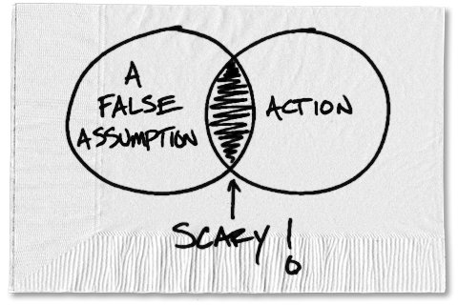
Communicate Clearly
Communicate complete and accurate information in a timely and appropriate manner:
To ensure that we hear details correctly
To ensure that we understand details
To prevent wrong assumptions and misunderstandings that could cause us to make wrong decisions

Slide 4
SBAR for Effective Communication & Notification
Situation: What is the situation, patient or project?
Background: What is the important information, problems and precautions?
Assessment: What is your read of the situation, problems, and precautions?
Recommendation: What is your recommendation, request or plan?
SBAR is a helpful tool for
anyone when a decision is needed

Slide 5
Practice
How would you effectively communicate the following circumstance in SBAR format?

Slide 6
Circumstance
On three occasions over the past few months, families and visitors of decedents have been escorted into the Gray Building by hospital employees to the autopsy suite. The Gray building is not open to visitors due to the nature of work that occurs in that area (research, autopsy, etc). In an effort to keep both visitors and employees safe, the Gray Building is locked and is not to be entered by anyone that is not an employee of the medical center.

Slide 7
Situation:
The headline of the problem or situation
Only employees should enter the Gray building.

Slide 8
Background:
What is the important information, problems or precautions?
Over the past two months, there have been three incidents where families have been escorted by Medical Center employees to the autopsy suite. The autopsy suite is not set up for family viewing. Also, there are numerous lab and research activities occurring in the Gray building, which further prohibits non-employees from entering the building.

Slide 9
Assessment:
What is your read of the situation, problems, and precautions?
To ensure visitor and family safety, visitors should not be allowed access to the autopsy suite or Gray Building at any time.

Slide 10
Recommendation:
What is your recommendation, request or plan?
When you enter the Gray building, make sure that anyone entering behind you is wearing a Medical Center badge.
Families arriving at the Medical Center requesting to see a decedent or requesting information about the decedent should be referred or escorted to Patient Relations, or they may call Autopsy at 716-2681 or 716-1184.

