Slide 1
Lab / Pathology
Managers Meeting
November 2018

Slide 2

Patient and Family Promise

Slide 4
Top RL6 by Category

Slide 5

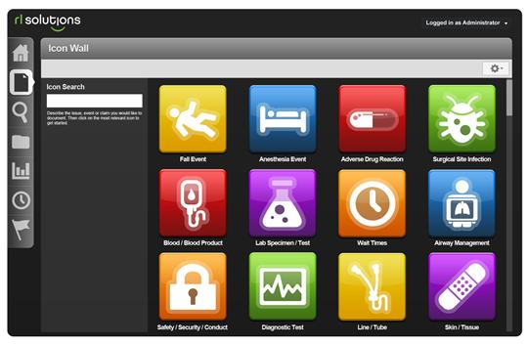

Safety Focus of the Month
November 2018: RL6
What to Report | How to Report
Anything that harms a patient or employee | Share with your direct inline leader Report in incident reporting system – RL – using Intranet.
Anything that threatens to harm a patient or employee
Reporting
for Success
Report
“Good Catches”
in addition to patient safety incidents
Icon link on WakeOne screen, every desktop, and found on “Clinical Applications and Links” page
Notes:
STOP WHEN UNCERTAIN
This technique is used when YOU have questions about YOUR planned actions.
Studies of significant events where people proceeded in the face of uncertainty show common things.
People performing outside of the policy & procedure or normal plan are more than 10 times more likely to make an error.
STOP whenever we realize that our job is off of the normal policy, procedure, protocol, plan, etc. get help.
Get the right people involved, follow the chain of command, and be very diligent in applying these error prevention techniques.

Slide 6
AHRQ Survey

Slide 7
AHRQ Survey

Slide 8
LEAN
Focus for the next 3 months:
1. Continued small projects for individual departments that are contained in their areas.
2. Implement Huddle Boards for every department to help the teams document their work and focus on our drivers.
Focus: Quality, Safety, and Deliverables
3. Process map the entire specimen process for all sections including both AP and CP. This is the biggest workflow effecting everyone and is intertwined both AP and CP.
a. Once this is mapped, host a Rapid Improvement Event with these sections.
b. Utilize Tesila to assist Brad and Shelley with this process mapping.
4. Train remaining employees on the LEAN material. Training to occur through a combination on online and face to face training.

