Slide 1
CAPA: Corrective Action / Preventive Action
Prepared by Laboratory Compliance, Quality, and Safety
November 2018

Slide 2

Corrective and Preventive Action (CAPA)
  A CAPA is an exercise for the detection of current and/or potential problems of nonconformance affecting the quality of analysis.
  The Goal is to eliminate the nonconformance, to prevent recurrences, and to improve quality.
  Documentation of nonconformance incidents is part of CLIA, JCO, and CAP regulations.

Slide 3

Corrective and Preventive Action (CAPA)
The purpose of a CAPA is:
  1. To have problems come to the attention of appropriate personnel (management) in a way that brings permanent solutions.
  2. To identify, prevent and eliminate the cause of actual or potential non-conformity, using risk management principles.
The success of a CAPA depends upon the investigation and planning that goes into it!

Slide 4
Common Definitions Used in the CAPA Process
  Corrective Action: Reactive Approach; Actions taken to eliminate the cause(s) of an existing nonconformity, defect or other undesirable situation in order to prevent recurrence.
  CAPA: A form that documents an existing or potential non-conformity and subsequent corrective and/or preventative action(s).
  Clinical Laboratory Improvement Amendments (CLIA): United States federal regulatory standards that apply to all laboratory testing performed on humans.
  Investigation / Root Cause Analysis: A comprehensive review of real or alleged issues related to nonconformance.
  Nonconformity: Non-fulfillment of a specified policy and/or procedure. Deviation from the established policy and/or procedure.
  Preventive Action: Proactive Approach; Actions taken to eliminate the cause(s) of a potential deviation, defect or other undesirable situation in order to prevent occurrence.
  Root Cause: A fundamental nonconformity that results in a deviation and must be corrected to prevent recurrence of the same or similar nonconformity.

Slide 5
Code of Federal Regulations
42 CFR 493.1282 – Corrective Action
“Corrective action policies and procedures must be available and followed as necessary to maintain the laboratory’s operation for testing patient specimens in a manner that ensures accurate and reliable patient test results and reports.”
“The laboratory must document all corrective actions taken…”

Slide 6
College of American Pathologist Regulations
GEN.20208 – QM Patient Care Services
  “The QM program include a process to identify and evaluate errors, incidents and other problems that may interfere with patient care services.”
  **Note: “There must be an organized process for recording of problems involving the laboratory…The process must be implemented in all sections of the laboratory and on all shifts. The laboratory must record investigation and resolution of these problems.
GEN.20316 – QM Indicators of Quality
  “The QM program includes monitoring key indicators of quality in the pre-analytic, analytic, and post-analytic phases.”
  **Note: The laboratory must also evaluate the effectiveness of corrective actions taken to optimize its critical processes.
  **Evidence of Compliance: “Quality management data and reports for quality indicator monitoring and evaluation, including comparison against benchmark data, and corrective action when targets are not met.”

Slide 7

Roles and Responsibilities of Laboratory Personnel
Clinical Laboratory Director:
  Review the submitted documentation for each incident and either suggest changes or approve the CAPA.
  If required, reviews the follow up documentation for each incident and either suggest changes or approves the CAPA.
  Once approved, the decision made by the CLIA Lab Director is final.
Technical Supervisor/Section Medical Director:
  Review and make suggestions to the incidents, investigations, corrective actions, and follow ups that involve his/her laboratory section
  Ensure that event information being submitted for their lab section is being appropriately classified and document under the CAPA SOP
General Supervisor/Manager:
  Initiates investigation per CAPA SOP.
  Opens the incident, by notifying the Section Director and Quality Assurance (QA).
  Recommend the incident for closure through the QA staff.
  Suggest any corrective and/or preventive actions that may be useful in preventing recurrence of this type of incident and record that on the CAPA form.
  Complete any required follow up for an incident and route the follow up for approval.
Testing Personnel:
  Understand the types of events that require Corrective Actions, per CAPA SOP.
  Report any nonconforming event(s) to the appropriate Supervisor/Manager in a timely manner.
  Participate in the Root Cause Analysis and Corrective and Preventative Action process/ discussions as necessary or requested by Lab Administration.

Slide 8
Roles and Responsibility of the Quality Assurance Personnel
Open and log each incident into the Nonconforming Events Excel Log for the Department of Pathology.
Review every incident reported for accuracy, completeness, and appropriateness.
Route the incident CAPA form(s) to the appropriate individuals for the approval process.
Review any follow up information, routing the follow up to the CLIA Lab Director for final approval.
Maintain all documents associated with the CAPA process in the Lab Compliance/QA Department.
Track and monitor the logged incidents for quality assurance purposes.
Notes:
The excel log will be located in the Lab_Compliance folder in the Lab_Shared Drive. Long term goal is to have this available on a Shared Drive or Electronic Document control system.

Slide 9

Stages Of a CAPA
Stage 1: Identification
Stage 2: Evaluation
Stage 3: Investigation
Stage 4: Analysis
Stage 5: Action Plan
Stage 6: Approval and Implementation
Stage 7: Follow Up
Stage 8: CAPA Approval and Closure

Slide 10
Stage 1: Identification
The identification stage defines an existing problem or a potential problem by explaining the problem and documenting available evidence.
Any employee who learns of a nonconformity or potential nonconformity related to testing or a quality system shall immediately notify his/her manager and review the situations.

Slide 11
Stage 2: Evaluation
In the evaluation stage, a determination is made on the need for action and the level of action required.
      Was it planned?
      Was it predicted?
      Was it included in the procedure?
      What is the potential impact?
      What is the level of risk?
CAPAs must be implemented and recorded for the following types of issues:
      Failed proficiency tests
      Issues that may affect the defensibility of quality test results
      Any issue that affects the operational readiness of the laboratory
      Mislabeled/Missing or Lost specimens occurring between lab to lab transport
      QA tracking failures
      Deviation from AP/CP Quality Assurance Audits
      Any other incidents of concern per manager’s discretion

Slide 12
Stage 3: Investigation
The investigation stages involves a review of all parameters related to the problem e.g. equipment, materials, procedures, analyst training, environmental parameter, etc.
A brief summary of the full problem/nonconforming event is documented.
QA department is notified of nonconformance.

Slide 13
Stage 4: Analysis
The analysis stage leads to the root cause of the incident.
Data is collected and possible sources/causes of the incident are listed out to discover the root cause.
      What happened
      Why it happened
      When it happened
      What else was happening
      Who was involved
      What areas were affected
      What the impact was
      Where additional information may be found
The root cause will not solely deal with the incident but also help to discover if this has occurred in the past and if so, at what frequency.
When analysis reveals that the scope or impact of a particular incident is sever or extreme, QA personnel may be brought in to assist the Section Manager with the analysis.

Slide 14
Stage 5: Action Plan
Corrective Action:
  Actions aimed at correcting the incident, these can include changes in exiting procedures and/or assignment of responsibilities.
  It may be necessary to first implement a simple, immediate corrective measure to contain and mitigate the immediate problem.
Preventive Action:
  Actions aim at preventing future occurrences of the current incident and/or new incidents.
All steps within the corrective and/or preventive action plans must be documented on the CAPA form and described in as much detail as possible.
Any and all modification and changes to procedures, assignments, etc. must be communicated to concerned personnel and departments. Documentation of personnel understanding of changes must be recorded.
Employee training is an essential part of any action plan and must be documented.
The date of implementation of the corrective and/or preventive action plans should be noted on the CAPA form (if known).

Slide 15
Stage 6: Implementation
Implementation of the long term corrective/preventive action plan is initiated once QA has reviewed and approved the CAPA.
Implementation may involve:
      Execution of identified tasks in the action plan
      Modification in documents
      Modification in processes
      Modification in environmental conditions
      Prevision of training on modifications and/or current procedures

Slide 16
Stage 7: Follow Up
The follow up stage verifies the completion of the identified tasks and also assesses during a monitoring period the appropriateness and effectiveness of the action plan.
  If no additional instances occur during the monitoring period and the action plan is confirmed to be effective, the action plan can be considered complete and the follow up can be completed.
  If the action plan was deemed not effective during the monitoring period, then it may be necessary to go back through the process of root cause analysis and develop an updated action plan. If this occurs, then the follow up stage is not completed and the CAPA remains active.

Slide 17
Stage 8: CAPA Approval and Closure
Once the CAPA form and investigation has been completed by the Section Manager, reviewed and approved by QA it is sent to the CLIA Laboratory Director for approval.
Documentation is filed and held for two years in the Laboratory Compliance, QA, and Safety Department.
The QA staff will log and classify each CAPA event for quality assurance purposes.

Slide 18
Incident Management Workflow Diagram

Slide 19
Additional Follow-Up Workflow
Diagram

Slide 20
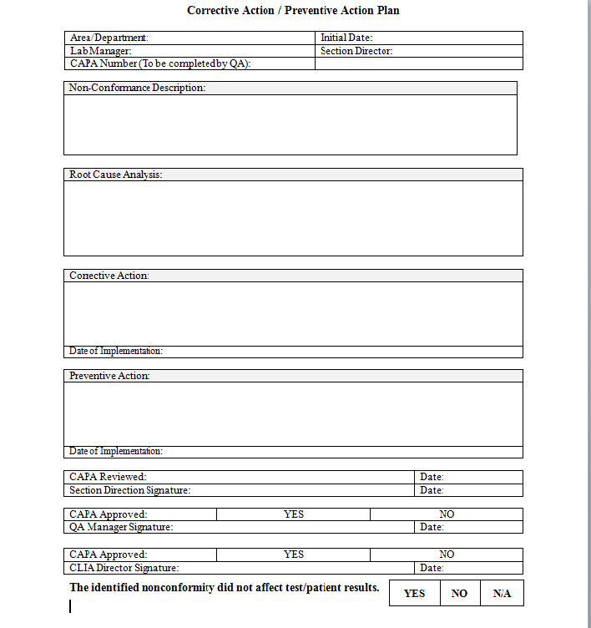
Example CAPA Form

Slide 21
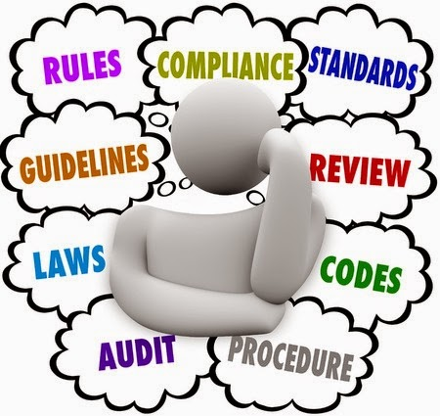
Let’s Practice…CAPA Scenario
Identification: An employee noticed while reviewing a batch, that the QC sample was not run
Evaluation: Is this an event that requires a CAPA per the SOP?
Investigation & Analysis:
  What happened?
  Why did it happen?
  When did it happen?
  Who was involved?
  What areas of the laboratory and/or patient safety was effected?
Action Plan:
  Corrective Action – What can we do right now to fix this incident?
  Preventive Action – What could have prevented this from occurring and how do we fix it so it doesn’t happen again?
Implementation/Follow Up/Approval/Closure: Put the corrective action and preventive action (if applicable) into place. Continuously monitor to ensure incident doesn’t reoccur.
Notes:
Evaluation: Yes
Investigation & Analysis: QC was not run; tech error/instrument error/extraction error; time/date occurred; tech, reviewer and instrument; department and batch number
Action Plan: Corrective action – extract/prepare the batch again with QC (if applicable); are there any other controls within the batch that could serve as a negative control? Have batch reviewed by section director for guidance; Employee training
Preventive action – any changes to procedure to make sure this step isn’t missed? Instrument maintenance, employee training
***document all actions***

Slide 22

Questions?

