Slide 1
Lab / Pathology Managers Meeting
December 2018

Slide 2
Patient and Family Promise

Slide 3
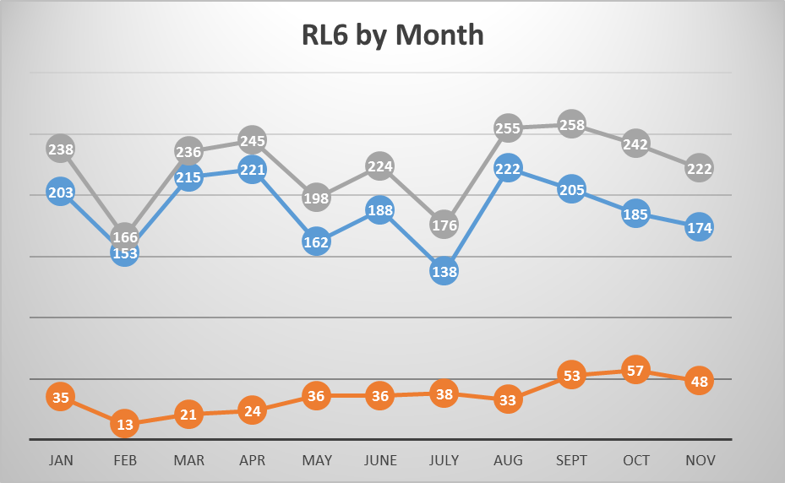

Slide 4
Top RL6 by Category

Slide 5
Safety Focus of the Month December 2018: STAR
Focus on Details: StopThinkActReview
Stop
Pause to focus attention on task
Think
Understand WHAT is to be done
Plan your actions
Decide what to do if the unexpected occurs
Act
Execute planned task
Review
Verify for expected/desired results

