Slide 1
Lab / Pathology
Managers Meeting
December 2018

Slide 2

Patient and Family Promise

Slide 3
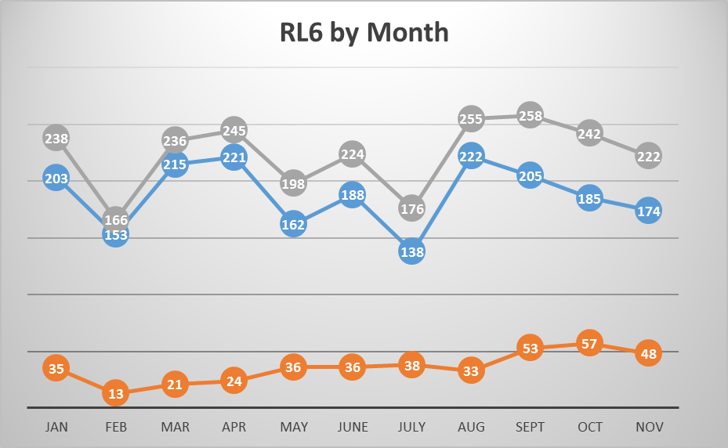

Slide 4
Top RL6 by Category

Slide 5

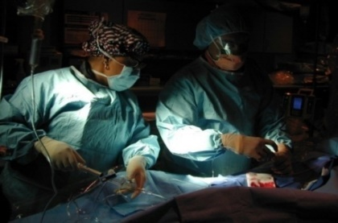

Safety Focus of the Month
December 2018: STAR
Focus on Details: StopThinkActReview
  Stop
    Pause to focus attention on task
  Think
    Understand WHAT is to be done
    Plan your actions
    Decide what to do if the unexpected occurs
  Act
    Execute planned task
  Review
    Verify for expected/desired results

Slide 7
Safety Coach Meeting Participation

Slide 8
LEAN
Huddle Boards - Brad

Slide 9
LEAN
Focus for the next 3 months:
1. Continued small projects for individual departments that are contained in their areas.
2. Implement Huddle Boards for every department to help the teams document their work and focus on our drivers.
Focus: Quality, Safety, and Deliverables
3. Process map the entire specimen process for all sections including both AP and CP. This is the biggest workflow effecting everyone and is intertwined both AP and CP.
a. Once this is mapped, host a Rapid Improvement Event with these sections.
b. Utilize Tesila to assist Brad and Shelley with this process mapping.
4. Train remaining employees on the LEAN material. Training to occur through a combination on online and face to face training.

