Slide 1
Lab / Pathology
Managers Meeting
March 2019

Slide 2

Patient and Family Promise

Slide 3
Serious Safety Events
Days since last SSE:
CY 18:
WFB: 28
BCH: 38
DMC: 339
HPMC: 34
LMC: 238
WMC: 190
373 events went to SSE Classification Committee
64 System-wide SSE
54 SSE Winston Campus
4 Deaths
*Employee Injuries – Let Shelley know if an employee is injured at work.

Slide 5
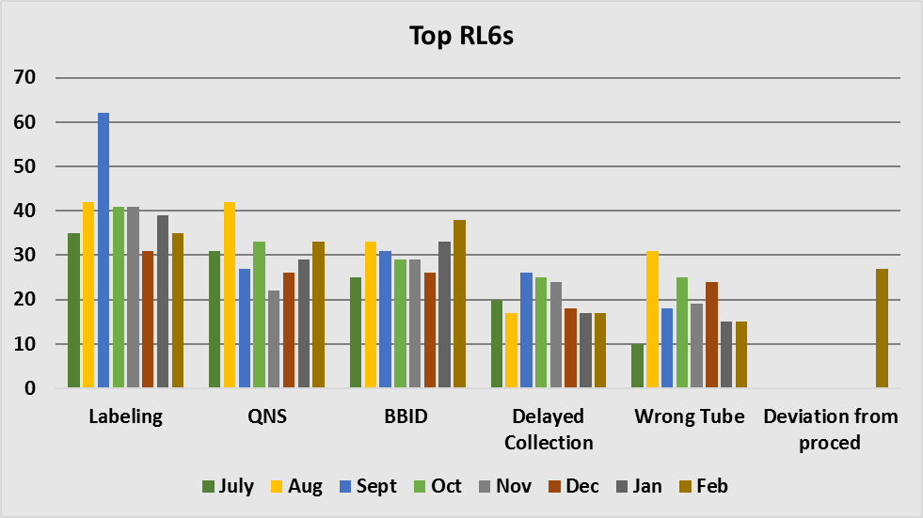
Top RL6 by Category

Slide 6
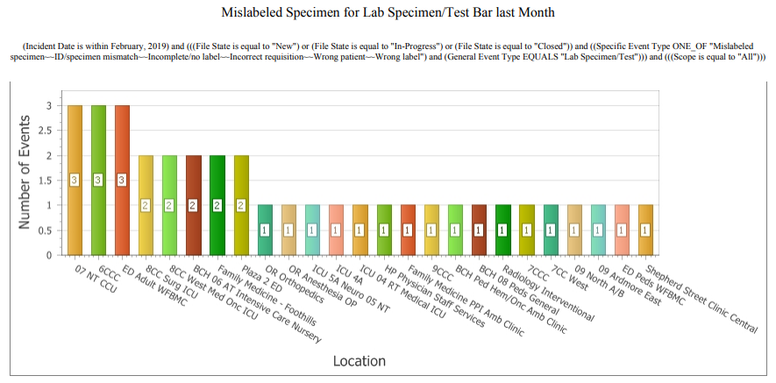
Mislabeled Specimens by Location

Slide 7
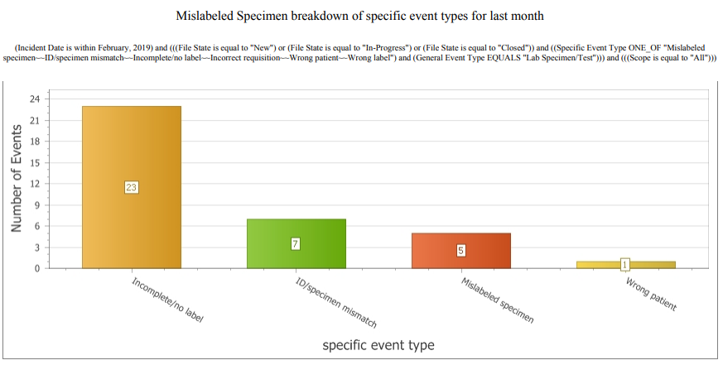
Mislabeled Specimens by Event Type

Slide 8
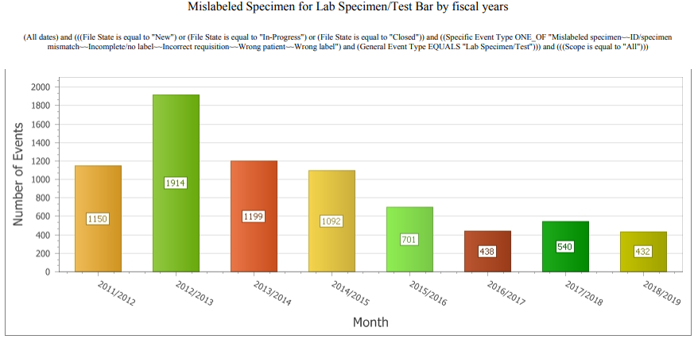
Mislabeled Specimens by FY

Slide 9

Safety Focus of the Month
March 2019

Slide 10
Safety Starts Here Section Compliance CY18

Slide 11
Safety Starts here Section Compliance CY 19

Slide 12
Safety Coach Meeting Participation

Slide 13

Safety Coaches Professional Development Day
March 29th, 2019
8:30 – 10am

