Slide 1
Lab / Pathology
Managers Meeting
May 2019

Slide 2

Patient and Family Promise

Slide 3
Serious Safety Events
Days since last SSE:
WFB: 33
BCH: 59
DMC: 48
HPMC: 89
LMC: 73
WMC: 253

Slide 7
RL6 Resolution and Feedback
17 Managers/Associate Directors – Managers Training
Timeline suggestions for completing resolution and feedback in RL

Slide 8
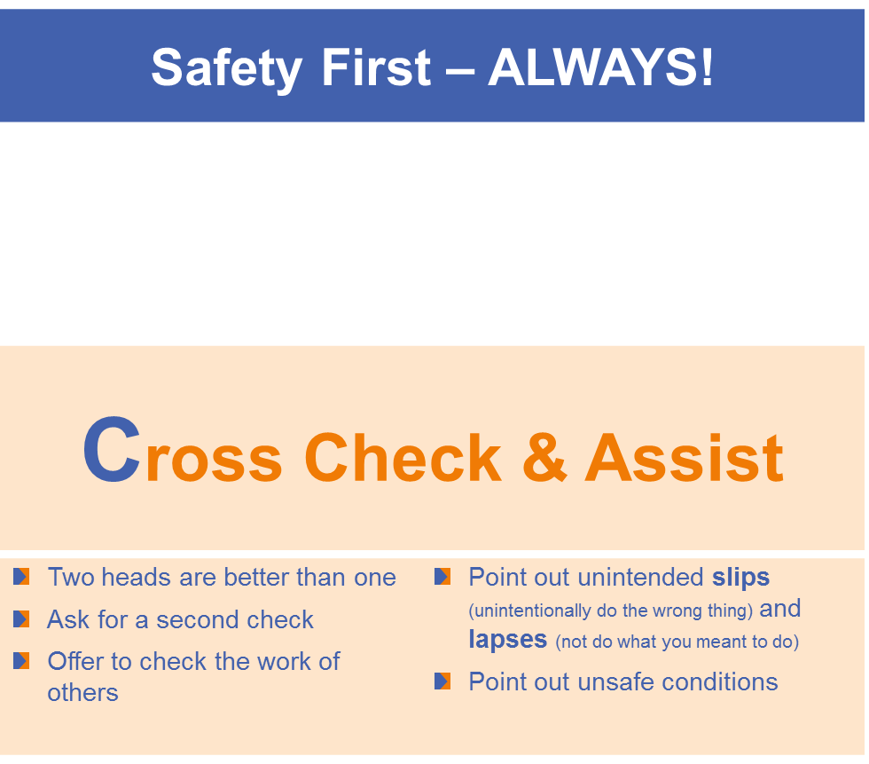
Safety Focus of the Month
May 2019:

Slide 9
Safety Survey for Lab Sections
Three question survey:
    What is(are) the biggest safety concerns in your section?
    As it relates to safety in your section, what keeps you awake at night?
    What would you change if you could in regards to the safety culture in your section?
HLA will pilot the survey. After we get their feedback, it will eventually be distributed to each section.

Slide 10
Safety Starts here Section Compliance CY 19

Slide 11
Safety Coach Meeting Participation

