Slide 1
Lab / Pathology
Safety Coaches Meeting
June 2019

Slide 2

Patient and Family Promise

Slide 3
Serious Safety Events
Days since last SSE:
    WFBH
    BCH

Slide 4
Blue bar – April (31)
Orange bar – May (61)

Slide 5
Blue bar – April (31)
Orange bar – May (61)

Slide 6

Resolution:
12/31 = 39%
Closing the Loop:
14/31 = 45%

Slide 7
Safety Focus of the Month
June:
QVV
Practice With & Accept Questioning Attitudes
Q- Qualify (Do I trust this source?) V- Validate (Does it make sense to me?) V- Verify (Check with an expert source)
A questioning attitude is the single most effective Critical Thinking Tool! A quick way to detect incorrect information and assumptions BEFORE you act. Qualify and Validate are quick checks in your head. Verify takes a little more time but addresses that feeling in your gut (your smoke detector). | Always Verify when: Your smoke detector goes off There is a change in plans You are in a high-risk situation You are in a new situation

Slide 8
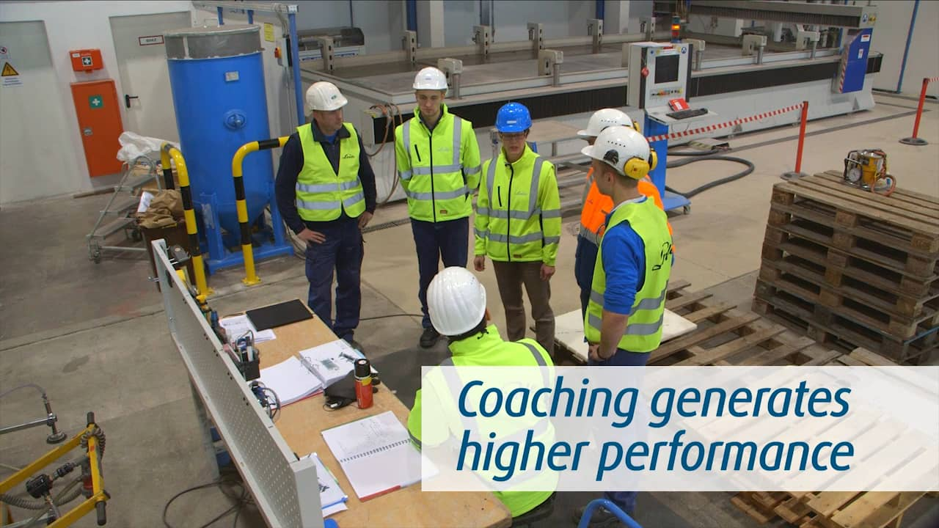
Your turn…
Concerns
Good catches
Rounding to Influence

Slide 9
Next Meeting:
July 25th, 2019

Slide 10
Rounding to Influence
Why: shaping practice habits at the front line
Scripting:
    Core Value: relate why safety is so important to the organization
    Can-do: review the expectation, tool or technique
    Concerns: ask for barriers to meeting the expectation
    Commitment: look them in the eye and ask for a personal commitment to making the safety tool a work habit.

Slide 11
Rounding to Influence
Have you been to our safety training? Can you name one error prevention technique or tool?
Which technique have you found the most helpful in your day-to-day work? Which is the hardest, why?
Tell me a story about a time you observed a co-worker using an error prevention tool.
What conditions make you most concerned that you are going to experience an unintended error or mistake that could result in harm?
Can you think of any close calls that almost resulted in harm? What can we do to prevent that type of close call in the future?

