Slide 1
Lab / Pathology
Managers Meeting
July 2019

Slide 2

Patient and Family Promise

Slide 3
Serious Safety Events
Days since last SSE:
WFB: 21
BCH: 73
DMC: 54
HPMC: 24
LMC: 144
WMC: 35

Slide 4
Blue– April (31)
Orange – May (61)
Green – June (27)

Slide 5
Blue– April (31)
Orange – May (61)
Green – June (27)

Slide 6
RL6 Closing the Loop Compliance
May = 61 deviations reported for Lab & Pathology
Closing the Loop May:
34/61= 56%

Slide 7
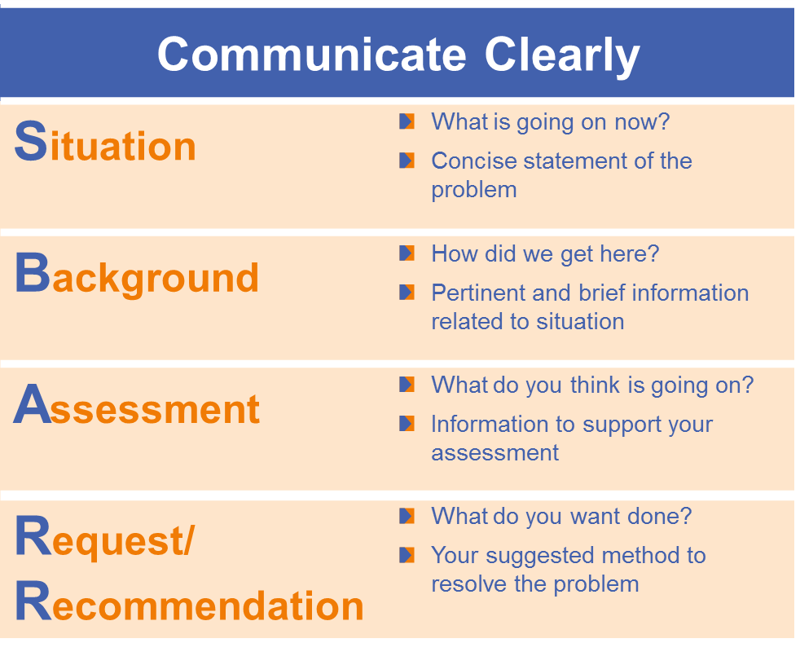

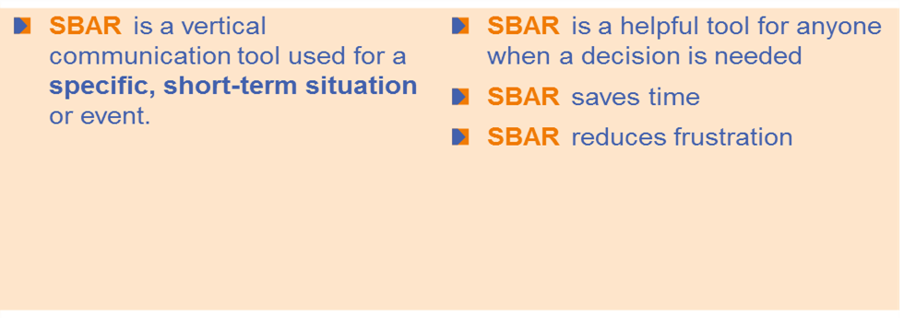

Safety Focus of the Month
July 2019: SBAR

Slide 8
Safety Starts here Section Compliance 2019

Slide 9
Safety Coach Meeting Participation

