Slide 1

Patient and Family Promise

Slide 2
Serious Safety Events
Days since last SSE:
WFB: 25
BCH: 19
DMC: 173
HPMC: 110
LMC: 263
WMC: 46

Slide 3
Lab Pathology Deviations
July - Blue (58)
Aug – Orange (107)
Sept – Yellow (94)
October – Brown (66)

Slide 4
Lab Pathology Deviations by Section
July - Blue (58)
Aug – Orange (107)
Sept – Yellow (94)
October – Brown (66)

Slide 5
RL6: Describe the Event
Include the following (when applicable):
    The exact deviation/error/concern and include the specific test
    What impact was there to the patient (specimen had to be recollected)
    If no impact to the patient (specimen was viable for processing, recollection not required) document that
    What was done, if anything (care team notified at date/time)

Slide 6
RL6: Describe the Event
Examples of appropriate documentation:
Troponin was collected in a gold top tube; troponins should be collected in a green top tube. Recollection was required. Care team was notified 10/11/2019 @ 1000.
A1C results that had an unacceptable graph were mistakenly posted in the medical record on 10/10/2019 @ 1000. Mistake was identified; the correct result was posted at 10/11/2019 @ 1200. Care team was notified 10/11/2019 @ 1200
CBC was hemolyzed. Recollection was required. Nurse was notified 10/11/2019 @ 1200
CMP arrived in a black carrier. Should have arrived in a red carrier. Recollection is not required.
Specimen arrived in lab without a requisition. Sample placed in refrigerator; recollection not required. Jane Doe notified 10/11/2019 @ 0800 that a requisition is needed to process the sample.

Slide 7
RL6: Describe the Event
How can these be improved upon?
Received unlabeled blood. Collected by Jane Doe per Beaker.
Urine collected in a culture preservation tube for chemistry and UA testing. Collected by Jane Doe.
Blood received in a no additive tube. Collected by Jane Doe.
Specimen received in lab and placed in a bin. The fresh tissue was not placed in the refrigerator over the weekend and there was no requisition.

Slide 8
Safety Focus of the Month
Incorrect Results Posted
Examples:
The pathology resident signed all the electrophoresis result sheets, which the tech had mistaken for our medical director's signature. The tech then released the comments on the sheet to the patient's chart. When the director came down later, he reviewed the results and told the tech to correct them and that he hadn't reviewed them. The IEOP/Immunofixation result was initially resulted on 10/2/19 at 0832 and corrected on 10/3/19 at 1301. The correction was called to the nurse. (Effected 6 patients medical records)
Technologist entered 1 as dilution factor rather than 1.1 when typing in results. Error was found on daily QA review of manually entered results. This calculation error resulted in the number of WBCs in the CSF changing from 897 to 1078 / cubic mm. Original result was reported 9/23/19 14:34; Correction was reported 9/24/19 09:52 and called to 5ATW. (3 additional incorrect results posted in Sept related to dilution errors)

Slide 9
Incorrect Results Posted
Example:
Tech reported TNTC bacteria in Beaker. Was not noted on the patient's worksheet. Employee looked at sample and only saw few bacteria. Changed result from TNTC to few. (2 separate times this same issue occurred)
Tech released glucose results of <10 before checking the sample and repeating. When she repeated the sample, the results change from <10 to 131 mg/dL. The result was corrected and called to the floor – 8 hours later

Slide 10

Safety Focus of the Month
Incorrect Results Posted
What safety tools can we use to minimize the risk of posting the wrong result to the medical record?

Slide 11
Eliminate High Risk Behavior
Distractions
Personal Electronic Devices and Internet Access Policy
      The use of personal cell phones and other electronic devices, in direct and indirect patient care areas is prohibited unless used for hospital business.
      Non-business related and social networking sites should not be accessed while on duty and/or on any computers within sight of patients and/ or visitors, including mobile carts and all computers in all Lab & Pathology departments work areas and hallways.
      Personal electronic devices should not be used in direct patient care areas, indirect patient care areas or laboratory work areas. This includes, but is not limited to, charging or laying out personal electronic devices in the work area.

Slide 12
Safety Starts Here Section Compliance 2019

Slide 13
Safety Coach Meeting Participation

Slide 14
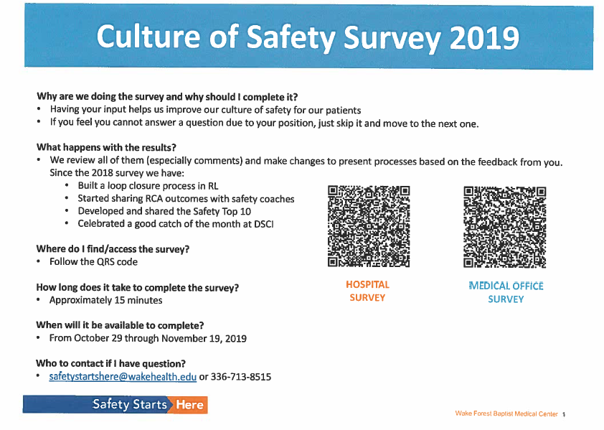

Slide 15
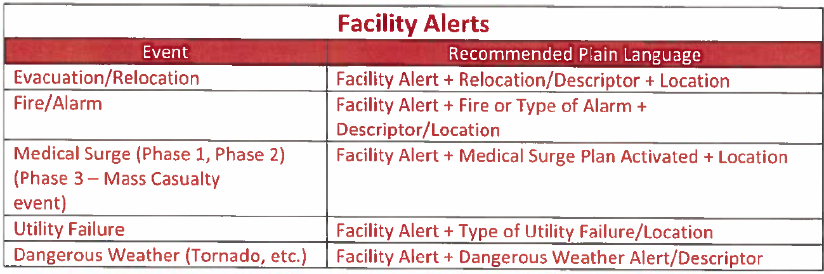
Emergency Alert Plain Text Matrix

Slide 16
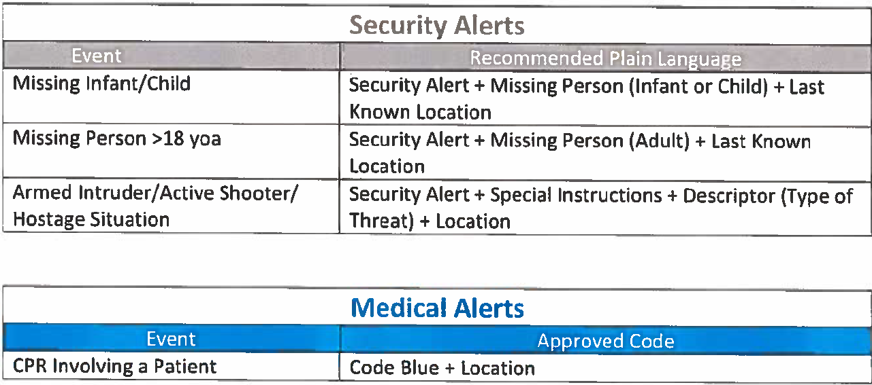
Emergency Alert Plain Text Matrix

Slide 17
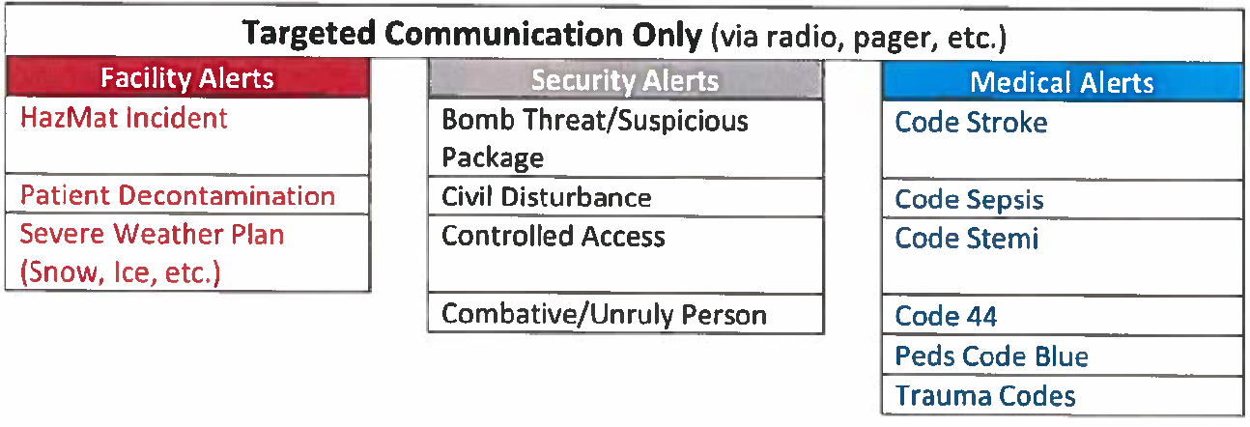
Emergency Alert Plain Text Matrix

Slide 18
