Slide 1
Lab / Pathology
Managers Meeting
December 2019

Slide 2

Patient and Family Promise

Slide 3
Serious Safety Events
Days since last SSE:
WFB: 30
BCH: 47
DMC: 201
HPMC: 23
LMC: 37
WMC: 74

Slide 4
Lab Pathology Deviations
July - Blue (58)
Aug – Orange (107)
Sept – Yellow (94)
October – Brown (66)
November – Green (57)

Slide 5
Lab Pathology Deviations by Section
July - Blue (58)
Aug – Orange (107)
Sept – Yellow (94)
October – Brown (66)
November – Green (57)

Slide 6
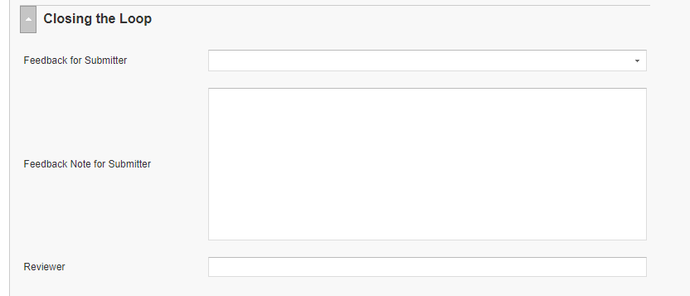
RL6 Closing the Loop Compliance
Closing the Loop
November 48/57 = 84%
Your name here!

Slide 7
RL6 Closing the Loop Compliance by
Section

Slide 8




Focus on Details: StopThinkActReview
0
  Stop
    Pause to focus attention on task
  Think
    Understand WHAT is to be done
    Plan your actions
    Decide what to do if the unexpected occurs
  Act
    Execute planned task
  Review
    Verify for expected/desired results
Notes:
Instructor Guide: Safety Behaviors for Error Prevention
You should always take a few seconds to STAR to reduce your chances of making an unintended mental slip or lapse by more than 10 times when:
Performing Multiple Tasks – The human mind is a single attentional resource. While the brain can do more than one thing at a time, the mind can only think of one thing at a time.
When you are distracted or tired and it is hard to concentrate.
Time Pressure – You are running behind schedule in your mind.
Peer Pressure to Work Fast – You’re cleaning a room to get it ready for a patient and are interrupted to hurry.
When you are about to do a high-risk intervention, process or safety-critical action.
Points to emphasize:
Work to make STAR a part of your skill-based acts and especially those safety-critical acts.
Using STAR decreases your chance of error by more than 10 times!

Slide 9
Focus on Details: Say Color, Not Word
YELLOW | GREEN | RED | ORANGE
BLACK | RED | YELLOW | PURPLE
RED | RED | GREEN | ORANGE
GREEN | BLUE | BLACK | YELLOW
Source: Stroop, J.R. Studies of interference in serial verbal reactions. J. Exp. Psychol., 18:643-662, 1935.
Notes:
Reading is a skill-based task. Most humans are so proficient at reading printed words that they cannot easily ignore them. In fact, it takes considerable attentional effort to ignore them.
Point to emphasize:
The Stroop Task is a great demonstration of a skill-based task and the value of STAR in helping to prevent unintended skill-based errors. The task takes advantage of our ability to read words more quickly and automatically than we can name colors.
Participants are asked to say the color and not the word.
Ask the participants to do this exercise fast…. Note how the participants will start making errors.
Then ask the participants to repeat the exercise, but this time ask them to stop for 1-2 seconds before each color, to stress how the 1 second pause helps for accuracy.
The words are shown in a color different from the color that the word actually names. If the word green is written in red ink, our tendency will be to say green instead of red. In this task, you have to manage your attention to stop one auto-pilot response in order to say or do something else.
The effect demonstrated in the Stroop Task was first reported by John Ridley Stroop in his Ph.D. thesis published in 1935.
Instructor Guide: Safety Behaviors for Error Prevention

Slide 10
Safety Starts Here Section Compliance 2019

Slide 11
Safety Coach Meeting Participation

Slide 12

Next Lab Huddle: January 14th, 2020

