Slide 1
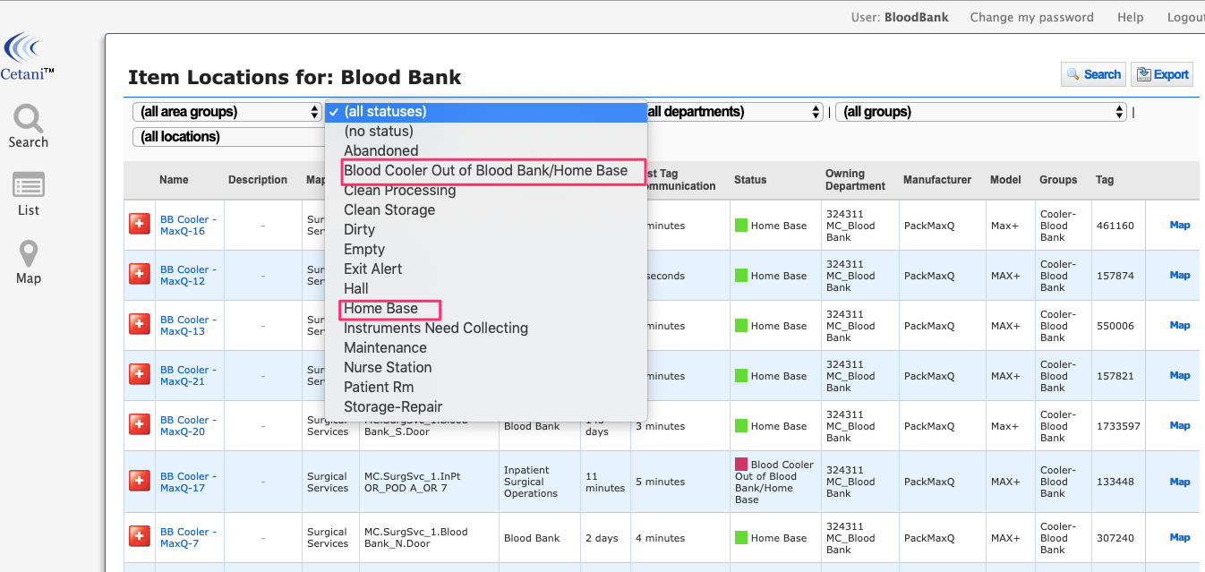
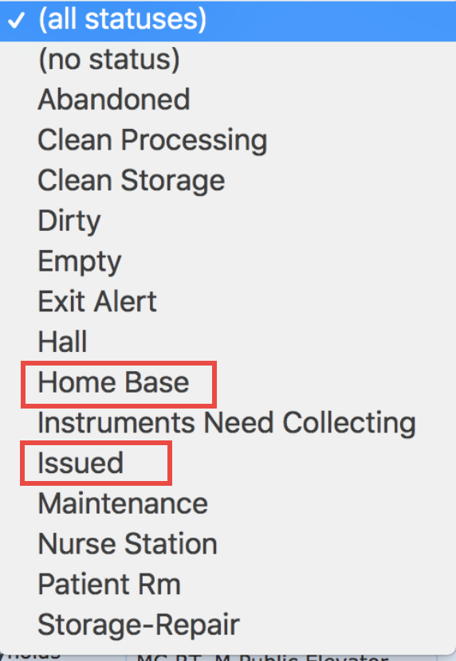
SPOT Blood Cooler Locating Display Instructions
To access the Application use http://spot.wakehealth.edu
Display login: BBFRONT
Display Password: BBFront
Blood Coolers
Blood Cooler Statuses: Select status and then Filter
Home Base OR
Issued

Slide 2
Viewing Coolers By Issued
Click on Column Header In Area For to resort list by those issued the longest.
E-mail: SPOTsupport@wakehealth.edu, Phone: 336-716-8899 (6-8899) 24 hours
Intranet: wakehealth.edu/SPOT, SPOT Pager: 336.806.7600

