Slide 1
Safety Focus
January 2020

Slide 2

Patient and Family Promise

Slide 3
Serious Safety Events
Days since last SSE:
WFB: 51
BCH: 82
DMC: 236
HPMC: 45
LMC: 72
WMC:109

Slide 4
Lab Pathology Deviations

Slide 5
Lab Pathology Deviations
December – Purple (62)

Slide 6
Lab Pathology Deviations by Section
December – Purple (62)

Slide 7
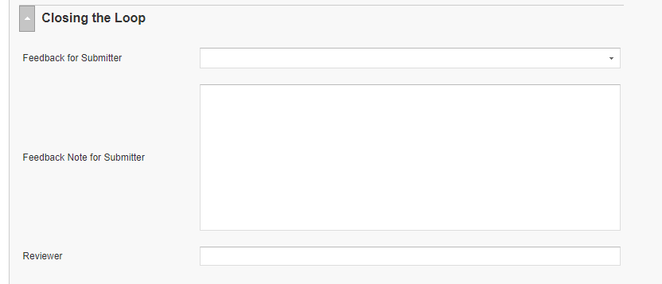
RL6 Closing the Loop Compliance
Closing the Loop
December 57/62 = 92%
Your name here!

Slide 8
RL6 Closing the Loop Compliance by
Section

Slide 9
Safety Focus of the Month: Read/Repeat Back
0
Read-Back Technique
Sender communicates an order, request, or information to a Receiver
Receiver writes the order or result and reads it back as written to the sender
Sender acknowledges the accuracy of the read-back. If not correct, repeats/clarifies the communication
“That’s correct.”
Notes:
The Read Back Technique is the same thing as a 3-Way Repeat Back, EXCEPT……
The Receiver writes down the
information, request, or order
and reads it back.
Don’t rely on your memory…
write it down whenever you receive critical information that may be difficult to remember.
A Joint Commission requirement for communication of critical test results and telephone orders
The 3-Way Read Back is different in only one way from the 3-Way Repeat Back – the Receiver writes down information that the Sender gives and reads back the written information. Joint Commission requires read backs for all telephone orders and telephone reporting of critical lab values.
Repeating or reading back information ensures the authenticity of the information – the Receiver heard it the way the Sender communicated it. Repeating or reading back does not ensure that the Sender sent accurate information or that the Receiver understood the information. For that, a second error prevention tool is needed – Clarifying Questions.
Instructor Guide: Safety Behaviors for Error Prevention

Slide 10
Safety Focus of the Month: Read/Repeat Back
0
Repeat-Back Technique
Use when communicating routine but important information.
Sender communicates an order, request, or information to a receiver
Receiver repeats back the order, request, or information to the sender
3. Sender acknowledges the accuracy of the repeat-back. If not correct, repeats/clarifies the communication
“That’s correct.”
Notes:
The repeat back is a three-way communication technique. The 3 steps are sender, receiver acknowledgment, and sender acknowledgement. Here is what a 3-way repeat back sounds like:
Sender (Nurse): “I’m calling because Jane Elgin’s blood pressure has dropped to 78 over 50.”
Receiver (Physician): “I understand, Jane Elgin’s blood pressure is now 78 over 50.”
Sender (Nurse): “That’s correct.”
That third step in which the Sender acknowledges the accuracy of the repeat back is an important one. The Receiver must listen for the words, “that’s correct.” If the information is not correct, the Sender repeats the communication.
Repeating back information ensures the authenticity of the information – you heard it the way I said it. Repeating back does not ensure that the Sender sent accurate information or that the Receiver understood the information. For that, a second error prevention tool is needed – the clarifying question.
Sender initiates communication using Receivers Name. Sender provides an order, request, or information to Receiver in a clear and concise format.
Receiver acknowledges receipt by a repeat-back of the order, request, or information.
Sender acknowledges the accuracy of the repeat-back by saying, That’s correct! If not correct, Sender repeats the communication.
Instructor Guide: Safety Behaviors for Error Prevention

Slide 11
Safety Starts Here Section Compliance 2019

Slide 12
Safety Coach Meeting Participation

Slide 13
Daily Safety Check-In (DSCI)
Everyday @ 0905

Slide 14

Next Lab Huddle: February 11th, 2020

