Slide 1
Quality Control 101
Wake Forest Baptist Health
Chemistry Lab
Winston Campus
Prepared by: Emily Dockery

Slide 2
Background Info
The overwhelming majority of laboratory results in clinical laboratories are being generated by automated analyzers.
Automated analyzers produce a tremendous number of laboratory results in a very short time.
This is achieved due to the combination of technology from 3 different fields:
Analytical Chemistry
Computer Science
Robotics
The combination substitutes a huge number of glassware equipment and tedious, repetitive laboratory work.
Over time laboratory personnel’s duties have shifted from manual work to:
Maintenance of the equipment
Internal and external quality control
Instrument calibration and data management of the generated results

Slide 3
What is Quality Control?
Quality control is an ancient procedure manufacturers used to detect the quality of their products by trying to find an early defect.
At the time manufacturers checked every product, one by one, without exception.
Today that standard is unattainable due to large scale production.
Modern quality control is used to check the quality of a minimum number of samples from total production.
This procedure is called statistical quality control (SQC) or statistical process control (SPC)

Slide 4
Why use SQC?
SQC is faster and more efficient than single checking.
A general definition would be – “SQC is a process that minimizes the variability of a procedure.”
A wiser way to define this would be - “The process that focuses on any deviation from well defined standards.”

Slide 5
How does this process translate in a laboratory setting?
SQC can be used in every automated production like the laboratory determinations which are performed by biomedical analyzers.
Unlike the industrial business, where all products are similar, the laboratory determinations are totally different because of the huge biological differences among human beings.
Because of this, SQC can only be done for the equipment and analytical methods and rarely for each laboratory result.
SQC of automated analyzers uses as samples not the patients’ results but the results of some special samples, control samples.

Slide 6
What are Quality Control samples?
Control samples are the materials that can be used for error detection in SQC methods.
Control samples are pools of biological fluid that contain analytes in varying known concentrations.
It is common in laboratories to use 2 or 3 different control samples which contain different quantities of an analyte (ie. low, normal, high).
Control samples with the same analytes but different concentrations are called levels.
Different levels check the performance of laboratory methods across all their measuring range.
In most cases control samples are manufactured by analyzers’ or reagents’ manufacturers, but some are also made by the laboratory.

Slide 7
How do I use Quality Control?
Before control samples can be used, each laboratory has to estimate their limits.
Control limits are upper and lower limits between which the control values are allowed to fluctuate.
The length of a distribution curve defines the variance of the variable.

Slide 8
How is the variance determined for a new control?
With every lot of quality control, an acceptable range for variation must be established.
This is done by performing repetitive analysis ideally across several days.
This is done to factor in any possible environmental fluctuations, varying maintenance timelines, technique variance among techs, etc.
If you are evaluating an assayed control, you must make sure your established range is still within the provided range from the manufacturer.
If you are evaluating an unassayed control, Peer Group data will be helpful to determine if you are possibly biased on the high or low side.

Slide 9
I have run my QC over multiple days. Now what?
Once you have your values, you can now calculate the factors needed to track you QC data– mean and standard deviation
The mean is an average of all you values per level.
The standard deviation is the amount of variation.
This can be done in the instrument software or by using an Excel spreadsheet.
The mean is easy enough to calculate but there is a high risk of mathematical errors in calculating the SD by hand
When establishing your SD it is important to not make it too small where you are detecting too many “errors” and also not make it too big where you are missing possible issues.

Slide 10
How do I chart Quality Control values?
The Levey-Jennings chart is the most important chart in laboratory quality control.
The chart consists of a mean line with lines above and below the mean indicating standard deviations.
It is used to detect all kinds of analytical errors – random and systemic.
Error detection can be done very easily using quality criteria.
The most widely used quality criteria today are the Westgard Rules.
Westgard rules (or modifications of them) are used in almost every single biochemical, immunological, or hematological automated analyzer.

Slide 11
What are Westgard Rules?
Multirule QC uses a combination of decision criteria, or control rules, to decide whether an analytical run is in-control or out-of-control.
The well known Westgard multirule QC procedure uses 5 different control rules to judge the acceptability of an analytical run.
Our facility currently implements 4 of these rules to determine whether or not QC is acceptable to report patient values:
1-2S
1-3S
2-2S
R-4S

Slide 12
Understanding Westgard Rules
For convenience the Westgard rules have adopted a short hand notation to abbreviate different decision criteria or control rules.
Example:
1_{2S} would indicate 1 control measurement exceeding 2 standard deviations
Combinations of rules are generally indicated by using a “slash” mark (/) between control rules (eg. 1_{3S}/2_{2S}).

Slide 13
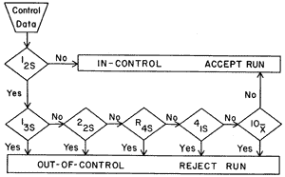
Rules used in our laboratory:
Warning Rules:
1-2s
R-4S
Hard Stop Rules:
1-3s
2-2s
M2-2s

Slide 14
1_{2S} Rule Violation
The 1-2S rule in Beaker is set up as a warning and will flag yellow.
This is letting you know 1 of your control levels is more than 2 SDs from the established mean value but within 3 SDs.

Slide 15
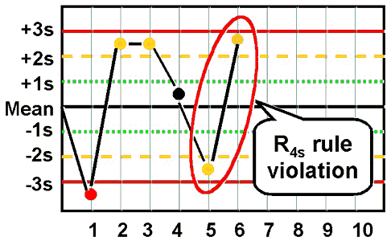
R-4S Rule Violation
The R-4S rule in Beaker is set up as a warning and will flag yellow.
This is letting you know a measurement exceeds the mean plus 2SD and another exceeds the mean minus 2SD.
This rule should be interpreted within run, not between runs.

Slide 16
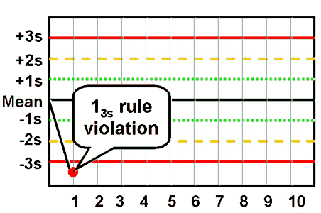
1_{3S} Rule Violation
The 1-3S rule is set up as a hard stop in Beaker and will flag red.
This is letting you know 1 of you control levels is more than 3 SDs from the established mean value.
If patients have already been run they will need to be repeated along with the QC.

Slide 17
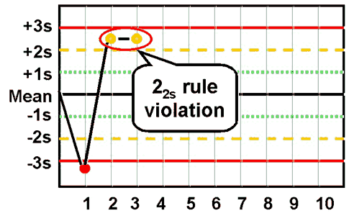
2_{2S} Rule Violation
The 2-2S rule is set up as a hard stop in Beaker and will flag red.
This is letting you know 2 levels of control are more than 2 SDs from the established mean but within 3 SDs for consecutive runs.
If these are results from 2 consecutive days this is an indicator of a possible systemic error that needs to be investigated.

Slide 18
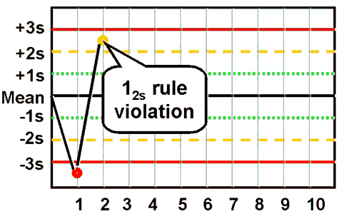
M2-2S Rule Violation
The M2-2S rule is set up as a hard stop in Beaker and will flag red.
This is letting you know that 2 related materials in Beaker (ex. MQ1c, MQ2c, MQ3c) exceeded 2SD on the same side of the mean.
Multiqual Level 1
Multiqual Level 2

Slide 19
What are the possible causes of QC failure because of a random error?
Random instrument malfunction
Power fluctuations
Temperature fluctuations (environment and/or incubation chamber)
Test operator mistake
Technique
Reagent preparation
Error in inconsistent preparation of reagent
Failure to consistently follow manufacturer instructions
Control Material
Error in or inconsistent preparation of control material
Failure to consistently follow manufacturer instructions
Software malfunction
Possible contamination

Slide 20
What are the possible causes of QC failure because of systemic error?
Calibration (most common cause)
Reagent integrity
New lot or newly prepared (second most common cause)
Lack of or inconsistent instrument maintenance
An LJ chart that is improperly set (mean or SD not properly calculated)
Instrument malfunction (reagent or sample pipette malfunction)
Light source (deterioration)
Incubation chamber temperature (shift in temperature or fluctuation)
Failure to follow manufacturer instructions for performing test
Operator technique
Software malfunction (recent updates can cause problems)
Possible contamination (of reagents, tubing, water flushes, ancillary equipment such as pipettes, etc.)

Slide 21
Quality Control Troubleshooting
If my QC is out where do I start to fix the problem?
Below are the steps your troubleshooting process should include:
Ensure the correct QC material was used including checking the open/expiration dates as well as the lot number
Ensure reagent is in date, appropriately mixed, and placed on the analyzer correctly. Check for bubbles or other possible issues.
Check instrument. Are there any noticeable issues? Is maintenance up to date?
Repeat QC.
Repeat QC using a newly opened container.
Recalibrate with current reagent (current lot) and run QC using the newly opened container.
Recalibrate with newly opened reagent (current lot) and run QC using the newly opened container.
Call vendor Hotline for additional troubleshooting

Slide 22
Things to keep in mind while trying to resolve a QC issue:
All troubleshooting requires appropriate documentation. Everything done should be written in a troubleshooting book located at the instrument.
Patient results may NOT be released until the QC issue has been resolved.
Patient results will need to be evaluated to determine if results were adversely compromised.
If it is determined that patient results were adversely compromised the technologist, supervisor or manager, and Laboratory Medical Director must determine the allotment of patient samples to be retested once the QC issue has been resolved.
Reagent cost should not influence the decision of patient retesting.
Management and/or the Laboratory director will need to determine the allowable deviation from the initial result to the retested result.
Retested results exceeding the allowable error will be evaluated for their clinical significance and may require an amended patient report with correction notification to the ordering provider.

Slide 23
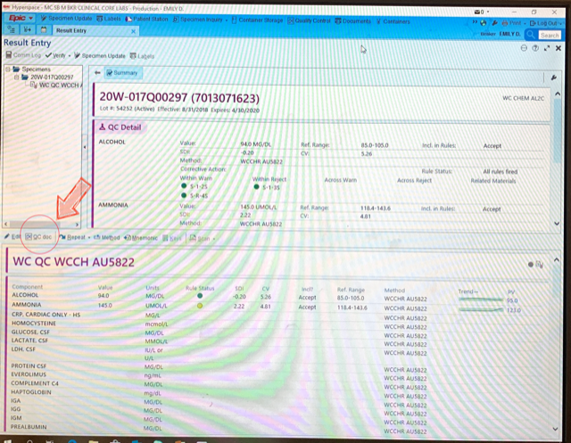
How are my corrective actions documented?
If QC flags with a yellow warning or red hard stop a corrective action must be documented before QC can be verified
These are documented through the QC doc option in Beaker.

Slide 24
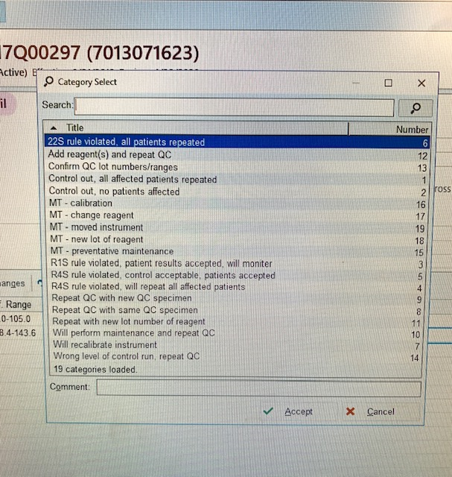
What do I select in QC doc?
Corrective Actions are selected from a pre-made list of options.
Comments can be added to further clarify what actions were taken.
This is helpful if something generic like “MT-preventative maintenance” is selected – what action was actually done?

Slide 25
How is this information helpful?
QC is reviewed daily as well as monthly
Techs performing the daily maintenance on an instrument do an initial review
Corrective Actions are documented for any warnings or hard stop QC failures
Techs should also take note if there is a pattern of QC failures from day to day indicating a systemic instrument error
There is then a second review of Daily QC by either a Specialist or Management to verify all QC was run and corrective actions were documented appropriately
they also take note of any repeat failures and may request additional corrective actions be taken
In addition there is a monthly review of all QC values by a Specialist or Management to identify any shifts or trends. Means and SDs are also re-evaluated at this time.
A second review is completed by the Laboratory Director where additional corrective actions may be suggested.

Slide 26
Final note…
Laboratory Quality Control is designed to detect, reduce, and correct deficiencies in a laboratory’s internal analytical process prior to the release of patient results.
QC should be run at a minimum daily on each instrument after maintenance is performed.
QC should also be processed if required after service, with new lots of reagent, after calibration, and whenever patient results seem questionable.

