Slide 1
Security and Safety
Hannah Ellsworth MLS(ASCP)
Blood Bank/BMT Safety Representative
Bettina Turner MT(ASCP)SBB^{cm}
BB Specialist Technologist / Education Coordinator

Slide 2
Security Phone Number
Dial 6-9111 if you need Security
State your location: BLOOD BANK or BMT Lab
  The security phone number can be found on the “Badge Buddy”. Take a minute to find it now!

Slide 3
Let Me In!
DO NOT buzz anyone into the Blood Bank, even if they have a badge.
If you do not know the person requesting access to the BB:
  Handle the customers at the window requesting blood products FIRST
  Ask the person their business
  Do not let the person in unless you establish their business, even if a physician
  Management should tell you if they are expecting an appointment
  If unsure, call Management, Charge Tech, Security.

Slide 4
Feeling Unsafe…
If, at any time, for any reason you feel unsafe in the department…notify someone that can help you
  NOTIFY MANAGEMENT IMMEDIATELY
  NOTIFY LAB ADMINISTRATION IF YOU WANT
  NOTIFY SECURITY IF NEEDED
  MAKE APPOINTMENT WITH EAP IF YOU CANNOT TALK TO ANYONE.
The Blood Bank / BMT departments that you work in should be a safe environment for you!

Slide 5
Panic Buttons
There are two panic buttons in the Blood Bank that, if pressed, will automatically call security / police to the Blood Bank.
There are five panic buttons in the BMT Lab
Panic Buttons should be used when you feel threatened or trapped by an individual while in the Blood Bank.

Slide 6
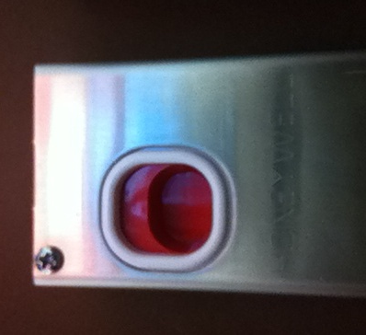
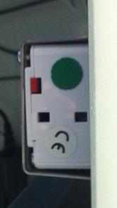
Blood Bank Panic Buttons
Front Desk:
  Under FD desk, BBMONITOR side, to
  right of door button
  To activate: Reach under box, place finger into depression, pull forward
Front View
Underside View

Slide 7
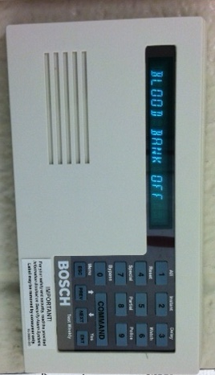
Blood Bank Emergency Key Pad
Outside Irradiator Room
  Key pad above badge scanner
    Key in the numbers 2 5 8 0 as if part of the normal access procedure to the irradiator room
      Keying in this code will activate an alarm in security
    Swipe badge, push door open as usual.

Slide 8
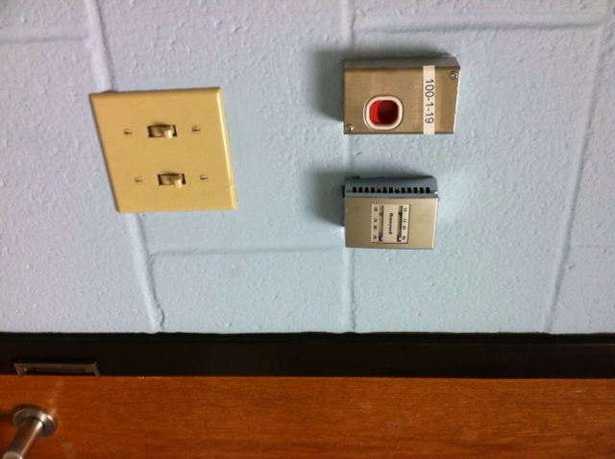
Blood Bank Panic Buttons
Inside Irradiator Room
  The Irradiator Room is considered a “Safe Room”
    Security cameras are in place to monitor the
    activity inside the room
  Directly to your right as you enter is a panic button that can be activated should you be caught in the irradiator room with an assailant.
  To activate:
    Place finger in depression
    Push down on red button

Slide 9
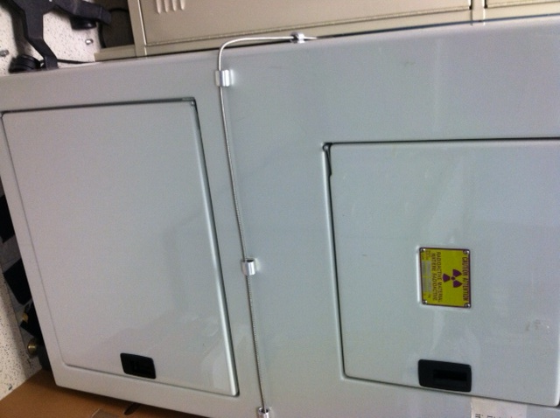
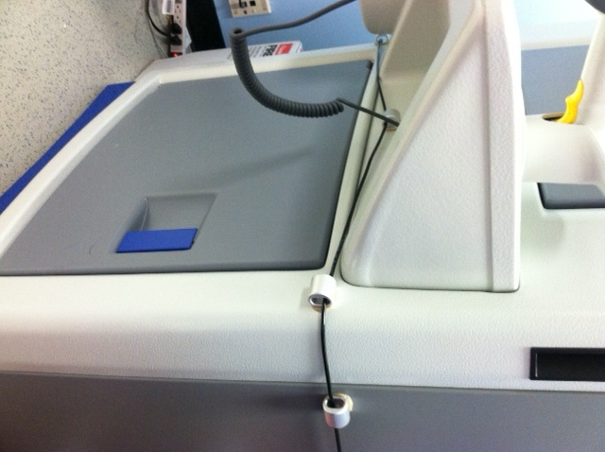
Blood Bank Panic Cords
Inside Irradiator Room
  Around each irradiator is a panic cord
  If you are caught in the irradiator room with an assailant and cannot get to the panic button, fall to the ground or lean forward and catch the panic cord. This will alert security.

Slide 10
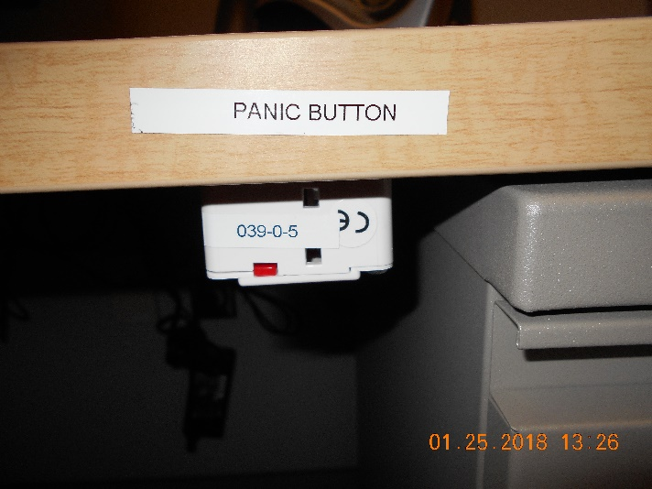
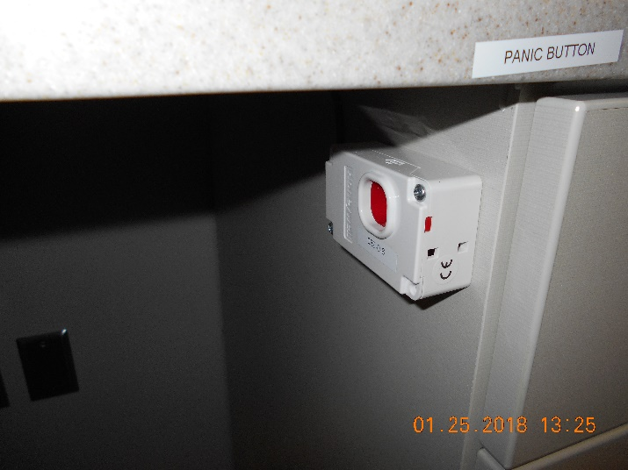
BMT Panic Buttons
BMT Office
  Under the desk that is next to the door.
Specimen Receipt Area
  Under the middle computer opposite the courier window.

Slide 11
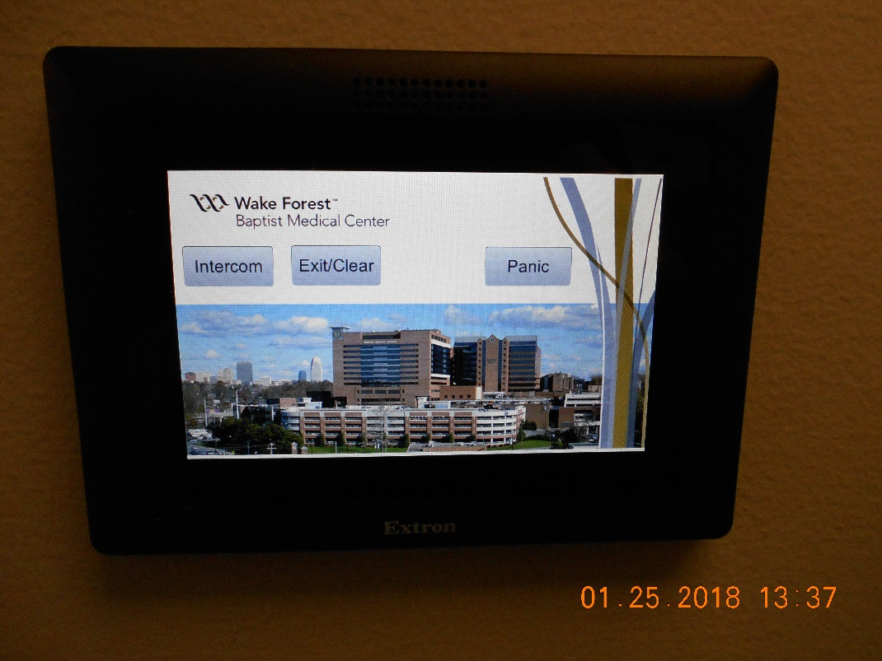
BMT Panic Buttons
Intercom system
  There are also panic buttons on each of the 3 intercom systems located:
    Hall
    Cryo Room
    Processing room

Slide 12
Blood Bank Key: Loss of Power
When there is a loss of electricity, the BB main door and the door to the irradiator room will not function.
An emergency key to access these doors is available in a lock box on the wall behind the Education Coordinator’s desk, to the left of the doorway that leads out into the hall.
    Open the Safety envelope next to the lock box
    Remove the code to unlock the lock box
    Lock box contains key to access main door and irradiator room
    Notify management if envelope security seal is broken

Slide 13
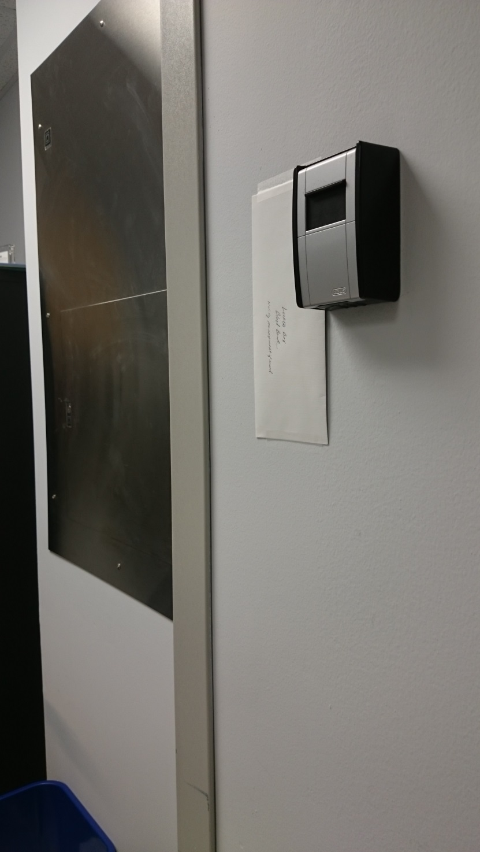
Blood Bank Key: Loss of Power
Security envelope containing
lockbox code
Lockbox containing
key to access BB
main door and
irradiator room

Slide 14
Irradiator Room Access
GammaCell irradiators contain CS137 as their radiation source which can be used by terrorists to make “dirty bombs”
The Radiation Officer of WFBH has mandated persons who access the irradiator room be cleared by background checks from various security databases. (Homeland, FBI, etc)
Process begins with fingerprints and complete background check of the person requiring access.
  Fingerprints are sent to governmental databases for checking
  Process takes approximately 6 weeks
  Once cleared, employee badge will open irradiator room

Slide 15
Irradiator Room Access
Persons with valid security can take other UNCHECKED persons into the irradiator room. Under NO circumstances should the unchecked person BE LEFT IN THE IRRADIATOR ROOM ALONE.
Remember, you are on camera inside and outside the irradiator room security is not always watching. Using the panic button, pushing violently on the door or pulling the panic cords on the irradiators will alert security to action.

