Slide 1
Lab / Pathology
Managers Meeting
February 2020

Slide 2

Patient and Family Promise

Slide 3
Serious Safety Events
Days since last SSE:
WFB: 79
BCH: 110
DMC: 264
HPMC: 38
LMC: 27
WMC: 137

Slide 4
Lab Pathology Deviations
January: 56
Average: 71

Slide 5
Lab Pathology Deviations

Slide 6
Lab Pathology Deviations

Slide 7
Lab Pathology Deviations

Slide 8
Lab Pathology Deviations by Section

Slide 9
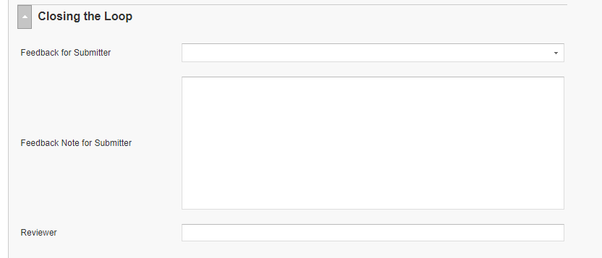
RL6 Closing the Loop Compliance
Your name here!

Slide 10
RL6 Closing the Loop Compliance by
Section

Slide 11
Please use this template as provided. Do not modify the font, bullets, border or background.
Use this for orange text
Use this for blue text
Or this if you need red
Communicate Clearly
Ask Clarifying Questions Any time you are in a high-risk situation Any time the information is incomplete Any time the information is not clear
The purpose is to make sure that you really understand what is being communicated… so that you don’t make a decision based on a wrong assumption. Asking 1 or 2 clarifying questions can reduce your chances of making a wrong assumption by 2 ½ times. | Clarifying questions can be asked by the sender or receiver – we want to improve communication for everyone involved. Support and encourage asking clarifying questions in your department.
Notes:
February

Slide 12
Safety Starts Here Section Compliance 2019

Slide 13
Safety Starts Here Section Compliance 2020

Slide 14
Safety Coach Meeting Participation
2019

Slide 15
Safety Coach Meeting Participation
2020

Slide 16
Daily Safety Check-In (DSCI)
Everyday @ 0905

Slide 17

Next Lab Huddle: March 10th, 2020

