Slide 1
Fire and Code Triage
Bettina Turner MT(ASCP)SBB^{CM}
BB Specialist Technologist and Education Coordinator
Hannah Phillips MLS(ASCP)
Blood Bank/BMT Safety Representative

Slide 2
Fire Alarms
ANY time a fire alarm sounds you should
Look for smoke or fire
Smell for smoke
Listen for announcement over PA system
Share information with management and co-workers

Slide 3
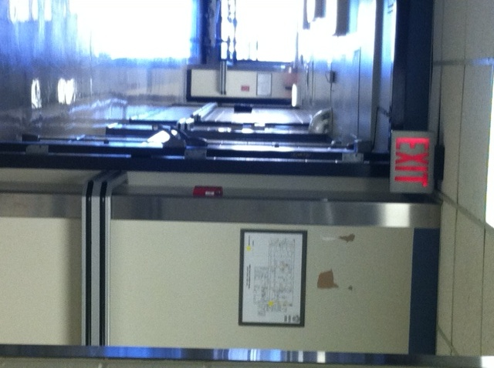
Fire Alarms
If you smell or see smoke or see fire:
DIAL: 6-9111 or
Blood Bank location: BB / 1st Floor NT / Room 1B074
ACTIVATE NEAREST FIRE ALARM BOX
LOCATION:
Out main BB door
Turn right
At elevator well
Fire box is on right directly under red EXIT sign
Elevators

Slide 4
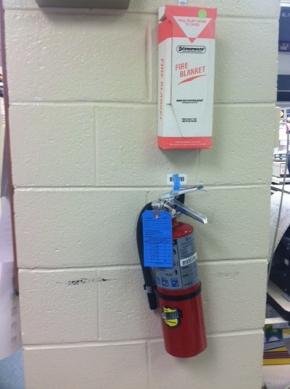
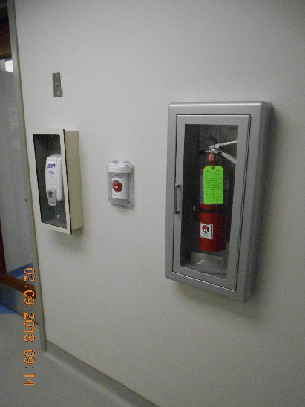
Fire Alarms
Fire Extinguisher Locations
In Blood Bank
On back side of column near unit tag printer #2
In BMT Lab
In the processing room next to the specimen receipt door
P.A.S.S.
When using a fire extinguisher remember:
Pull extinguisher pin
Aim extinguisher at base of flames
Squeeze extinguisher handle
Sweep extinguisher from side to side until flames are extinguished
Blood Bank
BMT Lab

Slide 5
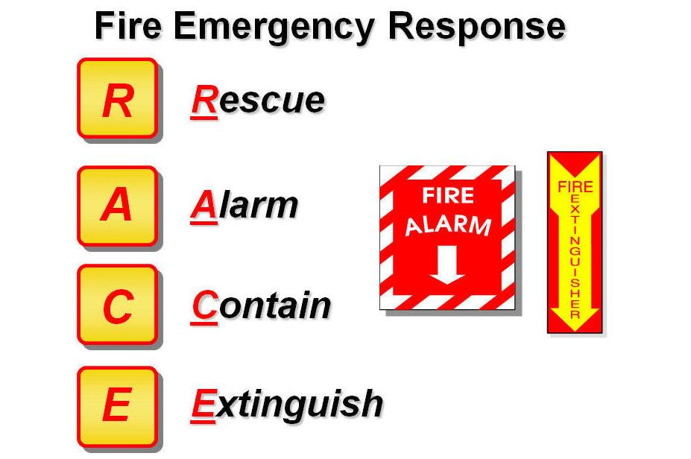
R. A. C. E.
Rescue any persons in immediate fire area without endangering yourself
Alarm: sound the alarm by calling 6-9111 or activating the nearest fire alarm box
Contain the fire by shutting doors and windows, and put wet towels under the door, etc.
Extinguish if the fire is small and localized, and you are familiar with the use of a fire extinguisher, use it to put out the fire – otherwise
Evacuate: use posted evacuation route.
Turn off gas, electrical machinery, close doors, windows as you leave.
Primary Blood Bank Evacuation Route
Turn right out of main BB
door into hallway.
Walk to end of hallway
Take stairs to bottom
Meet in street in front of power
plant

Slide 6
BMT Evacuation Route
Primary
Exit BMT through either door. Turn right. Turn right again after the North tower elevators if you exited BMT from the cryo room. Go Down North tower stairway at the end of the hall. Exit to meet at the front of the power plant.
Secondary
Exit BMT lab through the cryo room. Turn Left. Proceed to Gray building. Turn right down first hallway. Go through double doors. Go down stairway on left and exit building.
BMT Evacuation Route
Second Floor North Tower
 |  |  |  |  |  |  |  |  |  |  |  | Stair Well
 |  |  |  | North Tower Elevators |  |  |  |  | BMT Office and Specimen Receipt |  |  | Service Elevators
 |  |  |  |  |  |  |  |  | BMT Processing and Cryo Rooms
 |  | Stair Well
Primary
Secondary

Slide 7
R. A. C. E.

Slide 8
Emergency Alert Plain Text Matrix
Facility Alerts
Event | Recommended Plain Language
Evacuation / Relocation | Facility Alert + Relocation/Descriptor + Location
Fire / Alarm | Facility Alert + Fire or type of Alarm + Descriptor/Location
Medical Surge (Phase 1, Phase 2) Phase 3 – Mass Casualty event) | Facility Alert + Medical Surge Plan Activated + Location
Utility Failure | Facility Alert + Type of Utility Failure / Location
Dangerous weather (Tornado, etc.) | Facility Alert + Dangerous Weather Alert / Descriptor

Slide 9
Emergency Alert Plain Text Matrix
Security Alerts
Event | Recommended Plain Language
Missing Infant / Child | Security Alert + Missing Person (Infant or Child) + Last Known Location
Missing Person > 18yoa | Security Alert + Missing Person (Adult) + Last Known Location
Armed Intruder / Active Shooter / Hostage Situation | Security Alert + Special Instructions + Descriptor (Type of Threat) + Location

Slide 10
Emergency Alert Plain Text Matrix
Medical Alerts
Event | Approved Code
CPR Involving a Patient | Code Blue + Location

Slide 11
Code Triage
Blood Bank staff will be notified by the Incident Command Center (ICC) when Code Triage Plan is activated
Activate Telephone Call List immediately
Notify management / medical director immediately (24h / 7d)
Staff lab with minimum of 6 employees
Print inventory (RC, PLSMA,PLT) Give to medical director.
Medical Director / Path Resident will report to ICC.
Notify blood supplier of disaster situation

Slide 12
Code Triage
Virtual Personnel Pool
Assess the number and capabilities of the employees present and report personnel available to the Virtual Personnel Pool.
See step by step instructions on how submit a Virtual Personnel Pool
Lab Safety Manual / Code Triage section

Slide 13
Severe Weather
Tornado Approaching
Listen for ECC announcement
Evacuate to areas without exterior windows
Central, new renovated space / storage area
BMT office, conference room, breakroom
Interior stairwell, basement, sub-basement
Hurricane Procedure
Report damages or outage of service immediately to the Service Response Center using 6-9111, option 3.

