Slide 1
Lab / Pathology
Managers Meeting
March 2020

Slide 2

Patient and Family Promise

Slide 3
Serious Safety Events
Days since last SSE:
WFB: 67
BCH: 39
DMC: 292
HPMC: 62
LMC: 55
WMC: 165

Slide 4
Lab Pathology Deviations
February: 72
Average: 71

Slide 5
Lab Pathology Deviations by Section

Slide 6
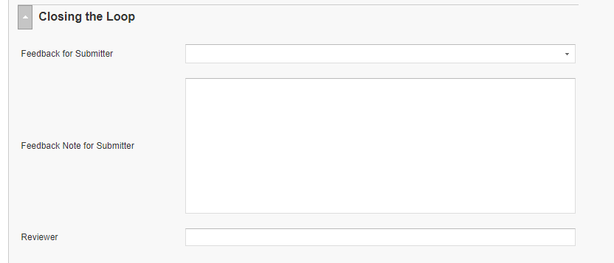
RL6 Closing the Loop Compliance
Your name here!

Slide 7
RL6 Closing the Loop Compliance by
Section

Slide 8

Safety Focus of the Month
Good Catch
Improving the safety culture includes reporting good catches.
Accentuates the positive.
Typically it is reporting near misses due to someone ‘catching’ the error before it reached the patient
“Just like the skin is the first line of defense against infection, so is Good Catch our opportunity to protect patients from something that’s potentially harmful to them.”
Alison Carmichael-Bishop
assistant nurse manager

Slide 9
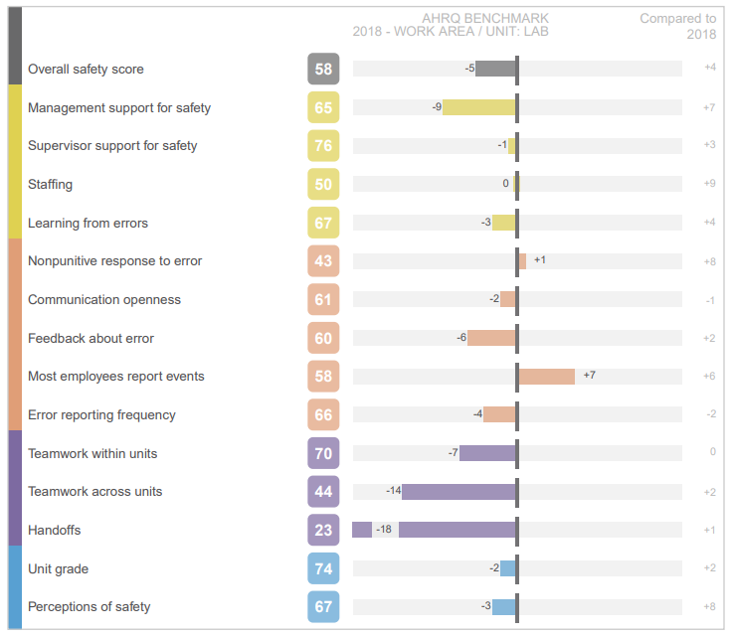
2019 Hospital Safety Culture Survey

Slide 10
Safety Starts Here Section Compliance 2019

Slide 11
Safety Starts Here Section Compliance 2020

Slide 12
Safety Coach Meeting Participation
2019

Slide 13
Safety Coach Meeting Participation
2020

Slide 14
Daily Safety Check-In (DSCI)
Everyday @ 0905

Slide 15

Next Lab Huddle: April 14th, 2020

