Slide 1
Critical and Corrected Values 101
Prepared by: Emily Dockery | Wake Forest Baptist Health – Winston Campus - Chemistry

Slide 2
What is a critical value?
Critical values are potentially life threatening laboratory results that must be conveyed to the physician or other health care professional so that therapeutic measures can be instituted rapidly.
Rapid and accurate communication of critical laboratory test results is required by the Clinical Laboratory Improvement Amendments (CLIA) regulations, included in laboratory accreditation standards, noted as a National Patient Safety Goal, featured in the World Health Organization’s World Alliance for patient safety, and codified in the International Organization for Standardization standard for medical laboratories.

Slide 3
Why is calling critical values important?
Improvement in critical value notification is driven by the assumption that timely reporting will lead to more timely clinical interventions.
This will improve treatment outcomes and help in the prevention of co-morbidities.

Slide 4
Current Critical Values Reported

Slide 5
Steps to Report a Critical Value
Step 1
Critical value appears in either Remisol or Beaker
Step 2
Verify the person you are speaking with about the value is either a physician or nurse responsible for the patient and provide them with patient name, medical record number, and critical value
Step 3
Make sure the person taking the value reads the value back to you along with the provided patient information and verify the information by saying “correct” or correcting information that was wrong and having them read it back again
Step 4
Document this call in either Remisol or Beaker using the preset “Called to read back” smart phrases including the person spoken to, time, date, and your initials
Identify ordering location and call using any of the provided phone lists or phone number information in Beaker
Notes:
List all of the steps used in completing your experiment.
Remember to number your steps.

Slide 6
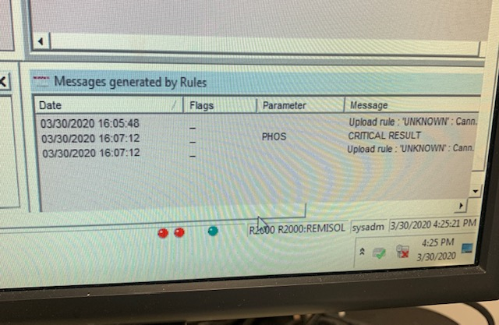
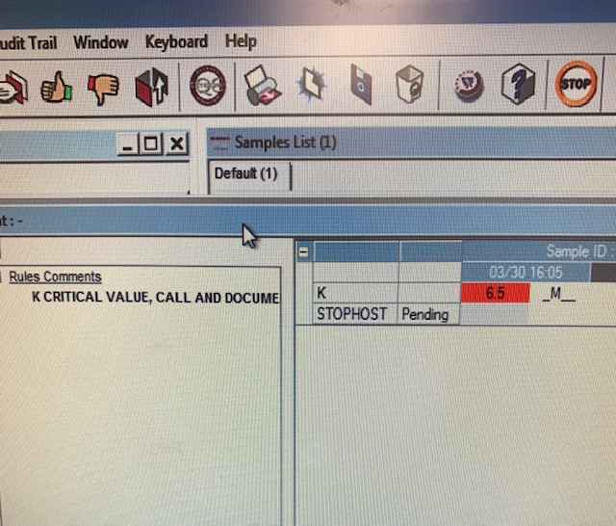
Critical Value Documentation in Remisol
A critical value message will show up in the “Messages generated by rules” window in the lower left of the screen and in the left hand column in the new window that displays when results are reviewed
The critical results should be highlighted in red, green, or blue
*The most commonly missed critical value is a Phosphorus value of <1.0 – value will be backlit in light blue.
Notes:
Summarize your research in three to five points.

Slide 7
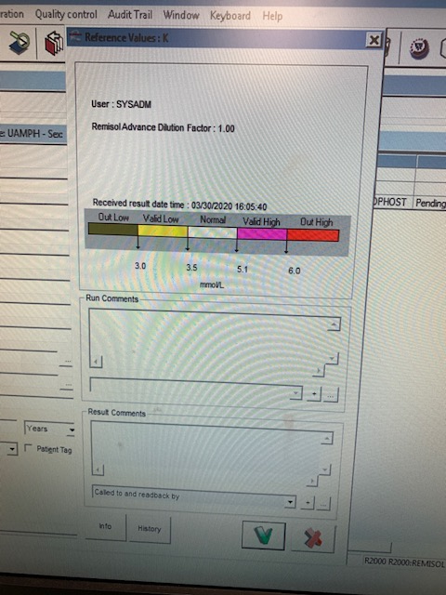
Critical Value Documentation in Remisol
Double click the critical value to open the pop up window where the communication can be documented
In the “Results Comments” box at the bottom of the window there should be a drop down arrow with several options
Select “Called to and readback by” and click the “+”
If hemolysis must be documented and did not automatically attach to the result select this first from the drop down menu and click the “+”

Slide 8
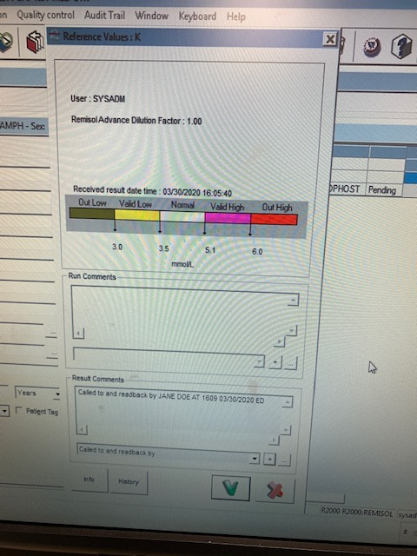
Critical Value Documentation in Remisol
After the result comment the following must be typed:
Person contacted
Time
Date
Tech initials

Slide 9
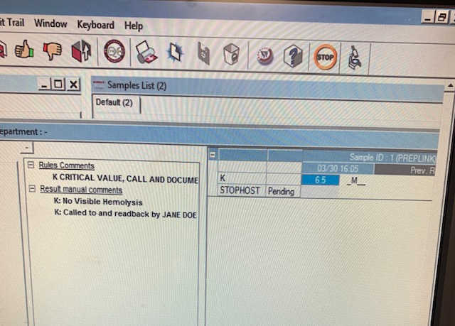
Critical Value Documentation in Beaker
Click the green checkmark at the bottom of the window
Verify all the information is complete at accurate on the left hand side of the window
Note: elevated K+ levels MUST indicate degree of hemolysis
If not noted in the left hand column this can be added as a smart phrase when you document your critical value information from the same drop down options
When all entered data is reviewed – verify results

Slide 10
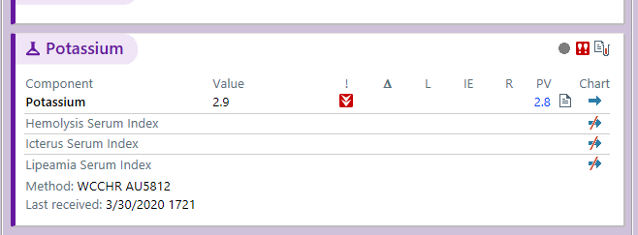
Critical Value Documentation in Beaker
Not all critical values go through the Remisol middleware
These will need to be documented directly in the Beaker program
Critical values may also need to be documented in Beaker during any Remisol downtime
These may be indicated by a message or by a high or low panic value symbol next to critical results

Slide 11
Critical Value Documentation in Beaker
Double click the patient information on the Outstanding List
In the Result Entry window select Edit
Double click the blank page symbol in the last column of the critical component row

Slide 12
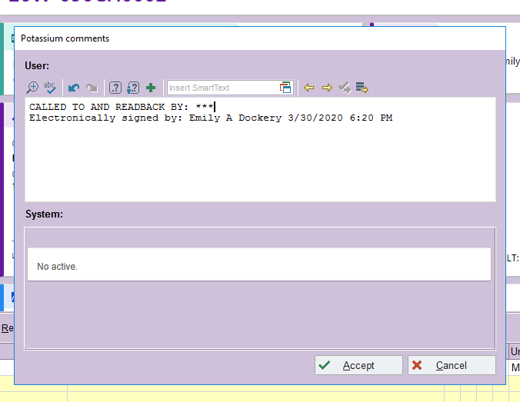
Critical Value Documentation in Beaker
In the pop up box type “.CTRB”
Double click the CTRB under the Abbrev column
Once the value has been called delete “***” and replace them with the name of the person notified
All other required information is automatically filled in by the smart phrase
Select Accept
Final Verify result

Slide 13
Verifying all Critical Values Were Called
The only way to verify all critical values were called and properly documented is to pull a Quality Assurance report in Beaker
The report is manually set up under the My Reports function in Beaker
If you do not have access to this report under your login let management or the specialists know so this can be set up
A QA report must be pulled at the very minimum at the end of your shift
It is a good idea to even pull the report multiple times during your shift to avoid delay of properly notifying providers of critical values

Slide 14
Reviewing a Quality Assurance Report
When reviewing you QA report you are verifying the following:
All critical values have the “Called to and readback by” comment in the Component Comments column
The comment lists person notified, correct date, time called, and the initials or name of resulting tech
Elevated potassium values indicate hemolysis

Slide 15
DO NOTs of documenting critical values:
Documentation for critical values should contain only the information on the previous slides
The following information belongs ONLY in the yellow lab comments box or in an RL6 reporting an issue:
Number of call attempts
Description of call experience
Phone number called
Opinions about critical value notification process
These comments DO NOT belong in the patient chart and will be attached to the patient result if documented with the critical value notification comment

Slide 16
What if no one will take the critical value?
For INPATIENTS and WFBH OUTPATIENT CLINICS:
You are required to make 3 call attempts to alert providers of a critical value
Intervals for these calls should be 5-10 minutes if inpatient and around 30 minutes for outpatients
If no one will answer the phone or you cannot find someone to take the value after 3 attempts page the Pathologist on call
Give the patient and critical value to them and they will attempt to contact an appropriate provider
If you are unable to contact any of the above page Dr. Pomper, Dr. Palavecino, or Dr. Fadeyi

Slide 17
What if no one will take an Outreach Patient critical value?
For OUTREACH CLINIC PATIENTS:
Call the provided number either on the Outreach phone numbers spreadsheet or number provided on patient requisition in CP or Customer Service
Make 3 attempts to contact the person on call for the clinic in 30-45 minute intervals

Slide 18
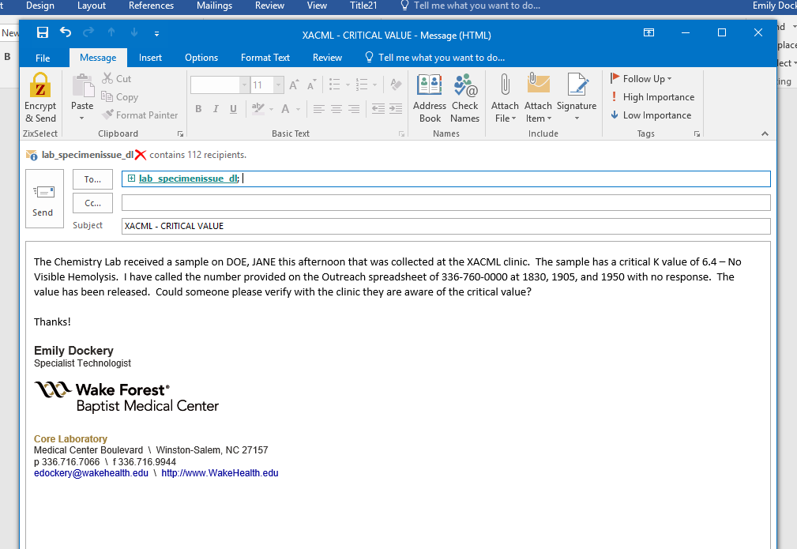
What if no one will take an Outreach Patient critical value?
If you have received no call back after 3+ hours and you have made the 3 attempts do the following:
In place of the “Called to readback by” comment type
Called XXX-XXX-XXXX X3 at HHMM, HHMM, and HHMM. No Response.
Release the value and email lab_specimenissue_dl with the following information:
Subject: start with clinic acronym and short description for email
In email include patient information, critical value, phone number called, time of attempts, and any other important information

Slide 19
Corrected Values
Possible reasons for a correction include:
Corrected after retesting
Corrected due to QC investigation
Corrected result due to user error
Instrument malfunction
Results entered on wrong patient
Test done on wrong patient
Test done on wrong specimen
Results removed at request of physician for cancellation
Note: Values should only be corrected if there is a significant clinical different between the reported and repeated values. If you are unsure verify with management or a specialist before changing any reported results.

Slide 20
How to Correct a Result
All corrected results must be called to the ordering provider, ordering clinic, or responsible nurse and notification documented in Beaker
Search for sample to be corrected using the Specimen Inquiry function in Beaker using either the Medical Record number or Sample ID
Click the icon in the upper right hand corner and select Result Entry from the drop down selections
Click the icon in the upper right hand corner and select Result Correction from the drop down selections

Slide 21
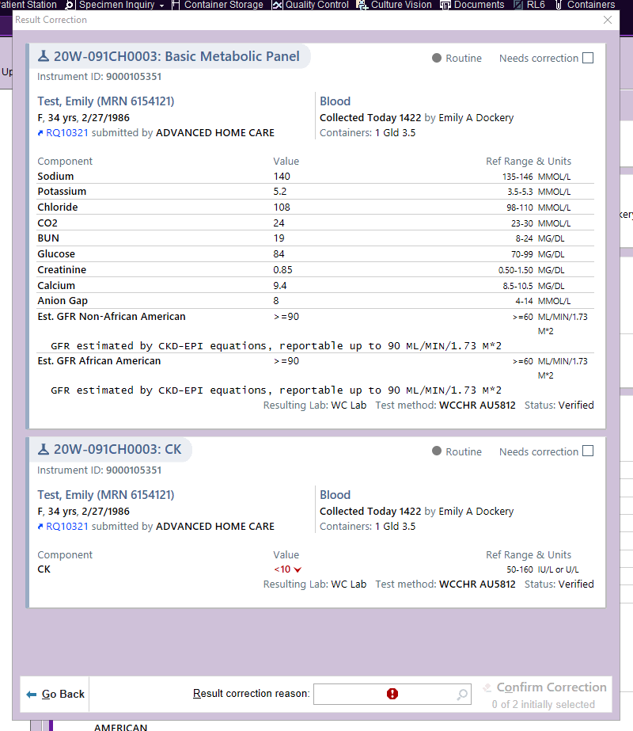
How to Correct a Result
From this window select the “Needs correction” box for any order that has a component needing a result to be changed
Next click the icon in the “Result correction reason” box at the bottom of the screen
Select your correction reason from the preset list
If you select Other as your reason you must provide a reason
Select “Confirm Correction”

Slide 22
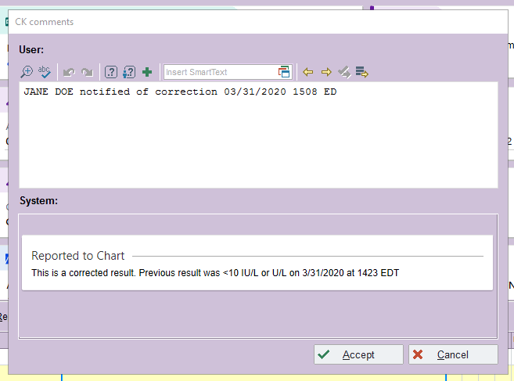
How to Correct a Result
Click the order to be corrected on the left hand side of the screen
Select Edit
Change the result and then double click the icon at the end of the row
In the comments box enter the comment in the example picture including the person notified, date, time, and tech initials
DO NOT enter any other information in this field – this information will be attached to the result in the patient’s chart
Any other information you feel important can be entered in the yellow Lab Comments box at the bottom of the screen or in the RL6 that must be completed
Select Accept and Final Verify

Slide 23
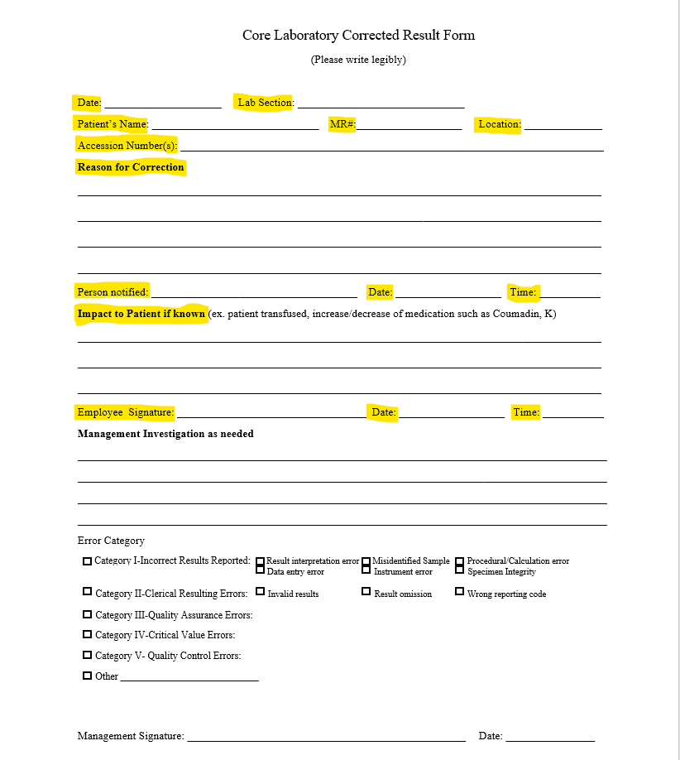
How to Fill out a Corrected Result Form
With any corrected result (with the exception of comment added) a Corrected Result form must be completed
The highlighted sections are required to be completed by the tech correcting the value
Please provide as much information as possible – attach a separate sheet if necessary
Place all completed forms on the manager’s door

Slide 24
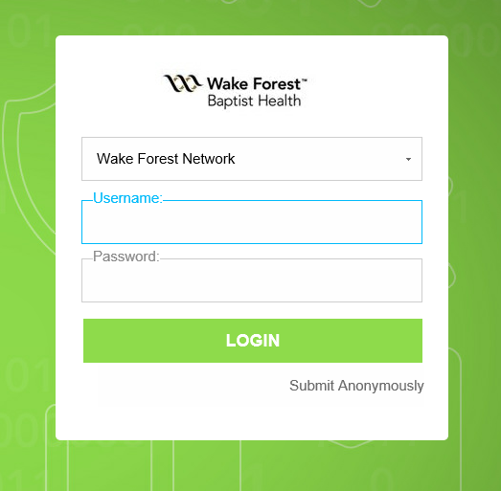
How to Complete an RL6
Once paperwork has been completed you must complete an RL6
The link can be found on your desktop or in Beaker
You can login using your hospital username and password

Slide 25
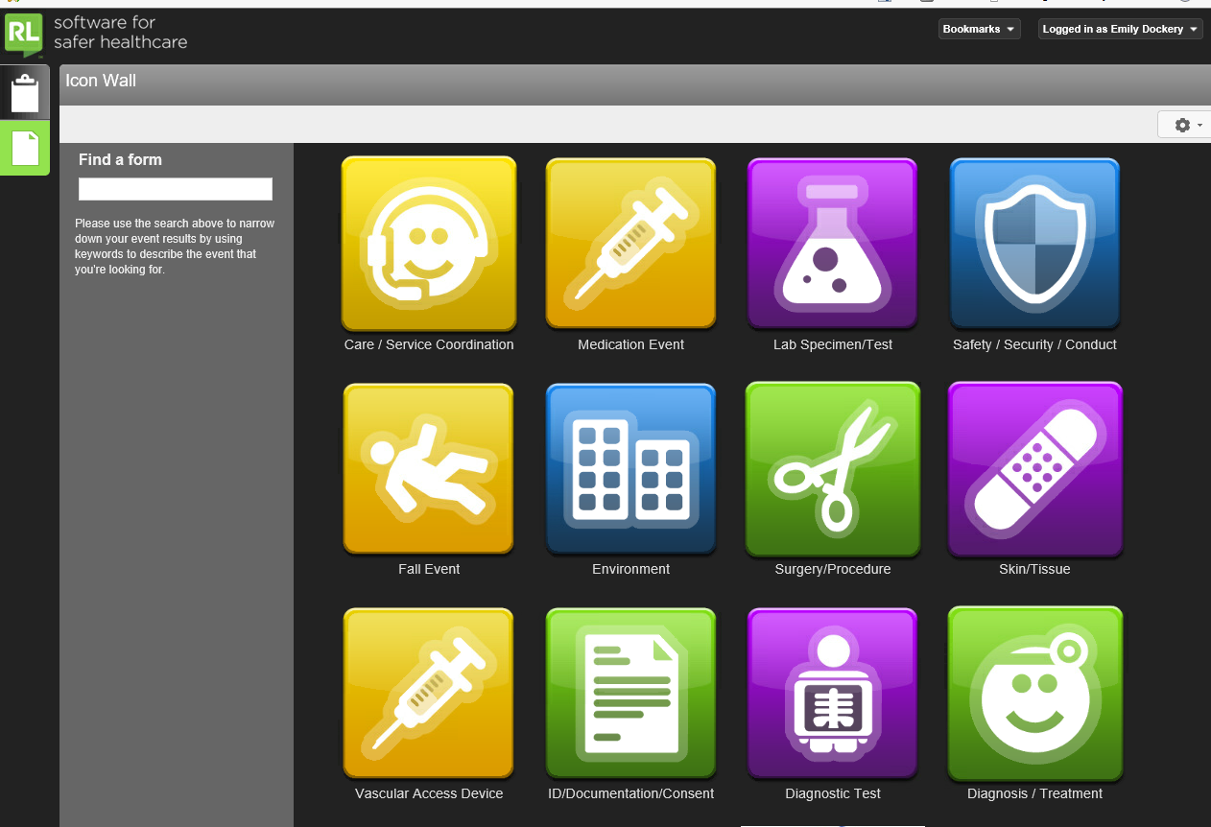
How to Complete an RL6
Skip the first screen and it should take you to the Icon Wall
Select the Lab Specimen/Test icon
You will be directed to the Lab Specimen Test Submission Form
You must fill out all fields with a green asterisk (*)

Slide 26
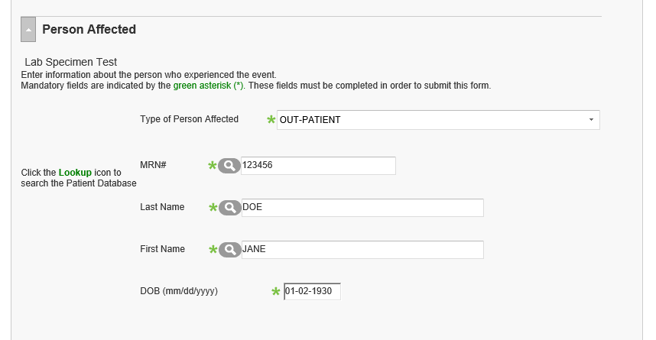
How to Complete an RL6
The first section will be for entering information about the patient affected
Enter whether the patient is an IN-PATIENT or OUT-PATIENT
Enter the Medical Record number
For Outreach patients (X locations):
Click on the blue Requisition number under Specimen Inquiry (ex. RQ304328)
The MRN in in the upper left as SUBMITTER PATIENT ID (ex. XRMER-000055)
Enter Last Name
Enter First Name
Enter the patient date of birth

Slide 27
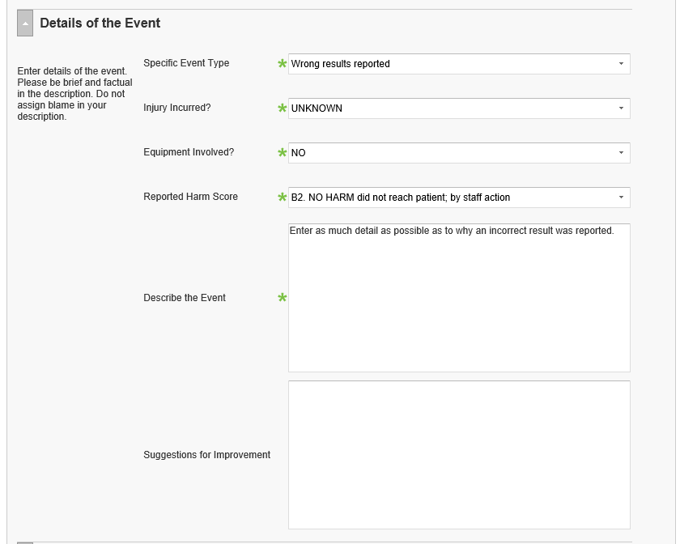
How to Complete an RL6
The next section to be filled out is Details of the Event
Under Specific Event Type pick the best option from the drop down menu
For corrected results this would be “Wrong results reported”
Fill in “Injury Incurred?” as UNKNOWN
Answer Equipment Involved as NO
Fill in Reported Harm Score as B2. NO HARM did reach the patient; by staff action
In the “Describe the event” fill in as much information as possible about why the result was reported incorrectly and what actions were taken to determine the correct result

Slide 28
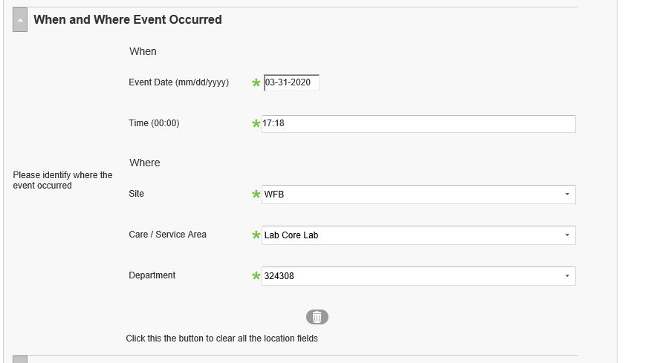
How to Complete an RL6
The next section to complete is When and Where Event Occurred
All fields of this section must be completed
Enter date of the result correction
Enter the time the result was corrected in Beaker
The site selected from the drop down menu will be WFB
Care/Service area selected will be Lab Core Lab
There will only be one option for Department - 324308

Slide 29
How to Complete an RL6
The last section is Person Submitting Report
This is where you will enter your information
Under Person Submitting Report type your first and last name
Reporter Role will be Allied Health Professional
Contact information will be 336-716-7066
Click the green Submit button when all sections are completed

Slide 30
Missed Critical Values and Corrected Reports Clinical Chemistry and Clinical Chemistry Mass Spec Labs
Missed critical values include values that were not called and values that did not have complete documentation.

Slide 31
Tips to Prevent Missed Critical Values and Corrected Value Reports
Pull a QA report often
You are required to pull a QA report at the end of your shift
If you are busy it may be a good idea to do this more often
It is easier to call a critical closer to resulting time than at the end of a shift after nursing has switched shifts or clinics may have closed
Make sure ALL information is present
If you notice an error on you QA report correct the result with the Comment Added option – as long as you do not modify the result Beaker will not attach a corrected result flag
Pay attention to what you are resulting
SLOW DOWN!
Make sure there are no flags attached to the result like an F flag indicating a dilution is needed
Notice patterns in results that may indicate instrument issues
If you suspect an issue run QC
From the Centaur read flags attached to results in Beaker – check the instrument computer for instructions if necessary

