Slide 1
COVID-19 Morgue Plan
Decedent Surge Team Training
Department of Pathology

Slide 2
Purpose:
To provide the guidelines and skills necessary for the Decedent Surge Team to complete the tasks of Decedent Affairs employees, in emergent situations.
Plan will be activated when the number of deaths either at our medical facility or in our community, rapidly exceed existing permanent staff processing abilities within a 24-hour period.

Slide 3
Team Member Expectations:
All Decedent Surge Team Members must:
Work in close proximity to decedents as required while transporting, storing and tracking
Follow all written and verbal instructions
Complete manual documentation
Utilize Excel to document
Posses effective communication skills
Be adaptable with regards to workflow/procedural changes
Have the physical abilities for decedent transport i.e. lifting, moving, pulling, tugging, etc.
Use all PPE according to institutional guidelines
Follow appropriate Safety/Ergonomic techniques during work shifts
Abide by all confidentiality, HIPAA and Privacy guidelines

Slide 4
Workflow Basics
All decedents originating from WFBMC, Winston Campus will be processed via Winston Campus Decedent Affairs.
  The only EXCEPTION is Fetal Demise. Birth Center staff will follow their protocol for handling. This includes transport of the body directly to the Fetal Cooler located on 2ND Floor Gray.
  These cases will NOT be routed through ANY otherwise stated protocol for Intake and Tracking.

Slide 5
Workflow Basics, contd.
Medical Examiner (ME) cases originating within our hospital and/or in our ME’s jurisdiction will be handled and tracked via the Department of Pathology Autopsy on the Winston Campus.
  Body bag will have seal OUTSIDE, seal will include:
    decedent name
    date of birth
    date and time seal was placed on exterior of bag
  Body Bag should have, at a minimum:
    a toe tag on the decedent
    paperwork stating decedent name, date of birth & date of death
  Seal should be intact with no sign of damage
  (The seal should not be broken, unless permission has been given by the ME on call. For any questions about the seal such as: law enforcement can open body bag to acquire fingerprints, gunshot residue, etc., prior to the autopsy being performed, contact the ME on call (336) 413-4095 or the Autopsy Manager (336) 469-9266.

Slide 6
Workflow Basics, contd.
WFBMC is a Regional Autopsy Center; coverage area does NOT include Davidson or Guilford Counties. However, if their decedent surge exceeds capacity, non-ME hospital deaths would be transferred to WFBMC.
If ME cases exceed capacity for these counties, the local County Medical Examiner should first reach out to county resources, and then the Office of the Chief Medical Examiner for advice.
Overflow Decedents under the ME system for Davie and Wilkes will be stored at WFBMC; these deaths would have already been examined by the County ME for those hospitals.
Decedents who may fall under the Medical Examiner system who expire at Forsyth Medical Center will be accepted at WFBMC on a case by case basis.

Slide 7
Workflow Basics, contd.
Decedent Surge Team
Individuals who have been willingly reassigned to assist in crisis situations
Fall under the direction of Autopsy/Decedent Affairs Office on the Winston Campus, highest command will be “Site Captains”
  Site Captains
    Aymes Davis – Decedent Affairs Manager
    Yasmain Rice- Decedent Affairs
    Dr. Jerri McLemore, M.D. Medical Director of Autopsy
    Paula Cooper Carson, Section Manager of Autopsy

Slide 8
Workflow Basics, contd.
Each shift will have a Shift Manager assigned to coordinate the activities in the absence of the Site Captains.
The Shift Manager will be in addition to the required number of team members performing duties at each Check Point.
There are 3 checkpoints for each decedent.
The checkpoints are:
  Intake
  Triage
  Storage

Slide 9
Nursing and Security Responsibilities:
Prior to decedent transport to the Intake Site nurse/security must:
Ensure that decedent is properly identified
Ensure that all required documents are complete and signed
Notify the Intake Site (ASCOM 24432)
  During the call-Staff member will be asked a series of questions by Decedent Surge Team member

Slide 10
Intake Check Point
Initially, there will be a single Intake location:
2nd Floor Gray Building – (Exact entrance TBD)
  This Check Point will be staffed 24/7 until the surge plan is deactivated.
  In order to perform duties appropriately, it is estimated 4 Decedent Surge Team members and 1 Site Manager will be assigned to each shift.
  If capacity is reached, additional Intake Check Points will require the same number of staff at each location.

Slide 11
Intake Check Point Team Member Responsibilities:
The Intake Check Point will be the entry site for all decedents to include hospital deaths, ME cases, and decedent from the community or community hospitals.
    Fetal Demise cases are the ONLY EXCEPTION! They will NOT be tracked through this process but will follow The Birth Center/Labor and Delivery process with no change.
The Winston Campus will be required to receive decedents from other outside locations such as:
Other Hospitals within our System
Community Hospitals within our Region
Novant, Forsyth Medical Center (case by case basis)
EMS- County or DHHS as well as Medical Examiner cases from different counties.

Slide 12
Intake Check Point Team Member Responsibilities:
Team member 1:
Review documents submitted with the decedent for completeness
Complete assigned Tracking Folder that will follow the body through the entire process
Team member 2 & 3:
Confirm the identity of the decedent
Check toe tags to ensure that information matches the document submitted
Responsible for transporting the body and the cart from the Intake Point to a Triage Point
Team Member 4:
Responsible for handling incoming phone calls, communicating with other check point sites, taking messages, etc.

Slide 13
Step 1 – Completing the Decedent Notification Questions by Phone
The Volunteer will obtain a blank Tracking Folder and complete the Step 1 questions.
As each question is verbally answered by the reporting staff member, the team member will record the information in the corresponding areas on the FRONT of the Tracking Folder.
Most answers can be indicated by the placement of a ✓ mark in the appropriate response box.
Once the questionnaire is complete the staff member may proceed with the transport of the decedent and necessary documents to the Intake Site.
The team member will then place the decedent’s folder in the TRANSPORT in Progress bin.

Slide 14
Intake Check Point Team Member Responsibilities: Member Answering Phone Call
This Team member generates the Tracking Folder documents info under STEP 1 on the front of the folder
Prior to the arrival of a decedent, the Intake Site should be notified by nursing staff by ASCOM phone. The Team Member assigned to answer the phone will ask and record the following info on the folder:
  Decedent Full Name
  Medical Record Number
  Time of Death
  Is this a Medical Examiner Case or a Pass Through or Unknown?
  Is the patient on hold for Carolina Donor Services suspended? YES or NO
  If No, did CDS hold for tissue, eyes or organs?
  Is Funeral Home or Cremation Service information available?

Slide 15
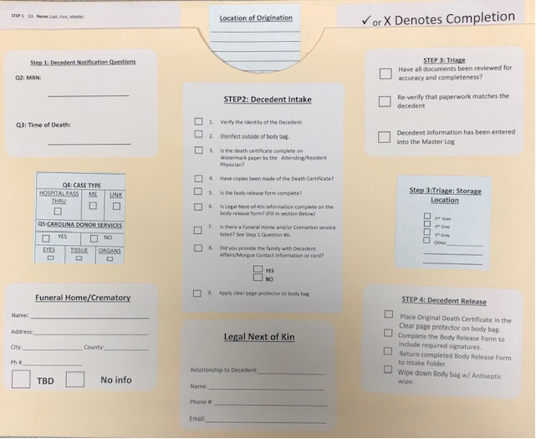
Intake Folder, STEP 1
Ensure all boxes indicated by arrows are complete.

Slide 16
Intake Check Point Team Member Responsibilities: Decedent ID Verification and Intake Document Review
NOTE: Inpatient decedents who have been diagnosed as with an infectious disease will present to the Intake Site with a YELLOW sticker on the outside of the bag.
Placement of this sticker will be the responsibility of Nursing in conjunction with the medical center’s protocol for handling Infectious patients.
When ANY decedent arrives at the Intake Site, the outside of the body bag must be wiped down with disinfecting wipes or towels and 10% bleach solution. This is true for ALL body bags, not just those that have been identified with the YELLOW Infectious tag.

Slide 17
Intake Check Point Team Member Responsibilities: Decedent ID Verification and Intake Document Review
The team member assigned to Review Intake Documents will pull the appropriate Intake Folder from the Transfer in Progress bin.
They will complete the Intake Folder information and will verify the identity of the decedent together with one of the Transport Team Members. Together they will confirm that the information on the toe tag matches the information on the paperwork. Confirm the following:
                Name
                Age
                Gender
                Race

Slide 18
Step 2 – Decedent ID Verification and Intake Document Review – Decedent ARRIVES at Intake
The Team Member assigned to complete the Intake Folder information will review the documents submitted to ensure that all required documents are present and appropriately completed.
Documents Required:
  Original Death Certificate (with water mark) – appropriately signed by an Attending Physician or Resident, Nurse Practitioner or Physician Assistant.
  2 Additional Copies of the completed and signed Death Certificate
  Completed Body Release Form to include:
    Funeral Home/Cremation Service Information
    Legal Next of Kin Information (Printed Name, Signature and Contact Number)
    Signature of Nursing Staff member
As each document or required information is accounted for, the Volunteer will place a ✓ in the box on the Front of the Intake Folder under STEP 2 questions.

Slide 19



Document Handling
The medical record, parts of the medical record, etc. may also be submitted along with the REQUIRED documents.
These documents must accompany the decedent through tracking along with the Intake Folder.
If the additional documentation does not fit neatly inside the Intake Folder, the team member should:
  Obtain a standard manila file folder.
  Write the patient’s full name on the outside of the folder.
  Place the additional documents inside the folder.
  Secure them together with a binder clip.
  Place a large rubber band around the file folder and its secured contents.
  Slide the Intake Folder containing the REQUIRED documents under the rubber band to secure the entire package.
  The entire package will follow the decedent through the tracking process.

Slide 20
Intake Folder, STEP 2
Ensure all boxes indicated by arrows are complete.

Slide 21
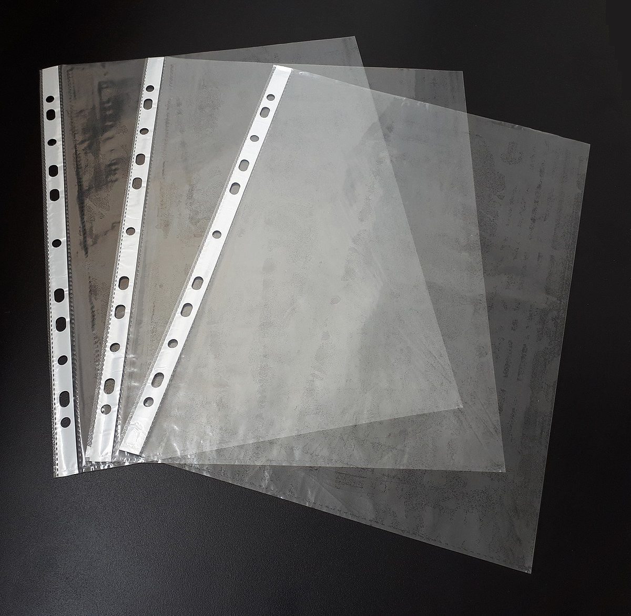
Step 2- continued
Before transporting the decedent to the Triage Site, one of the Transport Volunteers will be responsible for securing a Clear Page Protector to the outside of the bag using packing tape.
  This will be used later to hold the Original Death Certificate at the time the Body is Released.
If the decedent is determined to be an Organ Donor, they will also place a Neon Green DONOR sticker on the outside of the body bag.
The decedent and the Intake Folder containing the patient documents will then be transported to the Triage Site for the next portion of tracking.
DONOR

Slide 22
ONLY Department of Pathology and Decedent Affairs Will Have Access to 2nd Floor Gray
During the surge plan Nursing and Security Staff will not be allowed to transport bodies directly to the morgue.
They will be expected to bring the decedent and documents to the designated Intake Site location.
Exception: Fetal Demise, These will be transported in the normal process for The Birth Center Staff.
Nursing and Security Staff will not be able to Release Bodies during this time.

Slide 23
Intake Check Point:
Documents that MUST Accompany the Decedent
Original Death Certificate – appropriately signed by an Attending Physician or Resident, Nurse Practitioner or Physician Assistant.
2 Additional Copies of the completed and signed Death Certificate
Completed Body Release Form to include:
  Funeral Home/Cremation Service Information
  Legal Next of Kin Information (Printed Name, Signature and Contact Number)
  Signature of Nursing Staff member

Slide 24
Intake Check Point:
Example of Death Certificate
Complete all highlighted sections.

Slide 25
Intake Check Point:
Example of the Release of Body Form

Slide 26
Intake Check Point: Body Release Form
Green Highlighted Section Blue Highlighted Section Gray Highlighted Section
The Section in Green is completed on the unit by the nursing staff prior to the patient being transported to the morgue. If the funeral home is not known at the time of death the section is left blank and the information is written in once the family notifies Decedent Affairs or the morgue of the funeral home/crematory name.
This Section in Blue is completed by the unit nurse at the time of death to designate the status of a decedent for potential organ/tissue or eye donation. Both this section and the one above will be checked by a member Decedent Affairs Volunteer or other authorized individual to verify the completion of both sections.
This section in Grey is completed when the funeral home arrives to remove the body from the morgue. The funeral home representative signs and prints their name as witness. If the body is released to CDS (Carolina Donor Services) for release to go to their facility in Durham, then the Navy Blue line is completed.

Slide 27
Intake Check Point:
Determining Next of Kin Hierarchy
Legal Next of Kin Hierarchy
Any of the following persons, in order of priority:
The health care agent under a health care power of attorney (HCPOA) with authority to make decisions with respect to autopsies requests that an autopsy be performed upon the deceased principal;
The spouse;
Any adult child or stepchild;
Any parent or stepparents;
Any adult sibling;
A guardian of the person of the decedent at the time of the decedent’s death;
Any relative or person who accepts responsibility for final disposition of the body by other customary and lawful procedures;
Any person under obligation to dispose of the body.

Slide 28

Intake Check Point:
Organ Donors
Decedents who are identified as an Organ Donor will be identified using the NEON Green DONOR sticker attached to the outside of the body bag.
Organ Donor bodies will be retained on 2nd Floor Gray if at all possible until Carolina Donor Services can be onsite.
If space in the morgue on 2nd Floor is not available, the body will be taken to either 4th or 5th Floor Gray for temporary storage.

Slide 29
Step 3 – Triage Review
When the decedent and the Intake Folder arrive in the Triage area, the Autopsy staff will be responsible for:
  Verifying a second time, the Name and MRN or Identification number of the decedent
  Review of original documents for completeness and if necessary, review of additional documents submitted with the decedent
  Determine if the decedent is a Medical Examiner Case or a Pass Through or Unknown.
  If it is determined to be a Medical Examiner Case the Autopsy staff member will place a SECOND toe tag on the decedent. The SECOND tag will be RED in color. It will not replace the original ID tag it will be placed in addition to the original.
  If the decedent is a potential Organ Donor and this indication was overlooked at Intake, Triage will need to update that information and place a NEON Green DONOR sticker to the outside of the body bag.

Slide 30
Step 3 - Triage
Autopsy staff will confirm the decent ID for a second time and review the paper work and information on the FRONT of the Intake Folder. If it is all correct the Intake Folder will be given to the Volunteer or Pathology staff member assigned to enter the decedent information in to the Master Decedent Tracking Log on the Share Point Site.
The only people who will have enter/edit access to the Master Decedent Tracking Log will be those individuals named as Site Captains, Site Managers and Autopsy Administrative Leaders.
Numerous individuals through out the Wake Campus and possibly other locations will be given READ ONLY access.
The Master Tracking Log will allow for greater ease in knowing where decedents can be located through out the intake and release process.

Slide 31
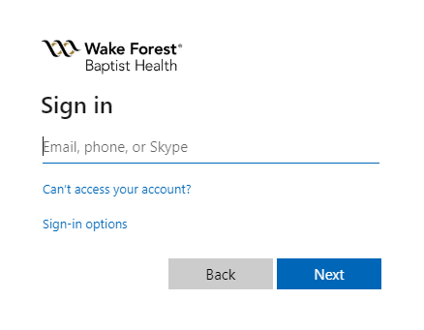
Login to the Master Decedent Tracking Log on Share Point
Open internet Browser e.g. Google Chrome, Internet Explorer, etc.
2. Browse to https://wakehealth.sharepoint.com/sites/pathology
Note: Login to this site is restricted to approved personnel.
3. Sign in using your medcenter email address and password.
e.g. someone@wakehealth.edu

Slide 32

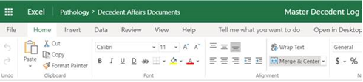
Share Point Login- continued
  4. Click Master Decedent Log Image
  5. The Master Decedent Log Excel Workbook (Spreadsheet) will open.

Slide 33
Share Point Login - continued
Click X to Close or left arrow to go back to Main Page or Share Point Site.
Go Back to Share Point Site
To Close Excel Workbook
7. When you are finished using the document please remember to close it.
8. Problems with Login or Access, contact a Site Captain, Site Manager or
Trish Warren
    Telephone: (336) 716-1520
    Email: twarren@wakehealth.edu

Slide 34
Step 3 - Triage
The staff member assigned to entering the decedent information in to the Master Tracking document will also be responsible for answering and checking off the questions listed on the front of the Intake Folder under Step 3.
This also includes indicating the correct storage location of where the decedent will be transferred and held by checking the box on the folder.
This staff member or Volunteer will notify the persons located at the storage location that a decedent is being transported to their area by ASCOM phone.
The Intake Folder and additional paperwork if present, will follow the decedent to the storage location.
Body bag will be wiped with disinfecting wipes or towels and 10% bleach solution prior to transport.

Slide 35
Step 3: Answering Triage Questions
Ensure all boxes indicated by arrows are complete.

Slide 36

Storage Site
Once the decedent reaches the assigned storage site, Volunteers assigned to body transport will place the body in its holding location.
A site Volunteer will take the decedent Intake Folder and file it alphabetically by first letter of last name in the HOLD ON SITE file case.
The decedent and the file will remain in place at this location until it is officially released to the Funeral Home or other Authorized Individual.

Slide 37
Step 4 – Release of Body Process
Decedents may only be released to authorized individuals.
If you are unsure of whether or not an individual is authorized, contact your Shift Manager, Site Captain or anyone in Autopsy Administration before acting.

Slide 38
Area Funeral Homes

Slide 39
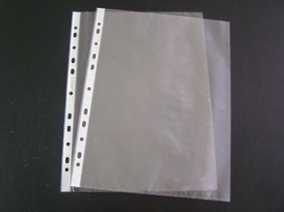
Step 4 - Release of Bodies
The Volunteer site member will ask the transporter to verbally identify the decedent they are there to pick up.
The Volunteer will pull the decedent’s Intake Folder from the HOLD for Storage file cabinet while the WFBMC Transport Volunteers retrieve the body from storage.
The Volunteer and Transporter will verify that the correct decedent was removed from storage by checking Name and Date of Birth in the presence of the individual there to pick up the body.
The Volunteer will remove the Original Death Certificate from the Intake Folder (make sure the watermark is visible) and place it inside of the Clear Page Protector secured to the outside of the bag.
The Volunteer will then remove the Body Release Form from the Intake Folder, obtain the appropriate signatures and return it back to the Intake Folder.

Slide 40
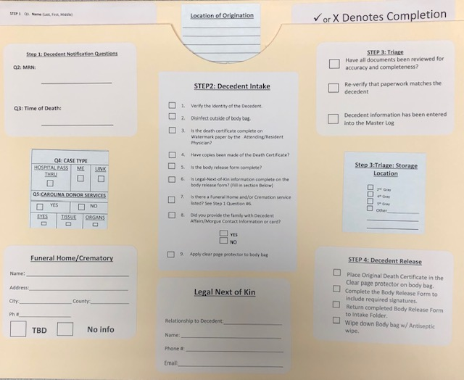
Step 4 – Release of Body Questions for Intake Folder
Ensure all boxes indicated by arrows are complete.

Slide 41

Release of Body
Volunteers will then wipe down the outside of the bag with a disinfecting wipe or towel and 10% bleach solution and release the decedent to the authorized person.
The Volunteer will place the Intake Folder and any additional paper work submitted with the decedent in the RELEASED file cabinet, filing it alphabetically by the first letter of the last name.
Intake Folders and additional documents will remain in the RELEASED file cabinet until Site Captains make regularly scheduled rounds to each storage location to retrieve the released files.
The Site Captains will then be responsible for finalizing the decedent information on the Master Decedent Tracking log and Nursing Master Log. If necessary, they will also register that case in to CoPath to assign a Decedent Services number.

Slide 42
Overly Full Release File Cabinet
Due to the excess volume of additional paper work that may be submitted with the decedent, it is possible that the Release File Cabinet will become overly full before the next Site Captain can come to empty it on their rounds.
Notify the Site Manager of the situation and they will come pick up the files.
Site Managers will hold the overflow files in a labeled Tote at the Intake Location for the Site Captains to retrieve there.

Slide 43
Release of Bodies – continued
After the Site Captains have completed updates to the Master Decedent Log they will file the decedent documents according to their normal processes.

Slide 44
Release of Bodies – Medical Examiner Cases
Medical Examiner cases will NOT be released by team members.
Only members of the Decedent Affairs Office or Autopsy staff may perform this task.
Hours of release for Medical Examiner cases will be limited to the hours of 7am – 7pm each day.
Any after hours questions concerning the release of an ME case should be forwarded to the Site Manager or a Site Captain for direction. Or the Medical Examiner on call at 336-413-4095.

Slide 45
Release of Bodies – Personal Effects
Team members will not be allowed to handle or release any personal effects belonging to a decedent during the COVID emergency process.
Family Members/Next of Kin will need to speak to a member of our Decedent Affairs office during normal business hours.
If nursing presents with personal effects belonging to an inpatient decedent they will need to take these back to the unit and process under hospital patient personal effects protocols.

Slide 46
Personal Protective Equipment
All team and staff members are expected to abide by policy guidelines pertaining to the need and indicated usage of PPE while volunteering.
If there are questions concerning PPE they should be referred to a Site Captain or Site Manager.

Slide 47
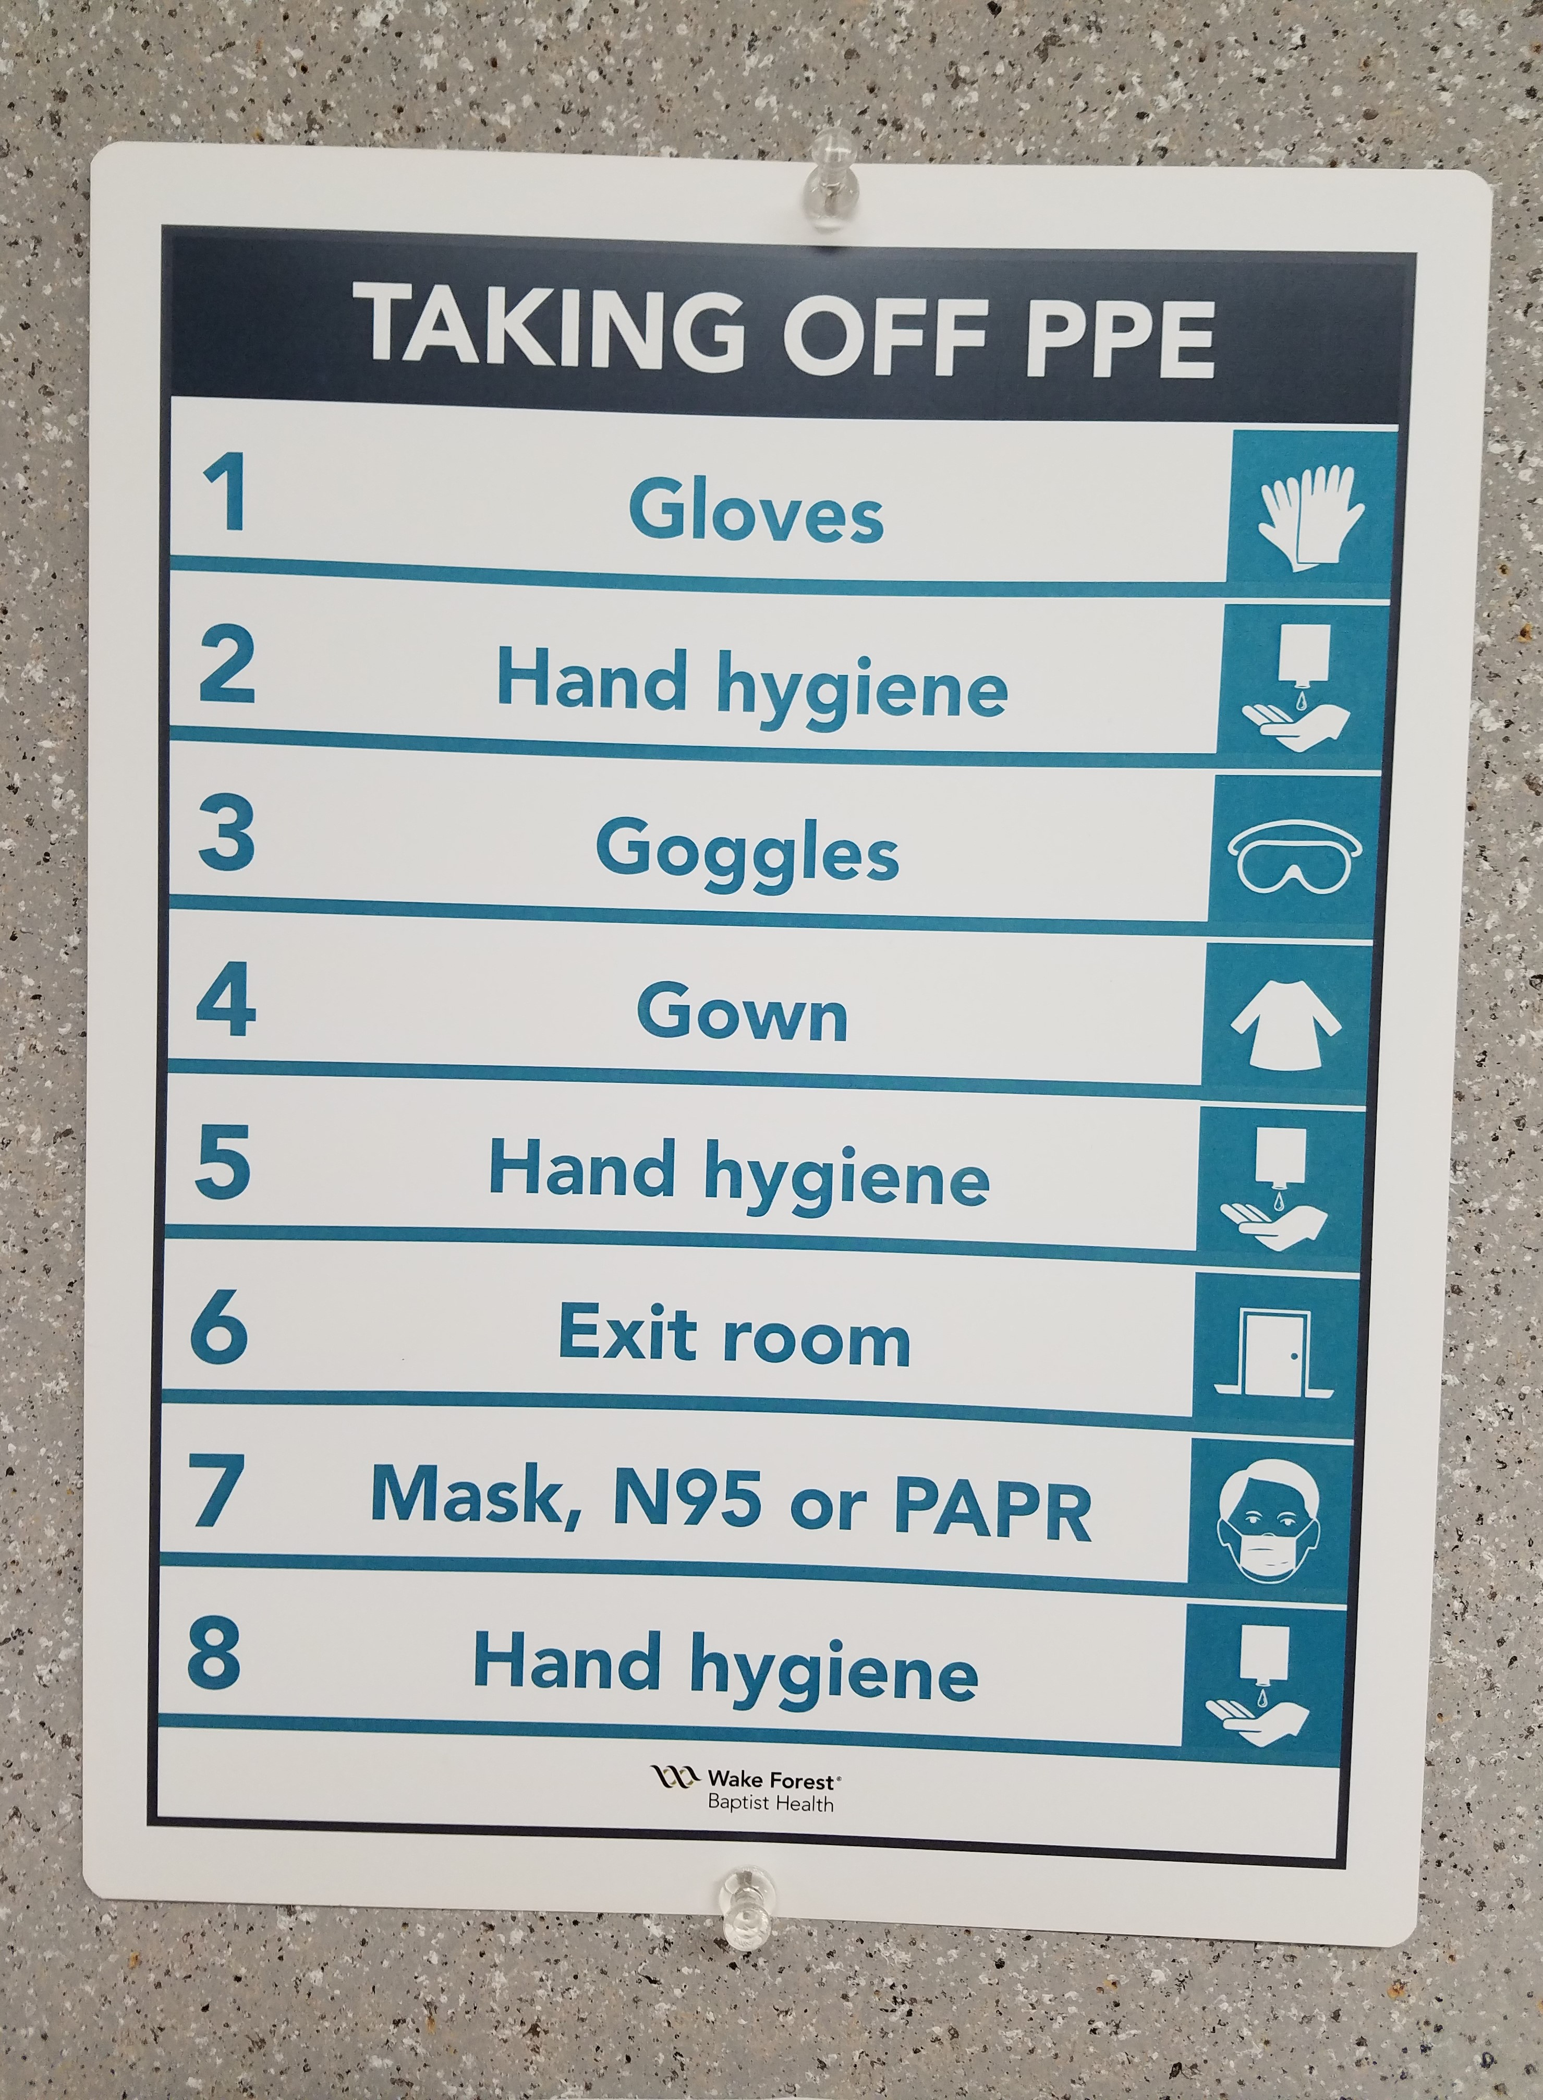
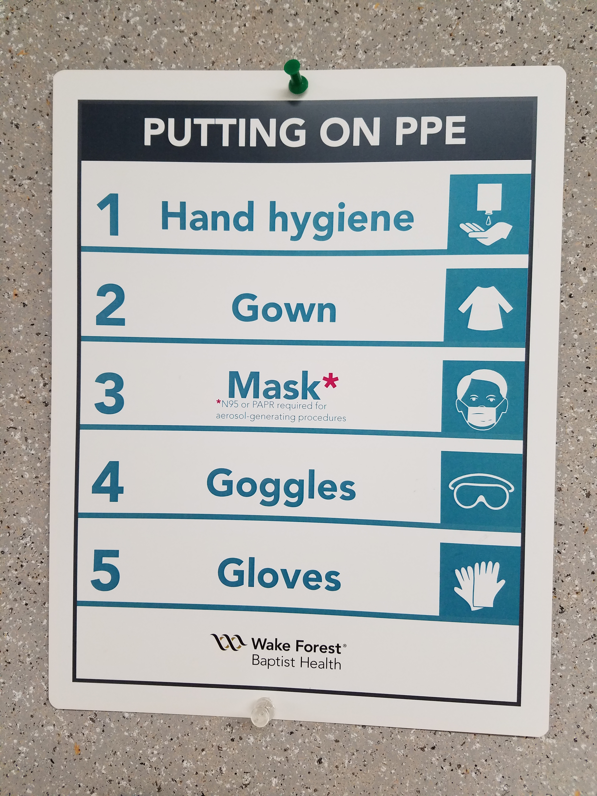
Proper Use of Personal Protective Equipment

Slide 48
General Safety Considerations
Practice standard precautions – wear gloves, change them often, washing hands in between changes.
Avoid touching face.
If at any time you start feeling ill, please make your Site Manager or Site Captain aware immediately.
If any accidents or injuries occur while volunteering contact the Site Manager or Site Captain so an Incident Report can be completed.
Possible exposure to blood, body fluids or chemical odors is possible. If any of these exposures occur notify the Site Manager or Site Captain immediately.
If at any time you feel that there is a problem with incorrect patient information documentation or there has been a mix-up during the tracking process, you have the right to call a TIME OUT across all site locations until the issue is resolved.
In the event of a called TIME OUT every person working in the Decedent Affairs workflow, should STOP what they are doing and focus their attention on the issue at hand.

Slide 49
Ergonomics Safety Points
Workers should determine the number of people needed to help move the body before attempting.
Ensure there is adequate staffing for any team handling requirements if gurneys or other equipment it not available.
Workers should be familiar with the types of physical, musculoskeletal, and health hazards of body handling, pushing and pulling.
Provide proper methods of lifting and handling so workers can protect themselves against strains and sprains.

Slide 50
Operation of Mechanical Equipment
It is recommended that team members not operate any mechanical equipment associated with lifting or moving bodies unless they have been properly trained. This includes the fork lift and the lifts that are available in the Gray Building.
Autopsy staff are properly trained on the use of any mechanical equipment used in the morgue. Therefore use of this equipment will be limited to Autopsy Staff when they are available.
In the event that additional operators are needed beyond the Autopsy staff, they must complete a separate supervised training performed by a Decedent Affairs or Autopsy employee.

Slide 51
Confidentiality and Privacy Considerations
While Volunteering in the Pathology laboratory, staff will encounter protected health information (PHI).
All Volunteers must maintain complete confidentiality and not discuss any information they may see, read or hear during the time spent in the Pathology area.
Do not open or read any patient documents that are not necessary for you to complete the task to which you are assigned.
Do not share any information learned from your volunteer services with other co-workers or family members.
Do not take any pictures or post any information pertaining to your volunteer services on social media.

Slide 52
Media Communication
No employee of the Department of Pathology or team member may provide information of any kind to media contacts.
All questions or information needs should be routed through the Media Relations Team on the Winston Campus.
It is appropriate to give the reporter the following pager number that will contact someone from the Media Relations Team. That pager number is:
Pager (336)-716-6770
#7552

Slide 53
Leader Contact Information

Slide 54
This completes your team member training module for the Decedent Affairs Morgue Surge Plan.
Please remember to take the quiz in MTS associated with this training.
THANK YOU FOR YOUR PARTICIPATION!!

