Slide 1
Lab / Pathology
Managers Meeting
April 2020

Slide 2

Patient and Family Promise

Slide 3
Serious Safety Events
*Days since last SSE:
WFB: 101
BCH: 73
DMC: 326
HPMC: 96
LMC: 89
WMC: 199
*Current as of 4/13/2020

Slide 4
Lab Pathology Deviations
March: 50
Average: 69

Slide 5
Lab Pathology Deviations by Section
March, 2020

Slide 6
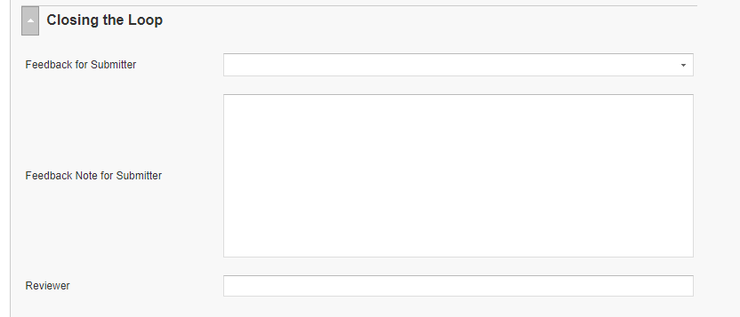
RL6 Closing the Loop Compliance
Your name here!

Slide 7
RL6 Closing the Loop Compliance by
Section

Slide 8
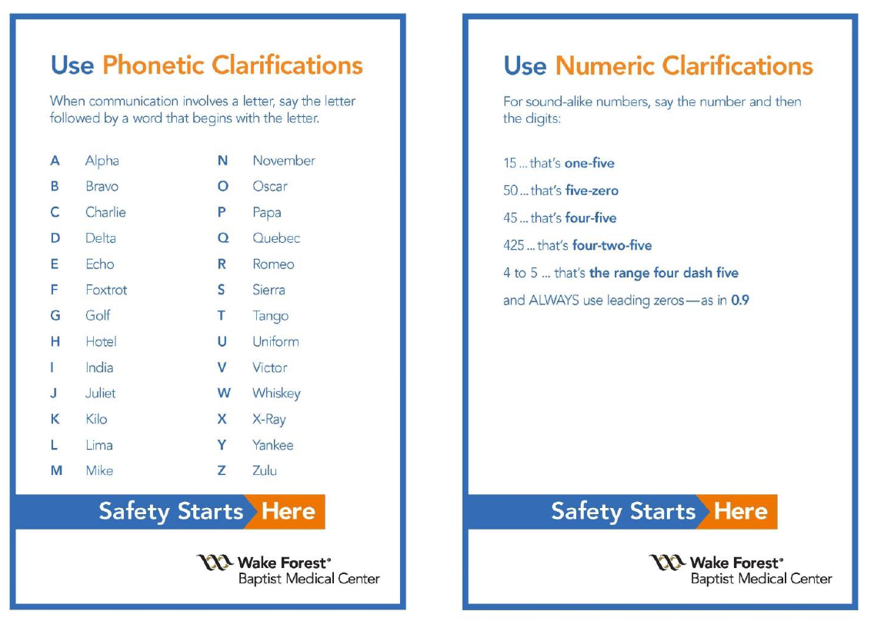
Safety Focus of the Month for April

Slide 9
Safety Starts Here Section Compliance 2020

Slide 10
Safety Coach Meeting Participation
2020
March Safety Coach Meeting
In March, the safety coaches received a power point presentation in lieu of a face to face meeting.
In order to be counted as present they were asked to email me that they had reviewed the presentation. The coaches that did that are marked present on the table.

Slide 11

Next Lab Huddle: May 12th, 2020

