Slide 1
Lab / Pathology
Managers Meeting
May 2020

Slide 2

Patient and Family Promise

Slide 3
Serious Safety Events
*Days since last SSE:
WFB: 65
BCH: 80
DMC: 354
HPMC: 45
LMC: 117
WMC: 50
*Current as of 5/11/2020

Slide 4
Lab Pathology Deviations
April: 54
Average: 68

Slide 5
Lab Pathology Deviations by Section
April, 2020

Slide 6
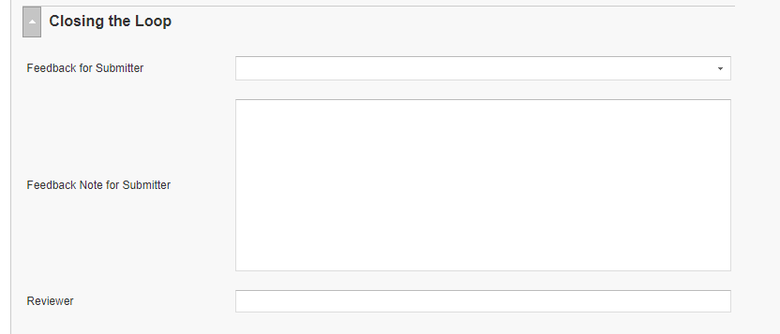
RL6 Closing the Loop Compliance
Your name here!

Slide 7
RL6 Closing the Loop Compliance by
Section

Slide 8

Pathology SharePoint Site
Everyone in the Department of Lab & Pathology is encouraged to use this excel spreadsheet to report your concern. All concerns will be followed up on.
*Continue to use RL6 for any patient related events; not this spreadsheet.

Slide 9



Safety First – ALWAYS!
Cross Check & Assist
Two heads are better than one!
Offer to check the work of others
Point out unsafe conditions
Ask for a second check
Notes:
May

Slide 10
Mask Requirements per Task Force for EMPLOYEES
All employees, including those in non-patient facing roles, and students are expected to wear a mask at all times in common areas inside Wake Forest Baptist Health facilities:
Employees should put on a mask before entering any campus building to arrive for their shift.
Mask-free times should only occur when employees are on break and socially distanced from others, or when working alone in individual offices.
For sanitary purposes, cloth masks should be washed daily by the individual.

Slide 11
Mask Requirements per Task Force for VISITORS
All patients (asymptomatic and symptomatic) and visitors should be masked as indicated below:
All patients, visitors and vendors should be masked upon their arrival to Wake Forest Baptist Health facilities or when they are outside of patient/exam rooms (when walking, going for tests, receiving therapy, etc.)
Personal, homemade, cloth and dust masks are permitted. Otherwise, provide the individual with a cloth or surgical mask.
Masks should be worn in common areas inside Wake Forest Baptist Health facilities.
Children should wear a mask if developmentally appropriate. Patients who cannot tolerate or refuse to wear a mask upon entry should be transferred to an exam room immediately.

Slide 12
Safety Starts Here Section Compliance 2020

Slide 13
Safety Coach Meeting Participation
2020
April Safety Coach Meeting
In March and April, the safety coaches received a power point presentation in lieu of a face to face meeting.
In order to be counted as present they were asked to email me that they had reviewed the presentation. The coaches that did that are marked present on the table.

Slide 14

Next Lab Huddle: June 9th, 2020

