Slide 1
ITC Hemochron®
Signature Elite
HPRLABHEMCHR20

Slide 2
Objectives
At the end of this online learning module the learner will be able to:
Discuss the HEMOCHRON® Signature Elite™ Whole Blood Microcoagulation System
List the steps in the HEMOCHRON procedure
Describe the documentation process

Slide 3
Introduction
The HEMOCHRON® Signature Elite™ Whole Blood Microcoagulation System is a battery-operated, A/C adaptable, handheld instrument
It performs individual point-of-care coagulation tests on fresh whole blood
The system is intended to be used only with test cuvettes that are available from ITC
The HEMOCHRON® Signature Elite™ instrument is intended for use with human whole blood

Slide 4
Introduction (continued)
The HEMOCHRON Signature Elite Whole Blood Microcoagulation System uses HEMOCHRON Jr. disposable single-use
cuvettes
Each cuvette contains all of the reagents necessary for Activated Clotting Time testing

Slide 5
Procedure Overview
The analyzer draws the correct amount of sample into the reaction well and sends excess sample to an enclosed waste receptacle in the cassette
The analyzer then pumps the sample mixed with reagents back and forth. This motion is monitored by a series of LED detectors until a clot forms, thus signaling the endpoint of the test
The analyzer beeps and displays the time on a monitor and records the value in its memory
After the cassette is inserted and is warmed to the proper temperature, the operator adds a drop of sample to the test well

Slide 6
Hemochron Signature Elite™ Analyzer
Overview of instrument
The Display Panel

Slide 7
Hemochron Signature Elite™ ACT+ Cassettes
The ACT+ cassette is a self-contained disposable test chamber preloaded with a dried preparation of silica, kaolin, phospholipid, stabilizers and buffers

Slide 8
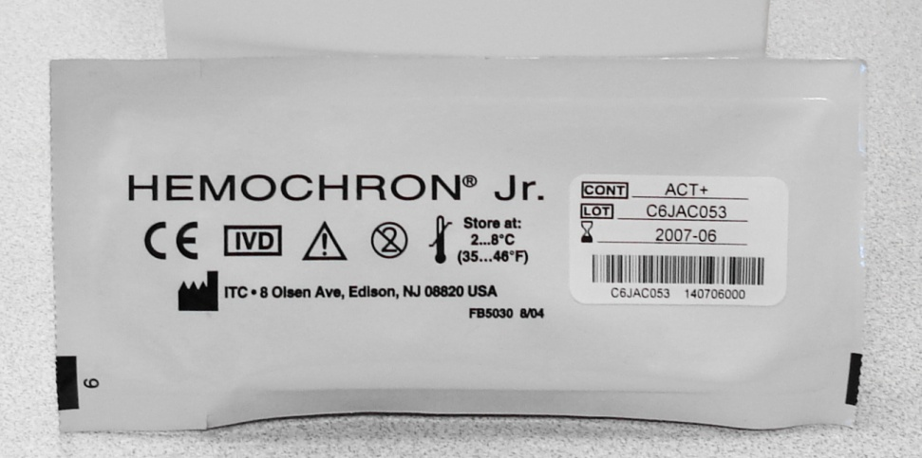
Hemochron Signature Elite™
Cassette
Each cassette is individually packaged in a pouch and each pouch is stamped with a lot specific expiration date
Test
Lot #
Exp. date

Slide 9
Hemochron Signature Elite™
Pouch
When refrigerated (2-8 degrees Celsius) the foil pouched ACT+ cuvettes are stable until the marked expiration date
Cuvettes should be at room temperature before using, are stable for 12 weeks, and re-dating is necessary if stored at room temperature. The new expiration date must never exceed the manufacturer’s expiration date.
Open the pouch immediately before use to maximize accuracy.

Slide 10

Internal Electronic Quality Control
(EQC)
Internal EQC and temperature
verification should be completed once every 8 hours
of operation

Slide 11
Patient Preparation:
Ensure 2 patient identifiers (e.g. patient name and medical record number) are utilized to correctly identify the patient prior to specimen collection

Slide 12
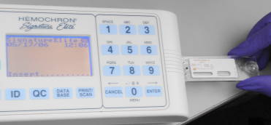
Hemochron Signature Elite™
Procedure for Patient Testing
Starting the Instrument by inserting a cuvette
When a test cuvette is inserted to turn on the instrument, the start up screens are briefly displayed and the Scan/Enter Cuvette Lot prompt is displayed

Slide 13
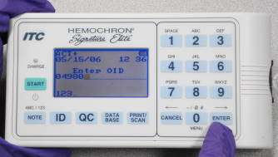

Hemochron Signature Elite™
Procedure for Patient Testing
Stored message at bottom of screen
XXXXX
When the Enter OID prompt is displayed, the operator ID can be scanned from the badge barcode or manually entered using the keypad

Slide 14
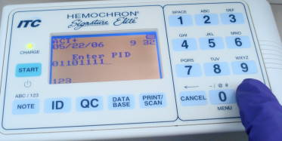
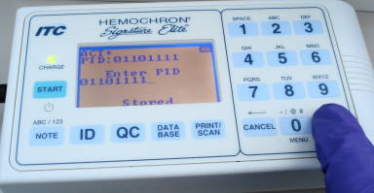
Hemochron Signature Elite™
Procedure for Patient Testing
Use only the CSN number as patient ID when performing ACT testing
Scan or manually enter the Patient CSN using the keypad and
press and hold ENTER until you see the Stored Message.
“STORED” Message

Slide 15
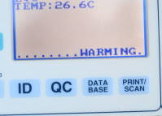
Hemochron Signature Elite™
Procedure for Patient Testing
Check the display for fault messages while the cuvette is warming

Slide 16
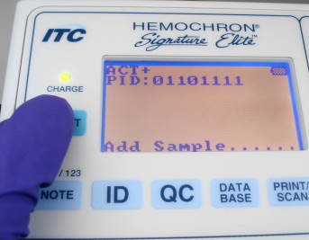
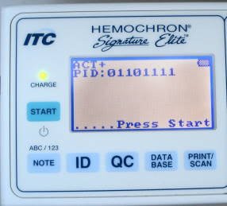
Hemochron Signature Elite™
Procedure for Patient Testing
When the cuvette reaches temperature, the instrument beeps and alternately displays the “Add Sample” prompt – the analyzer will time out after 5 minutes if testing has not started.
Wait for prompt to “Press Start”
to proceed

Slide 17
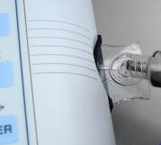
Hemochron Signature Elite™
Procedure for Patient Testing
Applying sample
Fill the sample well from the bottom up
Add enough blood so that the lower wall of the center sample well is completely filled (0.2ml of blood)

Slide 18
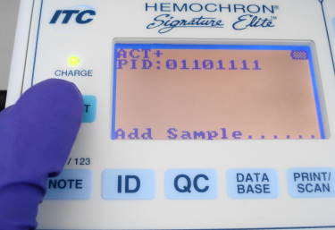
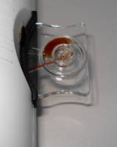
Hemochron Signature Elite™
Procedure for Patient Testing
After the sample is added, immediately press START to run the test
Sample is drawn into cuvette after pressing START

Slide 19
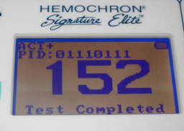
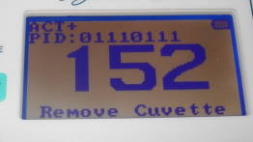
Hemochron Signature Elite™
Procedure for Patient Testing
The analyzer will display the results with the alternating messages “Test Completed” and “Remove Cuvette”, as shown below
The ACT result will remain on the screen until the cuvette is removed
Therapeutic values are determined by the protocol being followed and physician preference

Slide 20
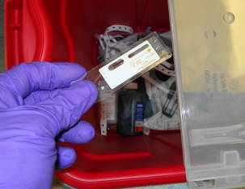
Hemochron Signature Elite™
Procedure for Patient Testing
Discard the used cuvette in the appropriate biohazard waste container

Slide 21
Docking the Hemochron Elite
Results are transmitted to the patient’s chart when the Hemochron Elite is docked, preferably every 8 hours.
Docking the device will also update patient IDs, operator IDs, and cassette lot numbers.
The Hemochron Elite should remain plugged in and charging when not in use.

Slide 22
Thank you for taking time to complete “Hemochron Elite”.
This information can help us better care for our patients and their families.
For more information about this course email
Kelly.Leiner@wakehealth.edu
For more information about this course, e-mailkelly.leiner@unchealth.unc.edu
For more information about this course, e-mail
kelly.leiner@unchealth.unc.edu

