Slide 1
Lab / Pathology
Managers Meeting
June 2020

Slide 2
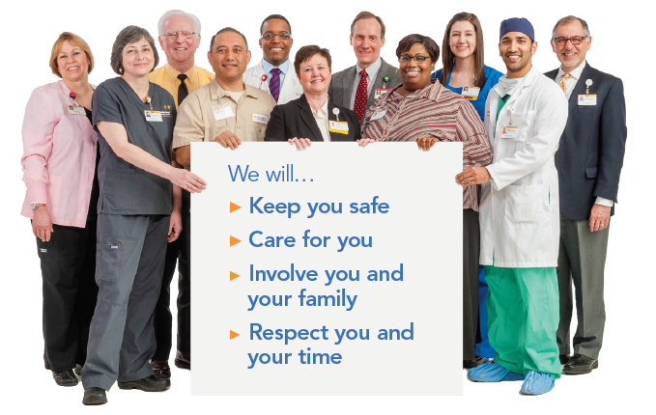
Patient and Family Promise

Slide 3
Serious Safety Events
*Days since last SSE:
WFB: 57
BCH: 50
DMC: 383
HPMC: 54
LMC: 146
WMC: 79
*Current as of 6/9/2020

Slide 4
Lab Pathology Deviations
May: 71
Average: 68

Slide 5
Top 2 Deviations in May

Slide 6
Lab Pathology Deviations by Section
May 2020

Slide 7
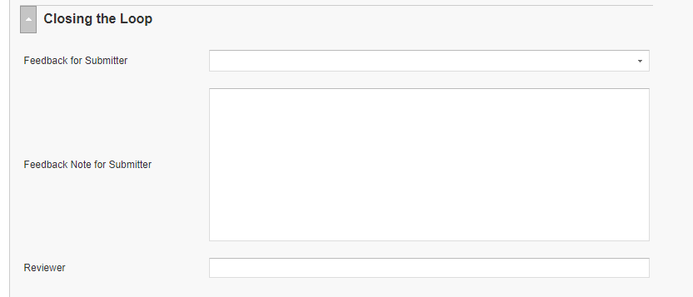
RL6 Closing the Loop Compliance
Your name here!

Slide 8
RL6 Closing the Loop Compliance by
Section

Slide 9
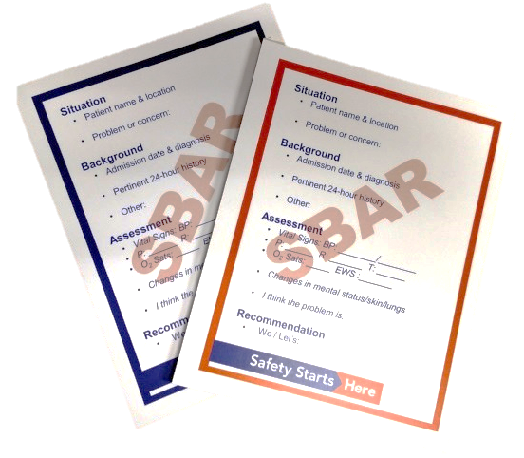
Communicate Clearly
Situation | What is going on now? Concise statement of the problem
Background | How did we get here? Pertinent and brief information related to situation
Assessment | What do you think is going on? Information to support your assessment
Request/ Recommendation | What do you want done? Your suggested method to resolve the problem
SBAR is a vertical communication tool used for a specific, short-term situation or event. | SBAR is a helpful tool for anyone when a decision is needed SBAR saves time SBAR reduces frustration
Notes:
June

Slide 10
Safety Starts Here Section Compliance 2020

Slide 11
Mask Requirements per Task Force for EMPLOYEES
All employees, including those in non-patient facing roles, and students are expected to wear a mask at all times in common areas inside Wake Forest Baptist Health facilities:
Employees should put on a mask before entering any campus building to arrive for their shift.
Mask-free times should only occur when employees are on break and socially distanced from others, or when working alone in individual offices.
For sanitary purposes, cloth masks should be washed daily by the individual.

Slide 12
Mask Requirements per Task Force for VISITORS
All patients (asymptomatic and symptomatic) and visitors should be masked as indicated below:
All patients, visitors and vendors should be masked upon their arrival to Wake Forest Baptist Health facilities or when they are outside of patient/exam rooms (when walking, going for tests, receiving therapy, etc.)
Personal, homemade, cloth and dust masks are permitted. Otherwise, provide the individual with a cloth or surgical mask.
Masks should be worn in common areas inside Wake Forest Baptist Health facilities.
Children should wear a mask if developmentally appropriate. Patients who cannot tolerate or refuse to wear a mask upon entry should be transferred to an exam room immediately.

Slide 13

Next Lab Huddle: July 14th, 2020

