Slide 1
Lab / Pathology
Managers Meeting
July 2020

Slide 2

Patient and Family Promise

Slide 3
Serious Safety Events
*Days since last SSE:
WFB: 92
BCH: 11
DMC: 418
HPMC: 25
LMC: 66
WMC: 114
*Current as of 7/14/2020

Slide 4
Lab Pathology Deviations
June: 69
Average: 68

Slide 5
Top 3 Deviations in May
#1
#3

Slide 6
Lab Pathology Deviations by Section
June 2020

Slide 7
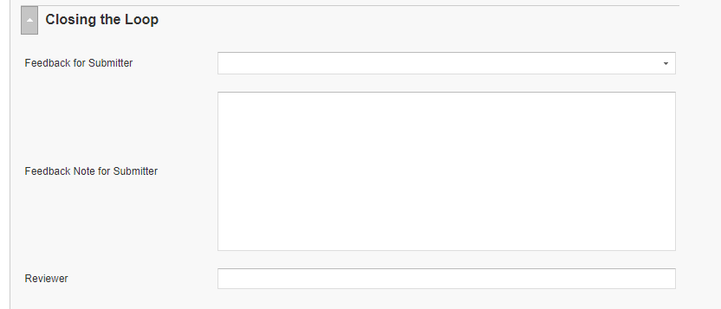
RL6 Closing the Loop Compliance
Your name here!

Slide 8
RL6 Closing the Loop Compliance by
Section

Slide 9
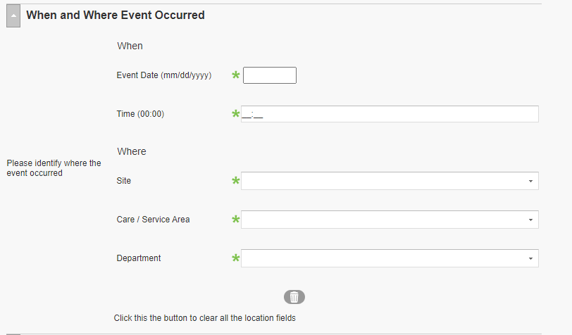
RL6 Changing the Event Location in RL6

Slide 10
Please use this template as provided. Do not modify the font, bullets, border or background.
Use this for orange text
Use this for blue text
Or this if you need red
Safety Starts Here
STOP if you have a Concern ARCC Escalate using SBAR
ARCC: A - Ask a question R – Make a Request C – Voice a Concern C – Use the Chain of Command | When to escalate: Immediate action is needed You are unable to reach the first call provider (no response in 5 minutes) You feel the response from the first call provider is inappropriate or unsafe
SBAR Situation Background Assessment Recommendation | How to escalate: Contact the upper level resident and/or manager/charge RN Then, as appropriate, Attending & Nursing Supervisor (806-9647) → Medical & Nursing Directors → Associate Chief Medical Officer (6-4200) → Chief Medical Officer & Chief Nursing Officer

Slide 11
Safety Starts Here Section Compliance 2020

Slide 12


Slide 13
Compliance with
Safety Focus of the Month
Lack of standardization in how it is presented to staff
        MTS & test
          Test scores range from 33% to 100%
          Some participant lists are not accurate
        Presented staff meetings with a sign-in sheet
        Emailed to staff; receive an email response back that it has been read

Slide 14

Next Lab Huddle: August 11th, 2020

