Slide 1
BB / BMT/New Office and Bathroom Fire Escape Routes
Bettina Turner MT(ASCP)SBB^{CM}
BB Specialist Technologist and Education Coordinator
Hannah Phillips MLS(ASCP)
Blood Bank/BMT Safety Representative

Slide 2
FIRE!!!
For full instructions on fire safety, see
Quarter 2 safety presentation: Fire and Code Triage
In Review:
In the event of a fire alarm:
Look for smoke or fire
Smell for smoke
Listen for information over public address system
Report All Fires
Call 6-9111
Activate the nearest pull station
Notify all BB / BMT staff
When evacuation required – XM1 person should grab schedule so all employees can be accounted for.

Slide 3
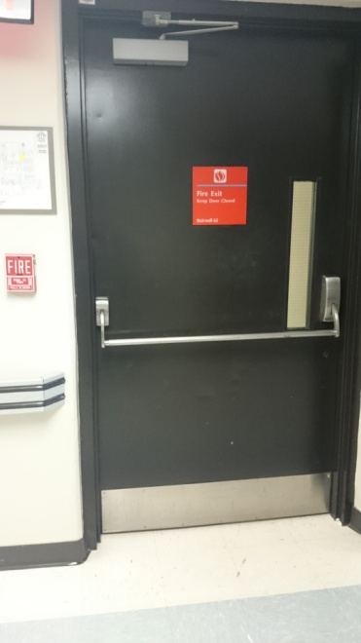
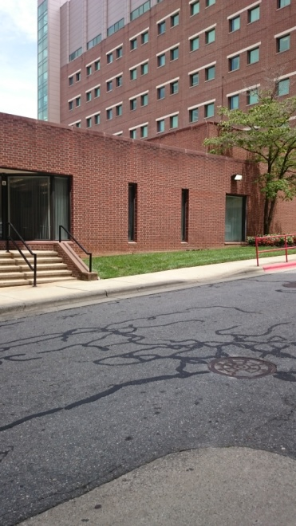
Blood Bank: Primary Escape Route
Exit main Blood Bank door, turn right
Continue down hallway past elevators to door at end
Open door, continue forward through 2 more doors to downward stairs.
Go down stairs to bottom
Exit door to outside
Meet in front of power plant

Slide 4
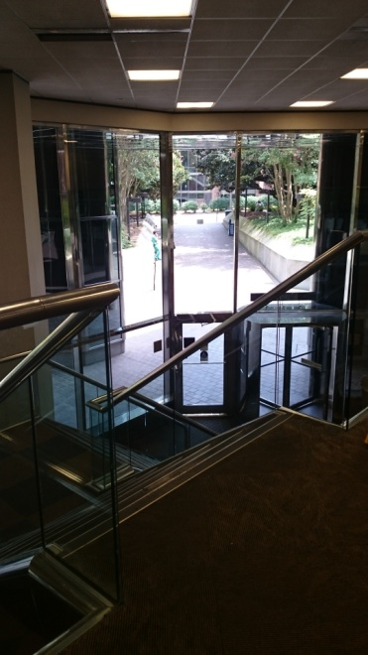
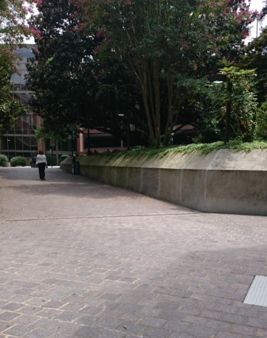
Blood Bank: Secondary Escape Route
Exit main Blood Bank door, turn left
At end of hallway, turn left
At end of hallway “Zig-Zag” right,
then left,
Continue down hallway – staying on the carpeted floor.
Enter Watlington Hall open area
Take steps down
Exit door in front of you
Meet outside Watlington Hall

Slide 5
Blood Bank Offices / Bathroom: Primary Escape Route
Exit door by bathroom
Take a few steps forward then turn left down hallway
Continue down hallway – staying on the carpeted floor.
Enter Watlington Hall open area
Take steps down
Exit door in front of you
Meet outside Watlington Hall

Slide 6
Blood Bank Offices / Bathroom: Secondary Escape Route
Walk through the conference room to the Blood Bank
Continue as for Blood Bank primary escape route

Slide 7
BMT Evacuation Route
Primary
Exit BMT through either door. Turn right. Turn right again after the North tower elevators if you exited BMT from the cryo room. Go Down North tower stairway at the end of the hall. Exit to meet at the front of the power plant.
Secondary
Exit BMT lab through the cryo room. Turn Left. Proceed to Gray building. Turn right down first hallway. Go through double doors. Go down stairway on left and exit building.
BMT Evacuation Route
Second Floor North Tower
 |  |  |  |  |  |  |  |  |  |  |  | Stair Well
 |  |  |  | North Tower Elevators |  |  |  |  | BMT Office and Specimen Receipt |  |  | Service Elevators
 |  |  |  |  |  |  |  |  | BMT Processing and Cryo Rooms
 |  | Stair Well
Primary
Secondary

