Slide 1
Lab / Pathology
Managers Meeting
August 2020

Slide 2

Patient and Family Promise

Slide 3
Serious Safety Events
*Days since last SSE:
WFB: 120
BCH: 39
DMC: 446
HPMC: 53
LMC: 94
WMC: 142
*Current as of 8/11/2020

Slide 4
Lab Pathology Deviations
July: 50
Average: 67

Slide 5
Top 3 Deviations in July
#1

Slide 6
Lab Pathology Deviations by Section
July 2020

Slide 7
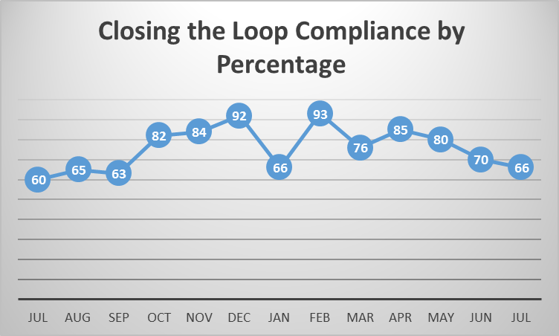
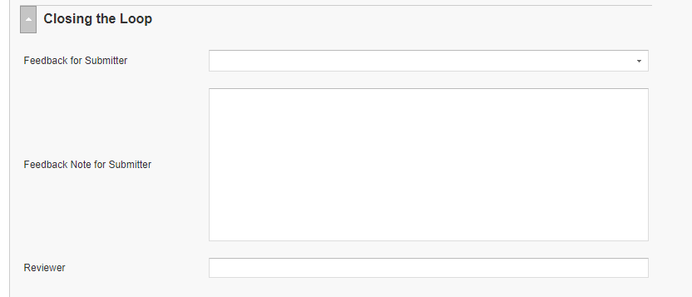
RL6 Closing the Loop Compliance
Your name here!

Slide 8
RL6 Closing the Loop Compliance by
Section

Slide 9
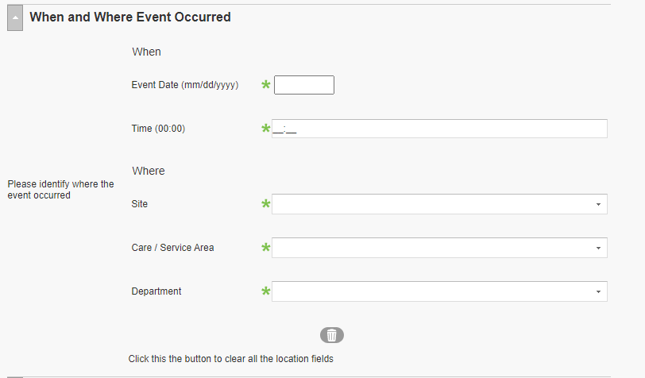
RL6 Changing the Event Location in RL6

Slide 10

Please use this template as provided. Do not modify the font, bullets, border or background.
Use this for orange text
Use this for blue text
Or this if you need red
Safety First – ALWAYS!
A- Ask a question R- Make a Request C- “I have a Concern” C- Chain of Command
“What you permit, you promote” Start with the lightest touch Especially helpful when we are hesitant or intimidated | Point out unsafe conditions If you hear someone say “I have a concern” stop and address this genuine worry that we may cause harm
Notes:
August

Slide 11
Safety Starts Here Section Compliance 2020

Slide 12


Slide 13

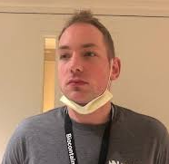



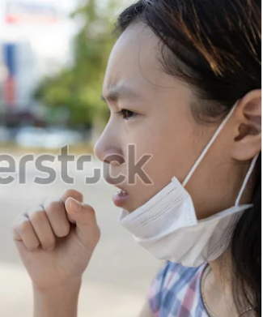

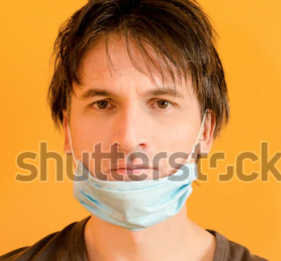
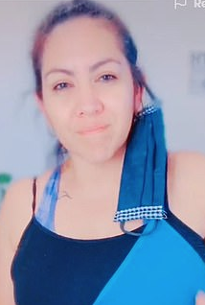

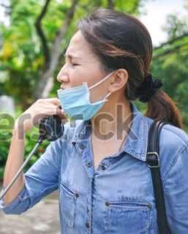

Slide 14
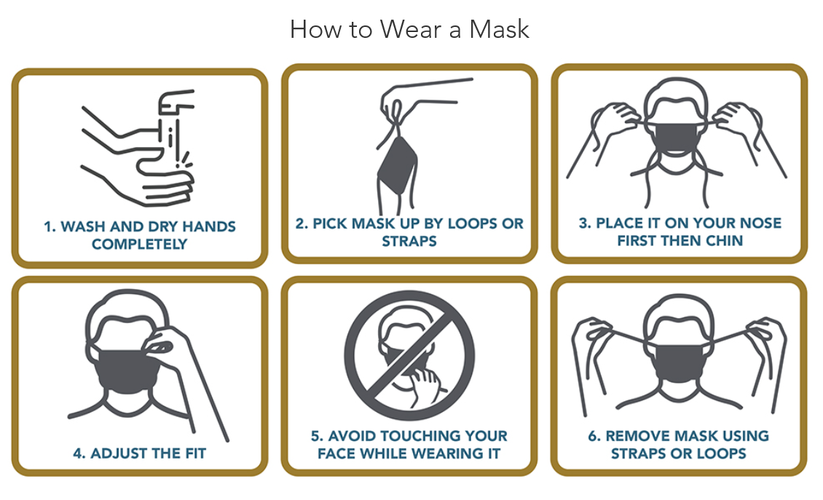
Don’t Let Your Guard Down…
Stay safe
https://www.wakehealth.edu/Coronavirus/Dont-Let-Your-Guard-Down?utm_source=Intranet&utm_medium=email&utm_campaign=homepage

Slide 15
Compliance with
Safety Focus of the Month
Lack of standardization in how it is presented to staff
        MTS & test
          Test scores range from 33% to 100%
          Some participant lists are not accurate
        Presented staff meetings with a sign-in sheet
        Emailed to staff; receive an email response back that it has been read

Slide 16

Next Lab Huddle: September 8th, 2020

