Slide 1
IRIS User Review
Wake Forest Baptist Medical Center
Hematology - Urinalysis

Slide 2
Objectives
Review IRIS to Beaker Translations.
Educate laboratory technicians on possible RBC and WBC discrepancies.
Assist laboratory technicians with Trichomonas identification/investigation.
Review Transition and Renal Epithelial Cell identification.
Cover proper Bacteria Grading criteria.

Slide 3
IRIS to Beaker Translations
IRIS Clarity → Beaker Clarity
Clear = Clear
Turbid = Cloudy
Ex. Turbid = Turbid
IRIS Glucose → Beaker Glucose
Normal = Negative
IRIS Urobilinogen → Beaker Urobilinogen
Normal = 0.2 EU/DL

Slide 4
RBC Discrepancies (From Memory Joggers)
Positive Chemistry vs No RBCs in Microscopic
RBCs readily lyse and disintegrate in hypotonic or alkaline urine. Such lysis can also occur within the urinary tract before collection.
Lysed RBCs releasing hemoglobin is enhanced in alkaline or dilute urine (SG <1.010).
Negative Chemistry vs RBCs in Microscopic
Ascorbic acid interference.
Confirm that RBC pictures are not CAOX.
Smoking and normal exercise cause hematuria. Anticoagulant drugs and toxic reaction inducing drugs can increase numbers of RBCs in urine.

Slide 5
RBC Discrepancies Cont…
Possible False-Positive RBC Chemistry Reactions
Menstrual Contamination
Bacterial peroxidases
Strong oxidizing agents (bleach)
Possible False-Negative RBC Chemistry Reactions
Ascorbic acid, uric acid, gentistic acid
Missing dietary nitrate (starvation, IV feeding, fasting)

Slide 6
WBC Discrepancies (From Memory Joggers)
Positive LE Chemistry vs No WBCs in Microscopic
Alkaline or hypotonic (SG <1.010) urine enhances cell lysis
Improperly mixed samples
Negative LE Chemistry vs WBCs in Microscopic
WBCs present may not be of the granulocytic series (lymphocytes)
Different populations of WBCs have varying quantities of cytoplasmic granules which can differ the amount of leukocyte esterase. (lymphocytes have no LE)
Over-hydration can cause LE to be diluted

Slide 7
WBC Discrepancies Cont…
Possible False-Positive LE Chemistry Reactions
Preservatives; formalin, formaldehyde
Contamination by oxidizing agents and detergents
Vaginal contamination or urine
Possible False-Negative LE Chemistry Reactions
High concentrations of protein, glucose, cephalexin and gentamycin
High SG
Strong oxidizing substances (soaps and detergents)

Slide 8
Trichomonas Identification/Investigation
Any WBCs, and some RBCs, may appear oval or irregularly shaped.
WBCs, and some RBCs, may appear out of focus due to motility.
Look for shadows that may be tails.
Review the patient’s chart to look for symptoms such as abdominal pain or genital discharge.
Any speculation of Trichomonas should be looked at under the microscope to confirm motility.
Review the following slides of possible Trichomonas images.

Slide 9
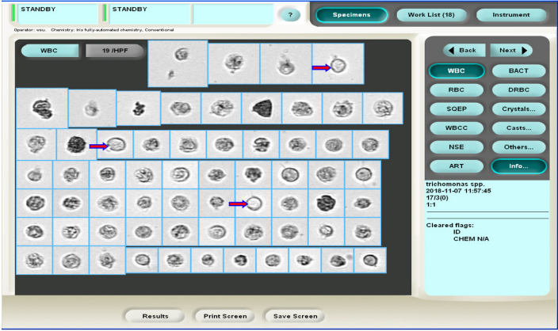

Slide 10
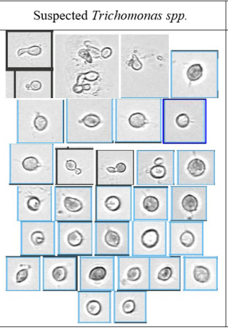
Irregular Shapes
Faint shadows that appear to be tails
Some images are blurry due to motility

Slide 11
Transitional vs Renal Epithelial Cells
Transitional Epithelial Cells
30-40 microns
Pear shaped with curved edges
Usually found in patients with UTIs or Catheters
Renal Epithelial Cells
<30 microns
One or more flat sides
Renal Epithelial cells usually are grouped together in small pairs
Appear with renal function issues

Slide 12
Bacteria Grading Chart (Found at Urine Bench)

