Slide 1
Lab / Pathology
Managers Meeting
September 2020

Slide 2

Patient and Family Promise

Slide 3
Serious Safety Events
*Days since last SSE:
WFB: 99
BCH: 67
DMC: 474
HPMC: 50
LMC: 122
WMC: 170
*Current as of 9/8/2020

Slide 4
Lab Pathology Deviations
July: 61
Average: 72

Slide 5
Top Deviations in August
#1
#2
#3

Slide 6
Top Deviations in August
#3

Slide 7
Lab Pathology Deviations by Section
August 2020

Slide 8
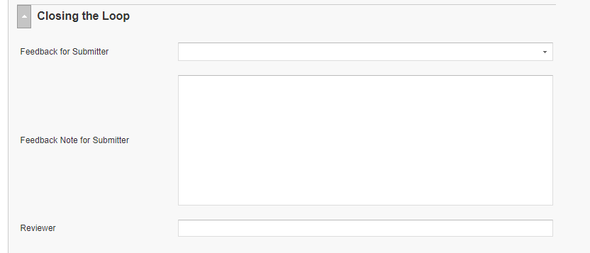
RL6 Closing the Loop Compliance
Your name here!

Slide 9
RL6 Closing the Loop Compliance by
Section

Slide 10
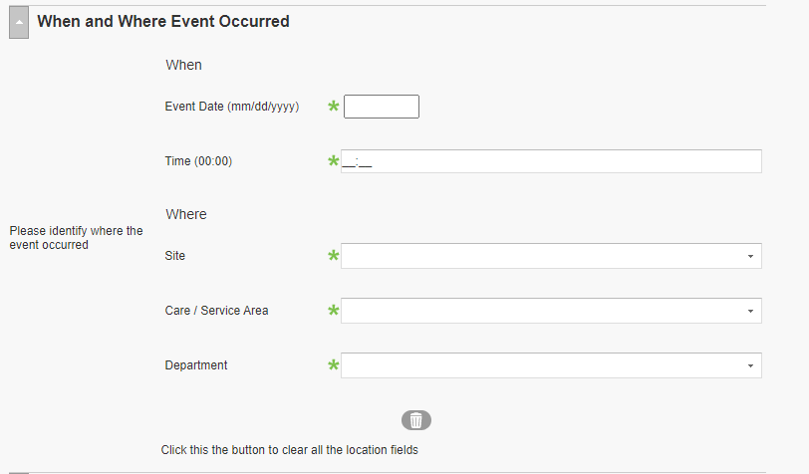
RL6 Changing the Event Location in RL6

Slide 11

Please use this template as provided. Do not modify the font, bullets, border or background.
Use this for orange text
Use this for blue text
Or this if you need red
Practice With & Accept Questioning Attitudes
STOP when you are uncertain
If you have a question about your planned action When you realize that the task does not follow the normal policy, procedure, protocol, plan, etc. | If something just doesn’t feel right If you hear someone say “I have a concern” STOP and address this genuine worry that we may cause harm
Notes:
September

Slide 12
Safety Starts Here Section Compliance 2020

Slide 13


Slide 14
ECRI Overall Response Compliance

Slide 15
Product Recall and Alert Notifications Policy (ECRI)
Auto-Match, Class I and Critical Priority – act on within 1 business day of notification
Class II and High Priority – act on within 2 business days of notification
Class III and Normal Priority – act on within 5 business days of notification

Slide 16
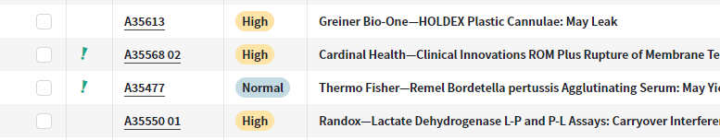
Identifying Auto-Matches

Slide 17
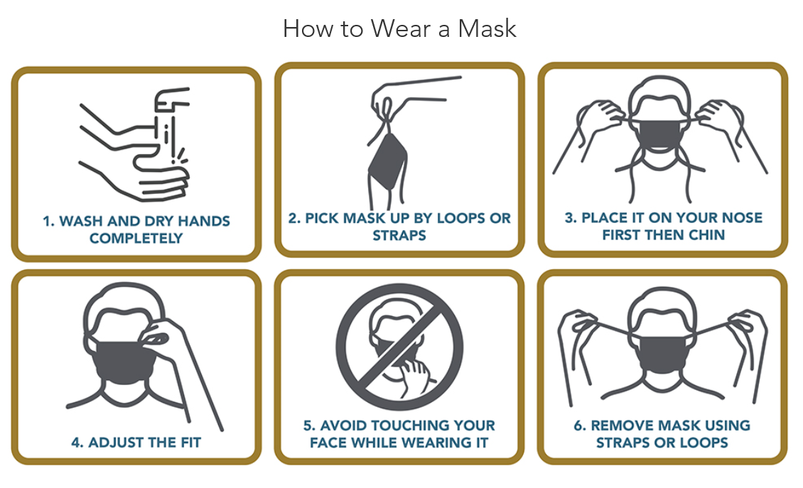
Don’t Let Your Guard Down…
Stay safe
https://www.wakehealth.edu/Coronavirus/Dont-Let-Your-Guard-Down?utm_source=Intranet&utm_medium=email&utm_campaign=homepage

Slide 18

Next Lab Huddle: October 13th, 2020

